Slide 1
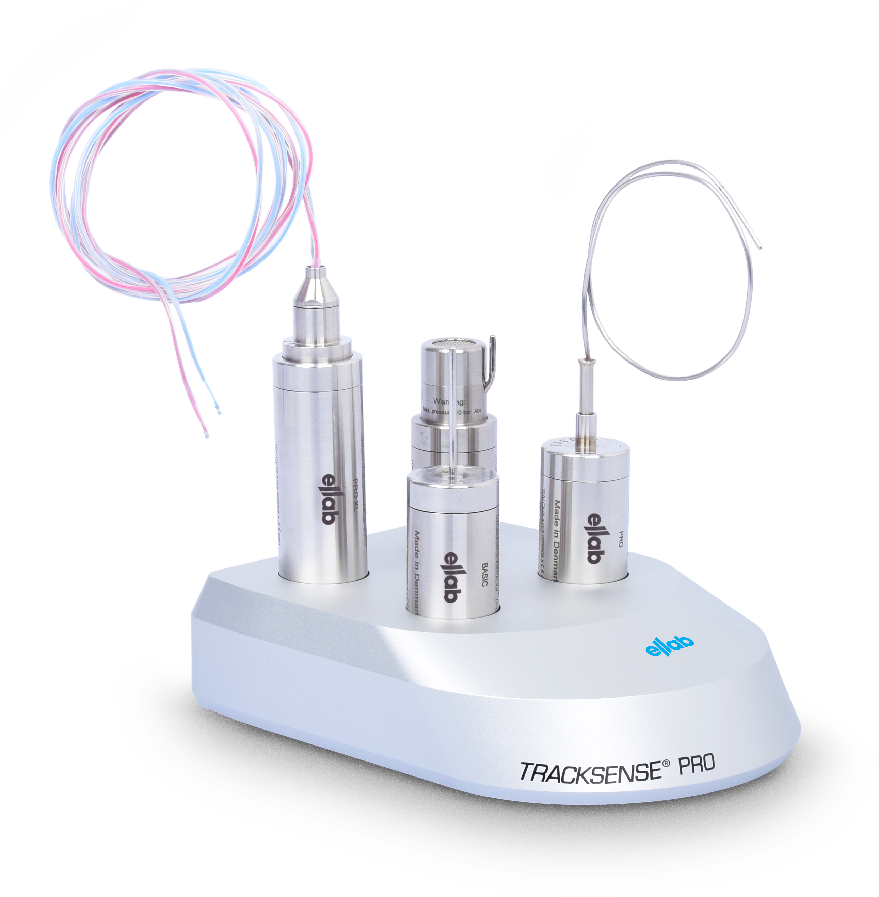
TrackSense® Wireless Data Loggers

Slide 2





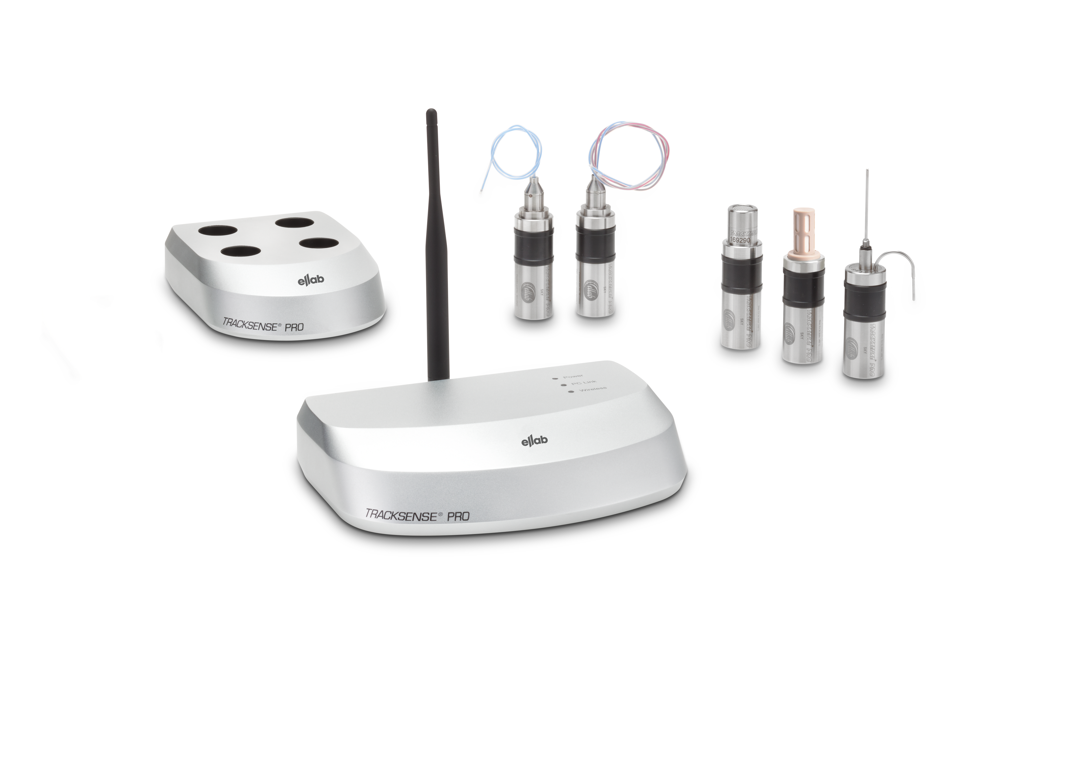
TrackSense® Data Logger System
Key Features
Compact Design:
Industry-leading stability with stainless steel housing
Exceptional accuracy: ±0.05 °C
Interchangeable sensors
Measurement range from -196 to +400 °C
Sky Radio Technology
Wireless data transmission
Online start and stop
No data loss
Alarm functionality
Measured Parameters
Temperature
Pressure/Vacuum
CO₂
Conductivity
Humidity
Your Life Science
Compliance
Partner
Notes:
All those services if done by our teams or the customers teams, are supported by the best software on the market for thermal validation projects.
Easy setup and various installation options to meet the customers requirements.
Compliant to the global standards.
Quick results & fast evaluation as well as compatibility with 3rd party validation software like KNEAT.
A real time saver, as you can repeat studies easily or start them with out any setup. You also can work offline and at the same time do reports somewhere else with the dual dynamic installation.

Slide 3
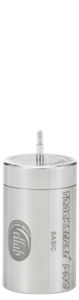
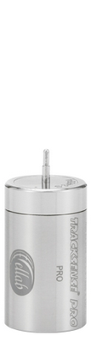
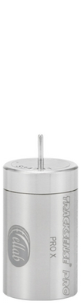
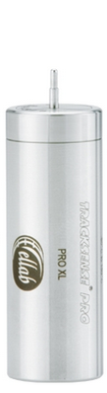
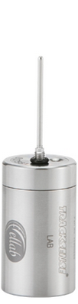
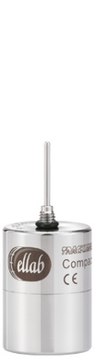
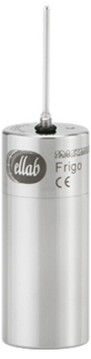


TrackSense® Data Logger Overview
Basic
Pro
Pro X
Pro XL
Lab
Compact
Frigo UX Sky
Frigo
Micro
Mini
-30 to +108 °C
-50 to +150 °C
-80 to +150 °C
-80 to +150 °C
-30 to +100 °C
-30 to +140°C
-90 to +140 °C
-90 to +85 °C
-20 to +140 °C
0 to +140 °C
Interchangeable sensor
Integrated sensor

Slide 4
General Features (1/2)
Withstands -80 to +150 °C and up to 10 bar pressure (extended to -196 to +400 °C with thermal barrier)
Fast response time with thin probes (minimized thermal error)
Accuracy: ±0.05 °C / ±0.25% FS (0-8 bar) / ±2% RH
Replaceable battery (up to 1,000 operating hours)
Large non-erasable memory (up to 120,000 data points)

Slide 5
General Features (2/2)
Durable and high-quality build:
Electronics sealed in protective plastic
High-end components
ISO-certified production
Extensive quality control—even for stocked items
Battery:
Specialized battery for up to 150 °C
Software warning for low capacity
Correct measuring position:
Extensive accessories and fixations
Custom sensor designs (length & diameter)

Slide 6
Data Point Distribution
Sensor type | Data point distribution
 | When using 3. Gen. Pro Logger (120.000 Datenpunkte)
Temperature Single sensor | 120.000 points
Temperature Double sensor | 60.000 points per channel
Multipoint Temperature sensor | 30.000 points per channel
Quad Sensor | 30.000 points per channel
Thermocouple Sensor | 40.000 points | 80.000 for temp calculation
Pressure sensor | 60.000 points | 60.000 for temp compensation
Pressure- / Temperature sensor | 40.000 pressure | 40.000 temperature | 40.000for temp compensation
Vacuum-/Temperature sensor | 60.000 vacuum | 60.000 temperature
Humidity-/Temperature sensor | 60.000 humidity | 60.000 temperature
Conductivity-/Temperature sensor | 60.000 conductivity | 60.000 temperature
CO2 Sensor | 120.000 CO2
Automarker Sensor | 120.000

Slide 7
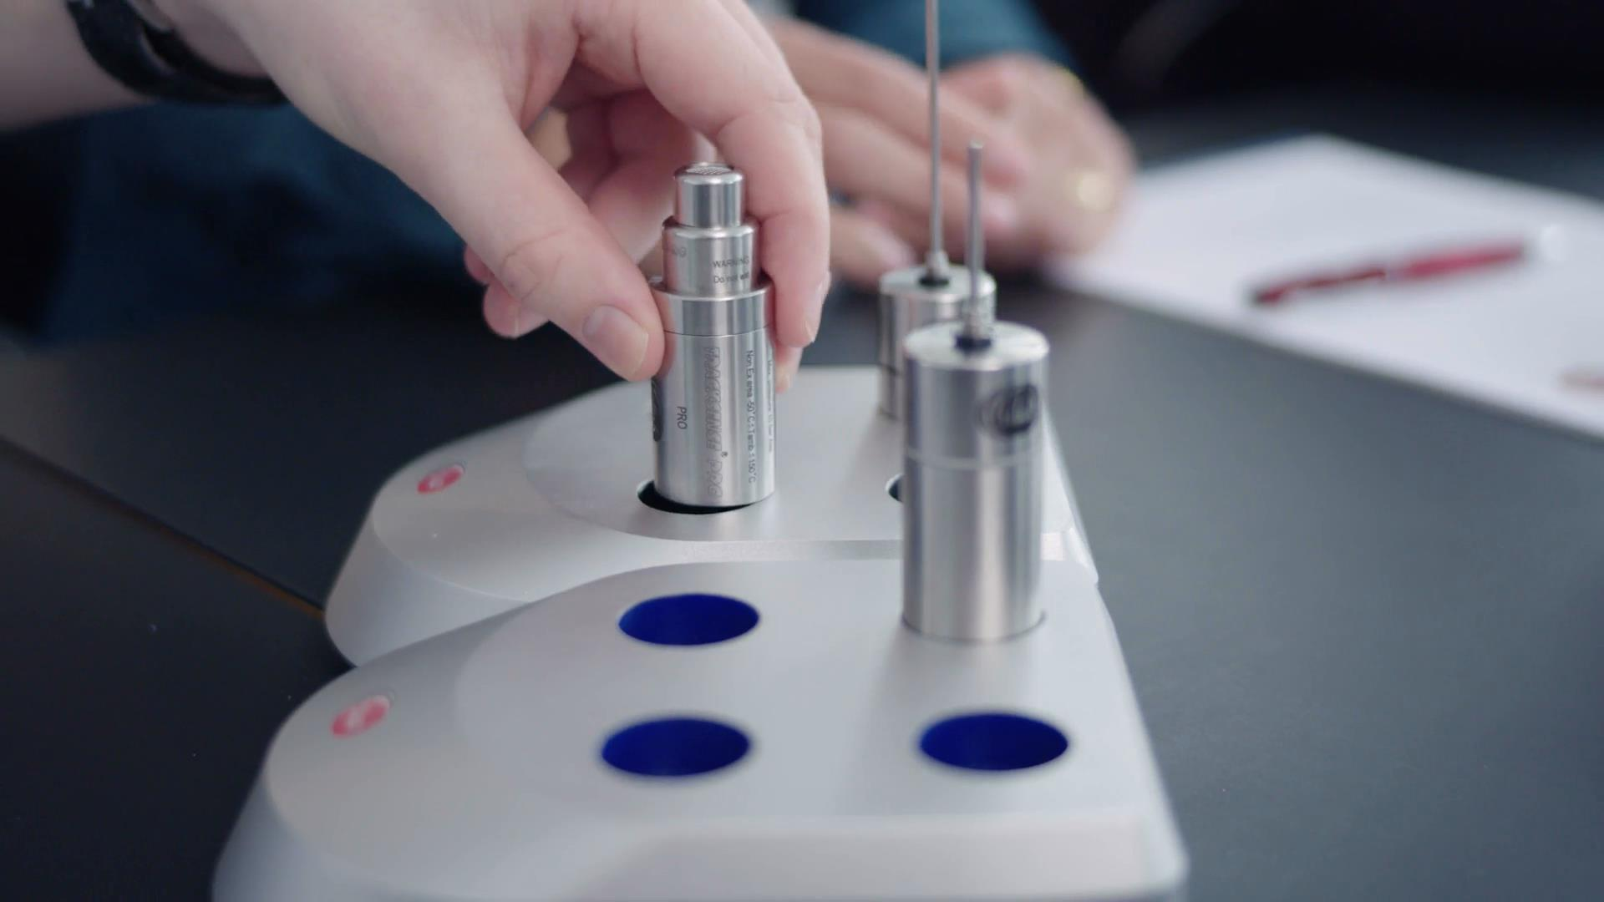
Multi - Reader Station
Easy USB or LAN connection to PC
Up to 3 expansion readers (requires power supply)
Simultaneous programming, starting, and readout (up to 16 loggers)
Inductive data transfer

Slide 8
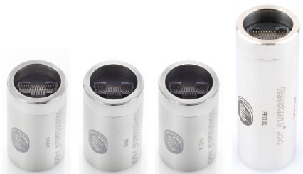
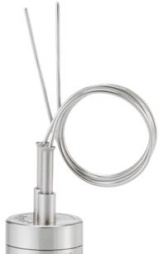
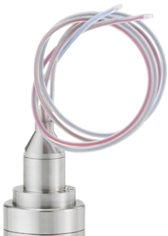
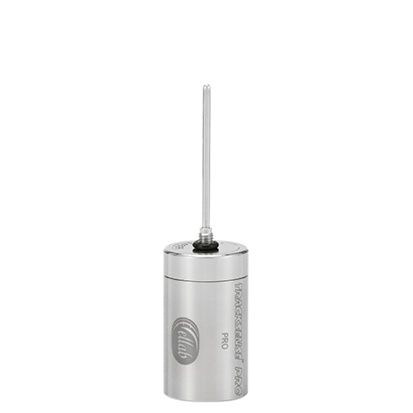
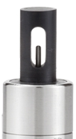
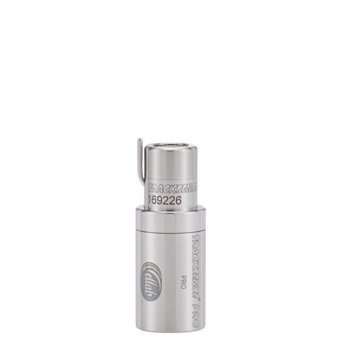
Interchangeable Sensors
Choose between Temperature-, Pressure-, relative Humidity-,
CO2- and Conductivity sensors.

Slide 9
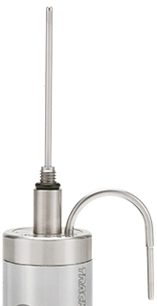
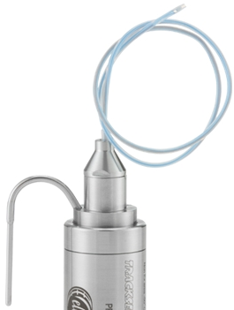
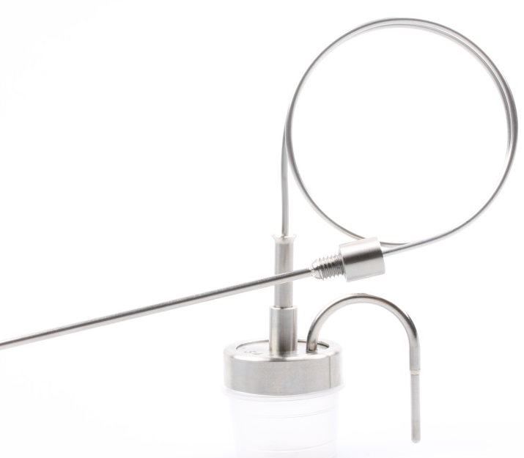
Rigid and Combined Temperature Sensors
Rigid:
Stainless steel
-196 to +150 °C
Ø2 mm
1 or 2 channels
Combination (rigid/flexible):
Stainless steel/PTFE
-196 to +150 °C
Ø1.8–2 mm

Slide 10
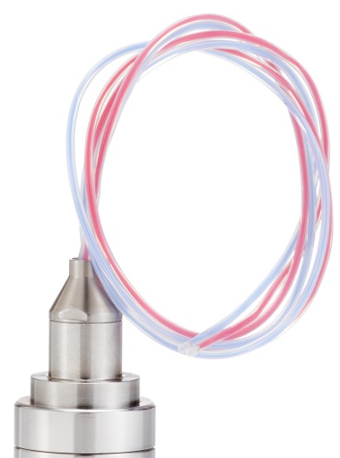
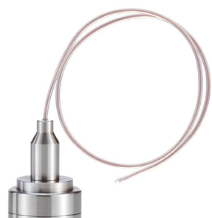
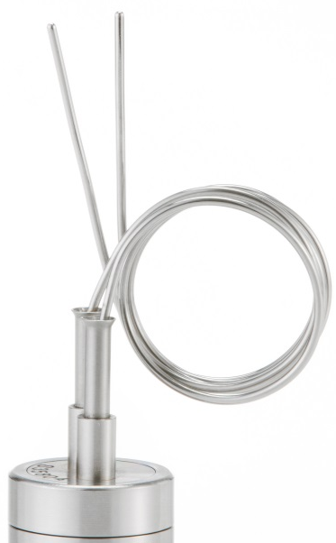
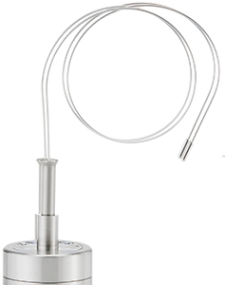
Flexible Temperature sensors
Smart flex. Single-/Double sensor
PTFE
-196 to +140 °C
Ø1.8 mm
Low temperature sensor
PTFE
-196 to +100 °C
Ø1.2 mm
Semi flex. Single-/Double sensor
Stainless steel
-196 to +150 °C
Ø1.5 mm
High temperature sensor
Stainless steel
0 to 400 °C
Ø2 mm

Slide 11
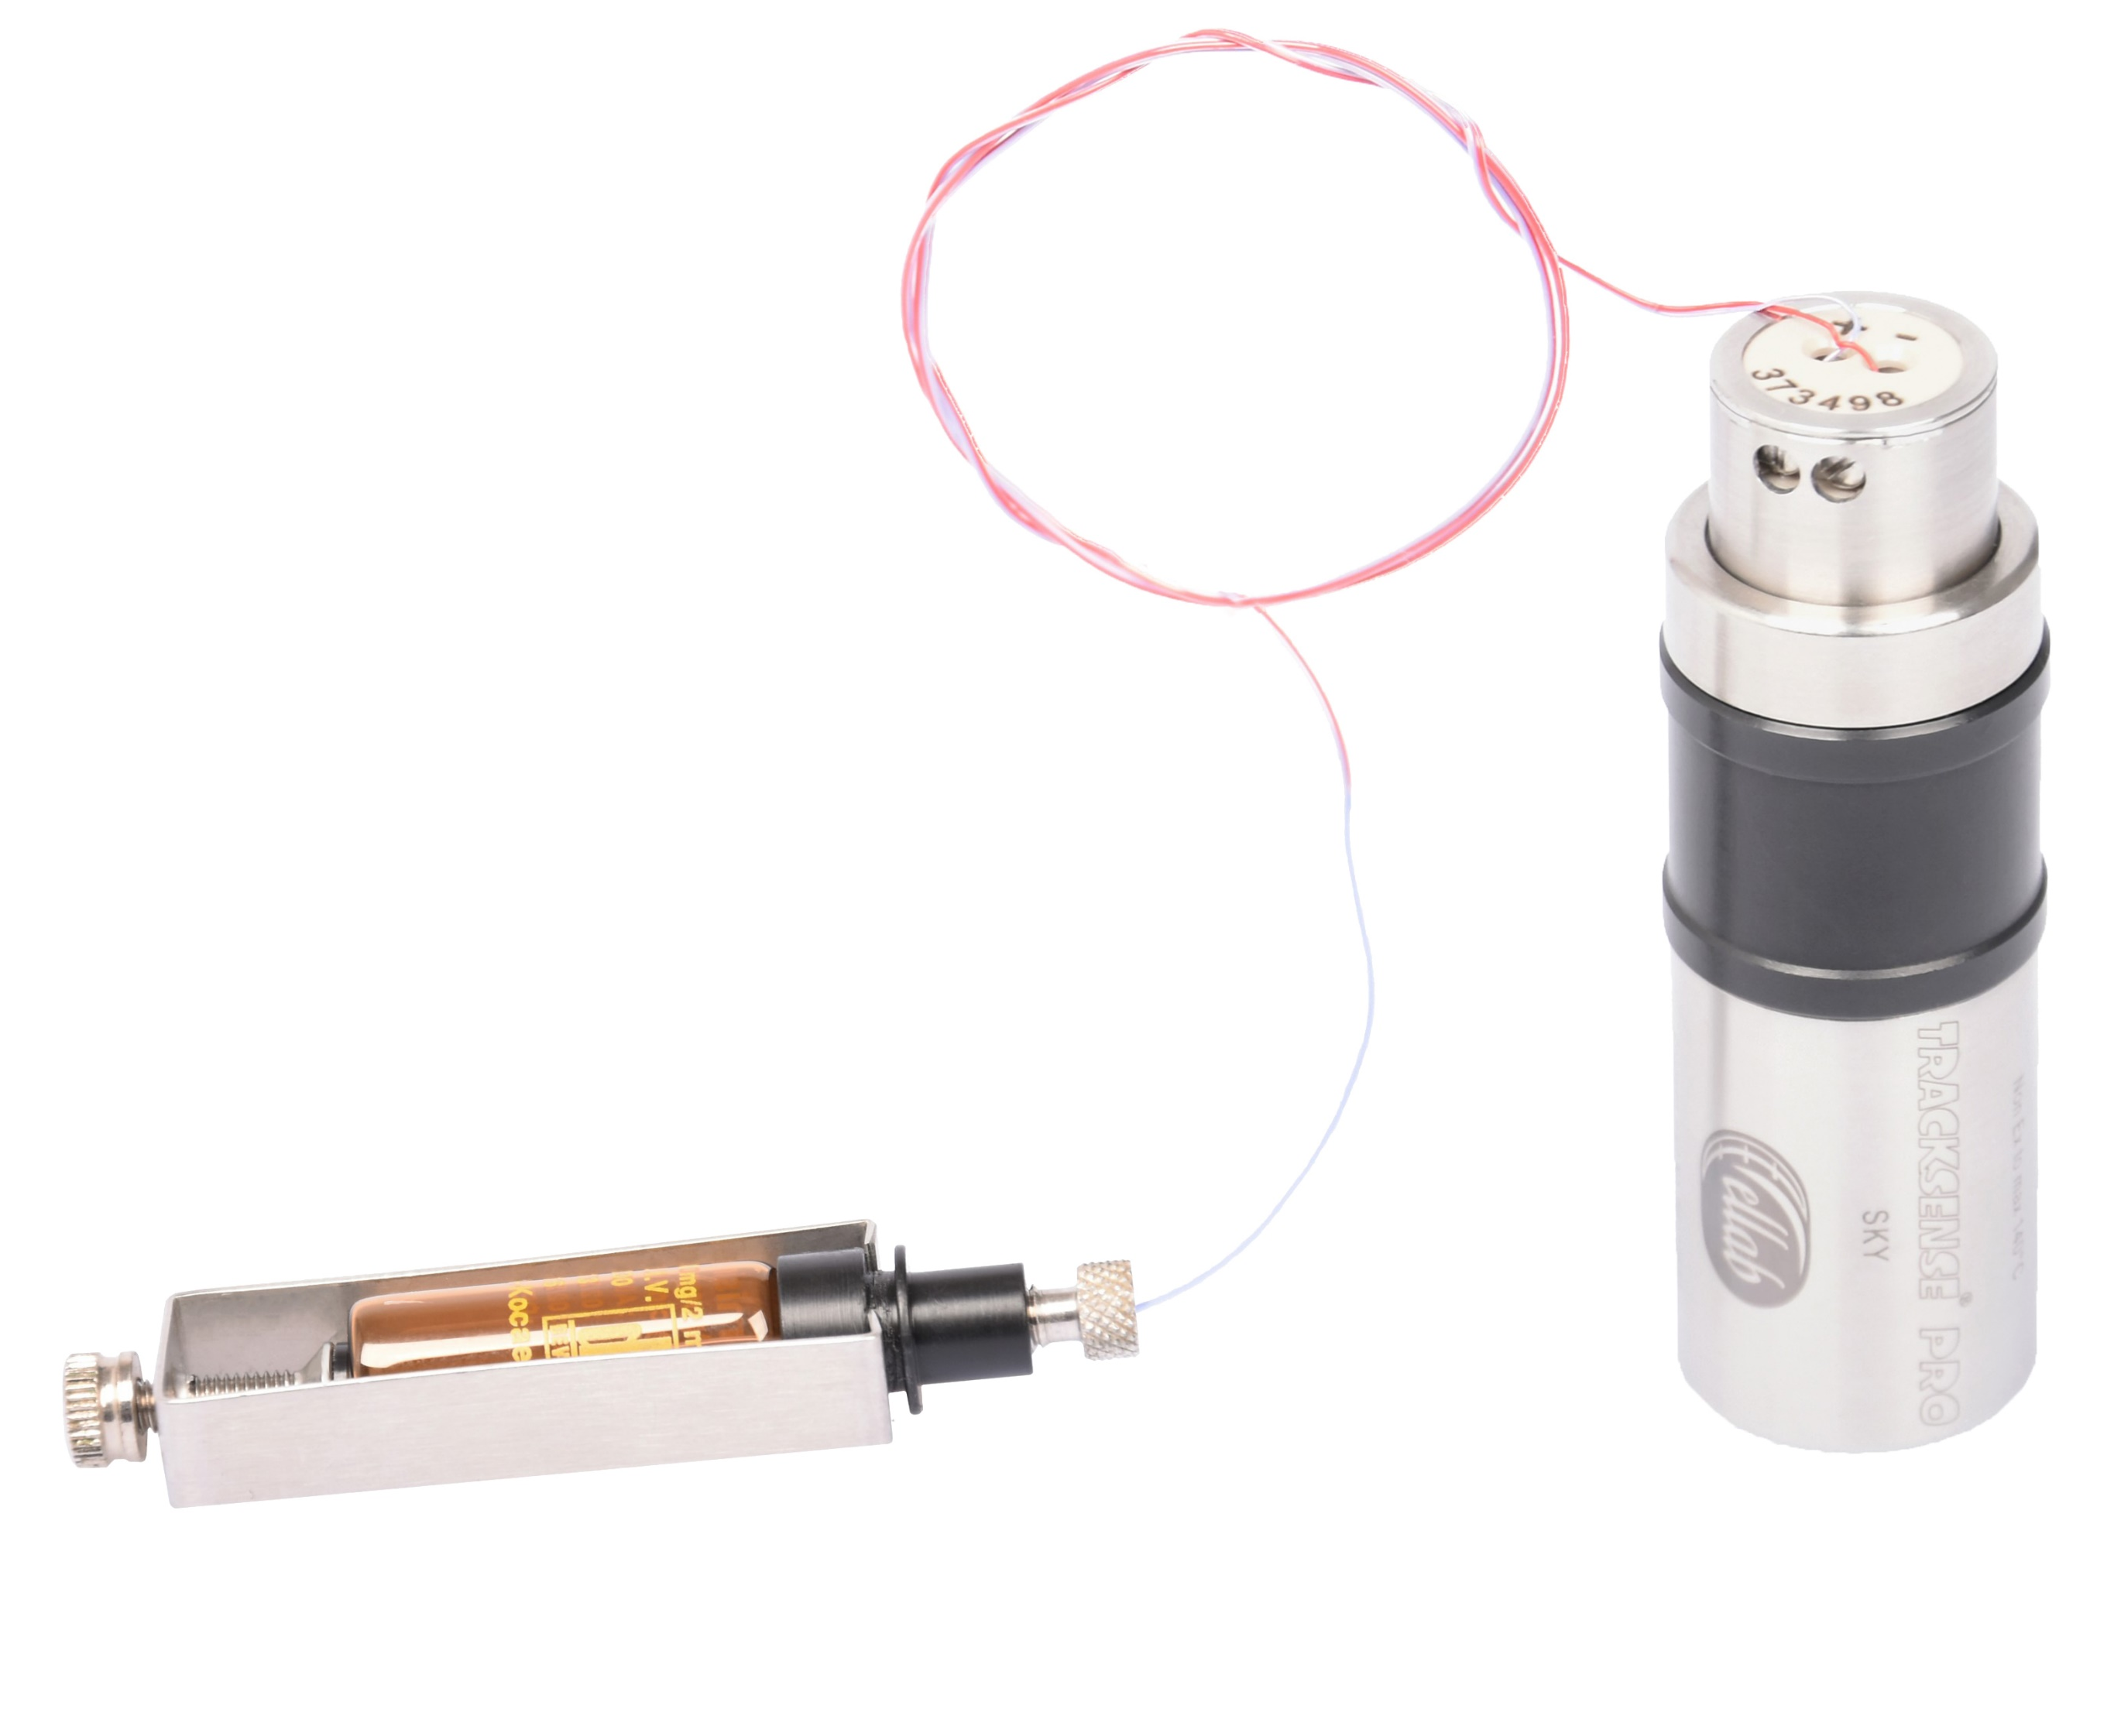
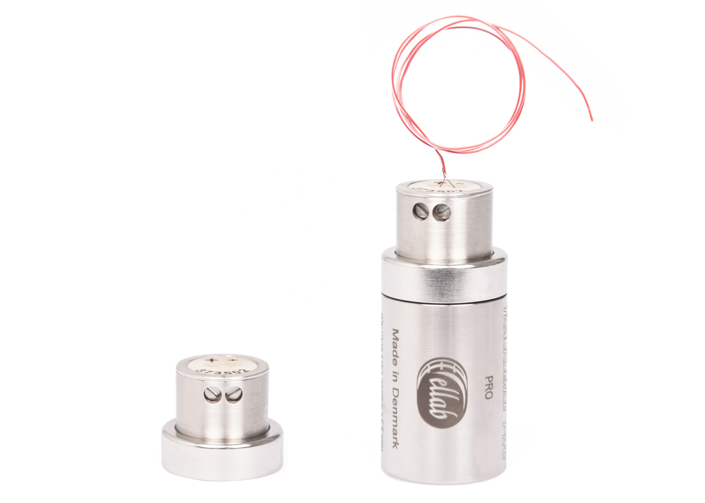
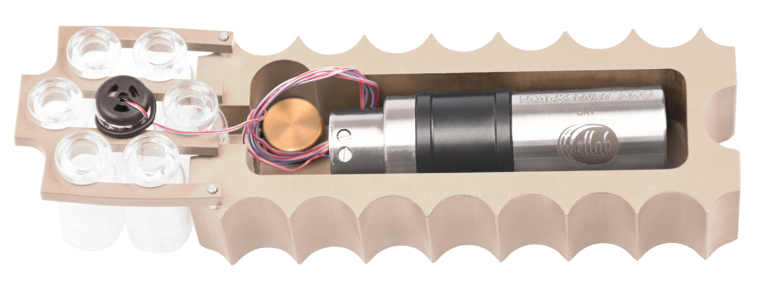
Thermocouple Sensor
Temperature Range logger exposed: -50 to 62 °C
Temperature Range only thermocouple: -50 bis 400 °C
Accuracy: ±0.3 °C
Replaceable probe tip using screwdriver

Slide 12
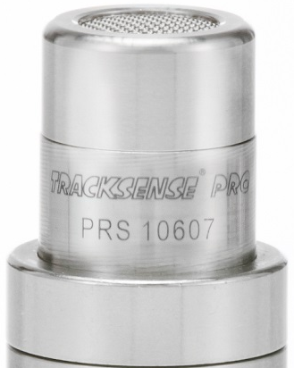
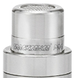
Pressure & Temperature Sensors
Pressure-/Temperature sensor
Temperature: 0 to 150 °C, Accuracy: ±0.5 °C
Vacuum & Temperature Sensor
Pressure: 0.0001 to 1,000 mBar, Accuracy: ±15–20% depending on range
Pressure sensor
Pressure: 10 mBar to 4, 6 or 8 Bar abs, Accuracy: ±0.25% FS
Pressure accuracy: 0,0005 mbar to 0,001 mbar: ±20 %
0,001 mbar to 100 mbar: ±15 %
100 mbar to 1.000 mbar: ±20 %

Slide 13
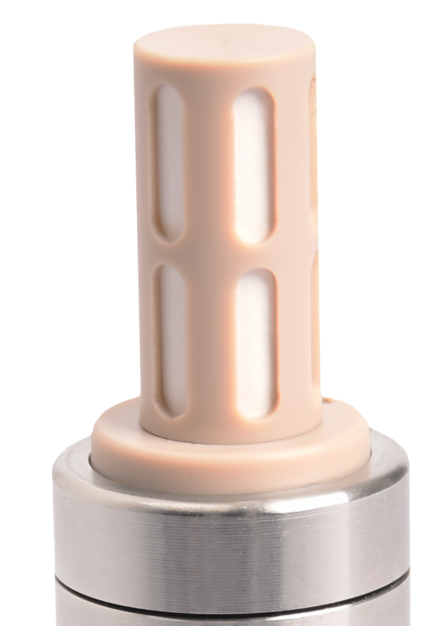
Humidity & Temperature Sensor
Humidity: 0–100% RH, Accuracy: ±0.2%
Temperature: 0–90 °C, Accuracy: ±0.1 °C

Slide 14
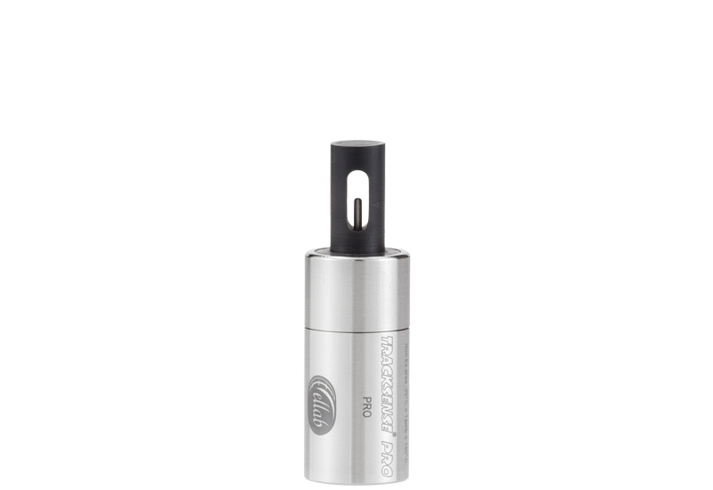
Conductivity & Temperature
Variant 1:
0–200 µS/cm
Temp Range: 0–100 °C
Variant 2:
200–2000 µS/cm
Temp Range: 0–100 °C

Slide 15
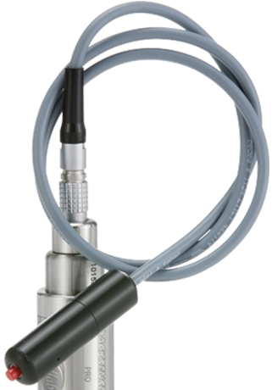
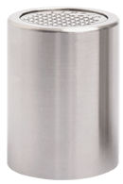
CO2 Sensor & Automarker Sensor
CO2 Sensor
CO₂: 0–18% (only with Basic L Logger)
Automarker-Sensor
Logs events during studies (time markers)

Slide 16
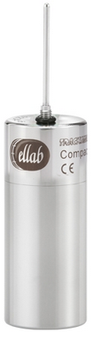
Integrated Sensors
The Sensor Element and Logger are one unit and can´t be exchanged.
(only available as single sensors)

Slide 17
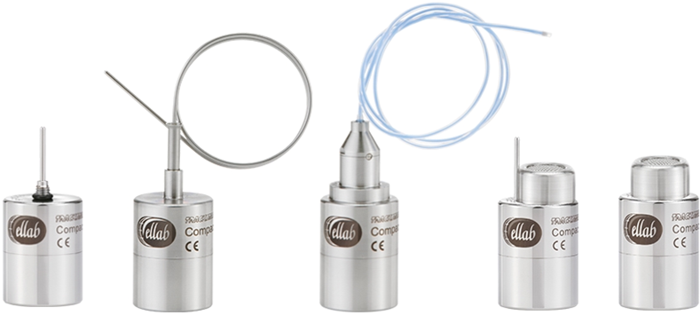
TrackSense® Compact Logger
A cost-effective solution for users who do not require replaceable sensors.
Temperature Data Logger
-30 to +140 °C
Accuracy: ±0.1 °C
30,000 points
Pressure Logger
10 mBar to 6 Bar
Accuracy: ±0.25% FS
5,000 points

Slide 18
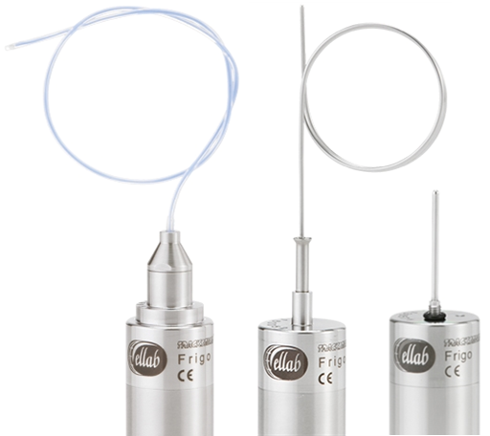
TrackSense® Frigo Logger
Temp: -90 to +85 °C
Accuracy: ±0.1 °C
60,000 points
TSF battery for long-term use (up to 12 months)
LED indicator for activity
Ideal for: refrigerators, freezers, incubators, water baths

Slide 19
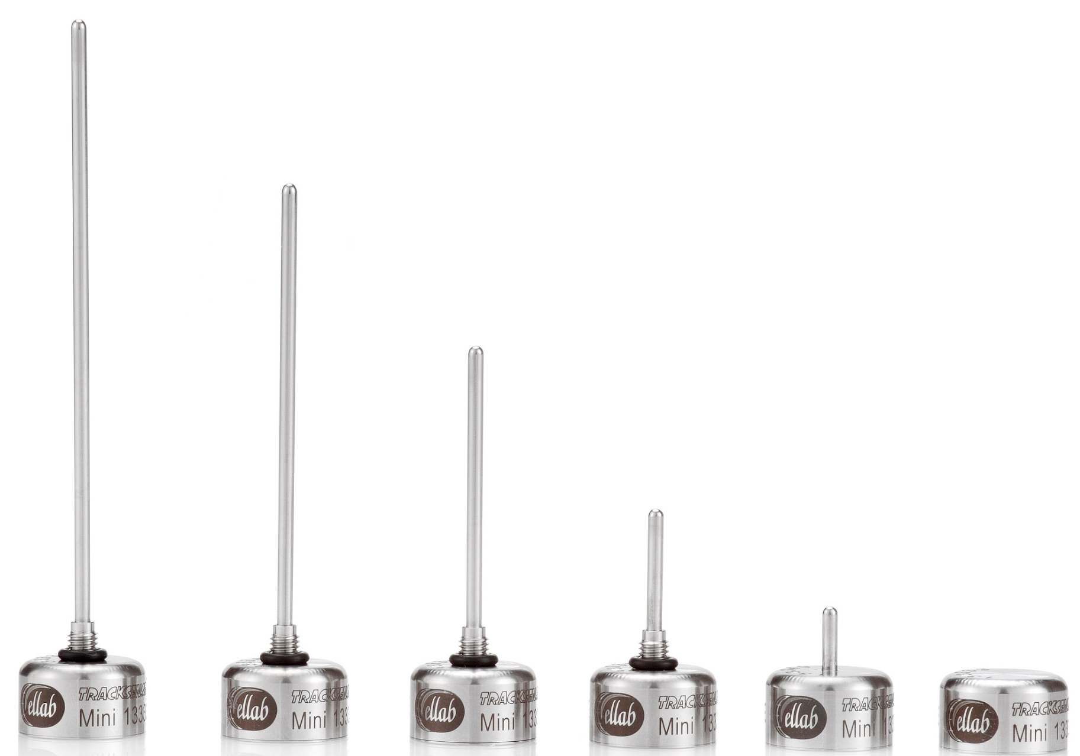
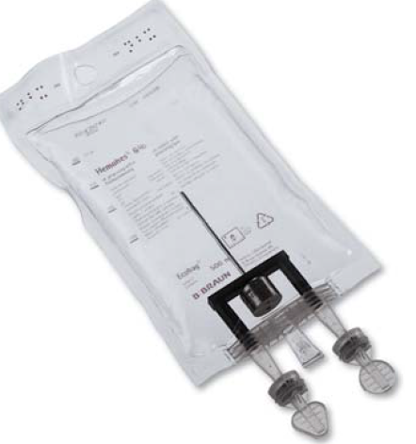
TrackSense® Pro Mini Logger
The mini-logger was developed for processes where a small size plays an important role in avoiding thermal conduction errors. (ideal for pharmaceutical applications)
Temp: 0 to +140 °C
Accuracy: ±0.05 °C
30,000 points
Small size ideal for pharma use

Slide 20
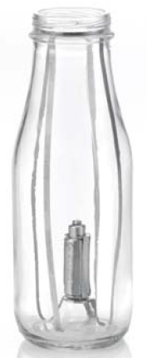
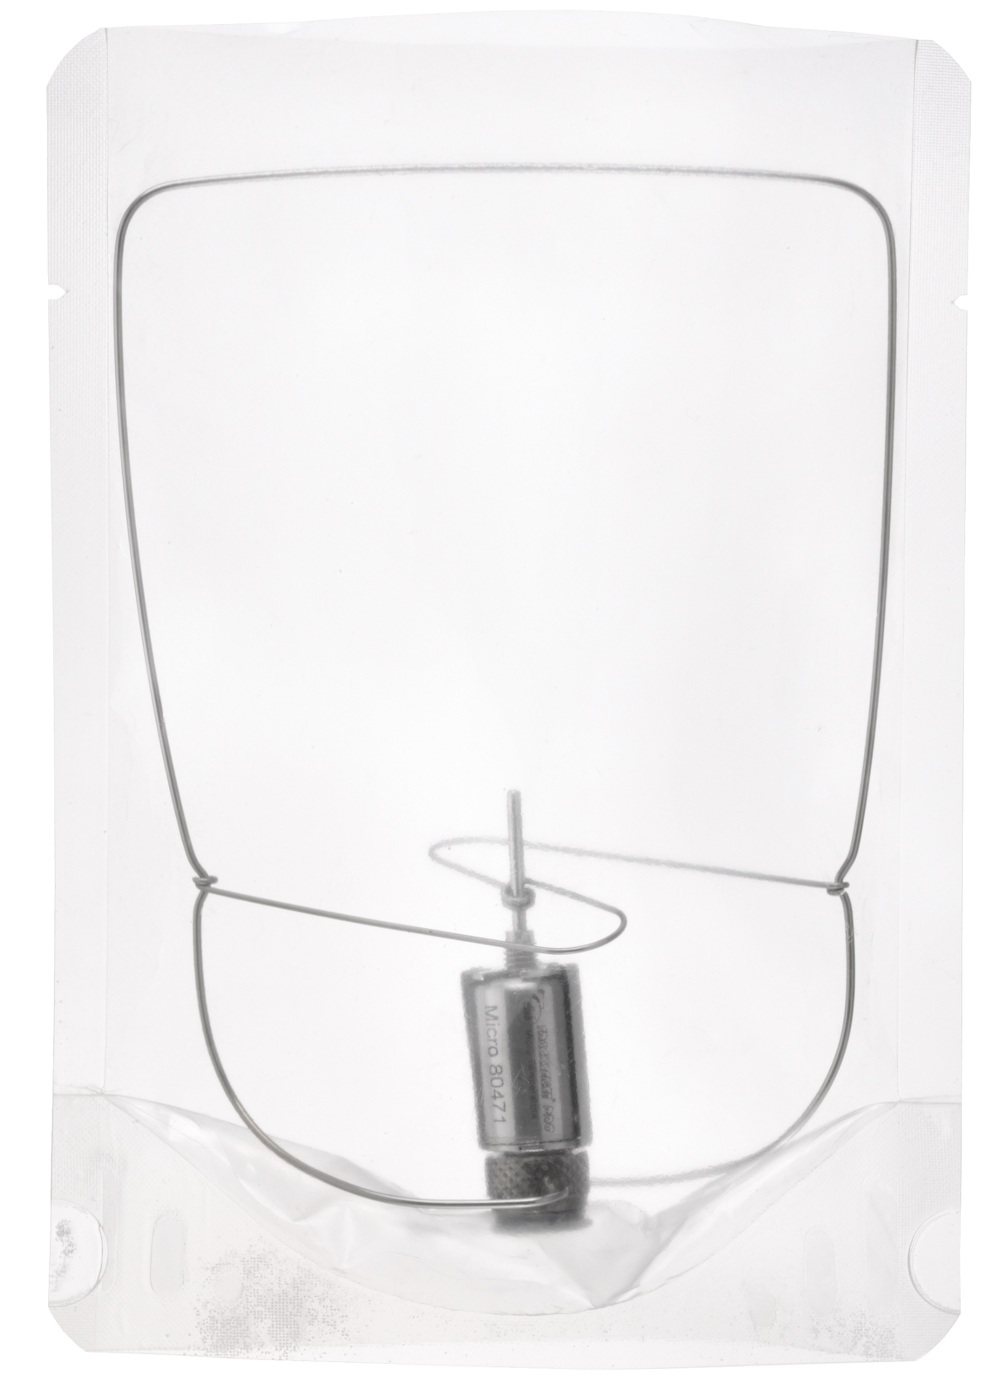
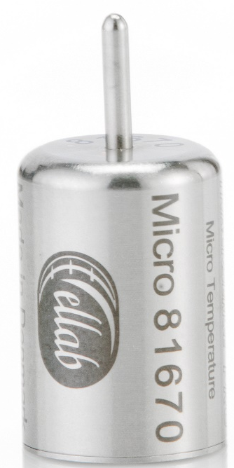
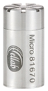
TrackSense® Pro Micro Logger
Temperature logger
Temp: -20 to +140 °C
Accuracy: ±0.05 °C
14,500 points
Pressure-/Temperature logger
10 mBar to 6 Bar
Accuracy: ±0.25% FS
30,000 points

Slide 21
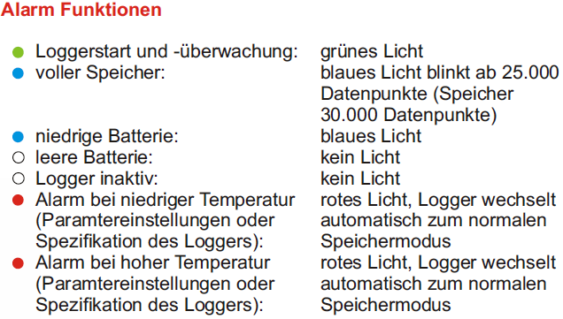
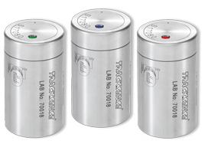
TrackSense® Pro LAB Logger
For temperature and humidity measurements
Including LED alarm function:
Ideal for monitoring temperature or humidity in long-term stability applications or during the validation of cleaning and disinfection systems.

Slide 22
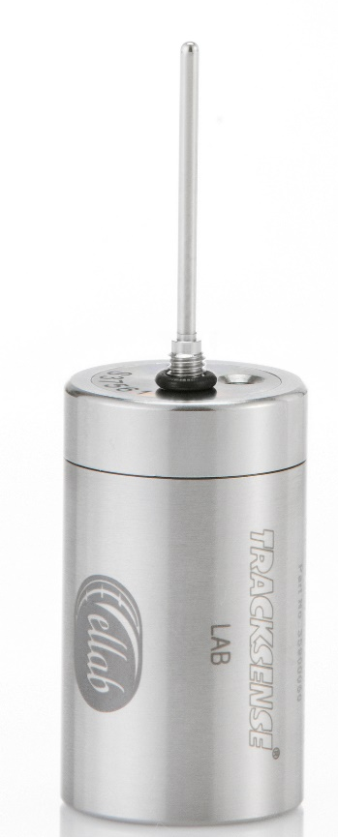

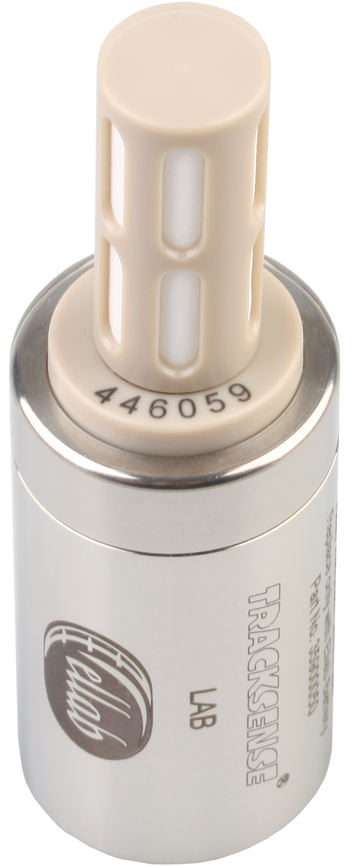
TrackSense® Pro Lab Logger
Temperature logger
Temp: -30 to +100 °C
Accuracy: ±0.1 °C
120,000 points
Humidity-/Temperature logger
Humidity: 0–100% RH
Accuracy: ±2% RH
30,000 points/channel

Slide 23
Specifications Overview
Logger | dimensions (mm) | Data Storage | Battery Lifetime (h) | Temperature range (°C)
TrackSense® Pro XL | 25 x 68,8 | 120.000 | 3.000*¹ | -80 bis +150
TrackSense® Pro X | 25 x 43,5 | 120.000 | 2.000*¹ | -80 bis +150
TrackSense® Pro | 25 x 43,5 | 120.000 | 2.000*¹ | -50 bis +150
TrackSense® Pro Basic | 25 x 43,5 | 120.000 | 2.000*¹ | -30 bis +105
TrackSense® Pro Basic L | 25 x 68,8 | 120.000 | 150*² | -30 bis +85
TrackSense® Pro Mini 2G | 20 x 12 | 30.000 | 200*³ | 0 bis +140
TrackSense® Pro Micro (TMP) | 15 x 22 | 14.500 | 75 | -20 bis +140
TrackSense® Pro Micro (PRS/TMP) | 15 x 30 | 30.000 | 50 | -20 bis +140
TrackSense® Lab | 25 x 43,5 | 60.000 | 2.000*¹ | -30 bis +100
TrackSense® Pro Compact | 25 x 35 | 30.000 | 2.000*¹ | -30 bis +140
TrackSense® Pro Compact X | 25 x 35 | 30.000 | 2.000*¹ | -50 bis +140
TrackSense® Pro Compact UX | 25 x 60 | 60.000 | 3.000*¹ | -80 bis +140
TrackSense® Frigo | 25 x 60 | 60.000 | 3.000*⁴ | -90 bis +85
*¹ 121 °C / 10 Sec. samplerate / 1 Temperature Sensor
*² 40 °C / 2 Min. samplerate / CO2 Sensor
*³ 2nd Gen
*⁴ -80 °C / 15 Sek. Samplerate
Notes:
*¹ Bei 121 °C / 10 Sek. Taktrate / 1 Temperatur Sensor
*² Bei 40 °C / 2 Min. Taktrate / CO2 Sensor
*³ 2nd Gen
*⁴ Bei -80 °C / 15 Sek. Taktrate

Slide 24
The most important applications
Application | TS Lab | TSP Micro | TSP Mini | TSP Basic | TSP | TSP X | TSP XL | Com-pact | Com-pact X | Com-pact UX | Frigo
Autoclave |  | X | x |  | x | x | x | x | x | x
Vacuum-Autoclave |  | x |  |  | x | x | x | x | x | x
EtO Autoclave |  |  |  | x | x | x | x
Rotations-Autoclave |  | x
Cleaning and disinfection device | x | x | x | x | x | x | x | x | x | x
Oven (over +150 °C) |  |  |  |  | x* | x* | x*
Incubator | x | x | x | x | x | x | x | x | x | x
Fridges | x | x | x | x | x | x | x | x | x | x | x
-40 °C Freezer |  |  |  |  | x | x | x |  | x | x | x
-80 °C Freezer |  |  |  |  |  | x | x |  |  | x | x
-90 °C Freezer |  |  |  |  |  |  |  |  |  |  | x
* Requires the use of a thermal barrier

Slide 25
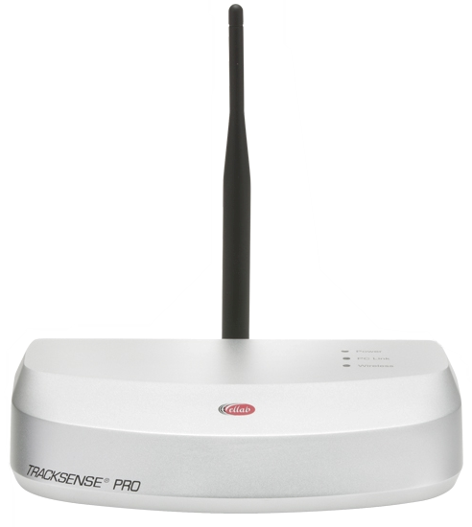
Sky System – Real-Time Data Transmission
Operating Temperature | 5 bis 50 °C
Environment | 0 bis 90 % RH, non condensing
Capacity | 1 to 4 Sky Access Points per study/process up to 64 Sky Modules (Loggers) / 128 channels
Transmission rate | 5, 10 or 60 seconds for 16 sky modules 10 or 60 seconds for 32/64 sky modules
PC-Connection | PC-connection via Ethernet or USB
Power supply | USB Link oder 12-36 VDC Supply
status indicator | LED
Sky Access Point
Enables remote start/stop
Continuous process monitoring

Slide 26
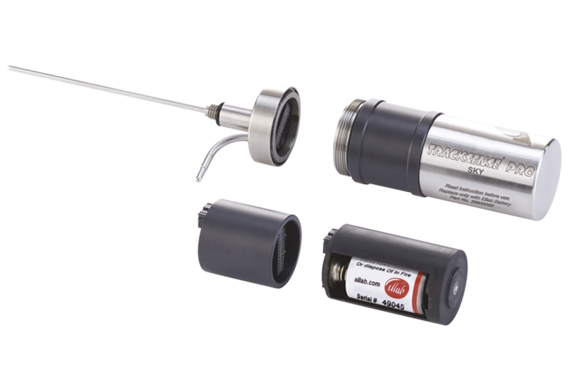
Sky System – Real-Time Data Transmission
Sky Module
Wireless communication
No data loss during transmission issues, data is stored in logger
Operating Temperature | -80 bis 140 °C
Transmission distance | Up to 15 m
Operating transmission frequency | 2.4 GHz/IEEE 802.15.4 Standard
Diameter | 25 mm
Length of the data logger with Sky module | 66,3 mm
ATEX protection class (when using Basic/Pro/X data loggers) | Ex II1G Ex ia IIC T3 Ga -60 °C ≤ Tamb ≤ 105 °C
ATEX protection class (when using XL data loggers) | Ex II1G Ex ia IIC T3 Ga -55 °C ≤ Tamb ≤ 105 °C
Sky Modul

Slide 27
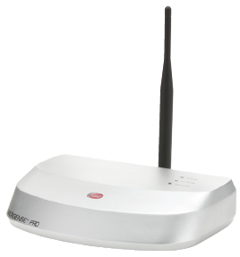
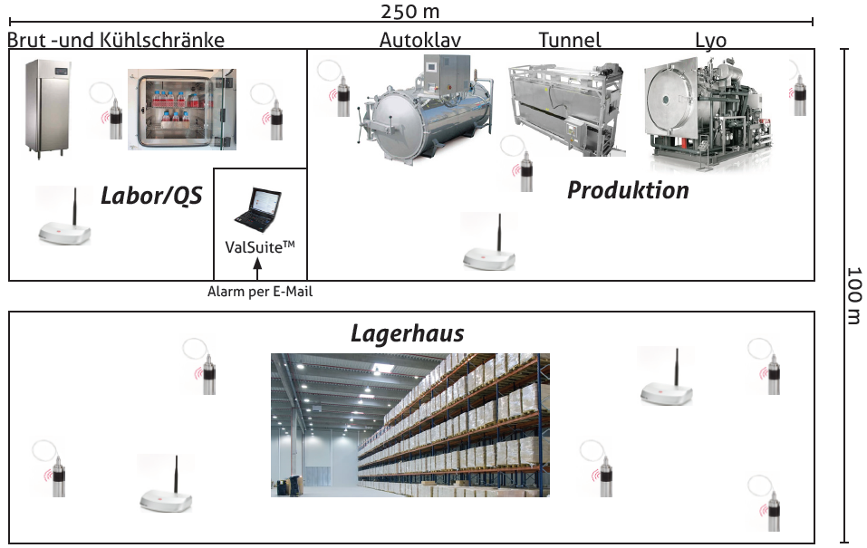
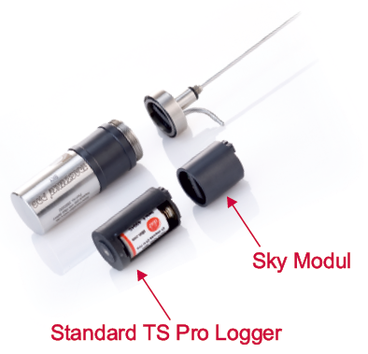
Sky System – Real-Time Data Transmission

Slide 28

High-Performance Lithium Batteries
ISO-certified
Enhanced lifespan when used in consistent temperature ranges
Our tip:
If lithium batteries are only used in a temperature range, such as during sterilization, the lifespan can be significantly extended.
A frequent change of temperature ranges (e.g., from sterilization to freeze-drying) is not recommended by Ellab (it adversely affects the capacity)!

Slide 29

Use of third-party batteries may:
Void warranty
Cause measurement errors
Lead to logger or sensor damage

Slide 30




Battery Replacement
Can be performed by the user
Battery activated for 1 hour before installation
Must be confirmed in software

Slide 31

Validation Accessories
Ellab provides the right sensor, feedthroughs, seals, and brackets for every container or product.

Slide 32


Thermal Barrier Use for High-Temp Applications
Enables measurements up to 400 °C
Compatible with single/double rigid or flexible sensors

Slide 33

Temperature-time profile of the thermal barriers

Slide 34
Application Tunnel & Oven
The Challenge
The Solution
Long tunnels make it almost impossible and very time-consuming to move thermocouples through the heating zone.
35 mm thermal barrier with 300 mm single or dual sensors (flexible)
Notes:
Customer: Merck & Co.

Slide 35


Application of steam sterilization (1/2)
The Challenge
The Solution
There are very small containers that rotate during sterilization.
Ellab Mini-Logger
Micro Logger
Notes:
Customer: Merck & Co.

Slide 36




Application of steam sterilization (2/2)
Vials/Ampoules Validation
Infusion bag validation

Slide 37


Application Sterilization
Stand-up pouch with special holder
Mini Logger

Slide 38




Application of fermenters and SIP systems

Slide 39



Application bottles
Distribution & Penetration temperature

Slide 40




Summary – Key Advantages
Real-time data via Sky Technology
FDA 21 CFR Part 11 compliant
-196 to +400 °C temperature range
Customizable for any process or product
Interchangeable and integrated sensor options

