Slide 1
Validation
Pricelist 2026

Slide 2
Price adjustments 2026
Validation Solutions | Product line | Price change
 | EVP Plus Module | 5%
 | EVP Arrays, TC and Accessories | 4%
 | Frigo Logger | 4%
 | Frigo UX Sky Logger | 0%
 | Lab Loggers | 4%
 | TSP Loggers | 3%
 | TS LyoPro, All | 3%
 | Mini & Micro Loggers | 3%
 | Compact Loggers | 6%
 | SteriSense, All | 4%
 | TSP Sensors | 3%
 | Software w. readerstation ValSuite Pro | 3%
 | Software w. readerstation ValSuite Basic | 6%
 | ValSuite Licenses, Plus and Pro | 3%
 | ValSuite Licenses, Others | 6%
 | Accessories | 3%
 | Validation EQ, All Other | 4%
 | ETI | 5%
 | Calibration – In-house | 0%
 | consumables | 4%
 | TSP Batteries | 0%
 | Repairs | 5%
Overview

Slide 3
Calibration
Quotation process for 3rd party calibration equipment
Access pricelist on Bording - ellab.bordingcentral.dk
Quote & submit directly to Ellab DK ordering team
(not all items are available in BC)
Final sales price will be informed to responsible Sales representative
Price increase 2026
AMETEK: 10%
Fluke: 10%
Kambic: 40%
Note: Please note that the sales price from the 3rd party pricelist is not final and will be subject to a final adjustments based on selected price adjustments.

Slide 4
Validation Price List 2026
Equipment, Software and After-Market
New Format
New Items
Excel Sheet like Monitoring Solution
Same look and feel for all Solutions
Ease overview and navigation
Printable
Frigo UX Sky Loggers
E-Val Pro Plus
etc
Structure
Cleaned-Up
Table of contents structured like the former “Price Book”, with tabs for TS Pro, LyoPro, SteriStense, EVP etc. included selected re-arrangements
Additional subtitles added to improve structure and overview
Item descriptions from the old “Price Book”
Updated according to the item clean-up done during the ERP Project (BC roll-out)
The price list has been streamlined to highlight and promote our strategic focus items

Slide 6
Table
Use this as a reference for table design – you can also copy-paste.
 | Text | Text | Text | Text
Text
Text
Text
Text
Text
Text
 | Text | Text | Text | Text
Text
Text
Text
Text
Text
Text

Slide 7


Brand Shapes
Logos
Text Boxes
Text Box
Text Box
Text Box
Text
Button-type list
Temperature
Pressure/Vacuum
CO₂
Conductivity
Humidity

Slide 8

























































































Brand Icons

Slide 9

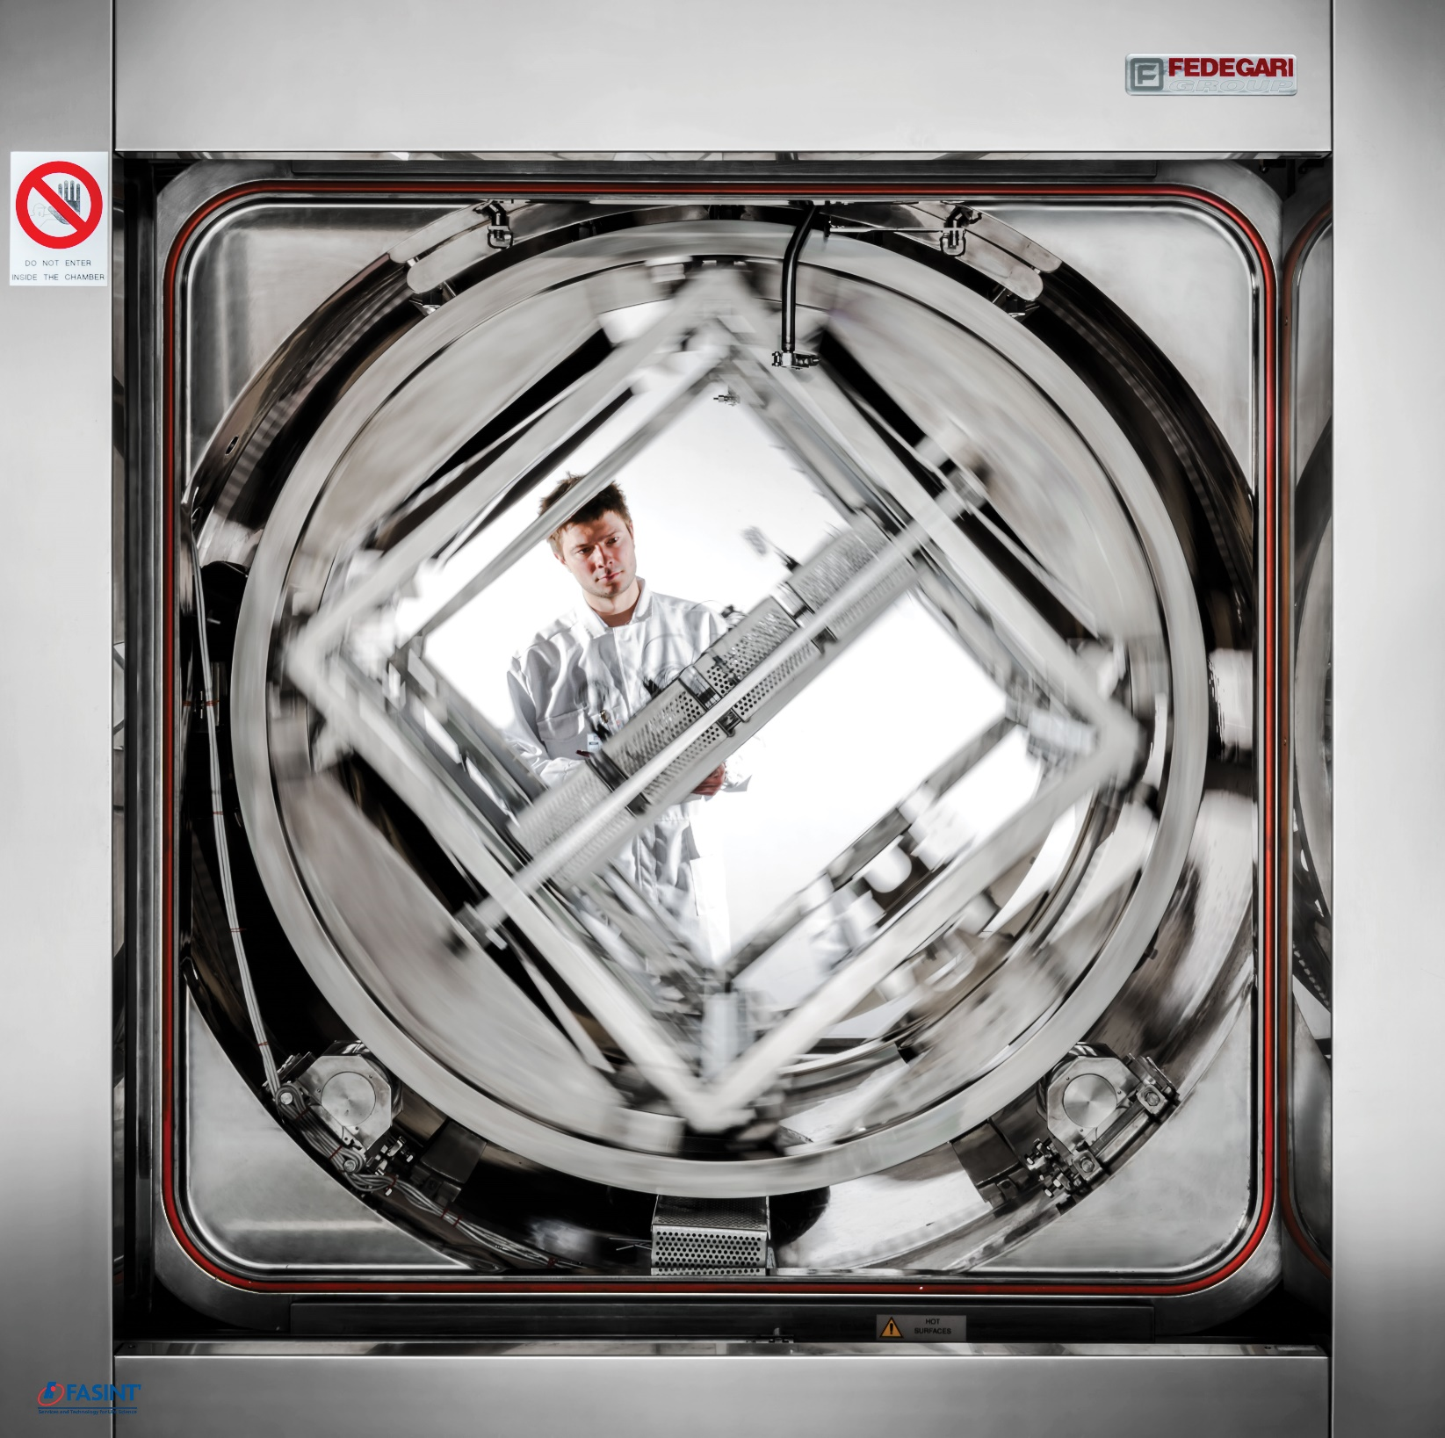














Pictures

