Slide 1
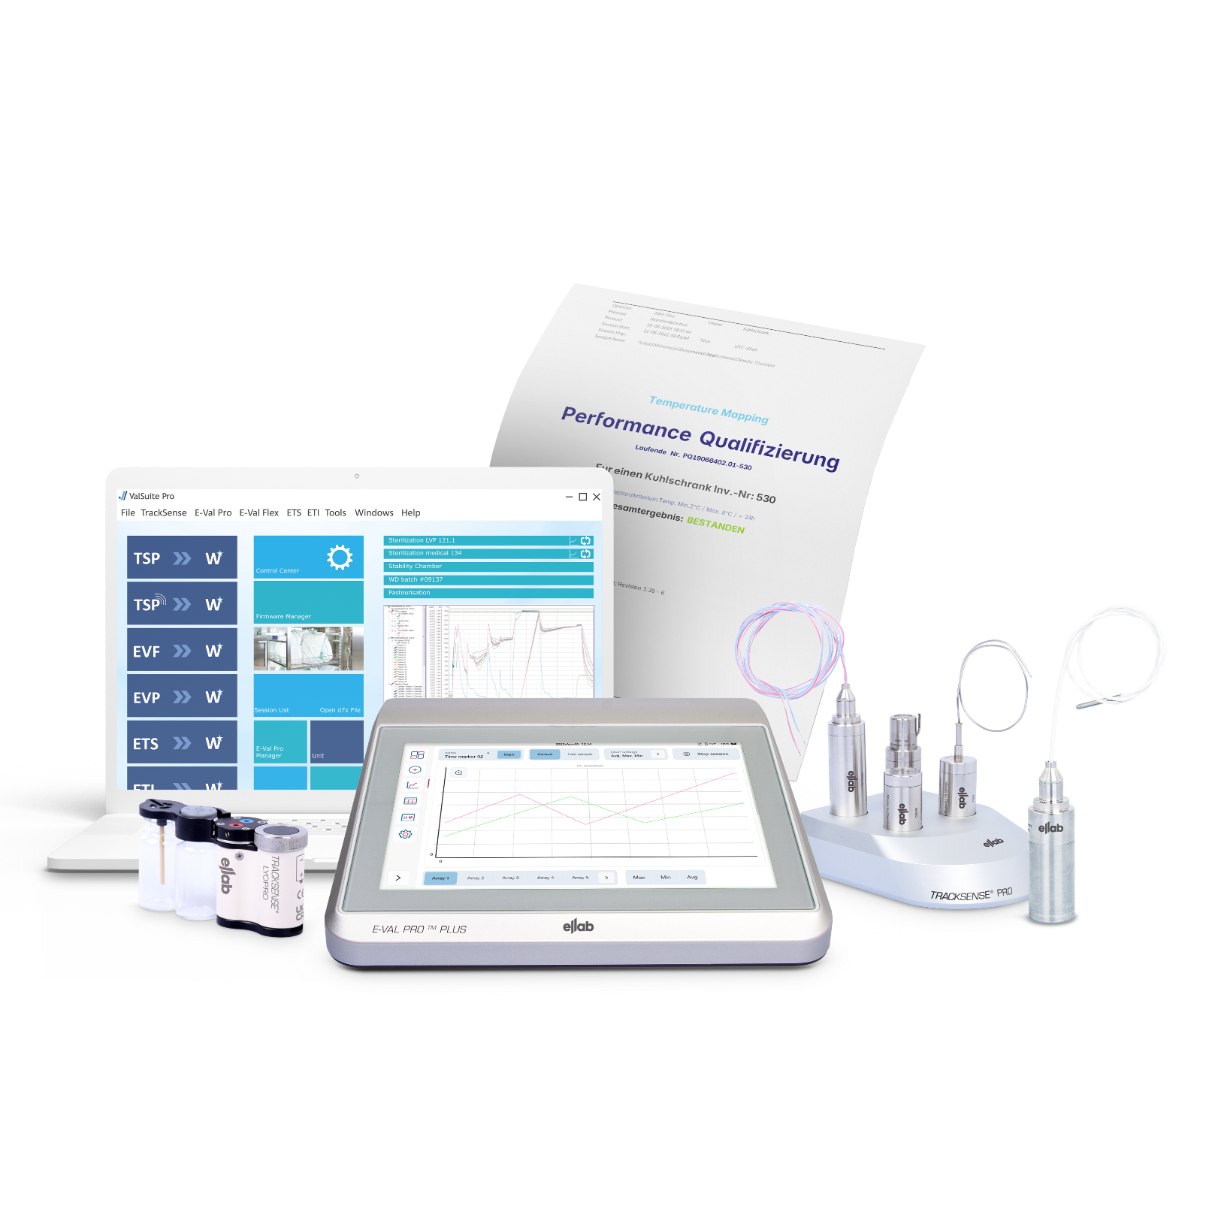

ValSuite®
Software

Slide 2

Everyday Mapping Made Quicker
Validation Software
with ValSuite®
Direct Pass/Fail criteria.
KNEAT integration
Merge sessions to detect trends.
Periodic evaluation.
Pre-defined reports according to ISO norms.
Local or client server installation.
Windows AD integrated security.
Citrix installation options.
Easy setup:
Installation & user setup
Result orientated:
Fast evaluation
Guaranteed data integrity.
Full system validation on site.
Data saved in encrypted database – no tampering possible.
Password protected – user profile operated.
Repeat sessions using the same setup.
Dual dynamic Auto transfer to work online and offline.
Drag-and-drop pictures in templates.
Time saving:
Pre-defined names & templates
Compliant:
21 CFR Part 11
& EU Annex 11
Your Life Science
Compliance
Partner
Notes:
All those services if done by our teams or the customers teams, are supported by the best software on the market for thermal validation projects.
Easy setup and various installation options to meet the customers requirements.
Compliant to the global standards.
Quick results & fast evaluation as well as compatibility with 3rd party validation software like KNEAT.
A real time saver, as you can repeat studies easily or start them with out any setup. You also can work offline and at the same time do reports somewhere else with the dual dynamic installation.

Slide 3
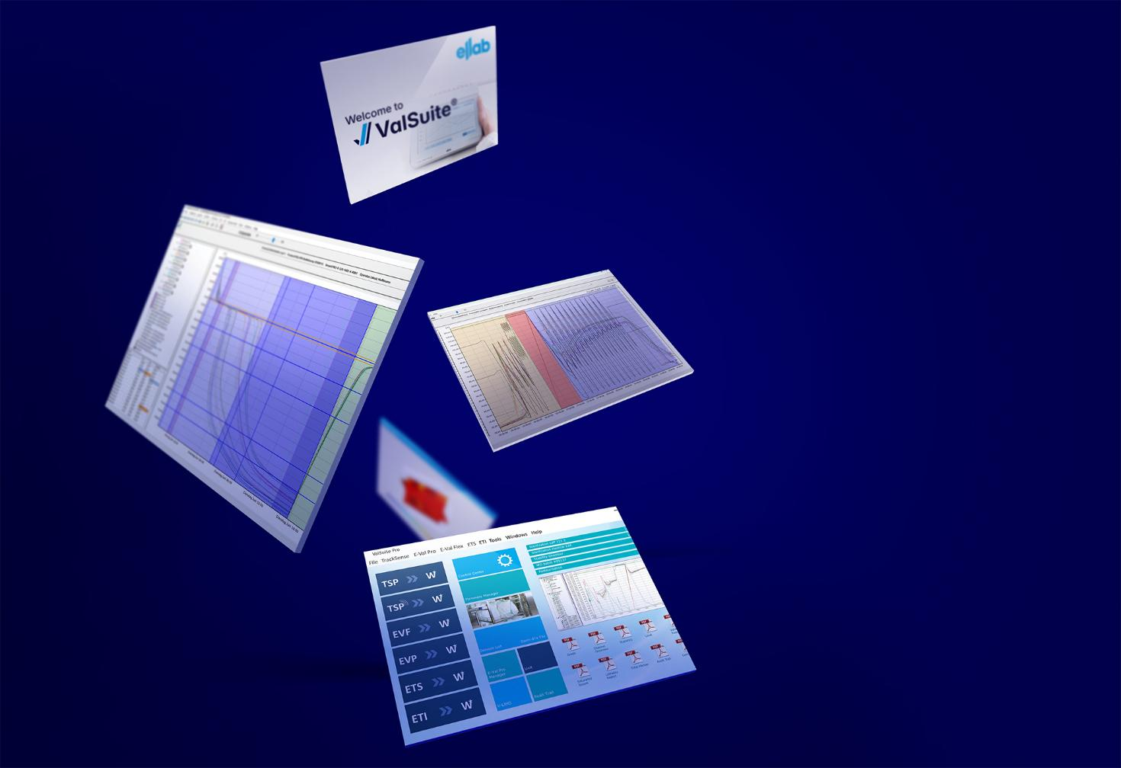
ValSuite® Highlights
Validation Software
Only access for authorized personnel
Standalone ValSuite security
Windows AD integrated security platform
FDA 21 CFR part 11, ISO9001 and GAMP 5 compliant
Security Modes & Access Manager – 2 security formats
Data cannot be tampered
Session data stored in MS SQL database (formatted as a BLOB in a V8x file, with CRC checks)
Supported with secure communication protocols (TLS 1.2 & LDAPS)
Database Design
Full traceability of actions (who, what, when)
Support 222 critical transactions within the software
Users can add comments to audit trail facilitating quality reviews (QA & external auditor)
Audit Trail
Secures digital approval by everyone involved in workflow
Specialized report for approval flow
More than 30 different analytic tools and reports
Electronic Signature
Numerous reports for data analysis
Your Life Science
Compliance
Partner
Notes:
All those services if done by our teams or the customers teams, are supported by the best software on the market for thermal validation projects.
Easy setup and various installation options to meet the customers requirements.
Compliant to the global standards.
Quick results & fast evaluation as well as compatibility with 3rd party validation software like KNEAT.
A real time saver, as you can repeat studies easily or start them with out any setup. You also can work offline and at the same time do reports somewhere else with the dual dynamic installation.

Slide 4
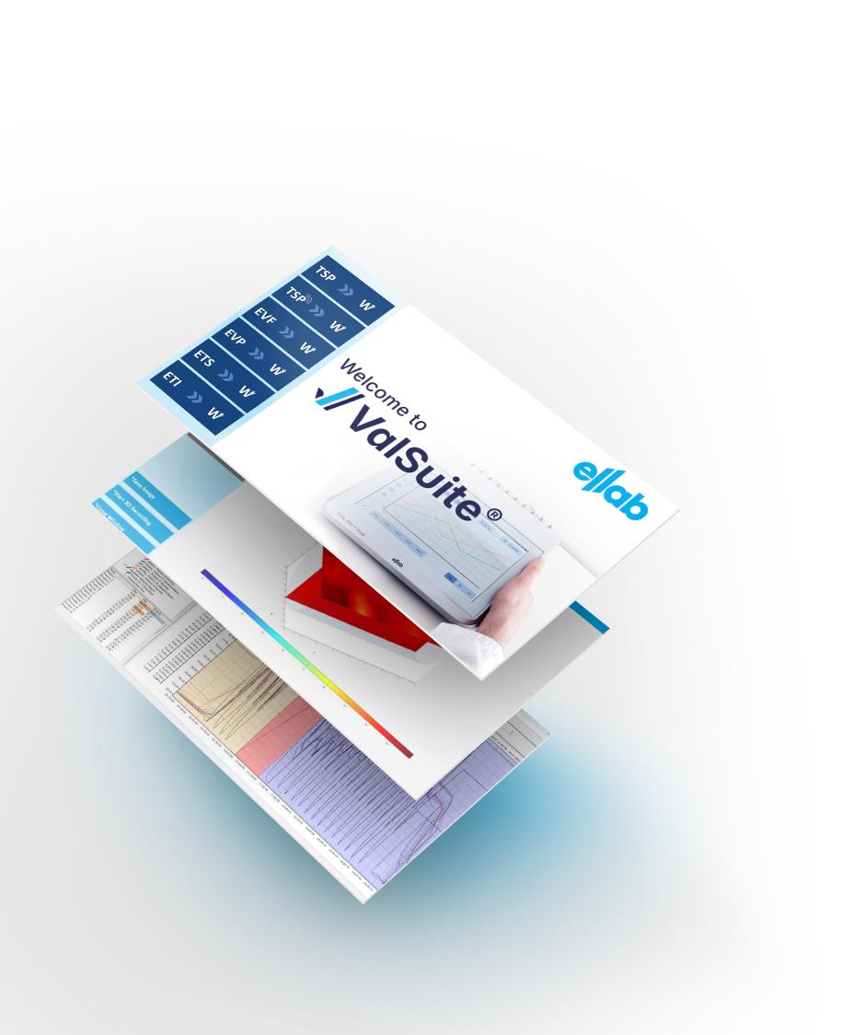

Validation Software
  More than 5000
  ValSuite installations Worldwide
IQ/OQ documentation included in delivery
Customer Support: Ellab Software Support Team
Notes:
Regarding PQ: In a PQ test, our equipment operates in its real process environment. This usually isn't part of our default scope unless our field service is engaged. Typically, we provide IQ/OQ, and for this purpose, we have defined products:
1: Template free of use, on the memory stick.
2: Generic protocol product No. 31182050
3: Validation of customer equipment, not sure of number.

Slide 5

Client/Server Installation
Validation Software
Central Storage
Enables central storage in one database of all sessions conducted
Many devices, one server
Several PCs/clients can be connected to the same server, hence access to all data at same time
Access All Data, Everywhere
Allows all studies from various operators / venues to be accessed centrally on main server
Auto-transfer of remote sessions
PCs used remotely during session acquisition, upon reconnecting, will auto transfer and send all new sessions to the server
Notes:
Site where all users are connected to the Software.
Ellab has different server setups available:
1: Microsoft SQL Server/client setup
2: Microsoft SQL Server/client setup with Dual Dynamic Database (includes users not always on the company network)
3: Citrix installation

Slide 6
Software Architecture
Validation Software
ValSuite consists of 2 components
System installation:
ValSuite Client („Fat-Client“)
Database
Database (Microsoft SQL-Server)
There are no additional components required
No services (besides SQL-Server)

Slide 7

Default Installation - Local
Validation Software
Each computer has ValSuite installed
System installation:
ValSuite and Database on the same device
Database backup
Fully automated per backup job
(Database Backup-plan)
Manually on demand, e.g. USB drive

Slide 8

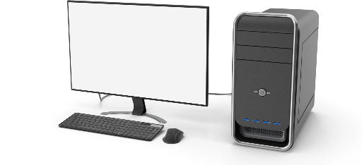
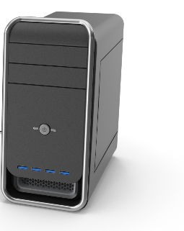
Server-Client Installation
Validation Software
System installation:
ValSuite Client running on client PCs
Database backup
On Server

Slide 9

Server-Portable-Client Installation
Validation Software
VPN
System installation:
Installed on laptop
Database backup
Database running on local laptop
Centralized database on server
Data regularly transmitted to server via Auto-transfer-tool

Slide 10

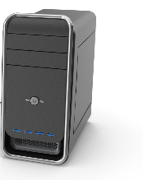

Connecting Remote Sites via VPN
Validation Software
With a VPN, several sites in different locations can be connected.
VPN
Citrix
SQL-DB

Slide 11
Mixed Configuration
Validation Software
ValSuite is flexible to combine several setups
VPN

Slide 12
Server-Client Installation
Validation Software
WMWare
Database
AD Groups Security
Client
ValSuite
Client
ValSuite
Client
ValSuite
Reader Station
Reader Station
E-Val Pro plus
E-Val Pro plus
ETS
Bath
USB
Ethernet
RS232

Slide 13


