Slide 1
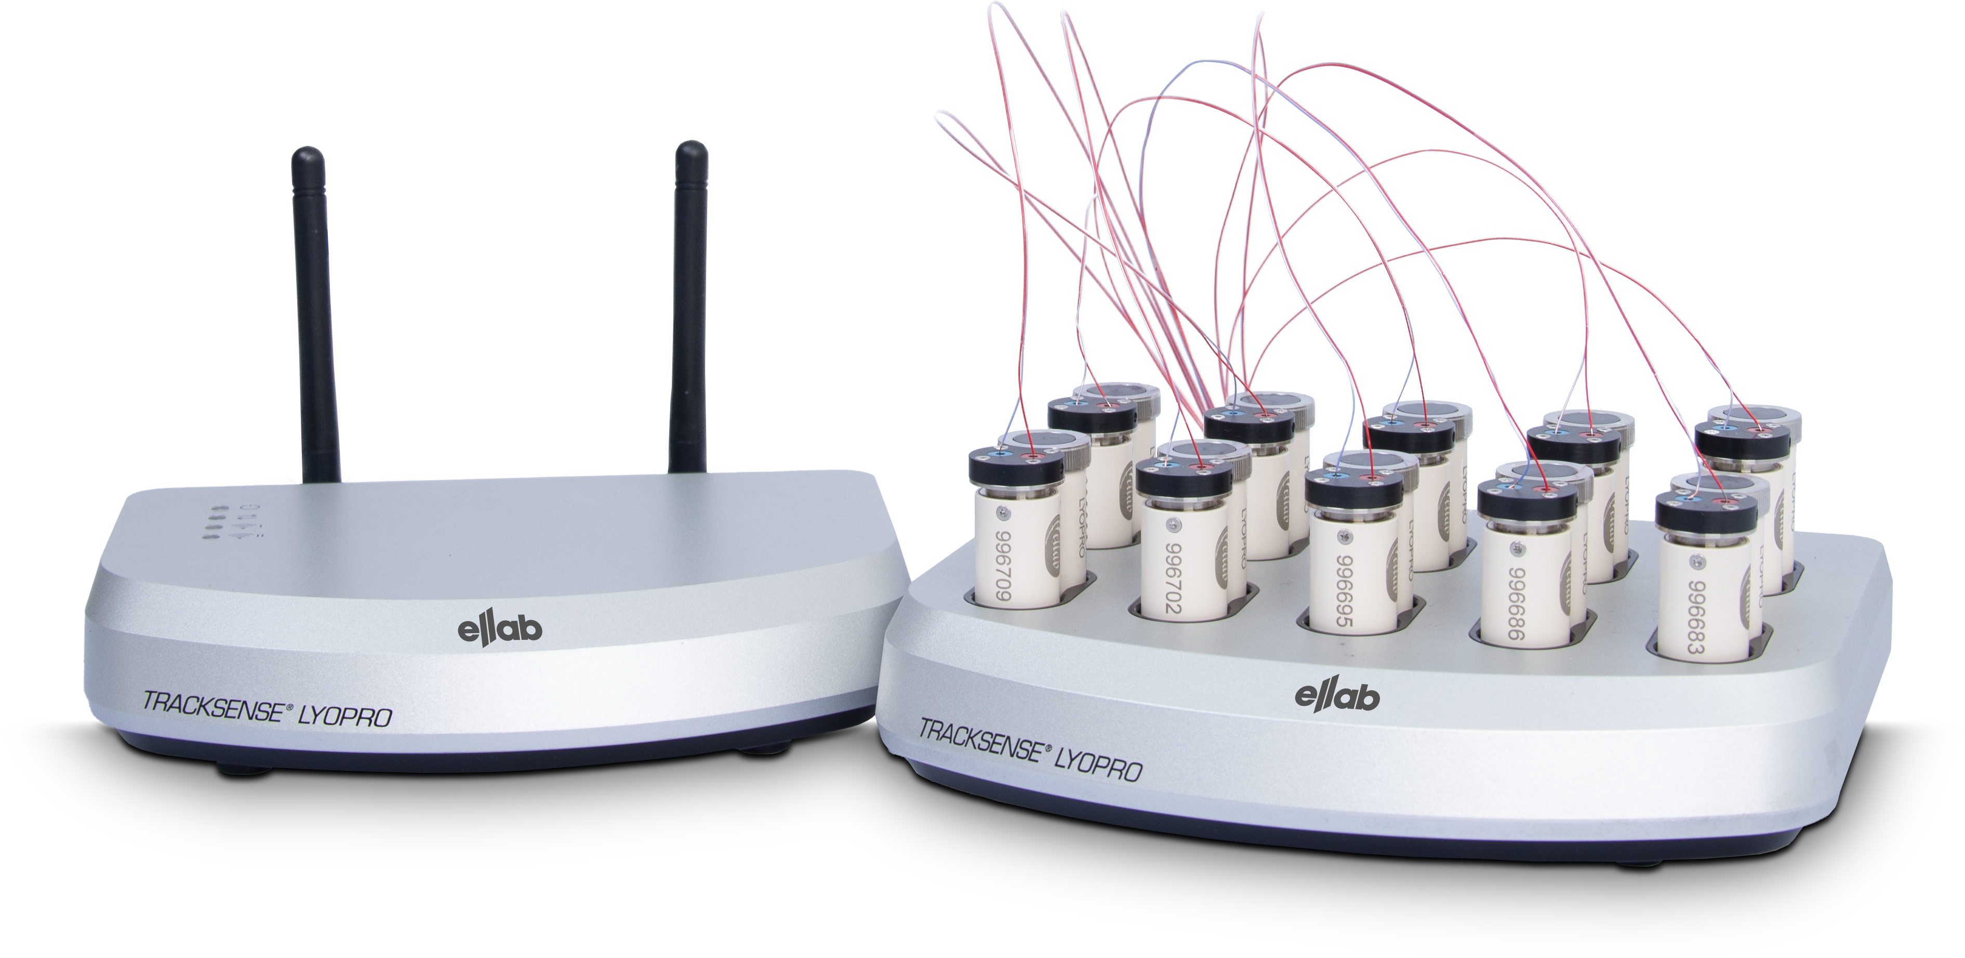
TrackSense® LyoPro
A new approach to batch control and validation of ALUS operated lyophilizers – the LyoPro concept from Ellab!

Slide 2

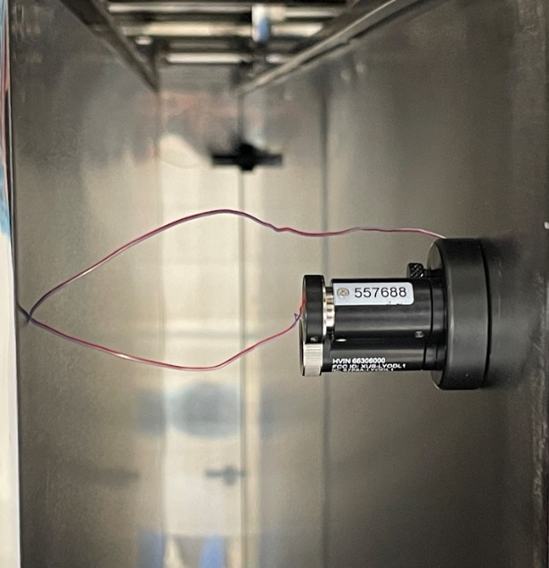
Agenda
A new approach to batch control and validation of ALUS operated lyophilizers – the LyoPro concept from Ellab!
1. Introduction to Ellab A/S
2. Why was LyoPro developed?
3. The advantages of the LyoPro System. Technical Highlights
4. The ValSuite Software. Features for Freeze Drying

Slide 3
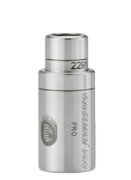
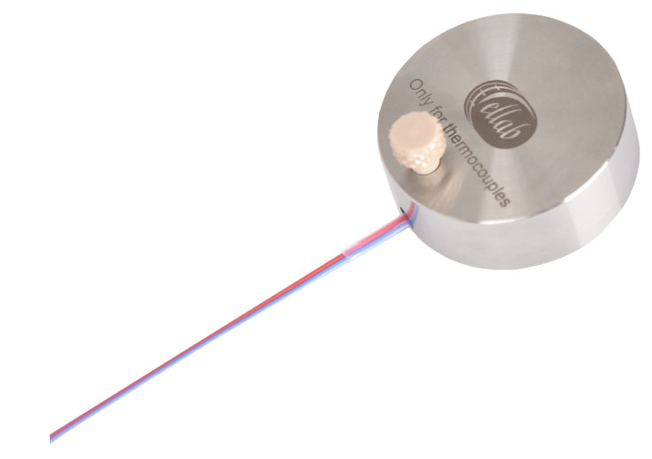
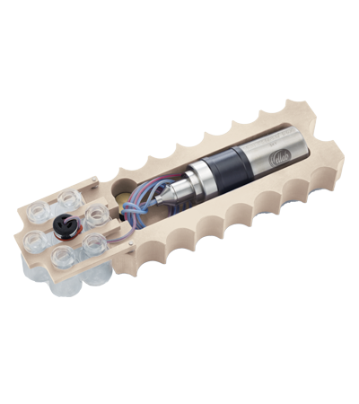
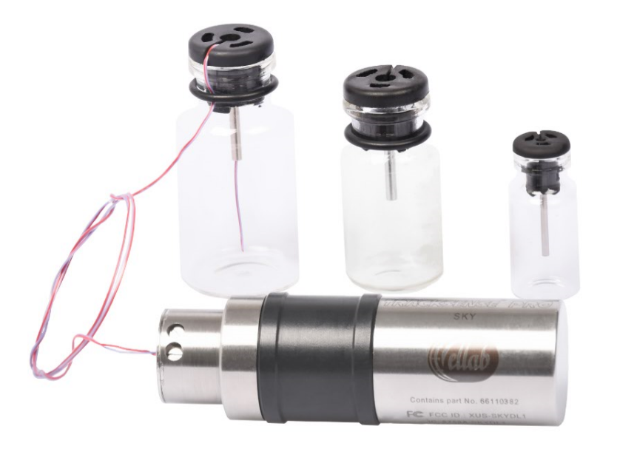
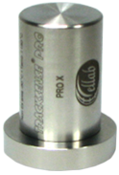
Pre LyoPro Offering – Freeze Drying
The TrackSense® Pro Solution – already more than 15 years of experience with Freeze Drying
Temperature Thermocouple Sensor
Contact Puck
Vacuum Sensor
Sky Module
LYO Stopper
LYO Shuttle

Slide 4
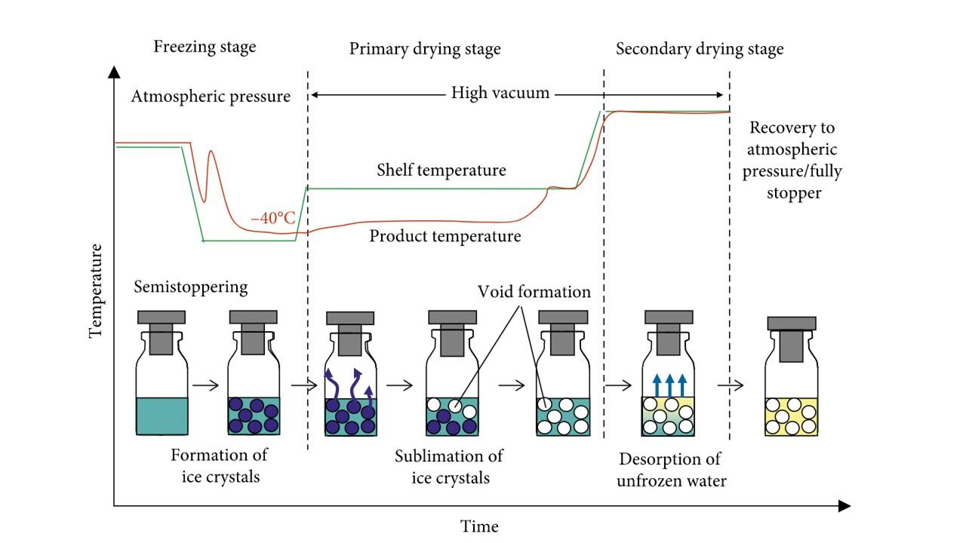
Why TrackSense® LyoPro has been developed
In order to optimize the freeze-drying process and to protect the batch, it is beneficial to know the temperature of the product inside selected vials as this data can avoid failures and determine when to stop the primary drying phase, which can save a lot of energy & time (costs)
All new pharmaceutical freeze dryers use automatic loading systems (ALUS), which means they prefer to be able to add the sensors before the vials are loaded onto the freeze dryer
All freeze dryers need to be validated regularly according to ISO 13408-3 norm which involves tests at various temperatures and pressures / vacuum simulating the actual process involving lots of measuring points (as high as 5 per shelf on ALL shelves)

Slide 5
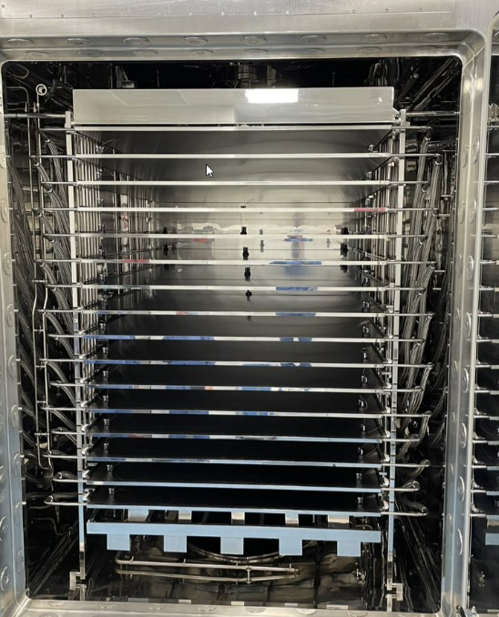
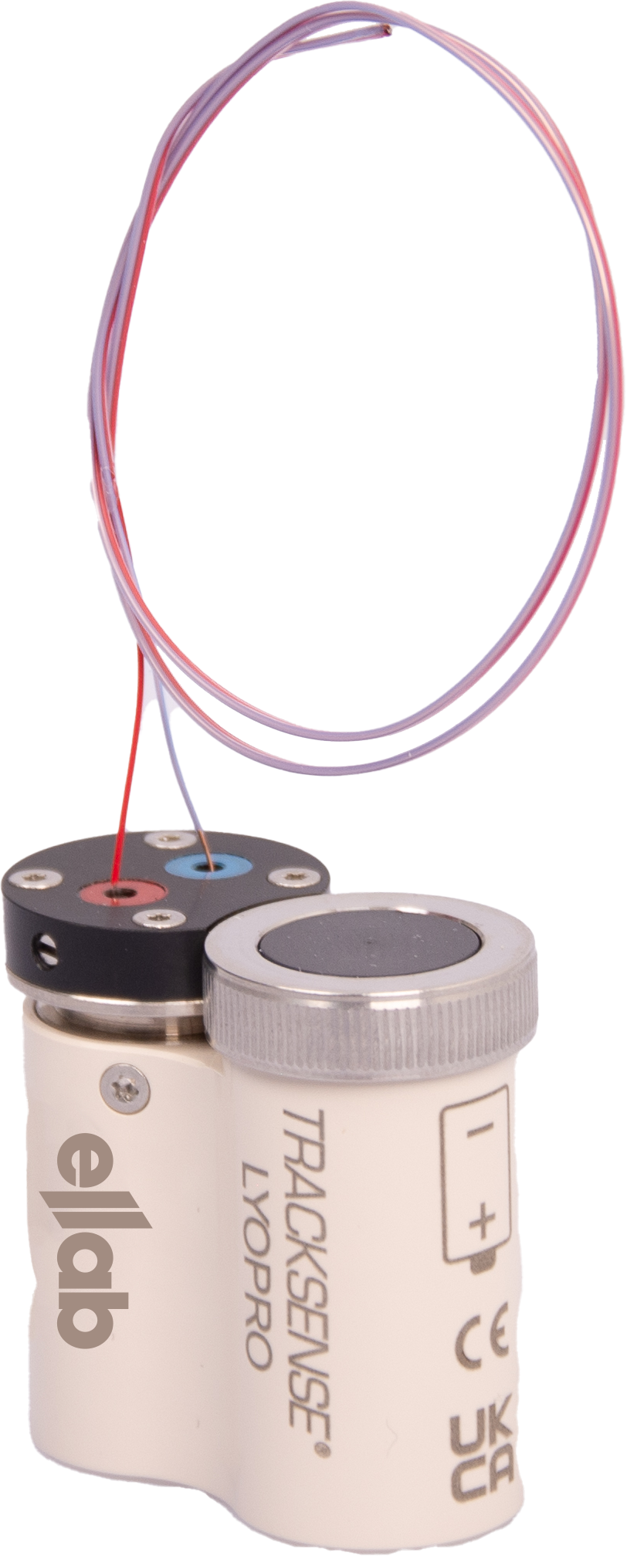
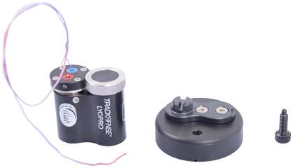
Why TrackSense® LyoPro has been developed
Temperature Measurement Challenges in Lyophilization
High vacuum leads to thermal resistance as most of the energy is transmitted by radiation, which make the use of conventional contact sensors problematic unless they are designed for the purpose
The temperature accuracy of the measurements can also be a challenge: Is it the real shelf temperature – or relative (and reproduceable) temperature, which is measured
If the shelf mapping relies on the relative temperature, it might lead to longer process time or loss of batches

Slide 6
Why TrackSense® LyoPro has been developed
Specific reasons - what we found missing:
Market needs sensors that do not affect the product temperature (much!) why they need to be tiny - and it should be able for clients to calibrate the sensors on site pre- and post to actual process.
Market needs simultaneous on-line measurements from +100 measurement points to cover even large production units in one take
Market requires data transmission BUT ALSO logging to battery operated memory to be fully FDA compliant (validation requirement)
Market needs one single datalogger system fitting all vial sizes
Market requires advanced Validation and Monitoring Software offering all sorts of analytical tools and reports without having to export data

Slide 7
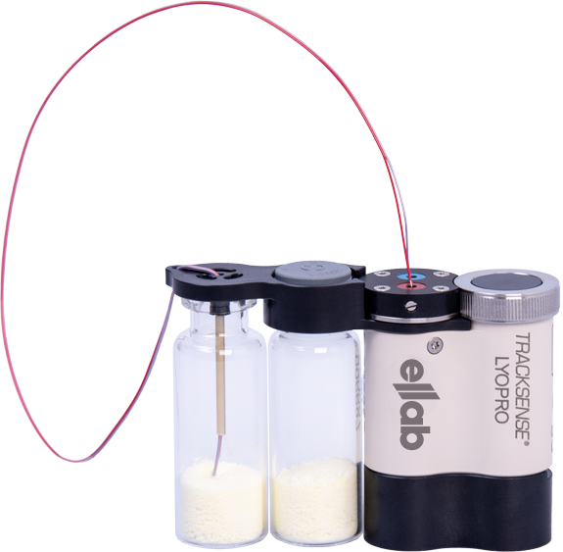
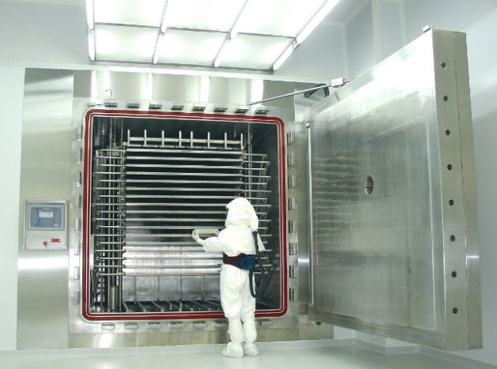
Why TrackSense® LyoPro has been developed
What we found was important for the measurement system design:
Non-conductive, minimally invasive, non-self-heating and flexible sensors with a single point measuring tip
The temperature sensors should ideally be connected to wireless data loggers, as feeding the inside of the chamber with sensors from the outside using a traditional feed-through system, may jeopardize the integrity of the vacuum sealed chamber
The wireless data logger design should be small and ideally match the vials in both height and diameter. This would make it ideal for systems with automatic vial loading and unloading systems (ALUS) – which are commonly used during the manufacturing of pharmaceuticals
The wireless data loggers must be capable of working completely unattended for several days to cover the typical length of freeze-drying cycles – while also measuring, storing and displaying data in real time
The wireless data loggers should ideally be able to measure both sample temperature as well as shelf temperature

Slide 8
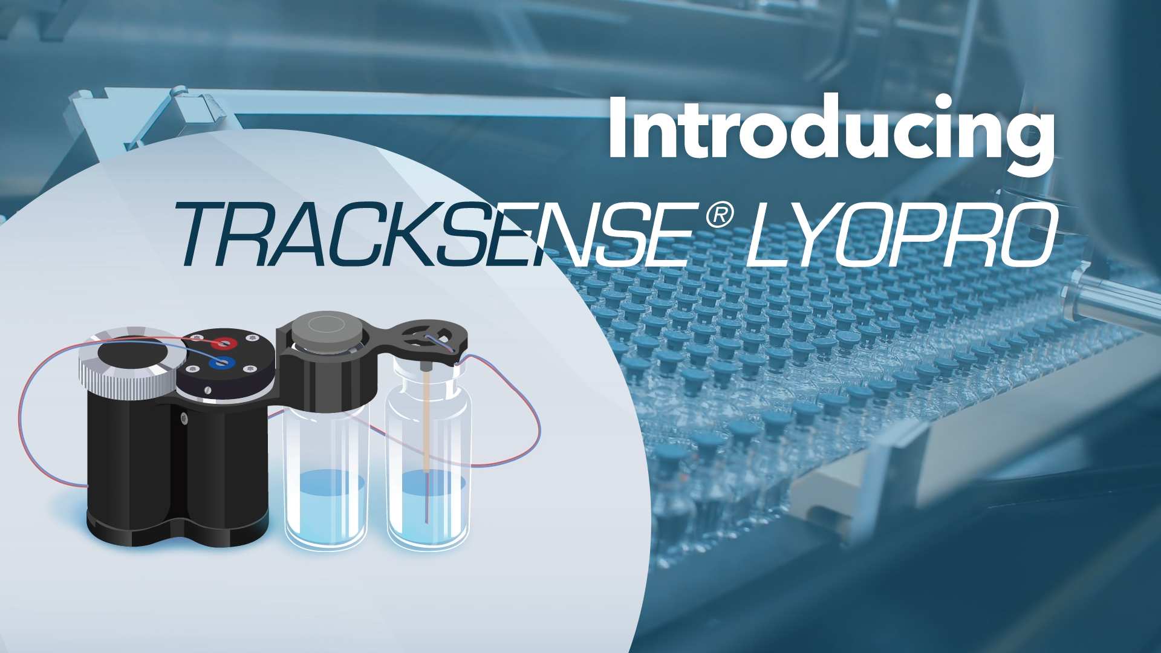

Slide 9
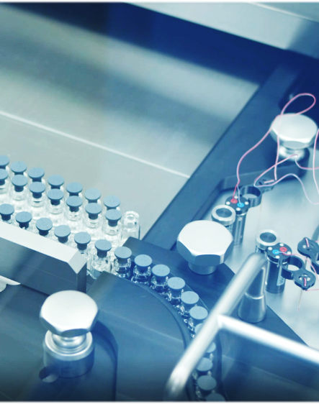
TrackSense® LyoPro – Ideal for Product Monitoring
Why? - Easy to handle and place in in sterile environments
Designed for automatic loading and unloading The design simulating the shape of vial allows for full integration within the vials on the shelf
The design allows for robotic handling For flexible attachment of logger to vial
Integrates sensor position into vial
Allows for buffer vial

Slide 10
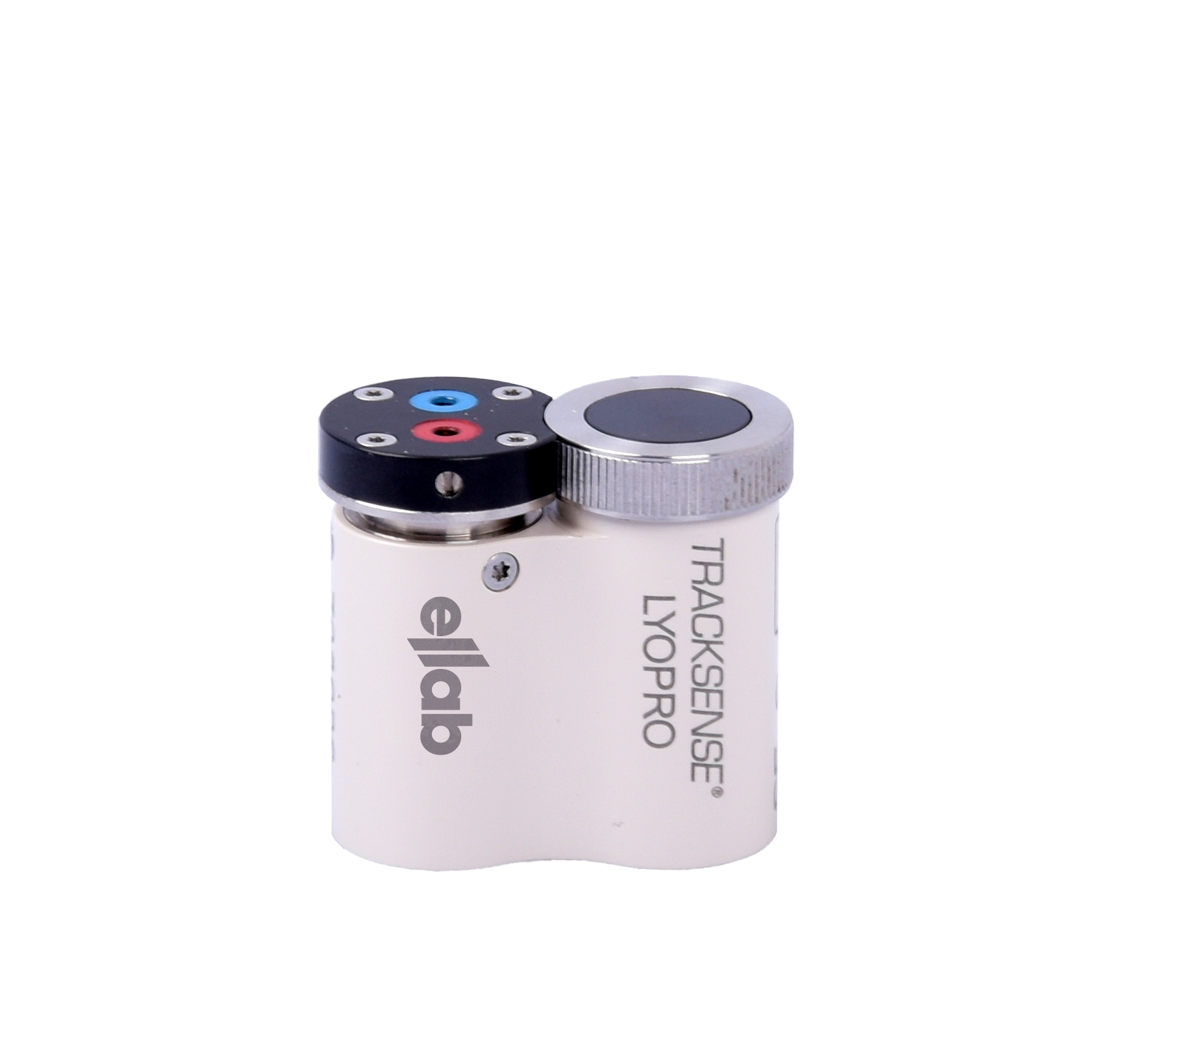
TrackSense® LyoPro – Ideal for Product Monitoring
Why? - LyoPro is a data logger – not just a data transmitter
LyoPro is a data logger – not just a data transmitter Battery operated memory eliminates data gaps which would otherwise jeopardize FDA 21 CFR Part 11 compliance
LyoPro is compact – same logger fits all sizes of vials
Replaces only a few vials and ensures maximum yield
LyoPro temperature sensor is tiny – using the thermocouple technology
No or very little impact on measurement
LyoPro can be multiplied – software accommodates 100+ loggers in same study No need for running multiple studies to cover entire chamber

Slide 11
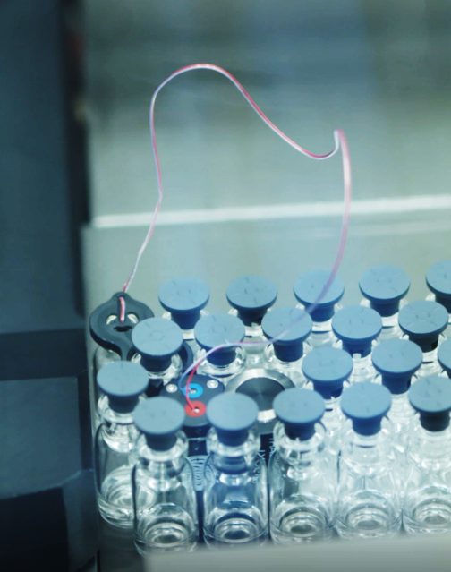
TrackSense® LyoPro – Ideal for Product Monitoring
Why? – Enables logging of LIVE Data
LyoPro system has several RF transmitters embedded in basic design Ensures fast and safe transmission of data between logger, access point and software
Long range Access Point required as only additional equipment Placed outside the freeze-drying chamber:
No chamber leak, no cables needed inside
No need for chamber modification
No thermal impact from extra mass

Slide 12
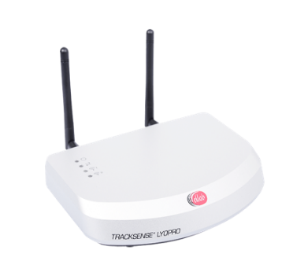
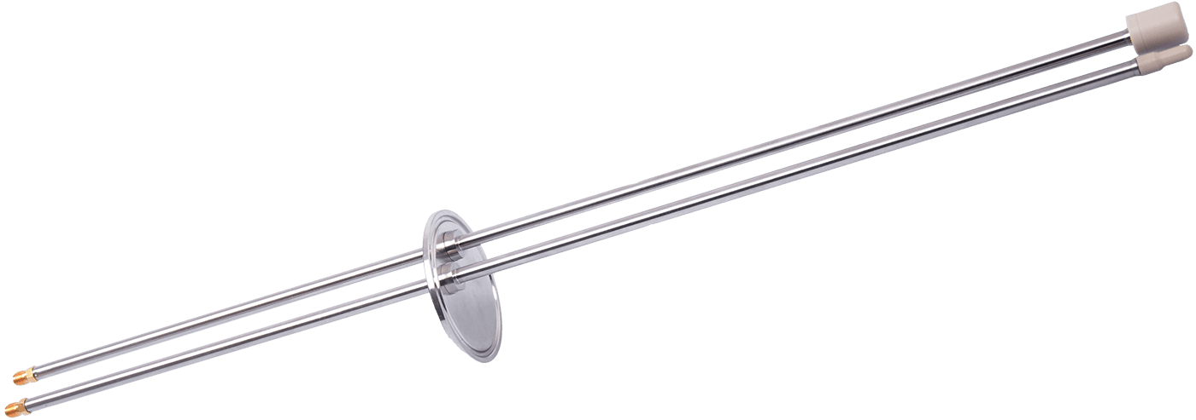
TrackSense® LyoPro – Ideal for Product Monitoring
Why? – Upto 100 loggers in a LIVE data study
Real time data
Increased response time to save valuable batches
Dual antenna
Improved areal coverage and signal strength
Proprietary data communication protocol secures no data interference with other devices

Slide 13
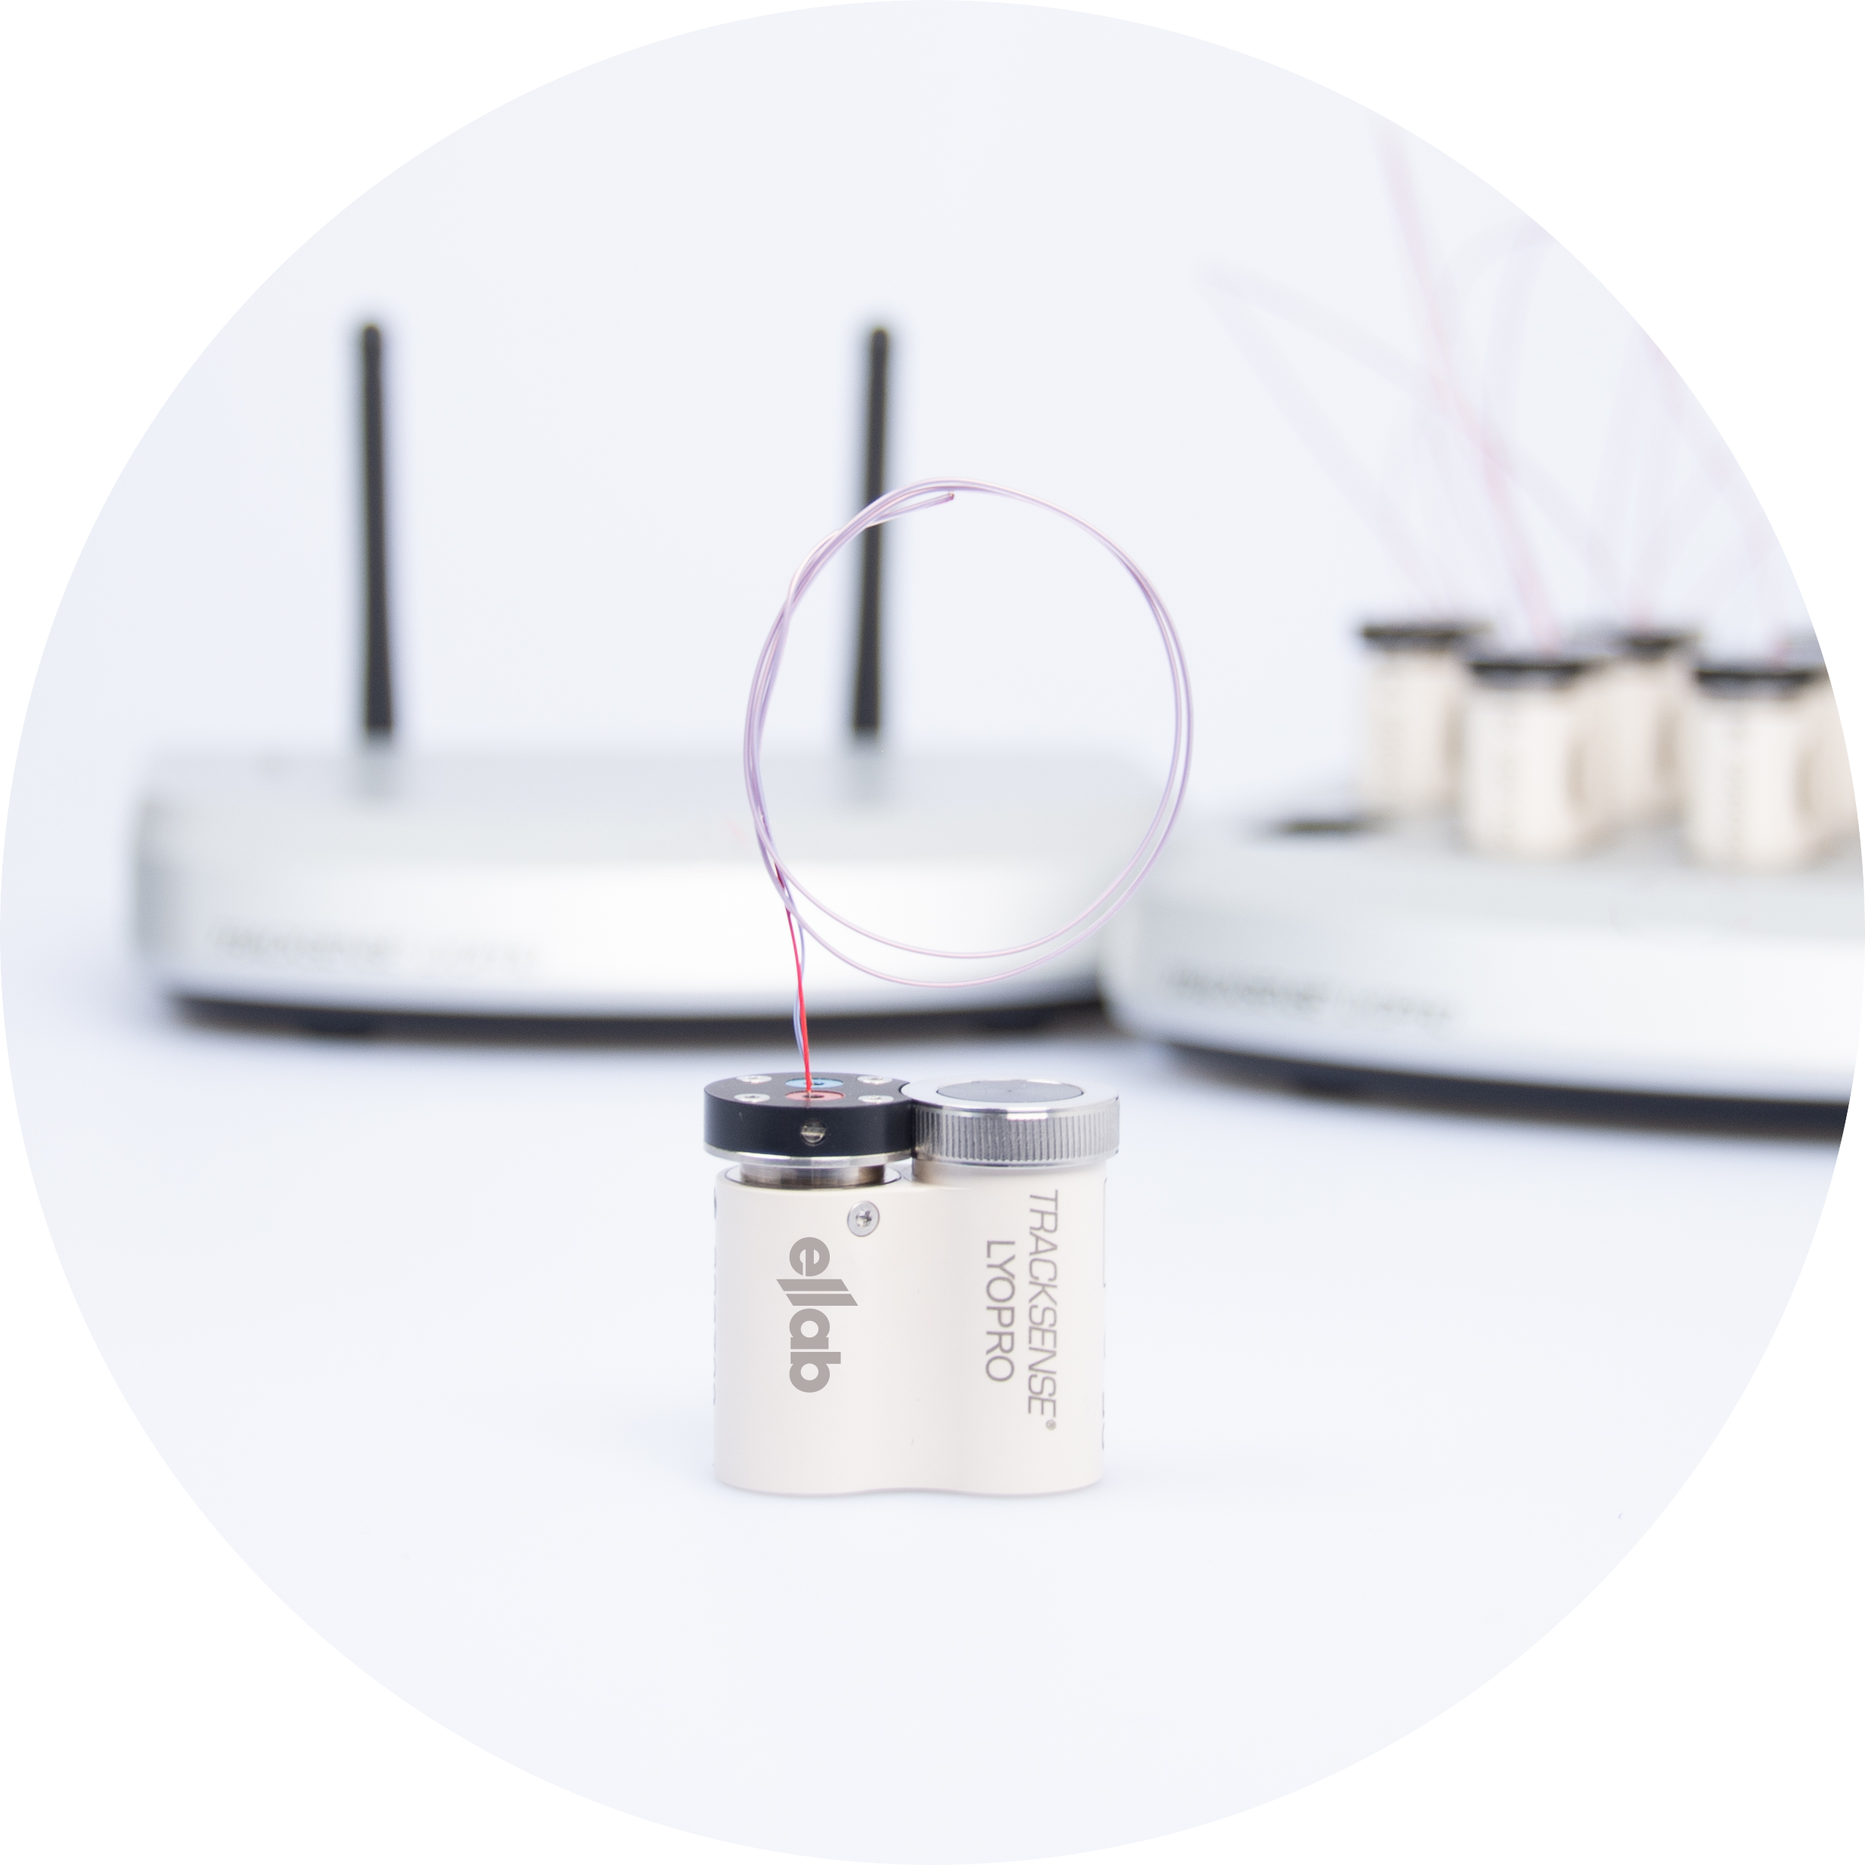
TrackSense® LyoPro – Ideal for Process Validation
Why? - No data gaps from start to finish
LyoPro is a real datalogger with memory – and not only a data transmitter
Maintaining the highest data integrity
No data gaps
Full FDA 21 CFR part 11 compliance
Allows same data logger technology from R&D to production

Slide 14
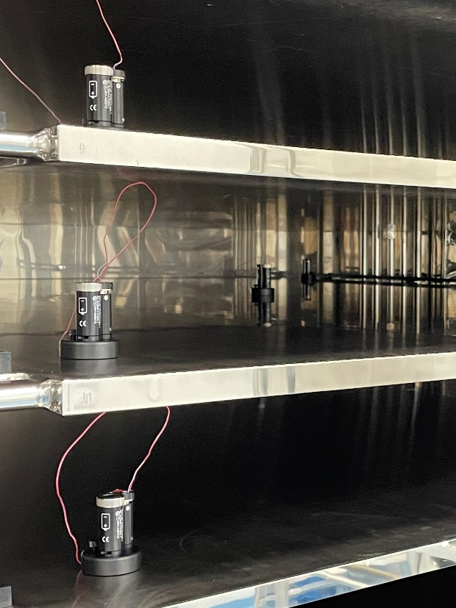
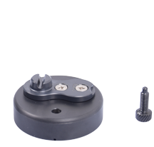
TrackSense® LyoPro – Ideal for Shelf Mapping
Why? - More than 100 loggers in one study
Full study in one session
No merging of split studies necessary to get the full overview when analyzing data
Shelf mapping of up to 20 shelves each 5 measuring points in one go Typical recommended positions are in 4 corners & center on each shelf

Slide 15
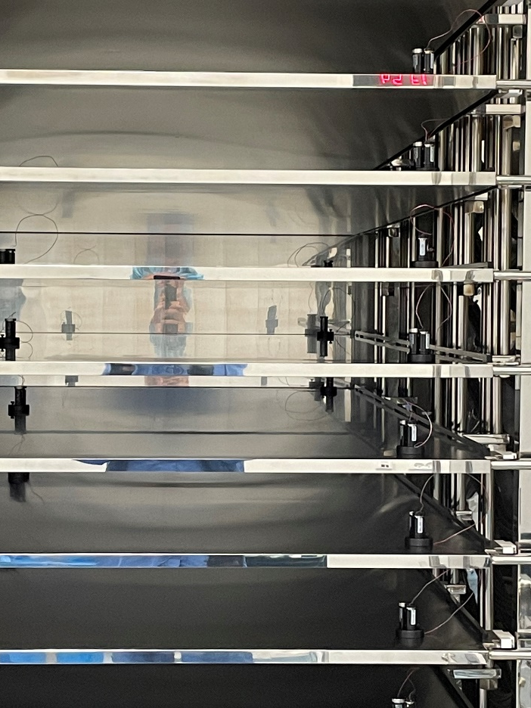
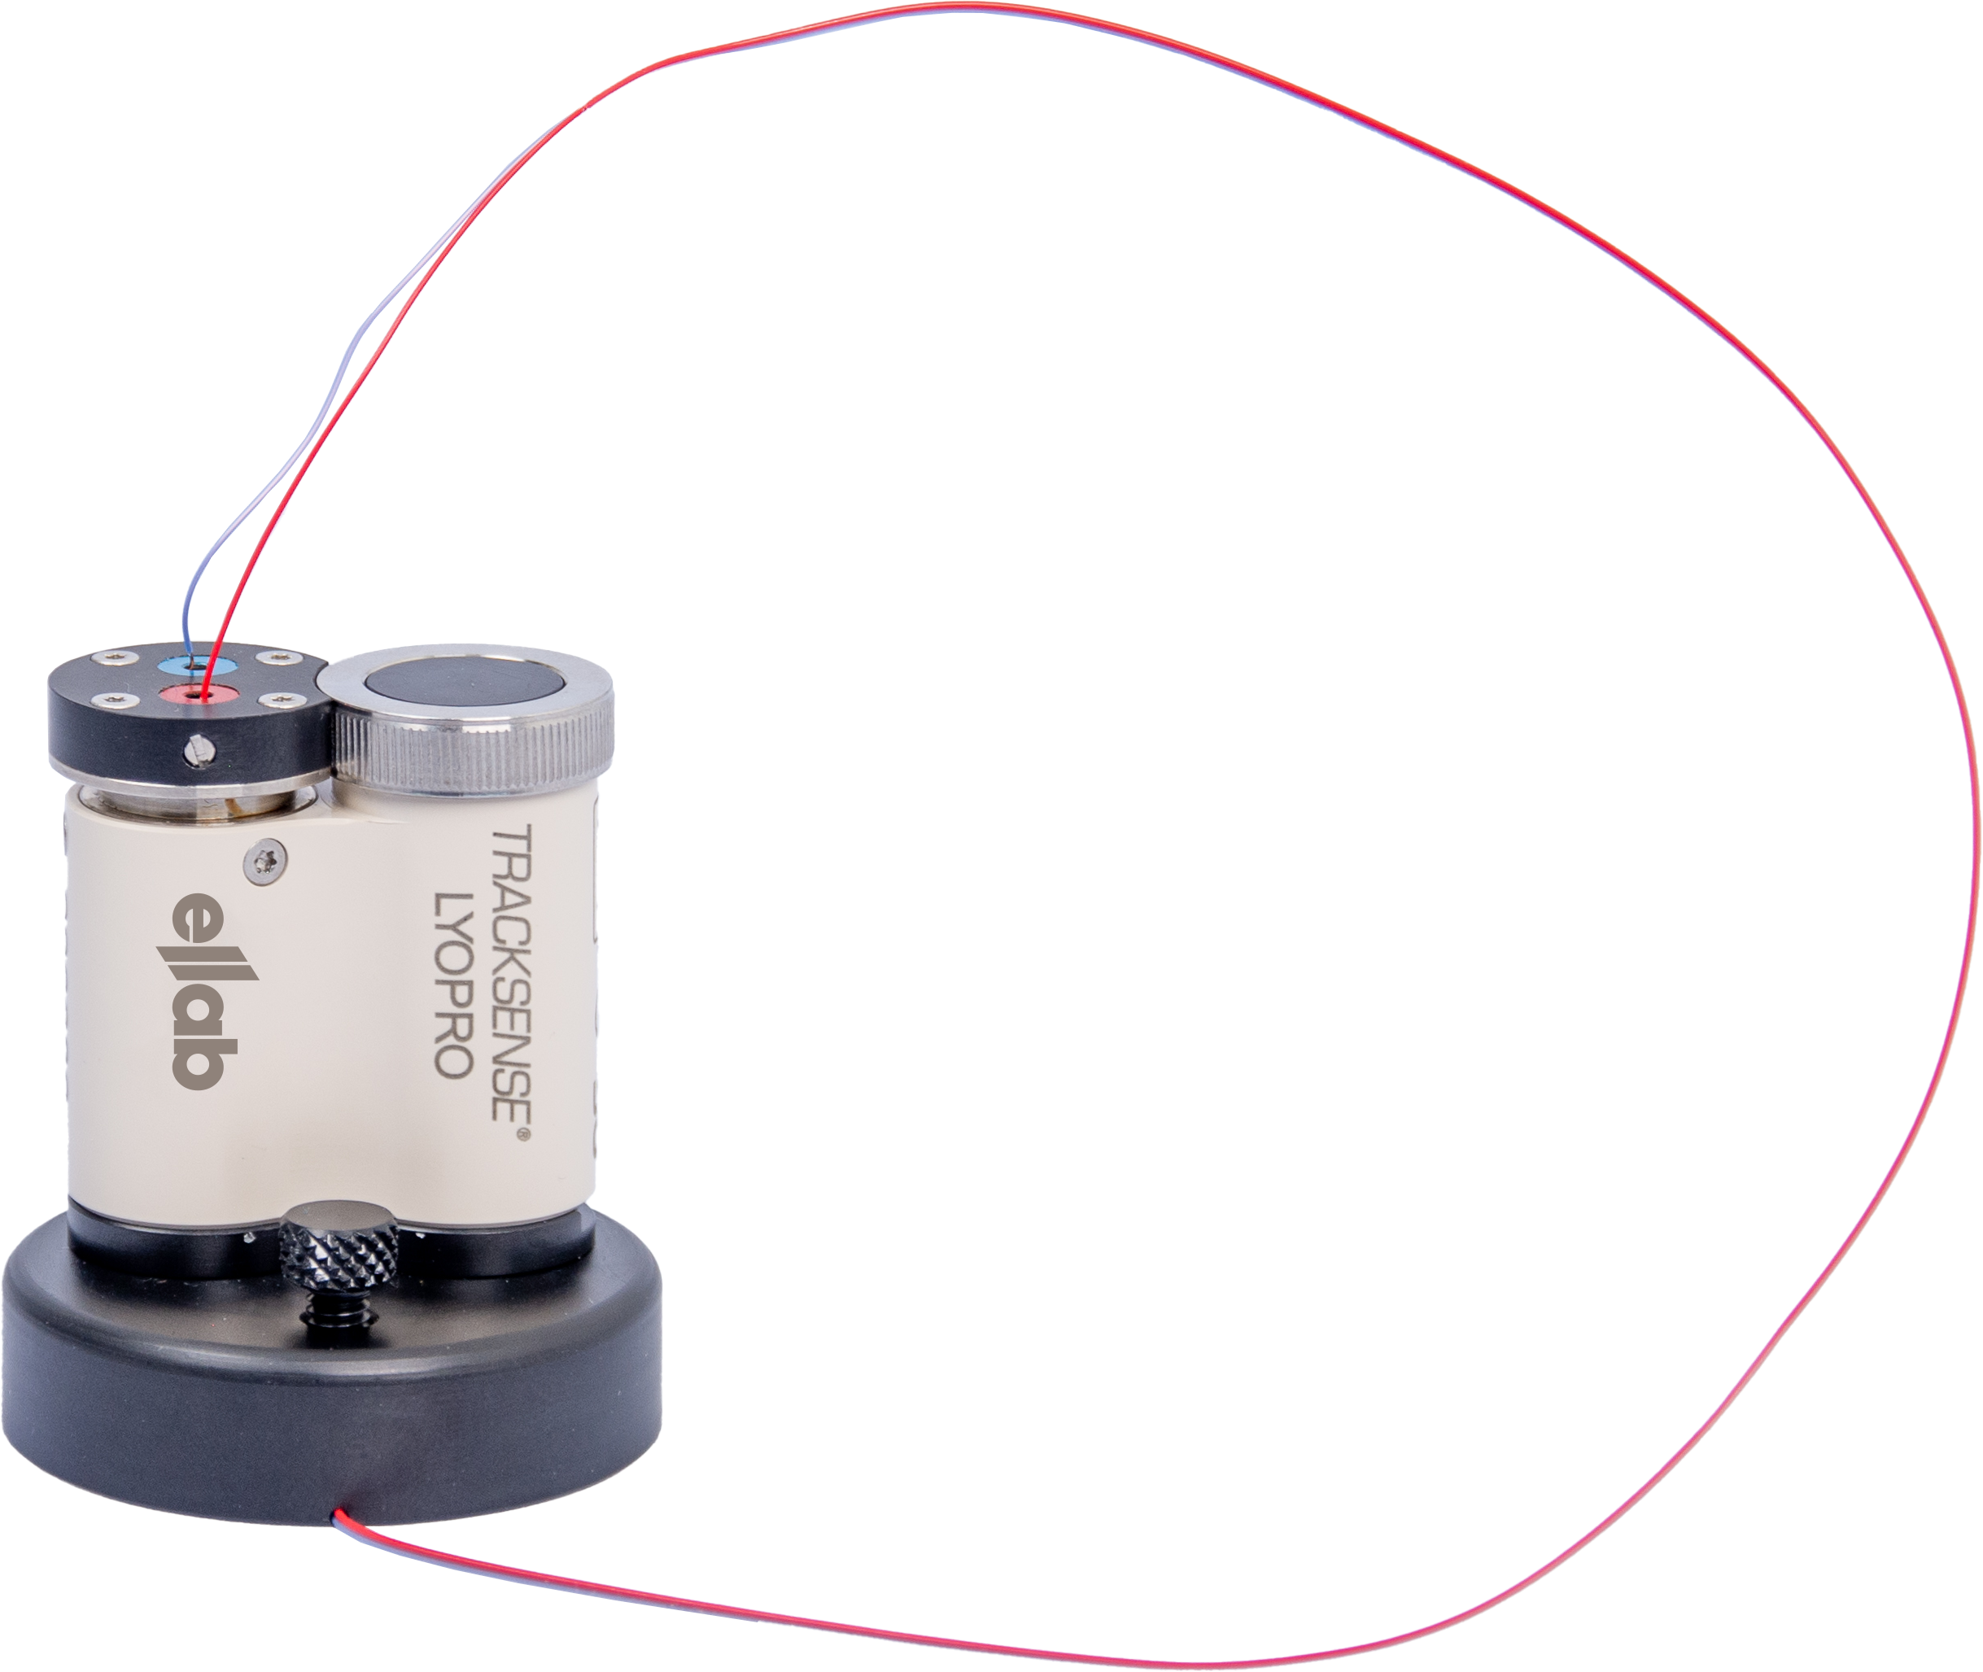
TrackSense® LyoPro – Ideal for Shelf Mapping
Why? – LyoPuck, a contact puck that measures the real shelf temperature
Designed for measuring the shelf temperature by attaching the LyoPro data logger to the LyoPuck
Inserting the thermocouple sensor in the bottom of the device that ensures the measuring tip is placed against the shelf in question
The designed allows Easily repeatable for consistent and accurate measurements
Eliminates bulky and homemade alternatives
Offers excellent performance at ambient conditions as well as during vacuum
Made of PEEK material and Stainless Steel 316L

Slide 16
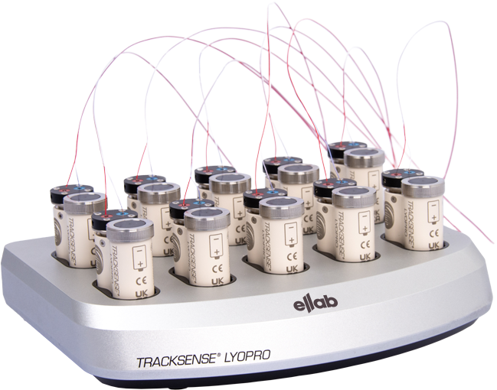
TrackSense® LyoPro - Technical Highlights
Main Specifications & Advantages

Slide 17
TrackSense® LyoPro - Technical Highlights
Materials, Dimension and Range
Logger made of PEEK with EPDM O-rings FDA Compliance materials only.
Build-In aerial transmitter for RF communication.
Compact Design: Logger Dimensions 32 x ø16 mm (housing) /ø18 mm (lid) Same dimensions as a 2R vial. Maximum yield thus minimal loss of production profit as only few active samples are replaced during tests.
Operational Range Temperature Range -62 to +62°C (can be sterilized)
Temperature Accuracy +/- 0.3°C

Slide 18
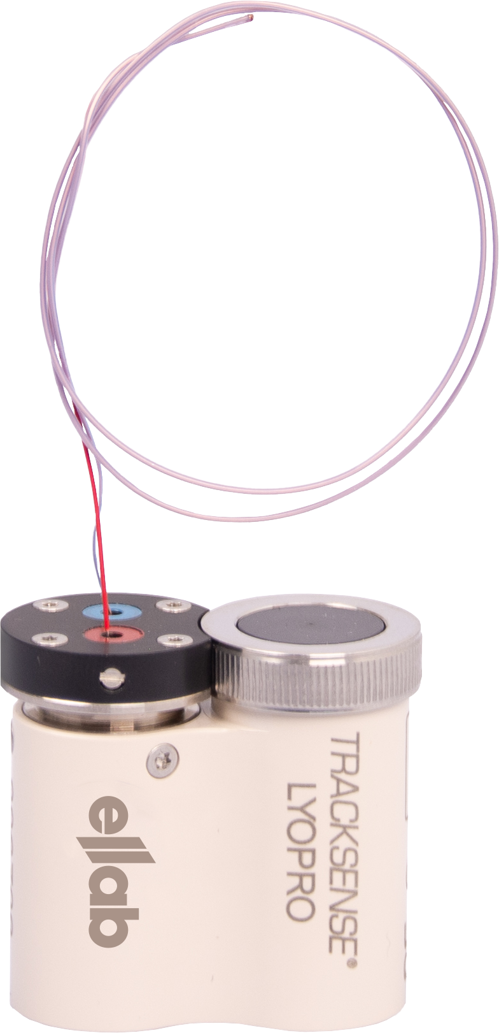
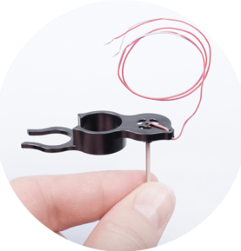
TrackSense® LyoPro - Technical Highlights
Pinpoint accuracy with fast response time and minimal impact on measurements
Easy to place sensor in correct position
Sensor dimension of only 0.55 x 0.95 mm TC cable (30 cm) mounted by screw terminals
Ultra thin thermocouple design
Can be locked by design of StopperClip for repeatability No tools required
User calibrated for optimum accuracy and elimination of down time

Slide 19
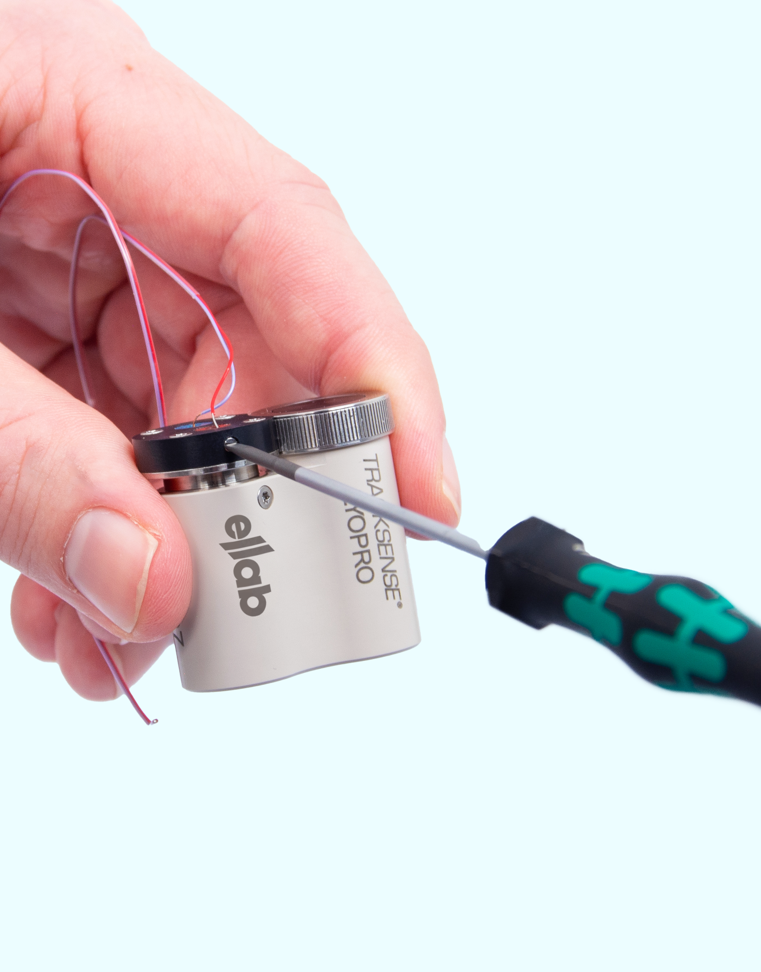
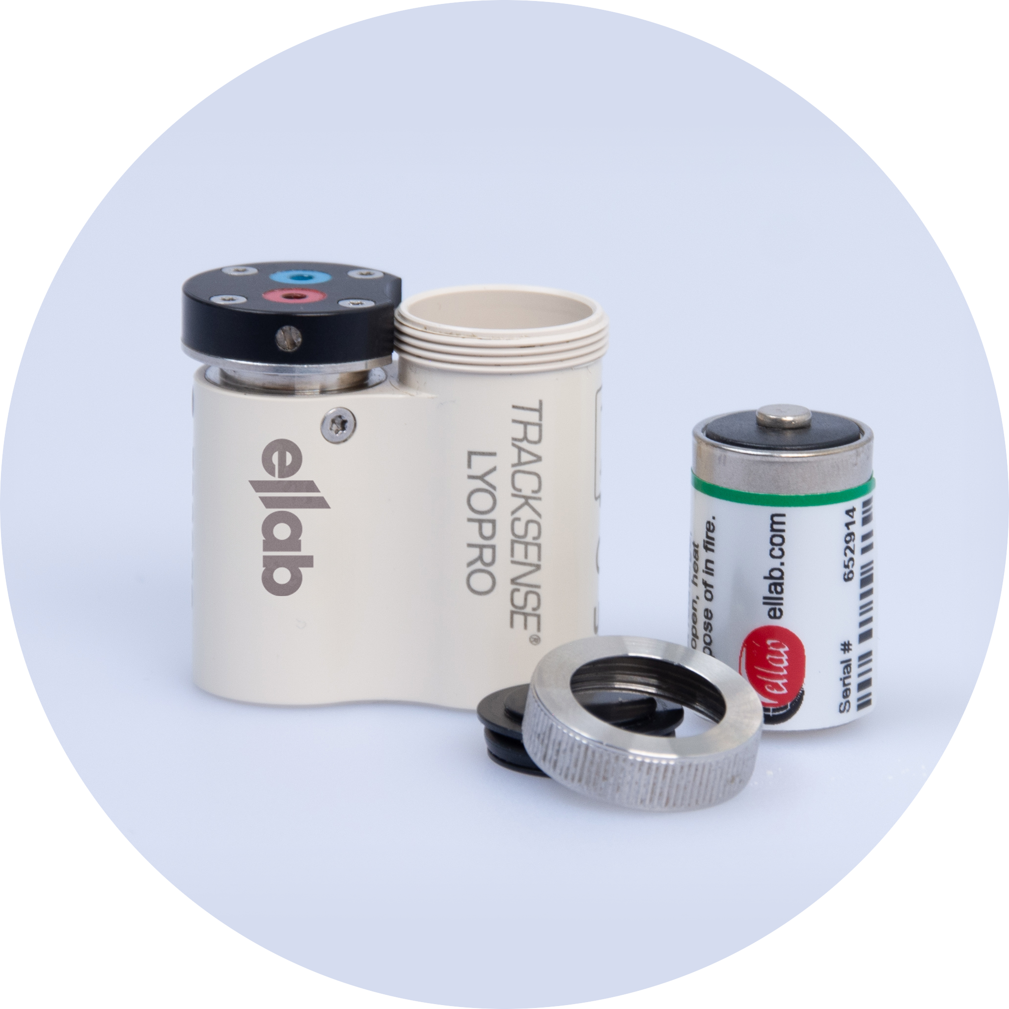
TrackSense® LyoPro - Technical Highlights
Battery operated storage with capacity of 100.000 samples
High storage capacity covering even lengthy studies with fast sample rate
Sensor dimension of only 0.55 x 0.95 mm Memory Capacity 100.000 Samples
Equals ~ 28 hours / 1 sec sample rate
Equals ~ 833 hours (35 days) / 30 sec sample rate
Battery Details Same Li battery technology as for all other Ellab loggers
> 20 years experience ensures liability
2400 hours of operation @-60°C / 30 sec sample rate
Easily replaceable

Slide 20
TrackSense® LyoPro - Technical Highlights
Size | Capacity (ml) | Percentage of total LYO vial on the market
2R | 4 | 25,0%
4R | 6 | 5,0%
6R | 10 | 12,5%
8R | 11.5 | 5,0%
10R | 13.5 | 15,0%
15R | 19 | 5,0%
20R | 26 | 10,0%
25R | 32.5 | 5,0%
30R | 37.5 | 5,0%
50R | 62 | 7,5%
100R | 123 | 5,0%
Total |  | 100%
Fits all vials from 2R to 100R as well as custom vials
Same logger for all vials Individual configuration using Logger Nest and Stopper Clip
No additional investment except accessories Keeps investment costs at a minimum

Slide 21
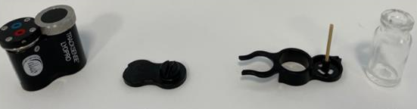
TrackSense® LyoPro - Technical Highlights
Configuration - What is required for a complete 2R system using StopperClip
1. LyoPro Logger with TC sensor
2. 2R Logger Nest
3. StopperClip
4. Vial 2R w/o rubber stopper

Slide 22
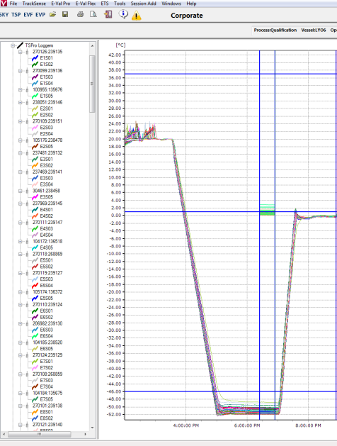
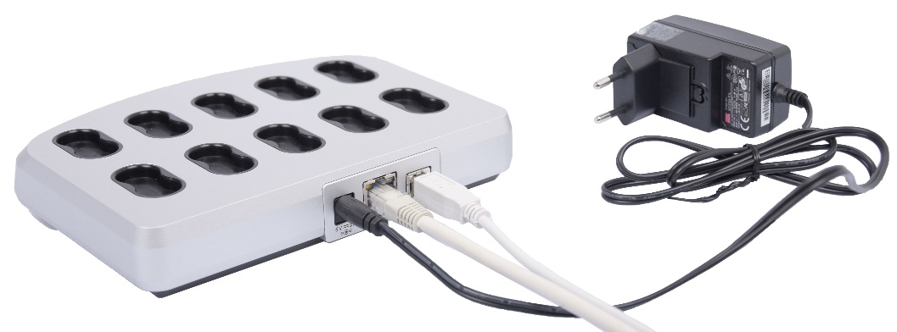
TrackSense® LyoPro - Technical Highlights
More than 100 loggers in one study
Se10 position reader station for quick startup
All 10 first loggers will have same time stamp
Further loggers will be time synchronized when added
Full study in one session
No merging of split studies necessary to get the full overview when analyzing data

Slide 23
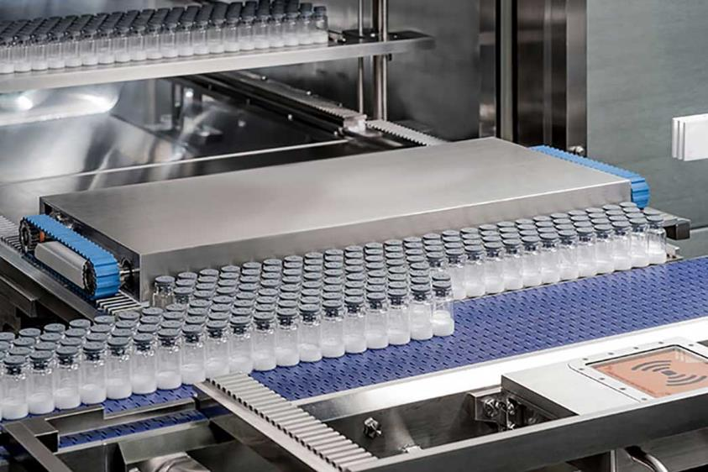
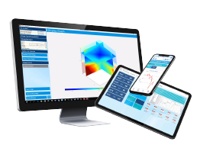
ValSuite Software Features
For Freeze Drying

Slide 24
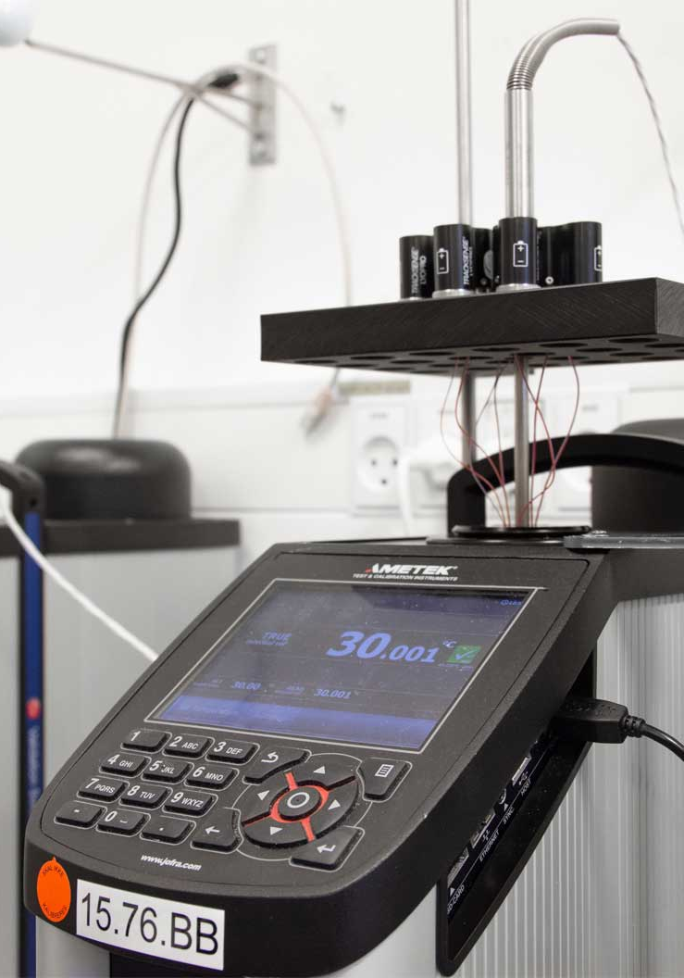
TrackSense® LyoPro - ValSuite Software Highlights
User Calibration
No need to send back loggers to get performance assurance eliminating downtime
Easy exchangeable long thermocouple sensors fit perfectly into wells
Calibration coefficients and constants saved in software – user calibration offsets are stored in software

Slide 25

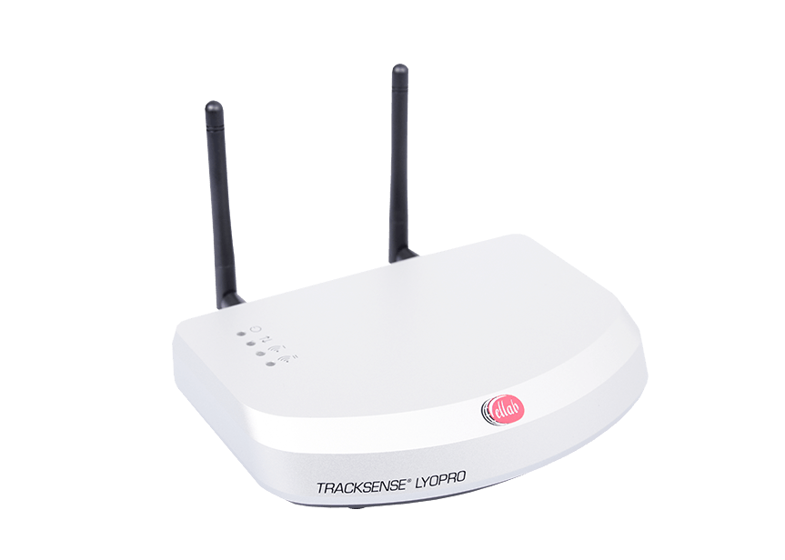
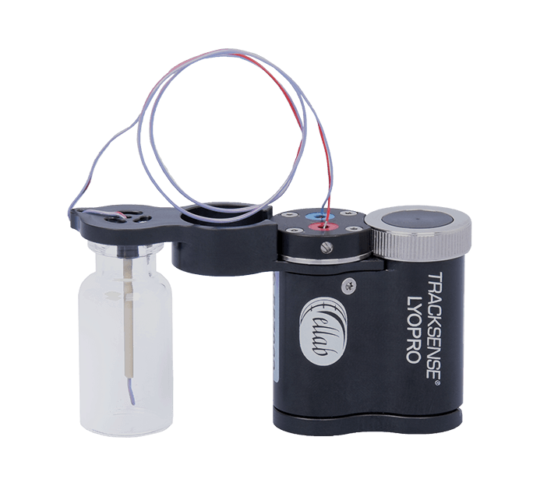
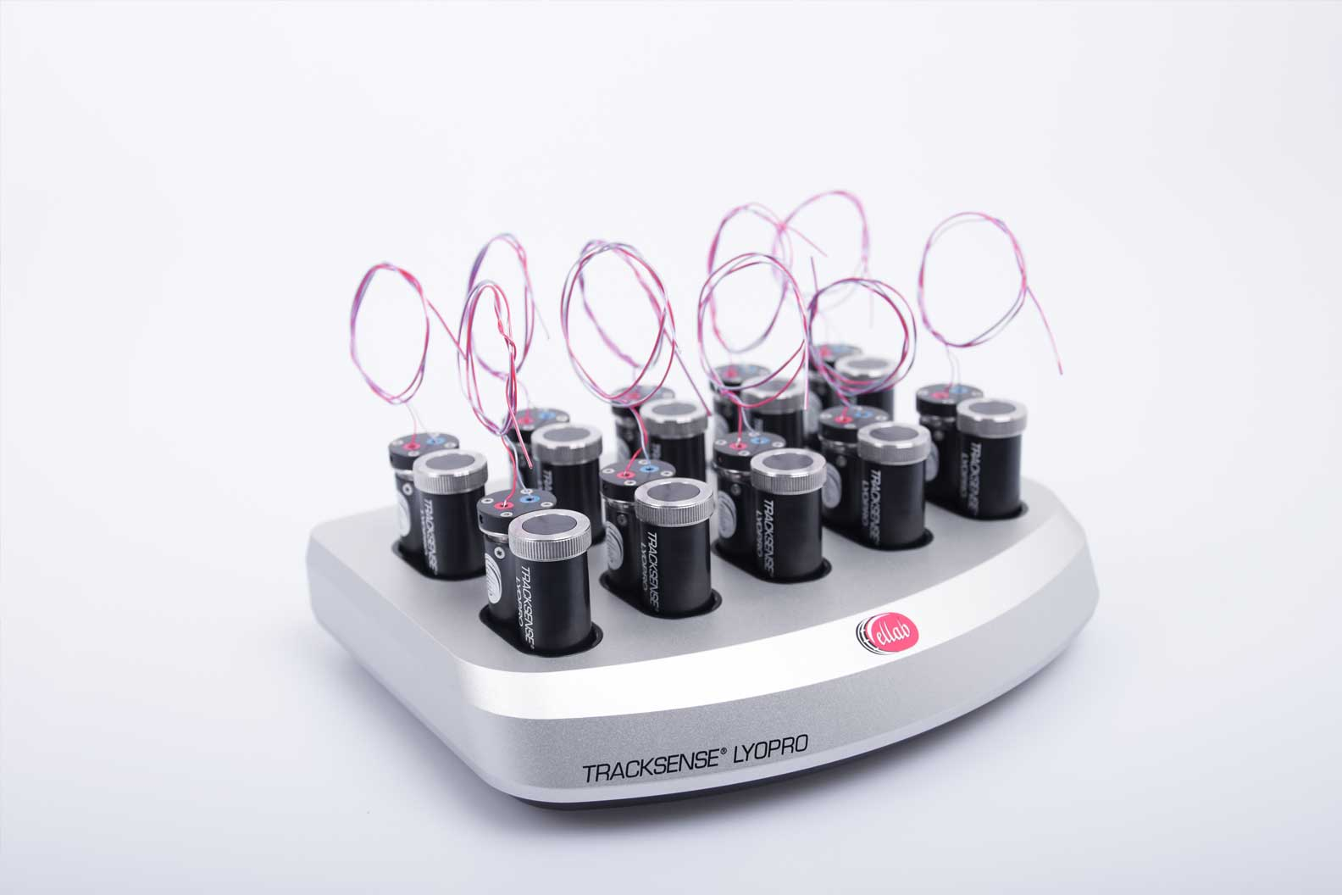
TrackSense® LyoPro - ValSuite Software Highlights
Transmit LIVE data directly into the SCADA system
Communication Hub – an OPC-UA server
Communication Hub, makes it possible for live data transmission from the LyoPro Data Loggers into the SCADA system
Communication Hub is a part of ValSuite OPC
Active List
SCADA Server
ValSuite OPC
Ellab OPC UA-Server
SCADA Client
Start of LyoPro Data Loggers
SCADA Database

Slide 26
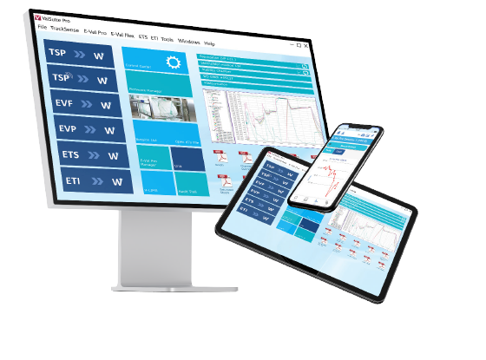
ValSuite® Software Highlights
Only access for authorized personnel
Standalone ValSuite security
Windows AD integrated security platform
FDA 21 CFR part 11, ISO9001 and GAMP 5 compliant
Security Modes & Access Manager – 2 security formats
Data cannot be tampered
Session data stored in MS SQL database (formatted as a BLOB in a V8x file, with CRC checks)
Supported with secure communication protocols (TLS 1.2 & LDAPS)
Database Design
Full traceability of actions (who, what, when)
Support 222 critical transactions within the software
Users can add comments to audit trail facilitating quality reviews (QA & external auditor)
Audit Trail
Secures digital approval by everyone involved in workflow
Specialized report for approval flow
More than 30 different analytic tools and reports
Electronic Signature
Numerous reports for data analysis
Your Life Science
Compliance
Partner
Notes:
All those services if done by our teams or the customers teams, are supported by the best software on the market for thermal validation projects.
Easy setup and various installation options to meet the customers requirements.
Compliant to the global standards.
Quick results & fast evaluation as well as compatibility with 3rd party validation software like KNEAT.
A real time saver, as you can repeat studies easily or start them with out any setup. You also can work offline and at the same time do reports somewhere else with the dual dynamic installation.

Slide 27
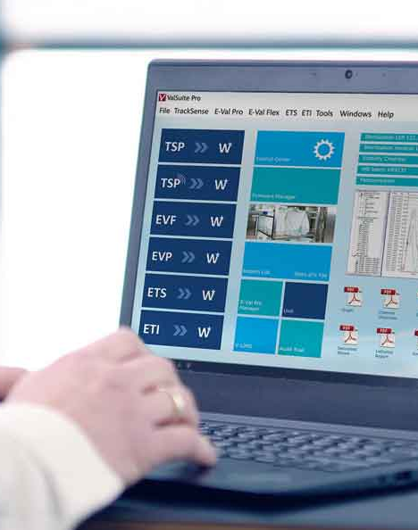
ValSuite Software Highlights
ValSuite - Industry leading validation software
More than 5000 ValSuite installations Worldwide
IQ/OQ documentation included in delivery
Customer Support: Ellab Software Support Team
Notes:
Regarding PQ: In a PQ test, our equipment operates in its real process environment. This usually isn't part of our default scope unless our field service is engaged. Typically, we provide IQ/OQ, and for this purpose, we have defined products: 1: Template free of use, on the memory stick. 2: Generic protocol product No. 31182050 3: Validation of customer equipment, not sure of number.

Slide 28
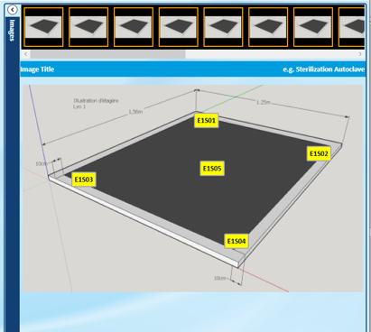
TrackSense® LyoPro - ValSuite Software Highlights
Unit & Profile with pictures
Ideal for documentation and repetition of study
Drag and drop of sensor positions into real pictures (up to 16 different) of actual study

Slide 29
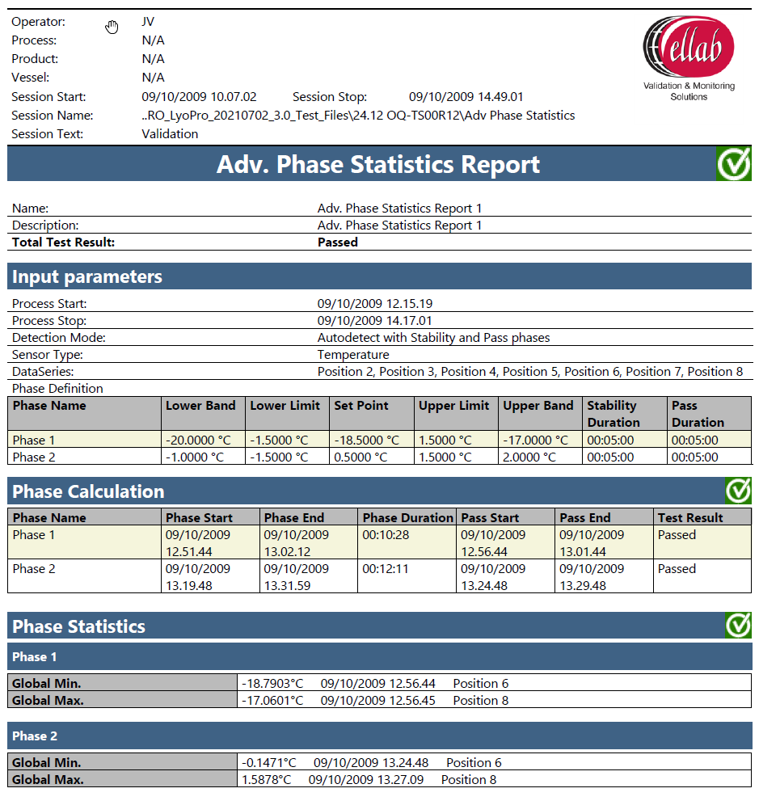
Selected ValSuite Software Features for Freeze Drying
Advanced Phase Statistic Report
A multi-flexible analysis tool providing statistics and limit tests on automatically detected phases in a process. Works ideally using ValSuite Sensor groups which can divide the sensors into groups representing a location or temperature zone.
Perfect for shelf mapping using sensor grouping
Examples of Inputs
Limits
Set point and Duration
Report
Passed/Failed

Slide 30
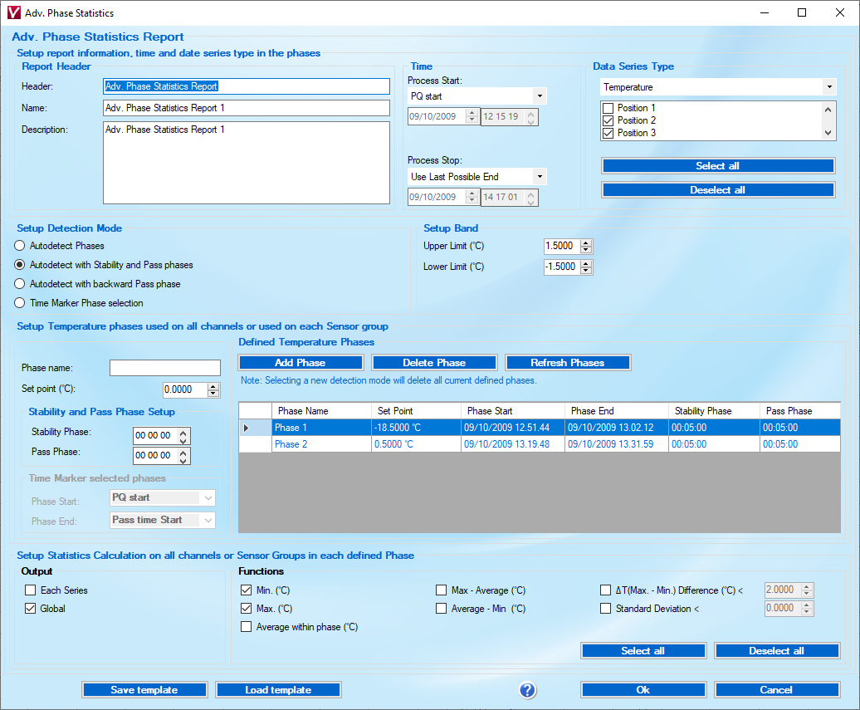
Selected ValSuite Software Features for Freeze Drying
Advanced Phase Statistic Report
A multi-flexible analysis tool providing statistics and limit tests on automatically detected phases in a process. Works ideally using ValSuite Sensor groups which can divide the sensors into groups representing a location or temperature zone.
Perfect for shelf mapping using sensor grouping
Examples of Inputs
Limits
Set point and Duration
Report
Passed/Failed

Slide 31
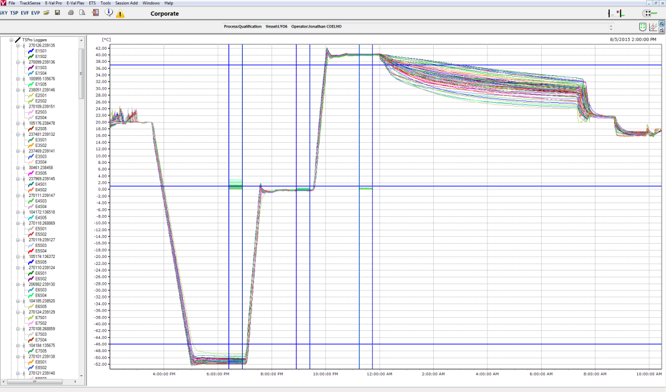
Selected ValSuite Software Features for Freeze Drying
Advanced Phase Statistic Report
A multi-flexible analysis tool providing statistics and limit tests on automatically detected phases in a process. Works ideally using ValSuite Sensor groups which can divide the sensors into groups representing a location or temperature zone.
Perfect for shelf mapping using sensor grouping
Examples of Inputs
Limits
Set point and Duration
Report
Passed/Failed

Slide 32
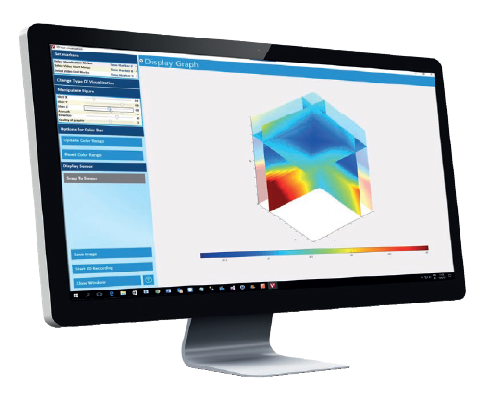
Selected ValSuite Software Features for Freeze Drying
3D Heat Mapping
Quick overview of temperature variations across chamber / shelf
Used to display data in 3D using automatic temperature coloring
Used to display data in 3D using automatic temperature coloring
Requires the scientific version of ValSuite.

Slide 33
Selected ValSuite Software Features for Freeze Drying
Client / Server installation
Allows all studies from various operators / venues to be accessed centrally on main server

Slide 34
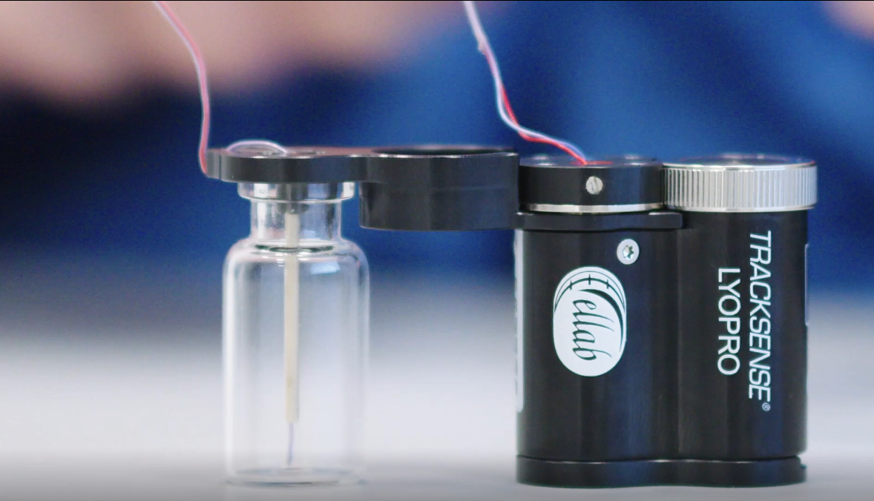

Slide 35
TrackSense® LyoPro
“Love the LyoPro system – especially, no needs for modification of the freeze dryer”
“The signal from the LyoPro data loggers is good without any built-in equipment for radio transmission”
Quotes from the Market
“The data loggers (LyoPro) proved ideal for shelf temperature mapping, without the need for feeding thermocouples through the chamber wall. Ellab went from proof of concept to delivering a system with 75 independent measuring points in less than 4 weeks. It has been a real pleasure working with Ellab on this project.”
“The LyoPro system provides great data, which reflecting the expectations
of process
temperatures”

