Slide 1
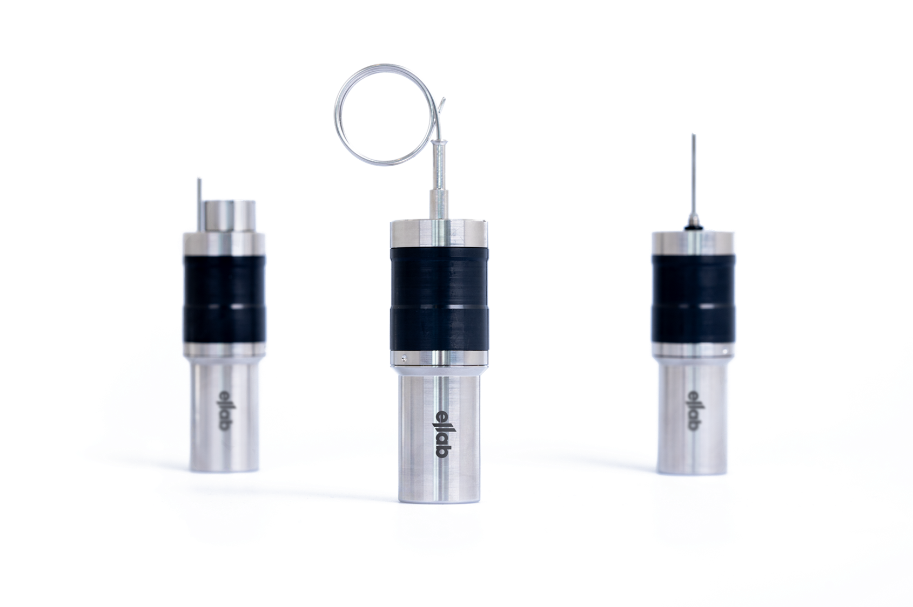
TrackSense®
Frigo UX Sky

Slide 2
TrackSense
Frigo UX Sky
The real-time data logger to speed up your freezer qualifications,
re-validations, and mappings.
Act early and save time fulfilling
your task.

Slide 3
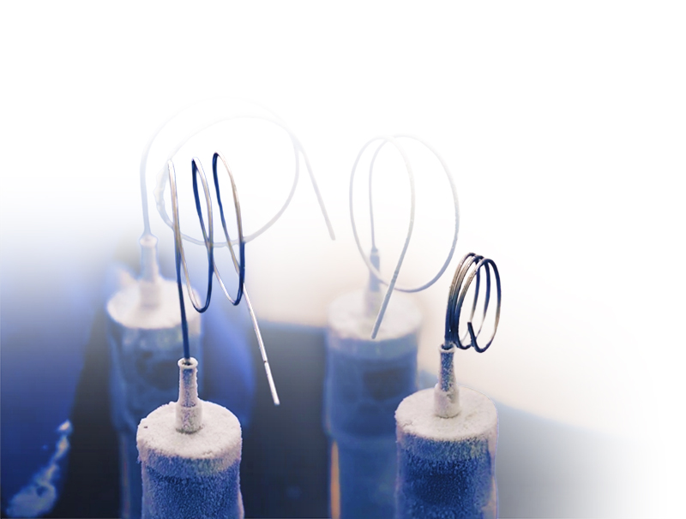
Efficient freezer qualification from start to finish
Wide temperature range for maximum flexibility
Can be calibrated on-site
Prevents the need to repeat qualification studies through live data that allows you to act instantly.
No data loss: data is stored and backfilled once connection returns
Strong RF signal that reaches up to 200m in open field conditions
Over 1500 hours of continuous live data with 10s sampling rate, even at -90°C
5

Slide 4

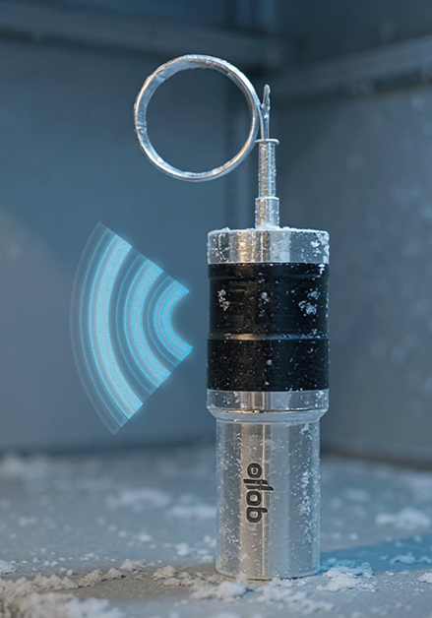
System Highlights
Frigo UX Sky
Live, Detailed Information at Your Fingertips
View data, min/max, statistic and lethality calculations in real time
Utility
Save time between studies and setup & start and stop from standby mode
Never Lose Data
Refill of data when connection reestablishes
Running over 1500h
Long battery life on live data, even at -90°C
Super strong RF signal
>200 meters on free field
-90 °C to +140 °C
Wide range of temperature measurements while maintaining complete control over live data.

Slide 5

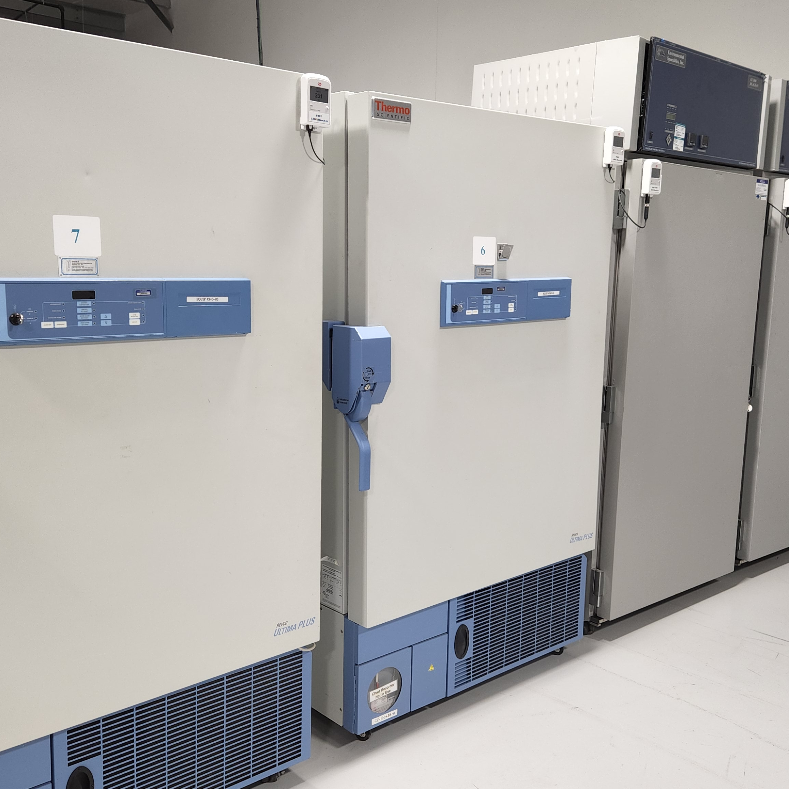
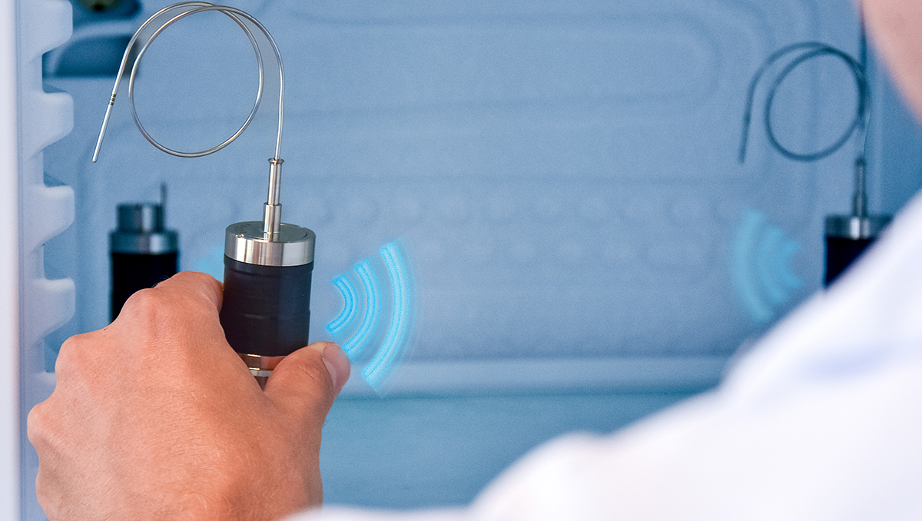
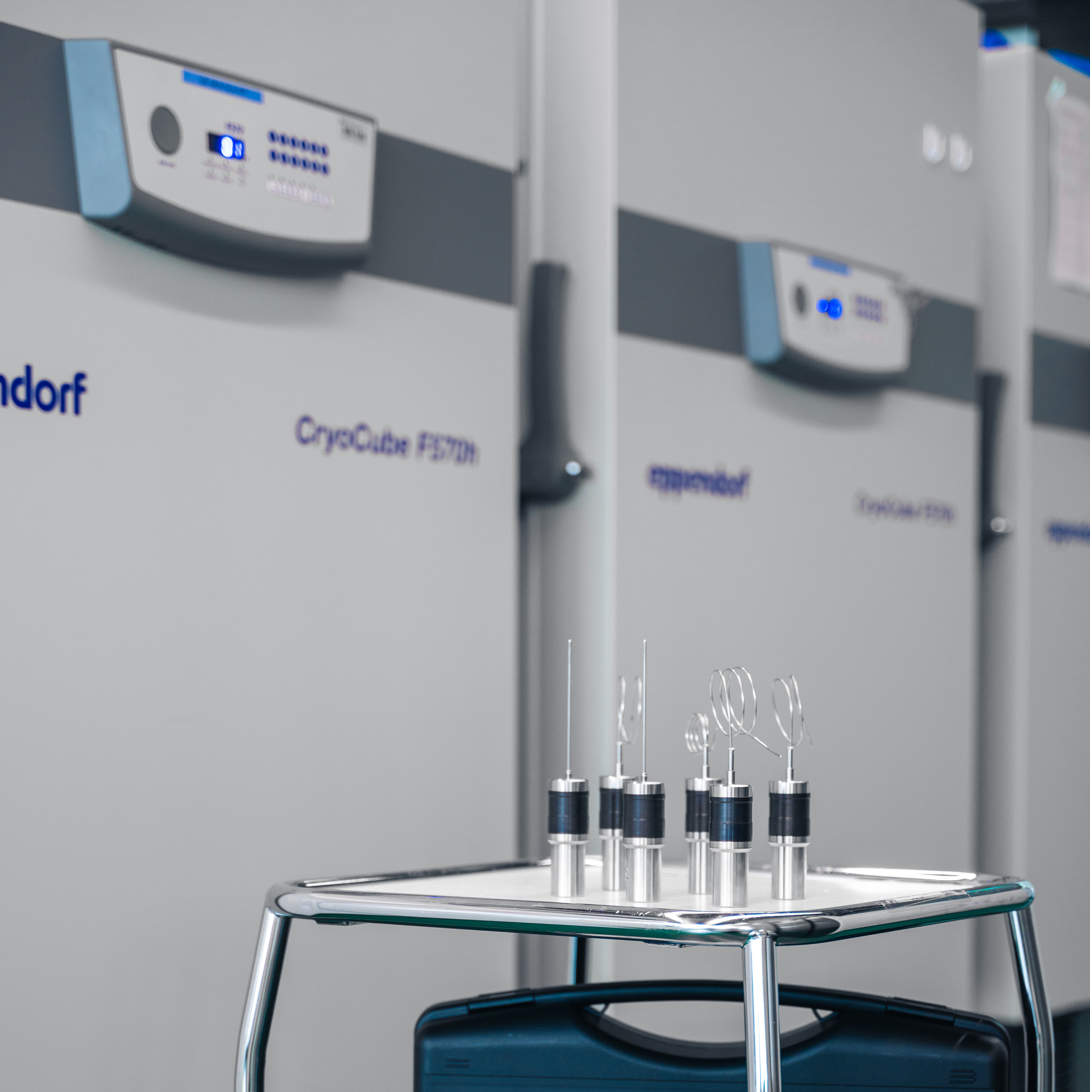
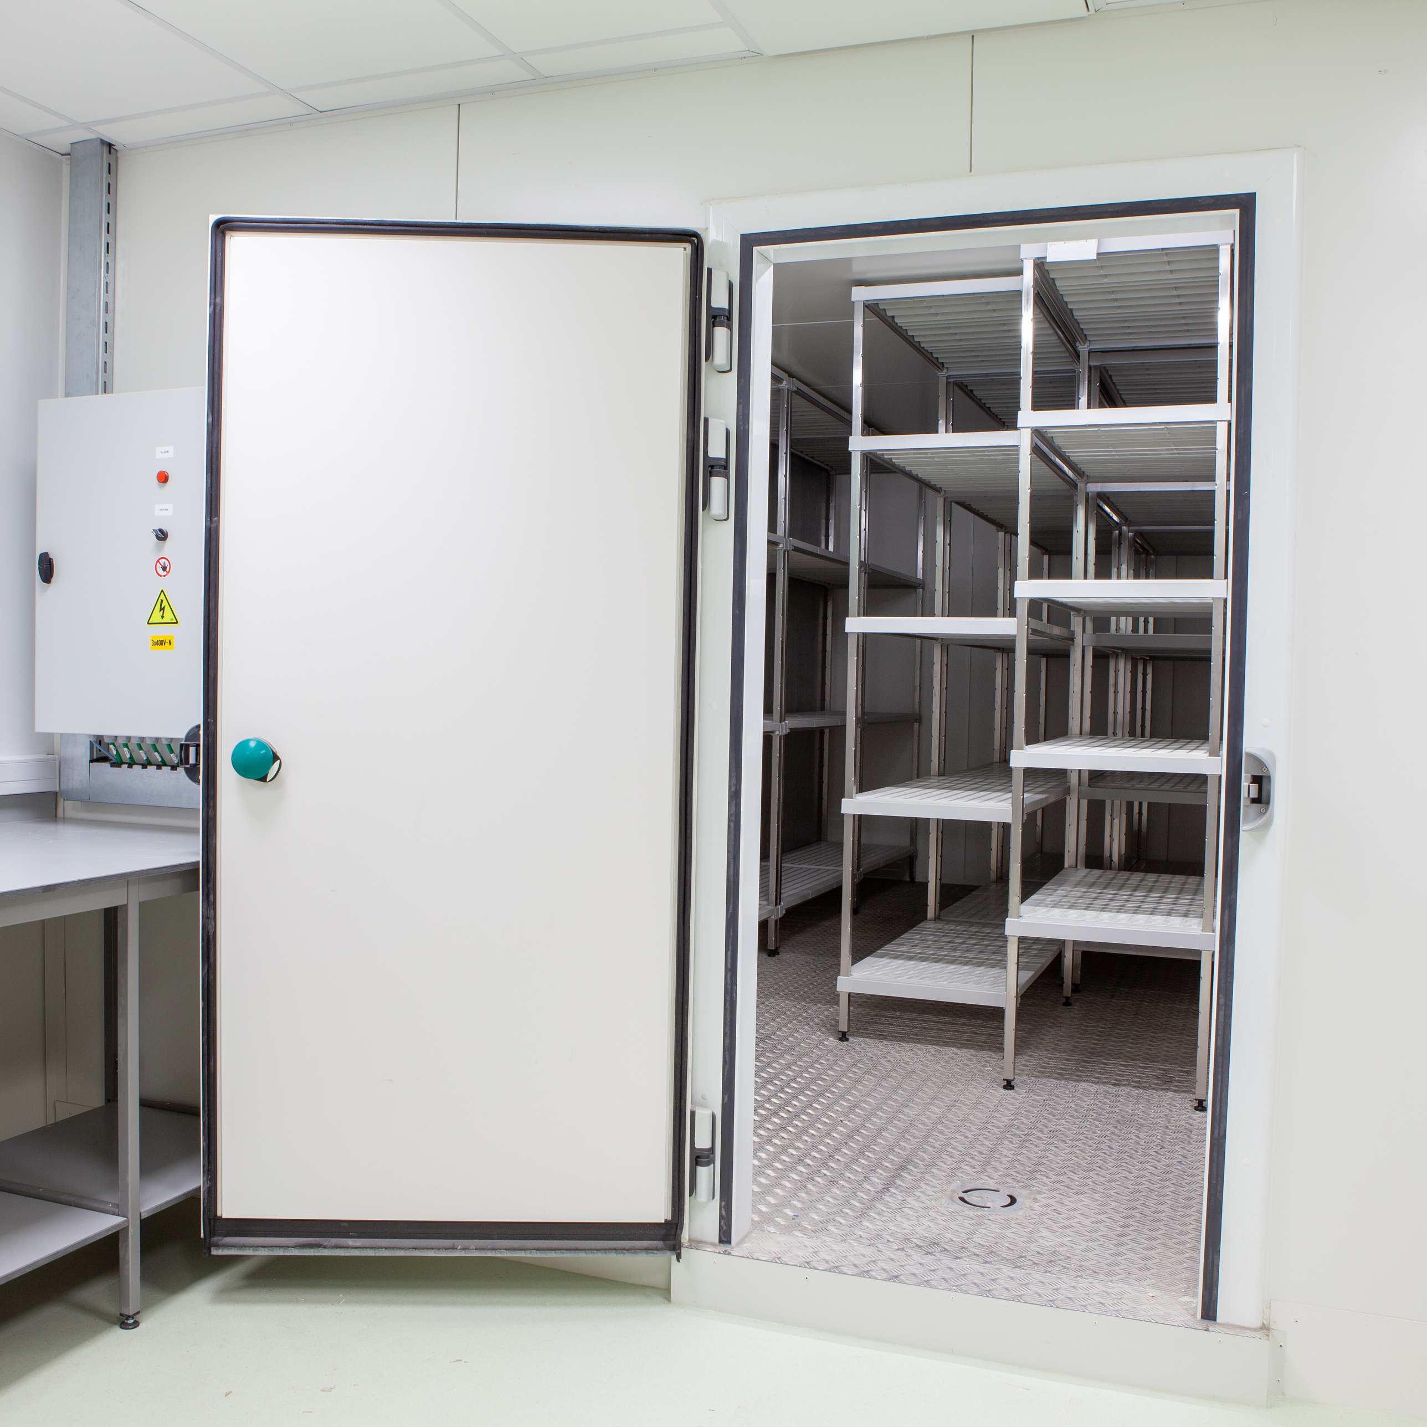
Main Applications
Frigo UX Sky
Where is this logger at home?
Fridges
Freezers
Play Video
Ultra low freezers
Walk-in freezers

Slide 6

Components
Frigo UX Sky
Product
Item Number | Description
31191210UX | TS Frigo UX SKY Logger with 35mm Rigid Sensor
31191213UX | TS Frigo UX SKY Logger with 100mm Rigid Sensor
31191214UX | TS Frigo UX SKY Logger with 30cm SemiFlex Sensor
31191215UX | TS Frigo UX SKY Logger with 50cm SemiFlex Sensor
31191110 | TS Frigo UX SKY Logger Pressure/Temperature
What you need to get started
ValSuite Software
Reader-station compact (blue holes)
Accessories
Item Number | Description
35900034 | Logger Magnet Fixture
35900036 | Logger Magnet Fixture US
20000159 | Dryblock RTC-159A
20001159X | Multihole Insert 24 x 2.2mm & 1 x 6.55mm
31186000 | Sky Access Point
31188113 | Reader Station
Access point
2 batteries per logger (regular ”red” batteries)
Calibration
Item Number | Description
09000023 | Pressure/Temperature calibration
09000109 | Temperature calibration

