Slide 2
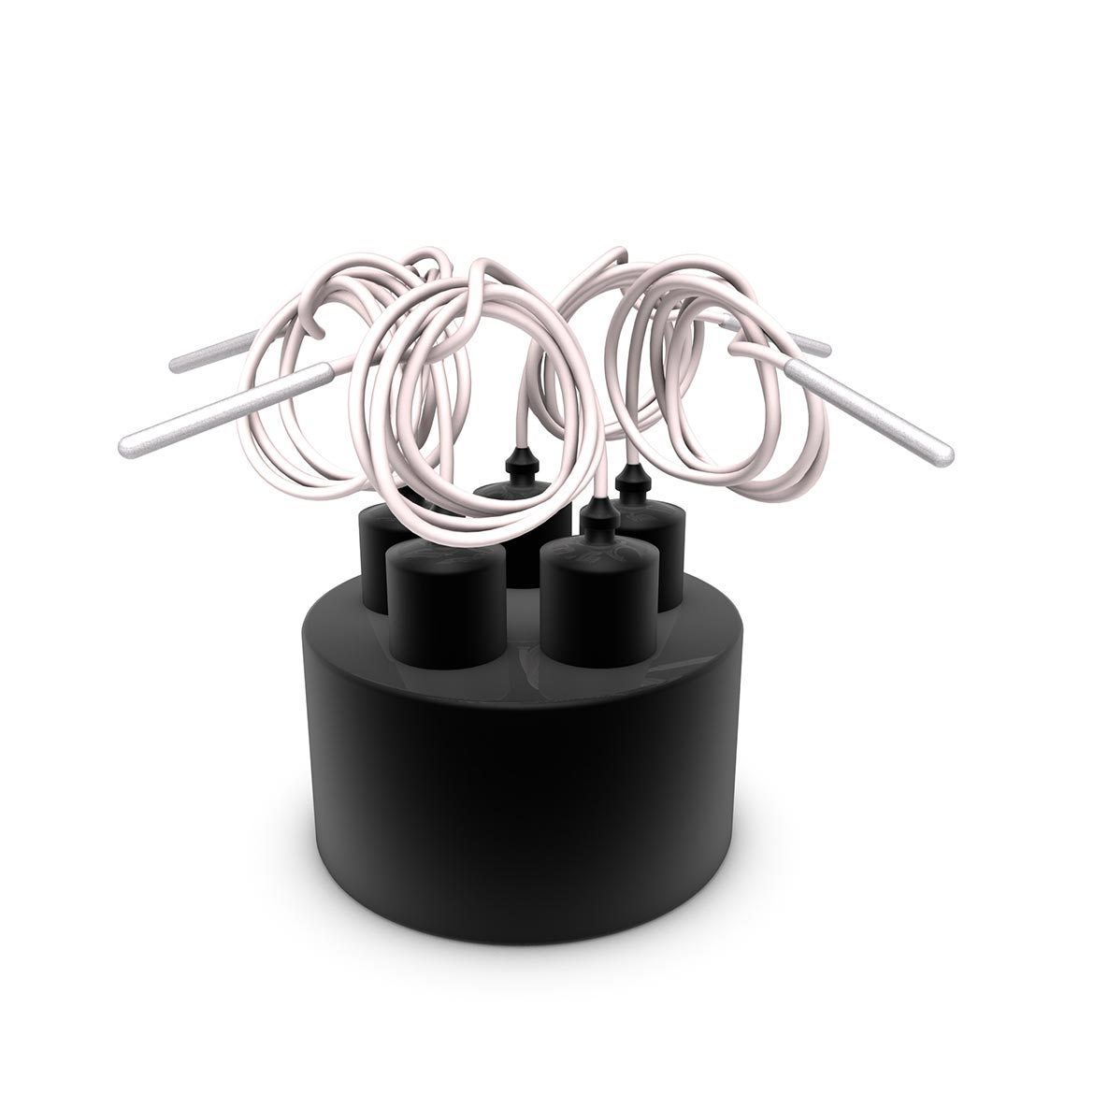
Competitive Battlecards
Lives International RF data logger vs Tracksense Pro data logger
August 2023

Slide 3

Competitive Battlecards – Lives RF loggers
Observations | Why We Win | Anticipated Landmines
Lives’ loggers are advertised as -90 to +140°C @ acc. ±0.01°C able to be used in autoclave, SIP, Feezers/ULT with RF. | The cold TMP range is greater than that of TSP SKY – The RF signal is stronger – but RF cannot transmit real-time in ULT as claimed. Our tests show transmitting will be suspended, and data will only spool up when thawed. Tested loggers could not hold specifications in oil bath @140°C. | Focusing solely on temperature range / specs in general.
Lives’ flexible sensors seem more durable and can be made longer than Smartflex. | PTFE sensors are slimmer and more flexible compared to Lives’ – semiflex steel and rugged flexible sensors also exist in Ellab portfolio. | A client prefers durability over other features – comparing smartflex to Lives RF flexible without more robust alternatives. Some clients express Lives flex sensors are more robust.
Lives’ loggers use 2 batteries per logger. Batteries are very difficult to replace. Battery lifetime seems short in tests, even though stated as “6 months use” from Lives. | Compare battery cost 1:2. Challenge the user-friendliness of replacement and battery lifetime. Might be the weakest point of Lives’ logger design. Ellab batteries are easy to replace, and last long. | Clients can focus on battery cost over user-experience and frequency of battery exchange.
Internal Use Only

Slide 4
Competitive Battlecards – Lives RF loggers
Observations | Why We Win | Anticipated Landmines
Lives’ RF loggers are activated with a ‘swipe’ over the access point and are awake for 2-3 minutes before going back to sleep unless started in a session. | Seems very clever on first glance, until you have to start a lot of loggers and the first in goes back to sleep.
The software seems simpler and more rigid than ValSuite user interface. | Lives’ software has less reporting functionality than ValSuite but still many functions. Graph and zoom functions work well. Lives can overlay sessions, VS can only merge. Starting loggers take 16 clicks, more complicated than VS. Selection of data for reporting seems easy and flexible | Beware that ValSuite can be overwhelming and too complex for some clients’ needs. It is vital to showcase that ValSuite can also be configured to be simple if that is important to the client.
Internal Use Only

Slide 5
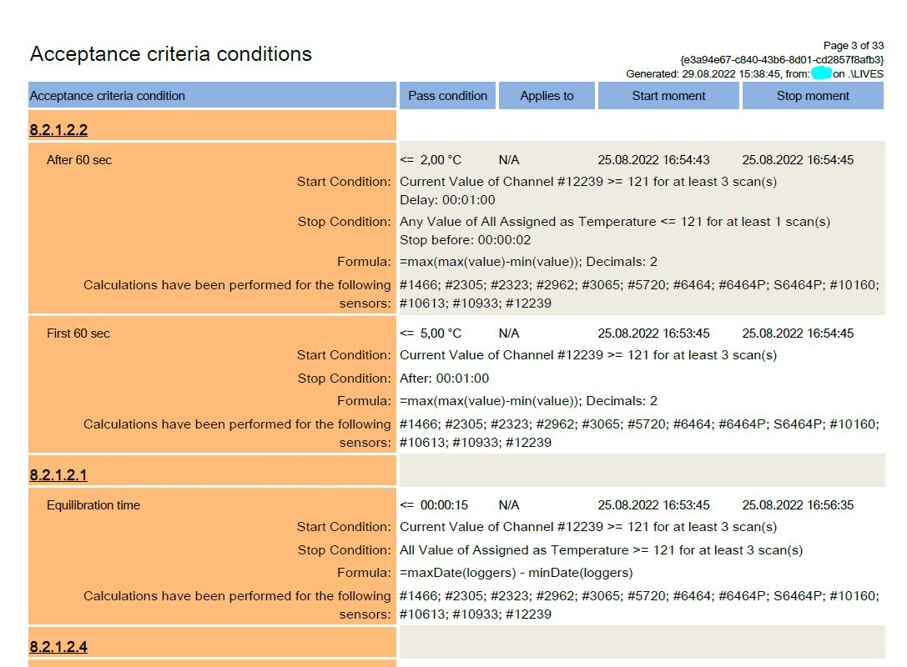
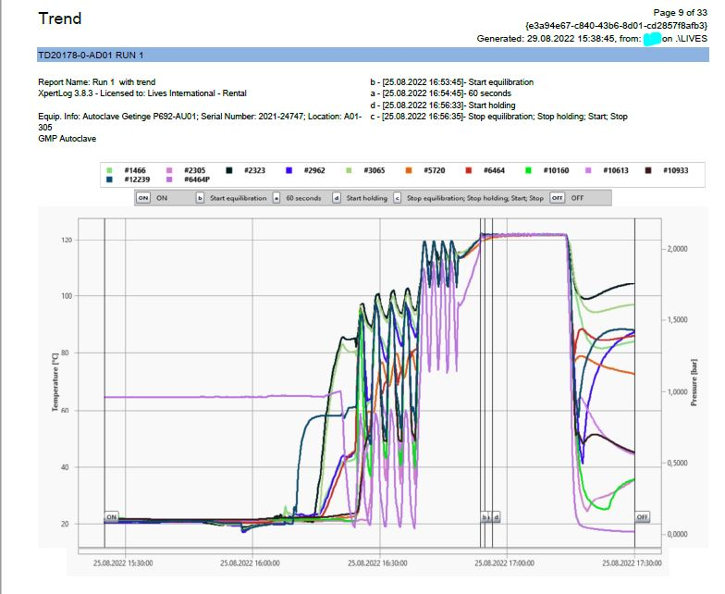
Competitive Battlecards – Lives RF loggers
Report examples Lives

