Slide 1
TrackSense® Pro Reader Station 3.1G

Slide 2
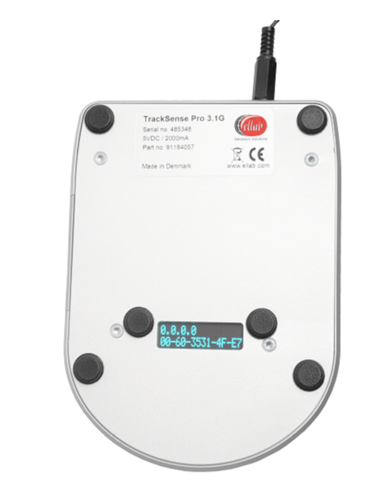
Multi RS 3.1G - Market Positioning
ValSuite software can be operated from a single laptop or be integrated into large-scale IT systems being fully compatible with:
Client server solutions with a central server database e.g. Citrix solutions
Virtual Servers and remote desktops
Cloud solutions like the Amazon Web Service (AWS)
Therefore it is essential that also the Reader Station can be connected via Ethernet.
All new systems (no change of ordering numbers) will automatically be delivered with this new Multi Reader Station
New Multi RS 3.1G can of course still be operated the traditional way using USB connection.

Slide 3
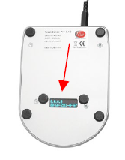
Multi RS 3.1G – How does it work ?
IP (Internet Protocol) and MAC (Media Access Control) addresses shown on the Multi Reader Station 3.1G backside through the sight glass are the addresses that uniquely defines the RS and its connection in a network.
The IP address (1st line) is a number assigned to the connection in the network. The setup of this is done easily in ValSuite using the Control Center functionality
The MAC address (2nd line) is the unique number assigned to the NIC card by the manufacturer (Ellab)

Slide 4
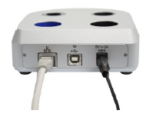
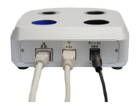

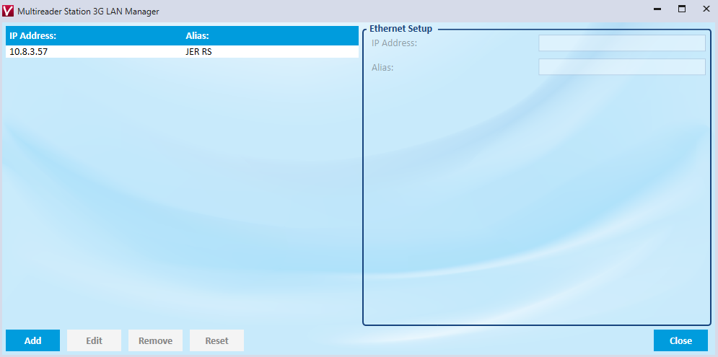
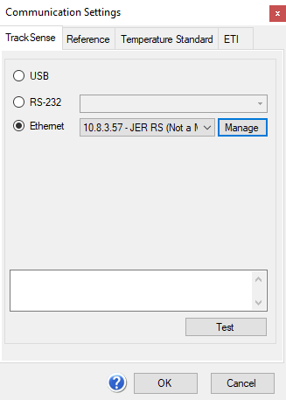
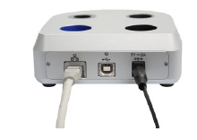
Multi RS 3.1G – Easy to connect
Connect the power supply and ethernet cable to the reader station
Connect the reader station to the PC using the USB cable
Read and note the reader station IP address located under the station
Open the ValSuite user menu, Tools / Communication Settings /TrackSense
Choose “Ethernet” and enter the IP address and an Alias
Select “Close” and remove the USB cable from the reader station
Use “Test” to control functionality

Slide 5
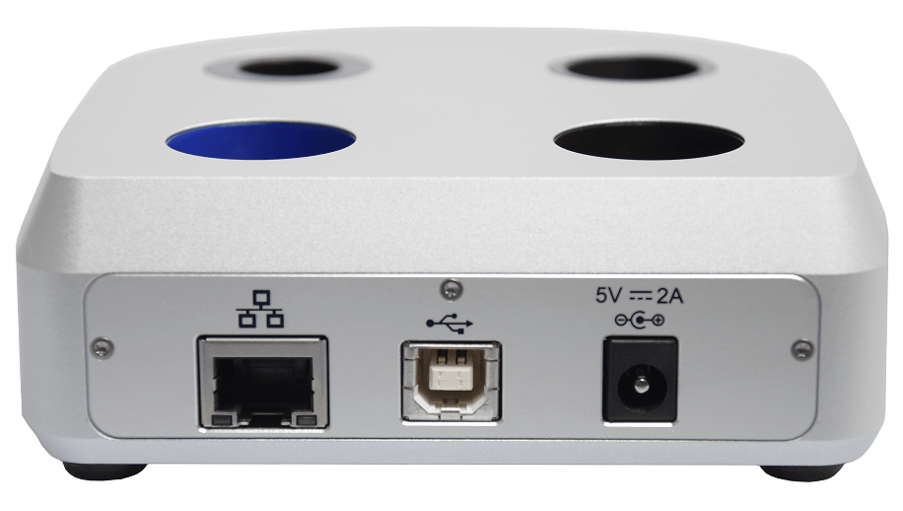
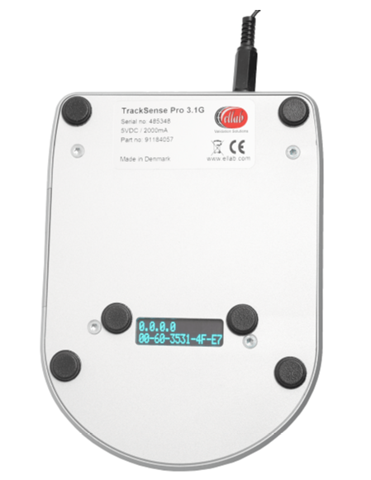
Multi RS 3.1G – Summary at a glance
Easy Connection to Ethernet via build in Ethernet / LAN port
Ideal for Citrix or Remote Desktop installations like AWS (Amazon Web Services)
Setup via ValSuite Control Center using USB and Ethernet cable
Operated with Ethernet cable and Power Supply
IP and MAC address shown in window at RS bottom plate for easy identification
Works with ValSuite 5.3.x version or later

