Slide 1
TrackSense® Pro
Maintenance

Slide 2
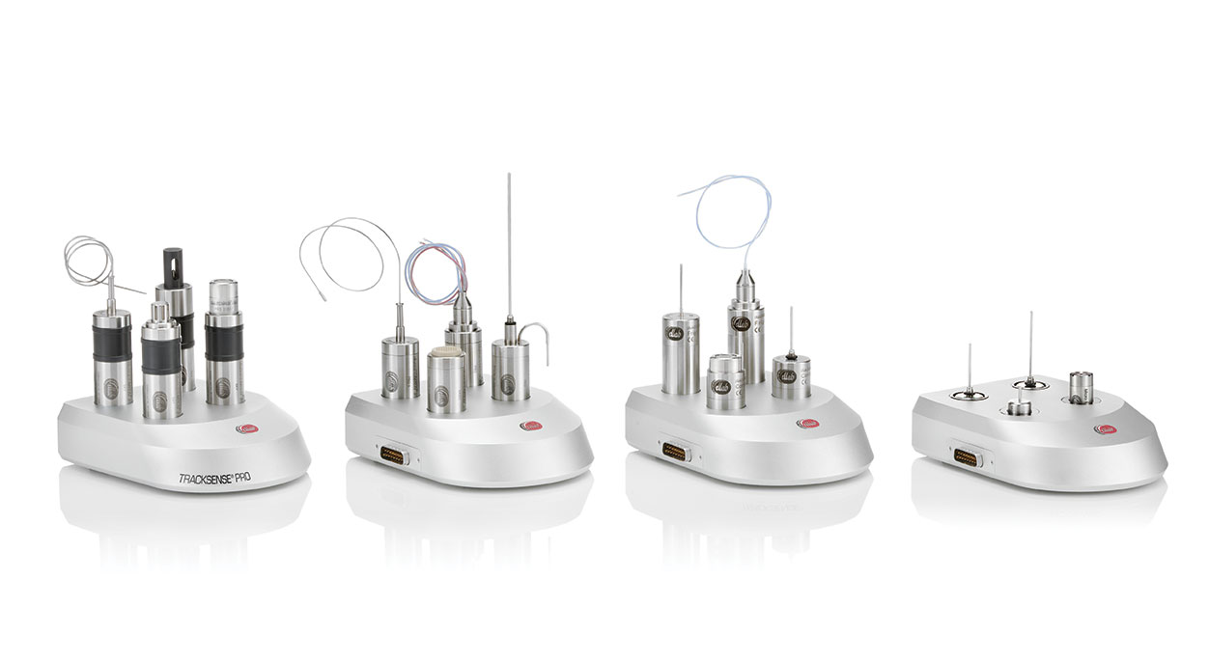
TSP Maintenance
Diassembling/Assembling
Cleaning Procedure
Changing of O-rings

Slide 3
TSP Basic/Pro/Pro-X
Disassembling & sensor change
  Unscrew spanner anti-clockwise
  Remove sensor by using the wrench
    DO NOT twist or wiggle
  Mount new sensor-be aware of pin-connector position
  Tighten spanner (by hand) so o-ring is not visible
    max 0.5 mm distance between housing and spanner

Slide 4
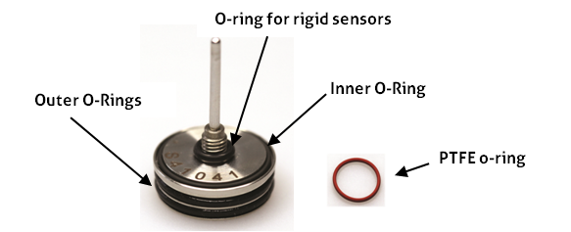
TSP Basic/Pro/Pro-X
Changing O-rings
  Inner and Outer O-ring
  Should be changed with every battery or sensor change and when calibrating
  Apply a light coat of grease to the O-rings with every change
  PTFE O-ring: Applications from -30 to -80 degrees

Slide 5
TSP Basic/Pro/Pro-X
SKY Module
  Important to mount the SKY module corretly in housing to secure free antenna signal
    If mounted correctly the signal strength can be improved significantly

Slide 6
TSP Basic/Pro/Pro-X
Battery exchange
  Remove empty battery from holder by pushing battery towards spring
  If needed write activation date on battery
  Insert new battery in holder after it being activated in Ellab Battery Activator for 1 hour exactly

Slide 7
TSP Basic/Pro/Pro-X
Battery handling & storage
  Always store batteries separately to avoid fire hazards or explosions
    In plastic bag
    Upright in a container

Slide 8
TSP Basic/Pro/Pro-X
Use of non-Ellab batteries
  Loss of warranty
  Possible errors in measurements
  Possible loss of data
  Possible false software warnings
  Possible damage of logger & sensor

Slide 9
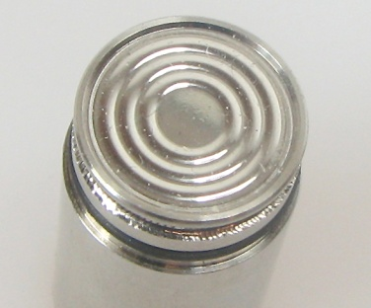
TSP Basic/Pro/Pro-X
  SPECIAL cleaning of Pressure Sensors
  Regular cleaning is important – preferably after each use as dirt will build up under the protection cover resulting in false readings over time
  The membrane is very sentitive (DO NOT TOUCH)
  Cleaning methods
    Spraying with hot rinse water
    Spaying with a non aggressive cleaner
    Use Washing machine
  Dry membrane by using a paper towel – no contact

Slide 10
TSP Basic/Pro/Pro-X
  Protection of Pressure Sensors
    Remove carefully the protection cap
    Apply silicone oil to the rim – don’t overfill
    Place the protection cap back in position
  Protection of Pressure Sensors by using Connector system
    Replace the protection cap by special filter cap

Slide 11
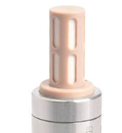
TSP Basic/Pro/Pro-X with RH sensors
Reconditioning - which might bring back the sensors to the original calibration status
  RH 5.2 sensor: not required
  RH 2.8 sensor: Oven @120 C for 1 hour / Ambient for 48 hours
  Older RH sensors: Oven @100 C for 12 hours / Ambient for 48 hours
Cleaning & Maintenance
  No physical cleaning possible – on RH5.2 never remove or even touch the PEEK protection cap
  Keep the sensor away from dusty areas – and/or aggressive chemical environments
  When not in use store it in an antistatic bag (3M Static Shielding Bag SCC 1000 or similar)
  Do never immerse sensor in liquid.
  Do never grease the o-rings to avoid migration to sensor

Slide 12
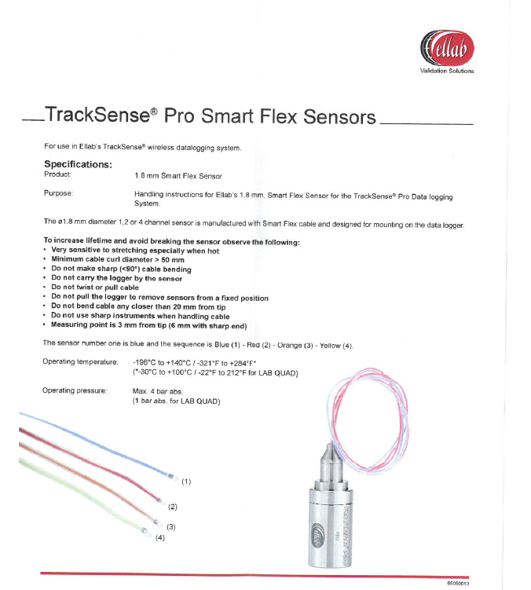
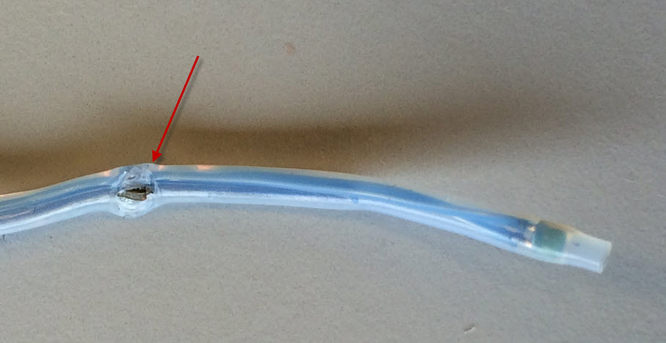
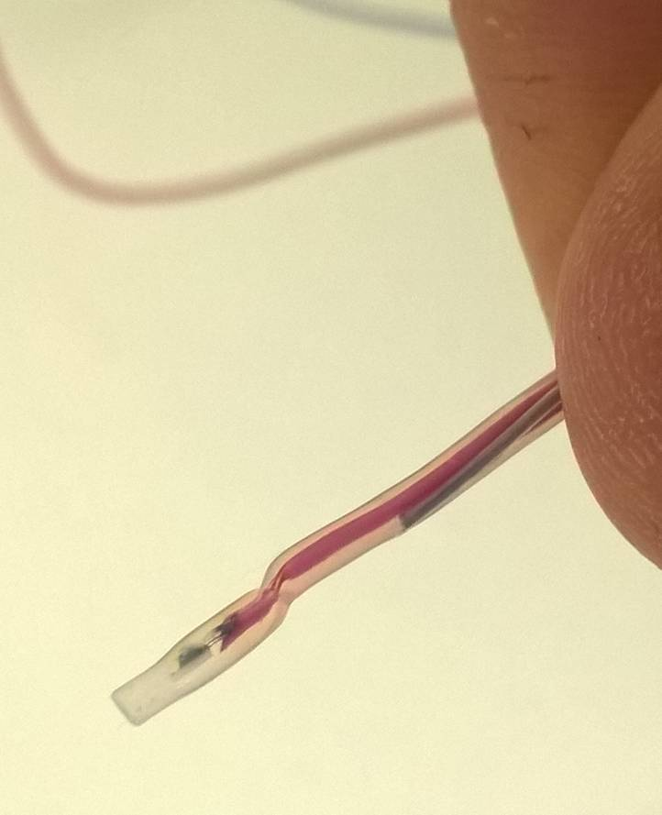
TSP SmartFlex sensors
Handling
  Follow instructions carefully

Slide 13
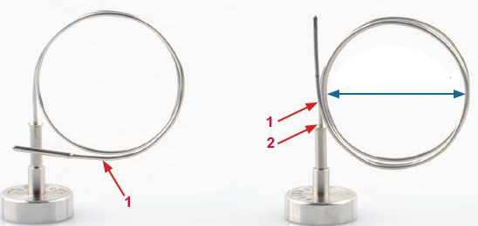
TSP Semiflex sensors
Bending
  Never bend the sensor closer than approximately 10 mm from the tip (mark 1)
  Don’t make any sharp bends close to the sensor root (mark 2)
  Bending diameter should be at least 25 mm – preferably 40 mm using the Ellab bending tool

Slide 14
TSP Micro Logger Battery exchange
Remove Battery Lid using wrench and tool (or coin)
Remove old battery
Change O-ring and apply grease to the new
Clean Battery contact with ethanol and cotton pad
Insert new battery using a forsept
  Never touch the battery
Close the lid

Slide 15
TSP Mini Logger Battery exchange
Remove Battery Lid using wrench and tool (or coin)
Remove old battery
Change O-ring and apply grease to the new
Clean Battery contact with ethanol and cotton pad
Insert new battery using a forsept
  Never touch the battery
Close the lid

Slide 16
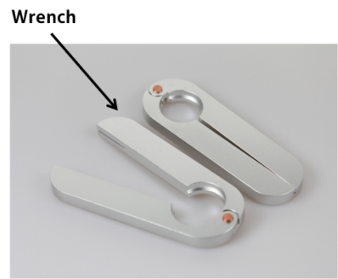
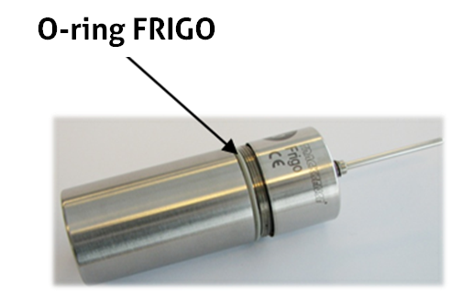
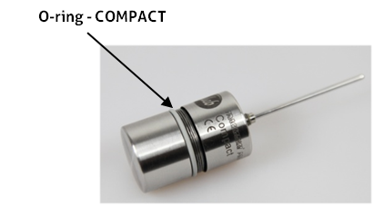
TSP Compact & Frigo Battery exchange
Disassembling using the wrench tool
Remove empty battery
Change O-ring with every battery change
  No turning which might cause leak
Assembling logger

Slide 17
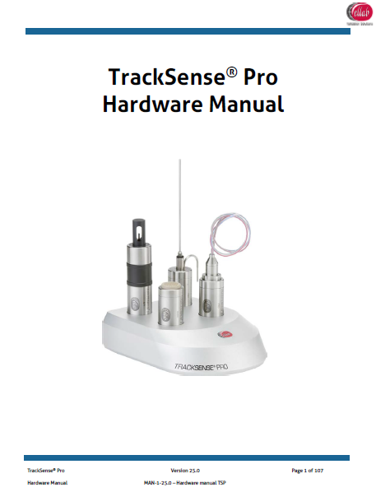
Do’s and don’t
Use information available
Follow instructions carefully
Read the HW manual

