Slide 1
TrackSense® Pro Sky Concept

Slide 2
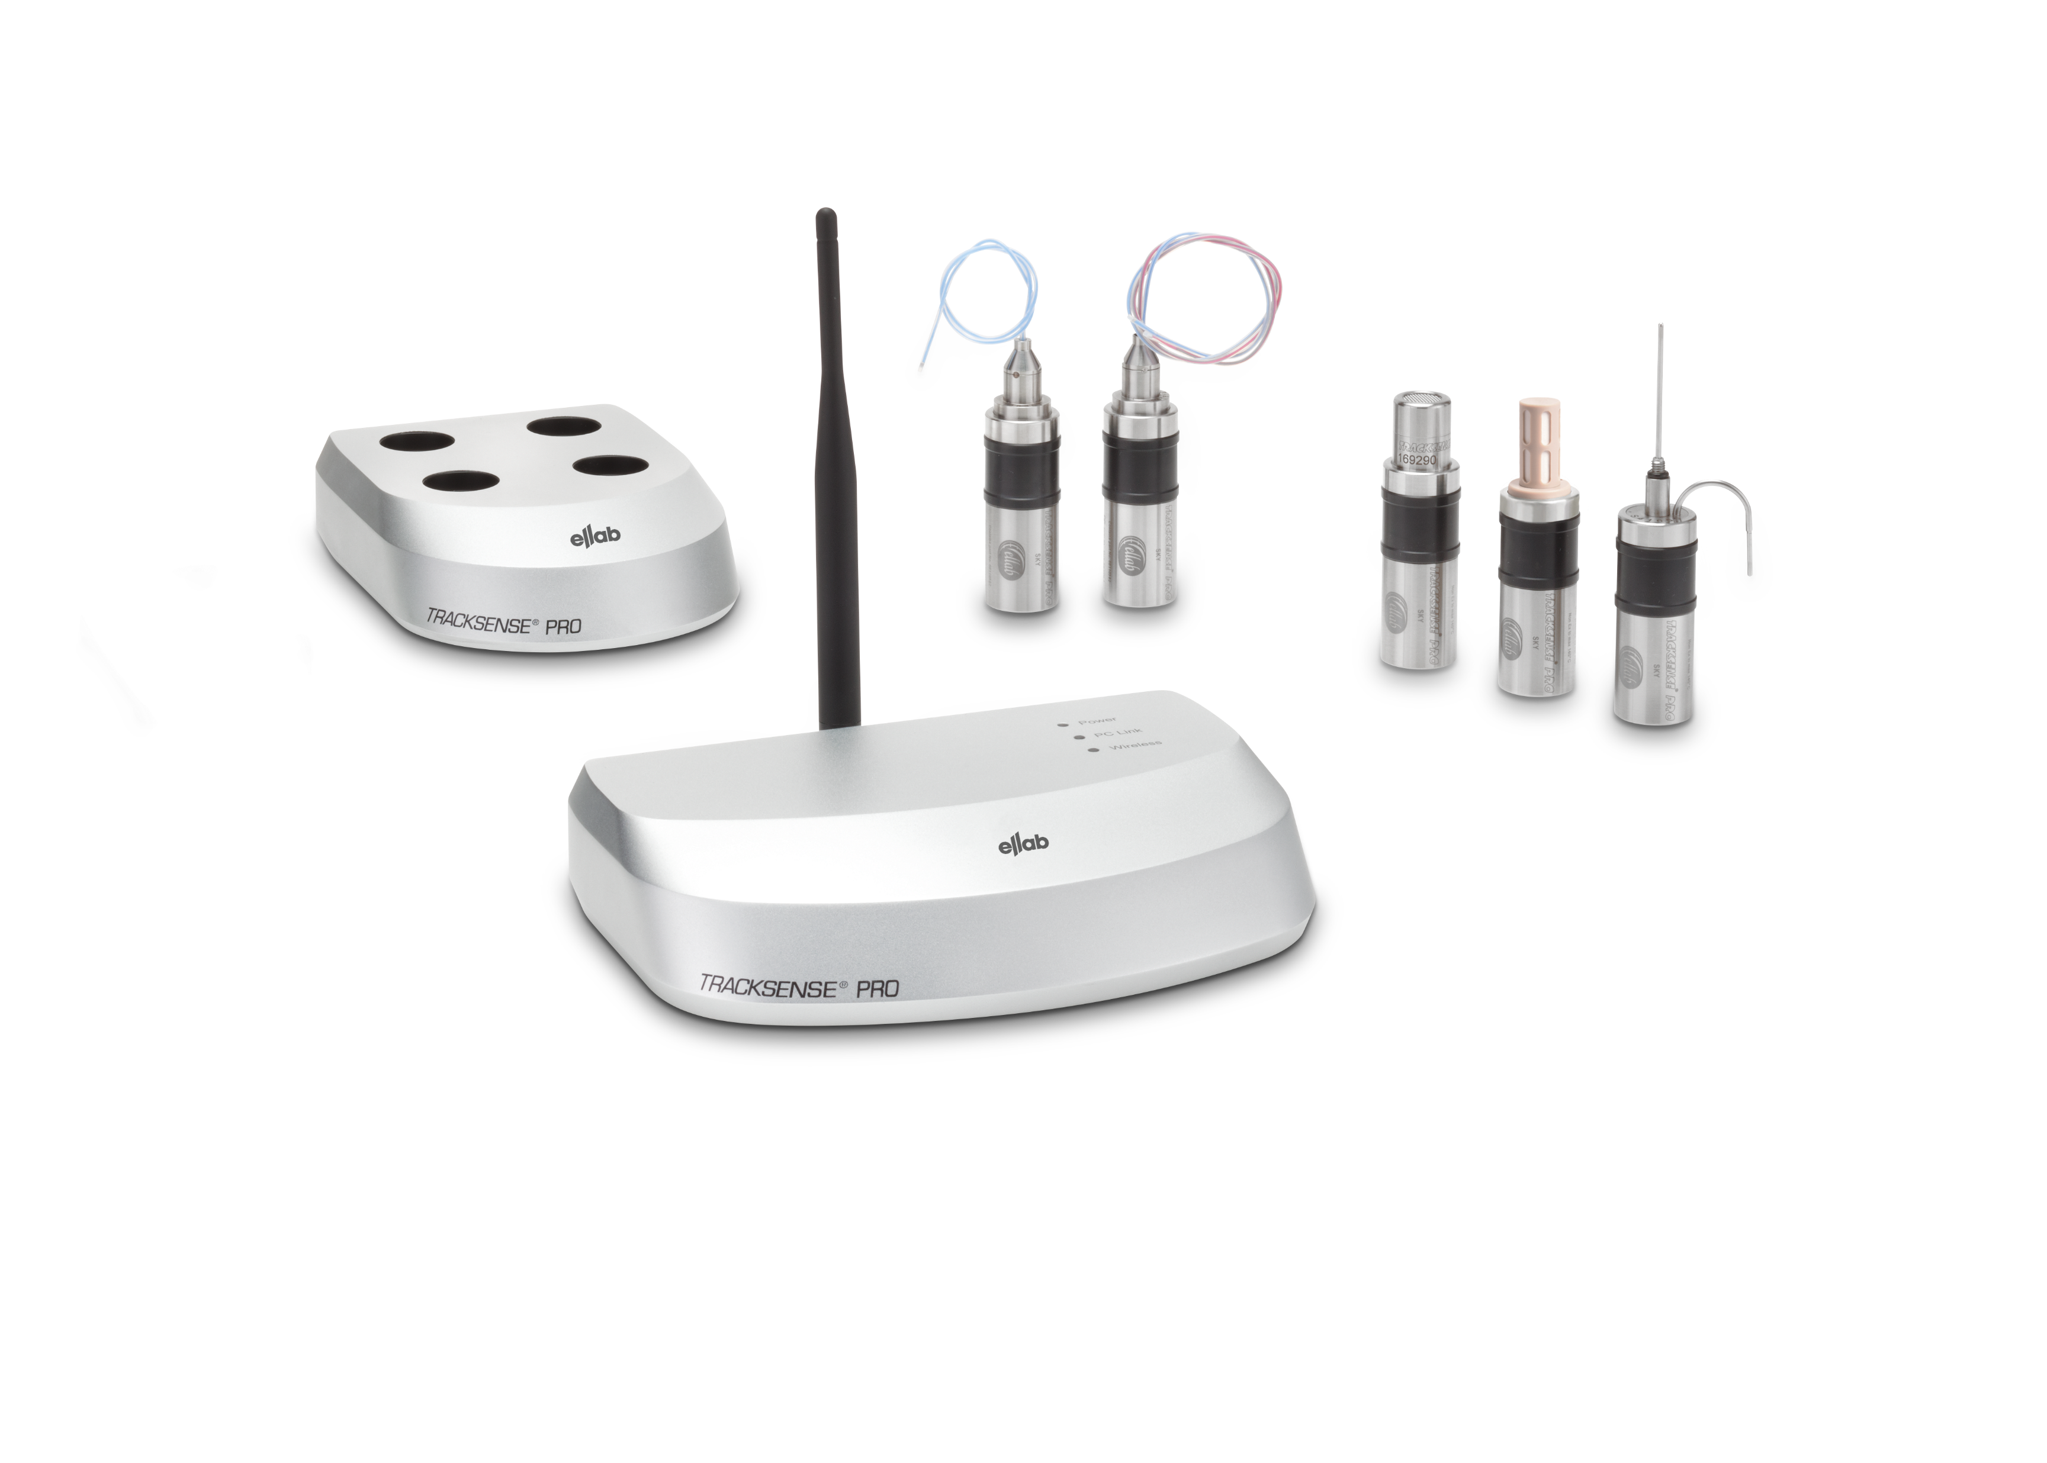
TrackSense® Pro Sky Concept

Slide 3
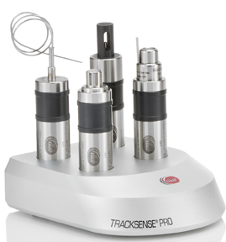
TrackSense® Pro Sky Concept
Real time wireless data logger
Operational temperature -80 °C to +140 °C
Provides instant information about your process
Transmission range +/- 15 meters
Save time between studies and setup
Superior online monitoring with ValSuite™ software
View data, min/max ,statistic and lethality calculations in real time

Slide 4
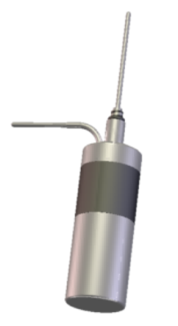
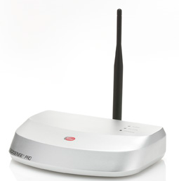
Main Applications
Lyophilizers
Stability chambers
Freezers
Warehouses
Smoke houses
Pasteurization

Slide 5
Sky concept components
TrackSense® Pro 2nd or 3rd generation data logger
Sky module
TrackSense® Pro T,PRS,RH ,CON,CO2 and Vacuum sensors
Sky Access Point
TrackSense® Reader Station
ValSuite™ Software (version 2.6 or later)

Slide 6
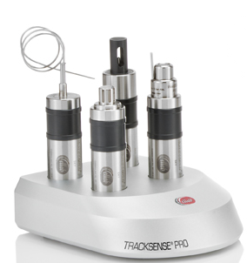
2nd Generation Logger
Improved electronics to support Sky module
Memory now 120,000 data points
Start up test – voltage and sensor is tested
Battery voltage and temp reading displayed
Longer battery life in standby mode
50% improvement when logger is not in use
Logger use monitor
records hours of operation and temperature exposure of battery

Slide 7
2nd & 3rd Generation Logger
Logger Status indicator - supports LED sensors
Green – logger is recording
Blue – logger has low battery
Red – alarm condition is met
Black Box Operation Recorder for service diagnoses
Records critical parameters for service diagnoses
Temperature exposure, hours of operation etc.
Battery Boost Function
Improves battery life and extents use when battery is low

Slide 8
2nd & 3rd Generation Configurations
Pro X/XL – operates from -80°C to +150°C (+140°C with SKY)
Pro – operates from -50°C to +150°C (+140°C with SKY)
Basic – operates from -30°C to +105°C
TrackSense® Pro 2nd & 3rd Generation loggers were designed for the future, but still support older TrackSense® Pro sensors, reader stations, 2.X software, and accessories

Slide 9
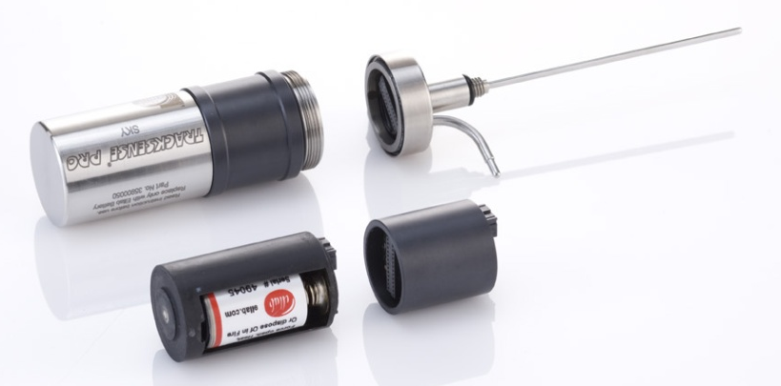
Sky Module
Contains all necessary components for wireless communication between the logger and Sky Access Point
Mounts between the logger and sensor
Standard module comes with an internal antenna
Maximum 64 SKY modules (loggers) in each session (128 measuring points)
Maximum 32 SKY modules (loggers) if restarted from Standby (64 measuring points)
Sky module

Slide 10
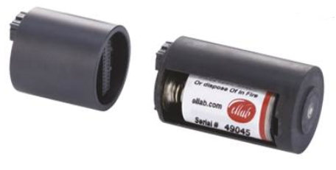
Sky Module Specifications
Operational temperatures -80°C to +140°C
2.4GHz (same frequency in US and Europe)
IEEE 802.15.4 standard
License free ISM-band (Industrial, Scientific, Medical)
Communication range up to 15 m.
Proprietary communication protocol to improve battery life
Up to 250 kbps data rate
Housing material - Peek

Slide 11
Sky Module Parameters
Critical to keep radio communication to a minimum
Battery consumption is 10 times higher than when just logging data
Module can transmit data at a different interval than logging
If Sky transmission is temporarily lost the logger is still logging and will transfer the data when Sky transmission is resumed, or the logger is read in the reader station
Data will never be lost or corrupted if using wireless transmission

Slide 12
TrackSense® Pro Sensors
All TrackSense Pro 1 and 2 channel temperature sensors can be used with the Sky module
Newer RH, Pressure/Vacuum , CO2 and Conductivity sensors also compatible
New sensors will have LED option – indicates logger is running and/or transmitting
1, 2 or 4 channel sensors are available
Custom sensors are available

Slide 13
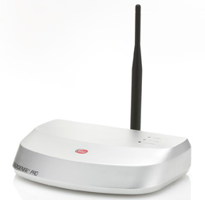
Sky Access Point Specifications
Antenna mounted directly on Access point or via remote cable
Communication range up to 15 meters
64 Sky modules (loggers) with max. of 128 sensor channels per Sky Access Point
Transmission rate:
5 sec with 16 Sky Modules
10 sec with 32 Sky Modules
60 sec for long processes with high sample rate(s)
1-12 Sky Access Points connected per session
LED Status indicators
Housing in aluminum

Slide 14
TrackSense® Pro Reader Station
Sky system will work with current TS-Pro Reader Stations
Initially loggers must be started in the reader station. Then assigned to a Sky Access point
You can start and stop sessions/loggers remotely via the Sky Access Point
When studies are complete read loggers in reader station. This shuts the Sky Module down and saves battery life

Slide 15
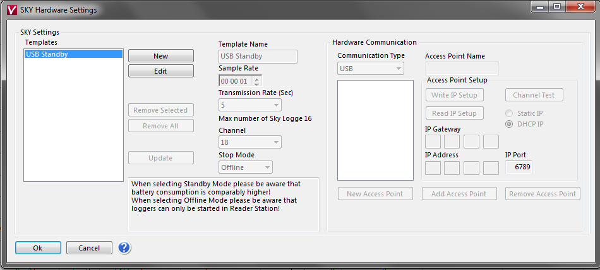
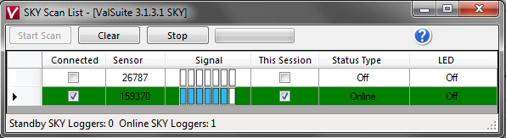
ValSuite™ Software
It is possible to read, restart and stop via the Sky Access Point
You can combine standard loggers with Sky loggers in the same session
Online signal strength detector
View data, min/max and lethality real time with zoom feature
Place Time Markers online
System can be networked

Slide 16
Advantages over current systems
PT1000 sensors are more accurate and stable compared with thermocouples
Real-time data critical for establishing a process
Tremendous time savings over positioning thermocouples
Eliminates slip rings and vessel integrity issues with wiring thermocouples
Results
Higher accuracy and quality
Dramatic time savings
Increased productivity

