Slide 1
Oxygen Depletion Alarm & Monitoring
Products for the Pharmaceutical Industry

Slide 2
Oxygen Alarm & Monitoring
Overview
Alarms for low oxygen levels in labs & cryogenic storage facilities where liquid or gaseous nitrogen is used or for high carbon dioxide levels in labs with incubators or other equipment using CO₂.
For human health and safety the alarm system will give sufficient warning for a space to be safely evacuated.
An additional analogue output module can be added which allows the connection of Hanwell pro transmitters to record the actual levels from the sensors. This information is useful for audit purposes keeping records of excursions. This data can be used to identify faulty equipment, bad practices by operators. In the case of bad practice for operators additional training can be implemented.
Display unit located in safe area shows status of each sensor allowing levels to be checked before entering a space.

Slide 3
Oxygen/CO₂ Alarm & Monitoring
Overview
Alarms for low oxygen levels in labs & cryogenic storage
Alarms for high carbon dioxide levels
Highly visible & audible alarms
Up to 4 sensors per display unit (any mix of O₂ & CO₂)
Up to 8 alarm repeaters (two per sensor)
Analogue output for long term monitoring
Long life oxygen sensor
Easily replaceable oxygen sensor
Infrared CO₂ sensor

Slide 4
Equipment Overview

Slide 5
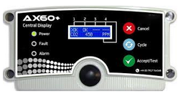
Oxygen & CO₂ Alarm & Monitoring
Main Display Unit
Supports O₂ and CO₂ sensors
Supports alarm repeaters
Up to 4 sensors
Visual display
Description | Part no
Display module | J265A

Slide 6
Oxygen & CO₂ Alarm & Monitoring
Main Display Unit
Supports O₂ and CO₂ sensors
Supports alarm repeaters
Up to 4 sensors
Visual display
Including 4-20mA output module for continuous monitoring
Description | Part no
Display module | J265C

Slide 7
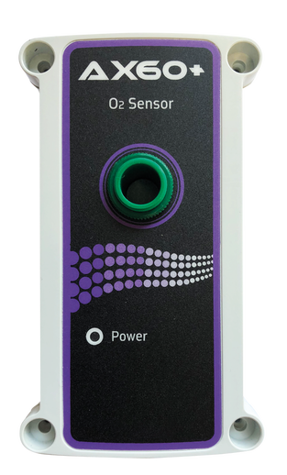
Oxygen & CO₂ Alarm & Monitoring
Oxygen Sensor
Long life sensor
User replaceable sensor
Up to 4 sensors can be used together
Description | Part no
Oxygen Sensor | J265B

Slide 8
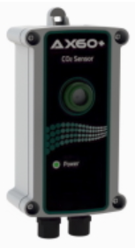
Oxygen & CO₂ Alarm & Monitoring
CO2 Sensor
Infrared CO₂ sensor
Up to 4 sensors can be used together
Description | Part no
CO2 Sensor | J265D

Slide 9
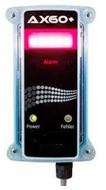
Oxygen & CO₂ Alarm & Monitoring
Alarm Repeater
High visibility strobe
Audible alarm
Alarm repeater connected to gas sensor
White LED strobe (optional blue, red or amber filters)
Description | Part no
Alarm Repeater | J267

Slide 10
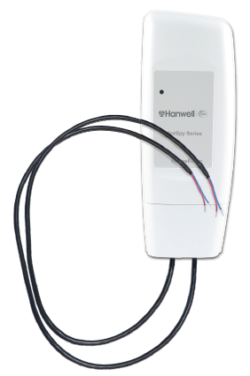
Oxygen & CO₂ Alarm & Monitoring
IceSpy Analogue Transmitter
Wireless interface to central monitoring system
2 x 4-20mA inputs
Battery power
Description | Part no
Analogue Transmitter | IN-MA001

Slide 11
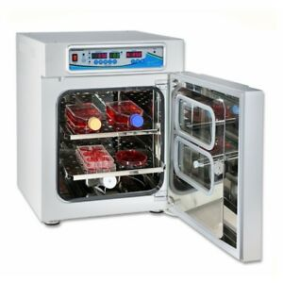

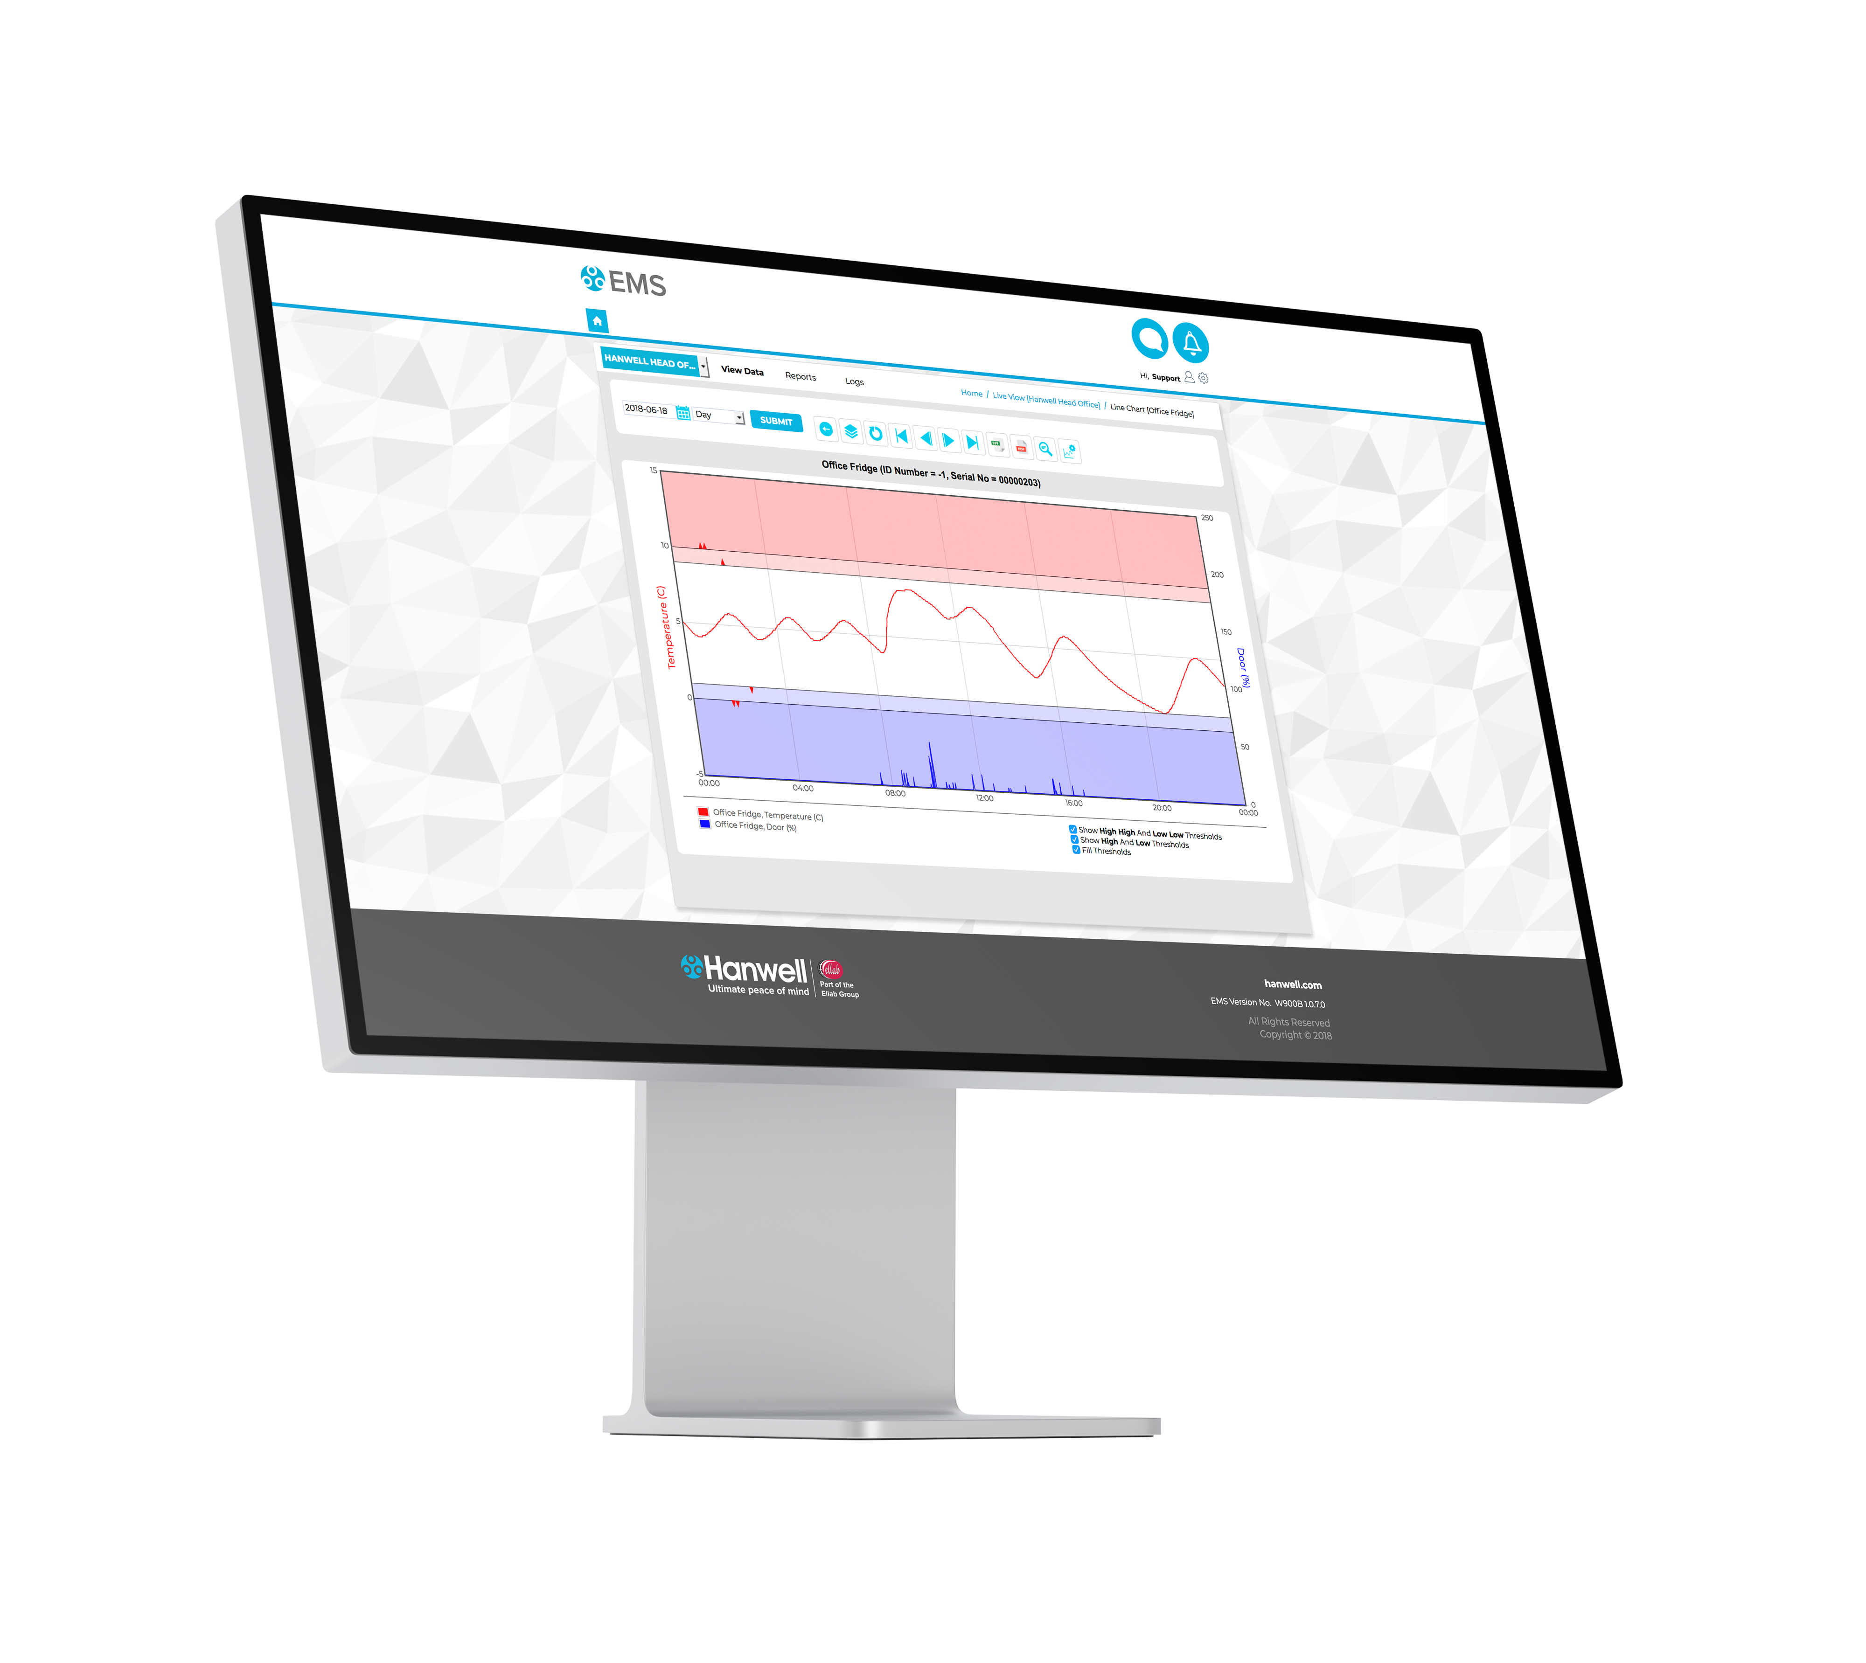
Oxygen & CO2 Alarm & Monitoring
Typical Layout
Cryogenic Room
Cryogenic Room
Incubator Room
Incubator Room
Danger of death from reduced oxygen
Danger of death from reduced oxygen
Danger of death from high CO2 levels
Danger of death from high CO2 levels
= Hardwired connections
Key
Safe Area
O2 sensor
Analogue output module
CO2 sensor
Display Unit
Alarm repeater
Network
connection
IceSpy analogue transmitter
Sensors and alarm repeaters powered from display unit
Display control unit
4-20mA output module
Hanwell EMS monitoring system
= 4-20mA connections
AC Power Outlet

Slide 12
Oxygen & CO2 Alarm & Monitoring
Connections
The Display unit requires a permanent AC power supply
The sensors are wired directly to the display unit and are powered by the display unit
A maximum of 4 sensors can be driven from each display unit
The alarm repeaters are connected to the sensor unit by a wired connection
Two alarm repeaters can be hardwired to each sensor unit and are powered by the sensor unit

Slide 13
Oxygen & CO₂ Alarm & Monitoring
Safety
The wireless interface is only for monitoring purposes this must never be used to transmit alarms for operator safety as the wireless signals and return notifications can be delayed due to things like network or system outages.
Operators can rely on the installed O₂ and or CO₂ sensors connected to in room alarm repeater units.
O₂ and CO₂ sensors should be positioned just above floor level when Nitrogen and Carbon Dioxide gases maybe present.
When lighter than air gasses pose a potential health risk the O₂ sensor should be position just below the ceiling.
The example in the previous slide are for heavier that air gasses.

Slide 14
There are many more options available

