Slide 1
Ellab Monitoring Solutions

Slide 2
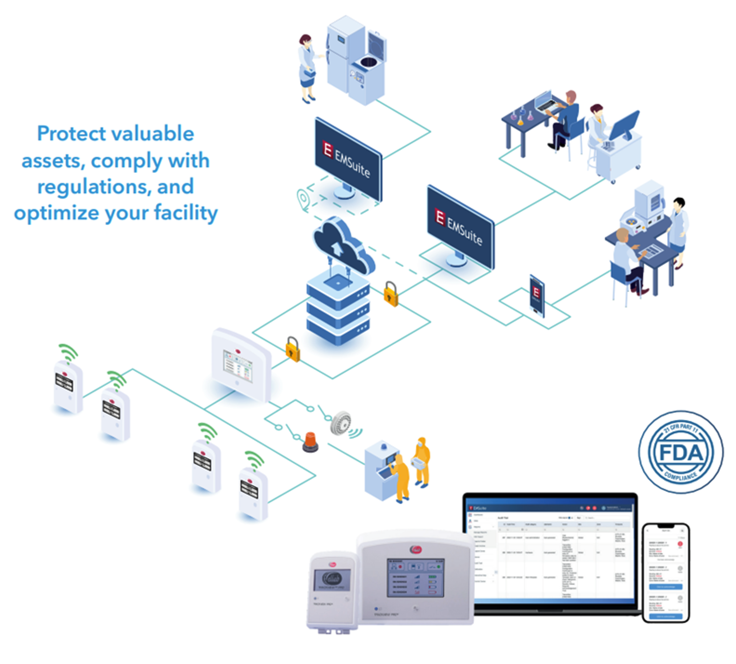
Full System Overview
Protect valuable assets, comply with regulations, and optimize your facility.

Slide 3
Stay in compliance with regulations and rules
Secure your data integrity Customizable reporting tool System validation and calibration

Slide 4
Stay in compliance with regulations and rules
Automatic data capture and transfer via either PoE or RF. No manual steps.
Secure your data integrity
Ensure that your data is always relevant and of high quality to maintain compliance
Continuously capture and log your data through automated systems to avoid data errors and improve your response time to irregular incidents in your environment.
You can be offline for extended periods of time without losing data of missing alarms.
Controlled access to your data and reporting suite.
Ensure that all your relevant environmental data and mitigation actions are captured for complete documentation and compliance.
2-way communication ensure handshake between Transmitter and access point.
Backfill of data: Storage happens on both Transmitter and Access point to ensure data is always available somewhere should the communication fail.
The audit trail shows trends, alarms, and actions taken to handle alarms.

Slide 5
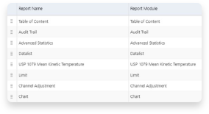
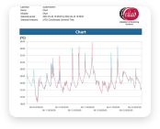
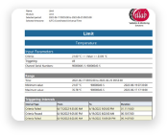
Stay in compliance with regulations and rules
Customizable reporting tool
Get relevant data reports at your desired frequency
Get customized reports pushed to your inbox when you want it – enabling data analysis and trending to optimize your environmental monitoring.
Generate reports that align with your Standard Operating Procedures for quick and appropriate actions.
Set up your reports to provide relevant data for audits that can be quickly and easily be accessed whenever needed.
Configurable reports to align to your existing criteria and SOPs
Easily accessible from the dashboard
Report examples

Slide 6
Stay in compliance with regulations and rules
IQ/OQ reports available in standardized format
System validation and calibration
Ensure the accuracy and performance of your entire system
Complete manufacturer IQ/OQ validation and documentation for your installation and help to integrate the system into your existing infrastructure.
Extending the installation to new areas becomes simple with IQ/OQ validations.
Ensure that all your systems stay accurate with annual or bi-annual calibration as required.
Get onsite calibrations with minimal downtime to ensure that your monitoring system continuously provides you the data you need.
Integrate your existing SOPs in the action cards.
Hot swap sensors by replacing a permanent sensor and do on-site calibrations. Insert a temporary sensor to ensure continuous monitoring and gain full traceability on the serial number.
Our field service team are experts on calibrations and can support you in doing this at your convenience.

Slide 7
Optimize alarms and resources without compromising on quality
Intelligent alarm structures for appropriate response and mitigation
Site and team management

Slide 8
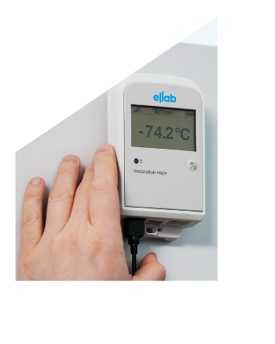
Optimize alarms and resources without compromising on quality
Intelligent alarm structures for appropriate response and mitigation
Ensure optimal use of your team’s time and reduce alarm fatigue
Automate data capture and report generation to save time for value-adding activities, such as data analysis and fault mitigation.
Configure and regularly review your alarms to ensure relevant data limits for an adequate sense of urgency depending on the criticality of the environment.
Only send alarms to people who should respond to it and ensure that they have appropriate instructions on what to do, so they can act immediately. This minimizes apathy and alarm fatigue within the team.

Slide 9
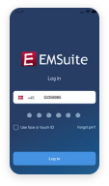
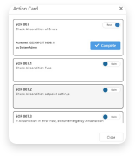


Optimize alarms and resources without compromising on quality
Secure & audit
Trail traceable
Action cards provides specific guidance to the team on what to do
Intelligent alarm structures for appropriate response and mitigation
Control user access to data
Acknowledgement possible without interference with data.
Send alarms only to relevant people

Slide 10
Optimize alarms and resources without compromising on quality
Scalable / multisites: The global system display and reporting allows for a consolidated overview of how your installation is doing.
Site and team management
Scale your environmental monitoring system to suit your growth plans
Manage and grow your environmental monitoring system across multiple sites with local data capture and global system overviews.
Re-organize or optimize your labs and production facilities with easy to re-configure data sensors and transmitters.
Leverage the advantages of cloud-based solutions to enable scalability at minimal marginal efforts.
Easily manage your users and their roles through the Microsoft Azure Active directory.
Cloud solution: Point to 1 of 78 global datacenters in MS Azure to stay in control of your data.
Expandable installation: Systems can be extended easily with as many measuring points as your desire. Grow with us as you need more areas included or you are re-organizing your Lab.

Slide 11
Alarms Resolution & Acknowledgement Flow diagram
Acknowledgement required

Slide 12
Alarms Resolution & Acknowledgement Flow diagram
Acknowledgement required

Slide 13
Mobile phone Application (iPhone & Android)
Viewing and Acknowledging an alarm via Mobile App

Slide 14
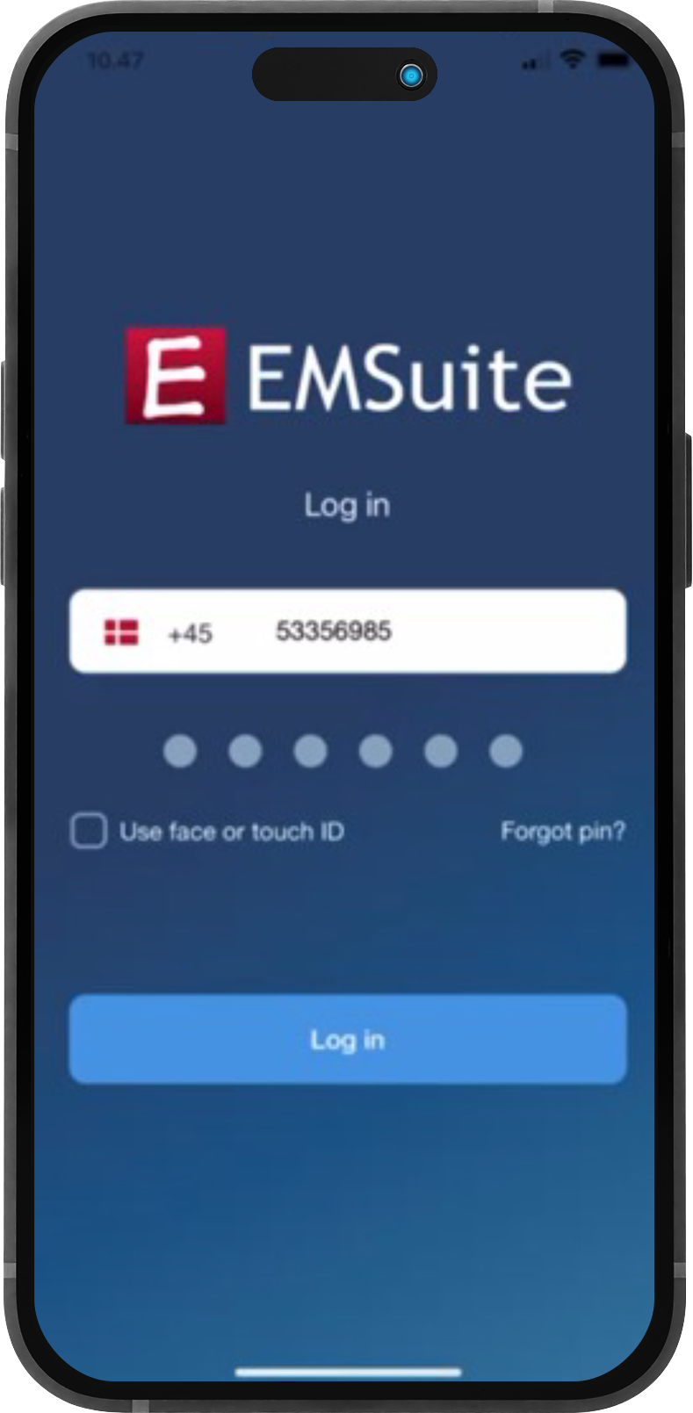
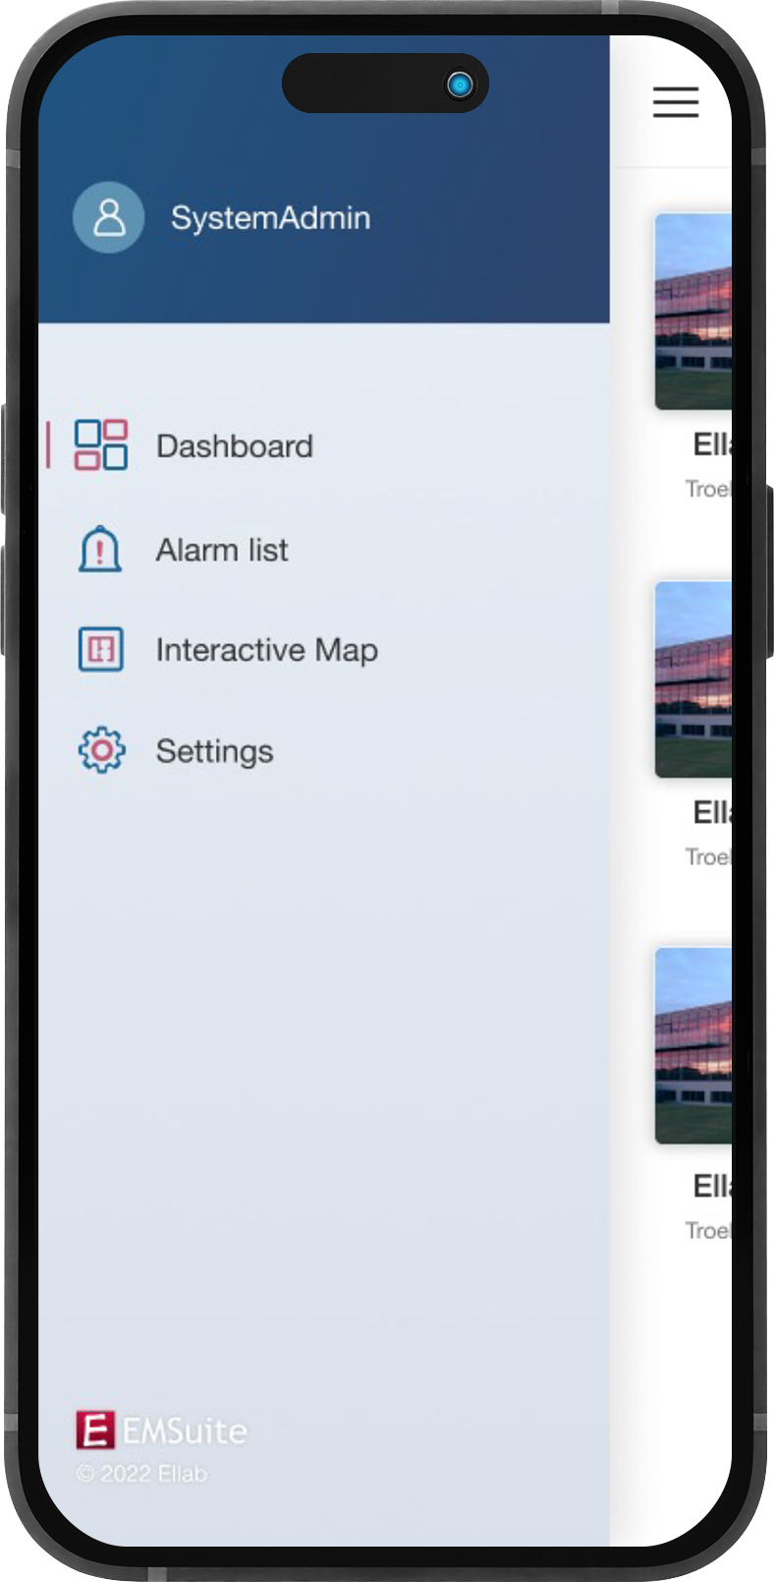
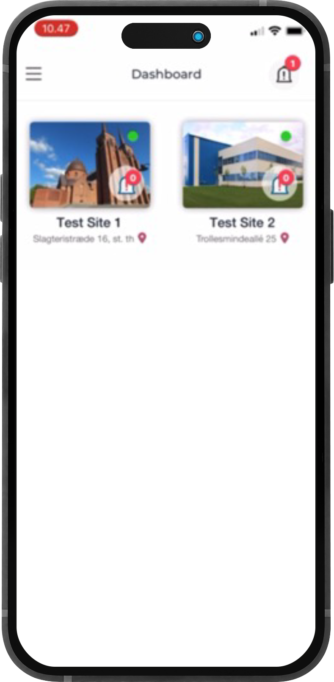
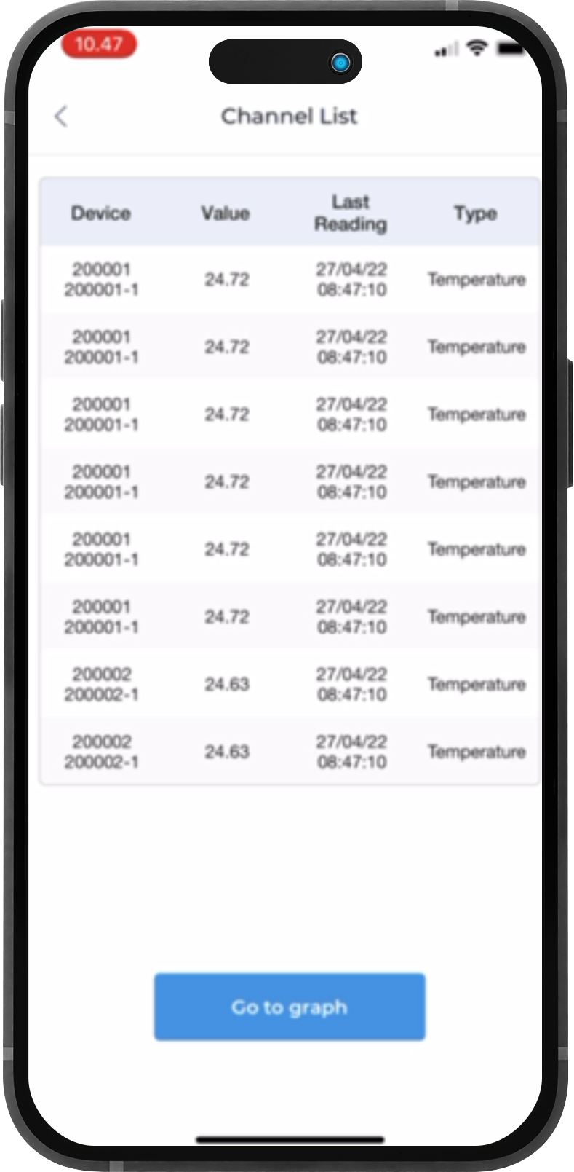
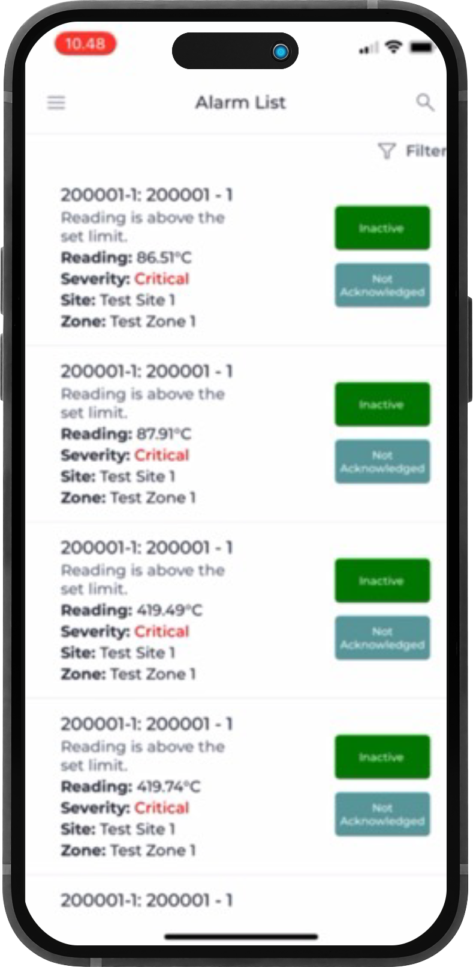
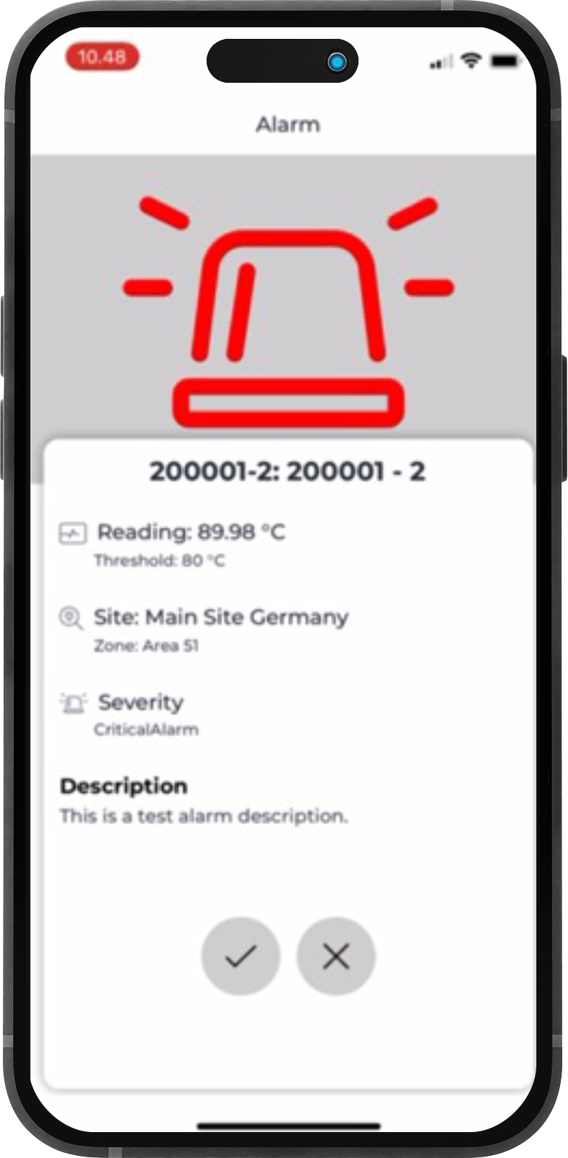
Mobile phone Application (iPhone & Android)
Viewing and Acknowledging an alarm via Mobile App
Secure & Audit
Trail Traceable
Simple & intuitive Interface
Dashboard & Zone list
Channels List
Alarms List
Notifications

Slide 15
Preserve the assets of your organization
Preserve the assets of your team’s efforts

Slide 16
Preserve the assets of your organization
The transmitter sends alarms ensuring they are always received and enables team to take action immediately.
Preserve the assets of your team’s efforts
Ensure timely response to problems and avoid losing valuable assets from your research or production
Use data to understand your operations to allow effective and sensible alarm parameters to be set in line with a “risk-based approach”.
Configure and regularly review alarms data limits for appropriate sense of urgency depending on the criticality of the environment.
Minimize alarm fatigue by only sending alarms to people who should respond to it and ensure they have adequate instructions to act immediately.
Get quick and intelligent help from local support teams, who can show up with short notice to resolve problems.
Alarms are fully configurable to suit the criticality of your environment. Rising, falling limits, elapsed time, escalation.
Mobile app => alarms list => Action card. Send to the designated people.
Full 24/7 support structure with local day to day support and global technical resolution program.

Slide 17
Manage risks in the operation
IT security at the core of the solution

Slide 18

Manage risks in the operation
IT security at the core of the solution
Keep data secure from cyber attacks and misuse either onsite or through cloud-based infrastructure
Run the solution inside your existing IT security zone
Minimize adjustments to your existing IT set-up
Mobile app allows controlled access to system for integration and alarm acknowledgement without risking your data
MS Azure cloud also allows you to
Store data in highly professional and safe regional data centers
Save you time and effort on managing a local IT infrastructure
Manage new/existing users’ access to applications through the active directory
SOC 2 compliant system.
HTTPS protocols for minimal interference with firewall when sending data from MP to EMSuite.
Mobile app offers limited access to system to allow for widespread installation.
Use your MS Azure tenant to stay in own cyber security zone.
On premise application blend into the existing SQL set-up at your site.

Slide 19
SW System overview slide

Slide 20
SW System overview slide

