Slide 1
2026 Monitoring Pricing Updates

Slide 2
High Level Overview – EMS price adjustments
EMS Software Pricing: Raise 7%
Supporting through December 2030
Hardware:
IceSpy:
Transmitters: Raise 4%
Sensors: Raise 4%
Hanwell Pro:
Sensors: Raise 10%
Support Pricing:
General Services: Up to 5%
Calibration: Hold
EMS With Hosting: Raise 7%
Support Plans: Potential future rollout
Goal to move HWPro customers to EMSuite
Goal to integrate IceSpy into EMSuite (Late 2027)
Continue trade-in program: HWPro & IceSpy

Slide 3
EMSuite: Software Purchase
Software: Changes from 2025 to 2026
No more EMSuite Standard or Pro. Now 1 version of EMSuite. Same as ‘Pro’.
EMSuite software now included in Channel pricing
Pricing has been adjusted to be more competitive.
More options for Channel pricing levels.
Changed terminology from On-Premises to Purchase.
Purchase may be on-premises, or on customer MS Azure.
Consolidated EMSuite versions. “EMSuite” will be the same as “Pro”
Eliminated EMSuite Standard & Pro part numbers. EMSuite “Pro” now included in Channel Part numbers.
EMSuite Standard
EMSuite Purchase: Standard/Pro
EMSuite
EMSuite with up to XX channels
EMSuite Pro
Max Quantity of Channels
If a customer needs to upgrade the size of their system. Provide credit for original purchase, sell larger size.

Slide 4
EMSuite: Mandatory Support
Mandatory Support: Renamed (for both Purchase & SaaS)
Pricing has been adjusted to be more competitive.
SMSAS
Is now…
Essential
(non-validated)
SMSAP
Is now…
Compliant
(Validated)
Essential: For non-validated environments
Software updates. Up to 4 available per year
Support during local hours
Mobile APP
Compliant: For validated environments
Essential Plus…
Software IQ during updates
GAMP 5 Category 4 documentation package with Software & Hardware IQ/OQ documents

Slide 5
EMSuite: Optional Items
Ellab Connect (Previously Ellab Communication Hub)
Previously: Individual part numbers lining up with channel quantity levels
Now: Reduced to 1 part number for purchase
Many Part Numbers, no license control
One Part Number, Need to control availability.
New: Migration of EMSuite
Moving existing software installations to new platforms. This fee covers the move of the software with IQ execution.

Slide 6
Example: Software Purchase
Quotation Configuration: New System
Mandatory
Optional
Software & System Size
Mandatory Support Plan Options
Software Installation*
Other Items
Remote Software Installation
Premium Support For XX Channels
Essential Support For XX Channels
EMSuite Software Purchase: Up to XX Channels
Remote Software Installation W/ IQ
SQL Lite
Ellab Connect (one size)
Compliant Support For XX Channels
Remote Software Installation W/IQ
Full SQL
Remote migration
*Some local regions install the software, some customers install their software, some distributors install the software.

Slide 7
TrackView Pro Hardware: Purchase
Pricing
Held 2025 pricing
All changes to Purchase are carried through Lease and Rental
New Ellab Hardware
Ellab 2mm Temp Sensors: 15m, 25m
Ellab 4mm Temp Sensors: 10m
Ellab TVP Pro T/RH. To be released end of January.
Specific Ellab USB required
Cables are optional: 2m, 3m & 5m
Ellab Dual Digital Input. With and without Light door sensor
Ellab Medium Door Sensor
Ellab TVP DP V2. To be released end of April.

Slide 8
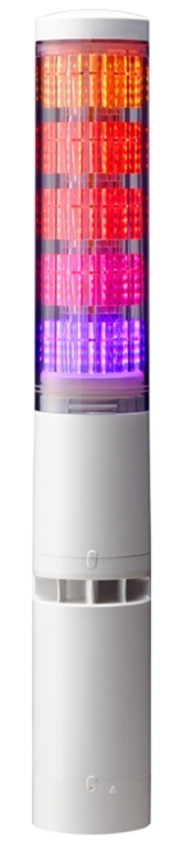
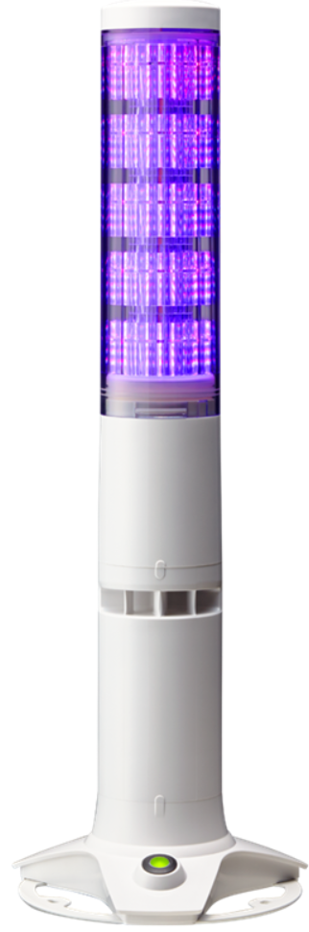
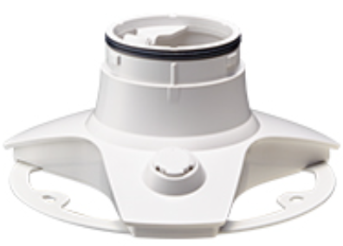
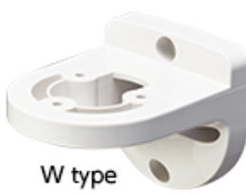
TrackView Pro Hardware: Changes
3rd Party Equipment
Patlite Light Towers: TBD
Airflow Sensors: Now include the appropriate Ellab USB Sensor (0-10V)
Accessories added to pricelist:
1.5V Energizer batteries (4-pack)
AC/DC Power supply (12VDC)

Slide 9
EMSuite: SaaS
Either on: Ellab MS Azure or Customer MS Azure
Minimum of 3 years, then going to year to year.
Make sure to get those agreements signed!
Annual fee charged…annually.
Difference from 2025 to 2026
Ellab Connect has 1 part number for annual fee
Pricing adjusted to be more competitive
Reflection of adjustments on purchase side:
Software is no longer have separate fee, and now included in Channel pricing
Channel pricing has been adjusted to be more competitive
Changes to mandatory support
Pricing has been adjusted to be more competitive
A more favorable SaaS calculation.
Pricing now spread over a 36-month period (previously 25-months), plus finance fee

Slide 10


Ellab MS Azure Cloud Hosting (1/2)
Warning !!! Current retail pricing is below cost, and then we provide a 35% discount on top of that pricing!!!
Unique Selling Point:
Ellab offers a completely isolated environment in the best cloud environment available.
***Most competitors will not openly say this, but they are providing lower caliber hosted environments.
***Many competitors are likely using co-mingled instances, meaning multiple installations on the same environment.
***Some competitors may even be sharing databases without the customer knowing it.

Slide 11
Current Ellab MS Azure Retail Vs. Cost
Channels | Current Retail in DKK | Current Cost
10 | DKK 14.745 | 23,400 kr.
25 | DKK 20.697 | 26,700 kr.
50 | DKK 26.650 | 30,000 kr.
75 | DKK 32.602 | 48,000 kr.
100 | DKK 38.555 | 51,000 kr.
150 | DKK 46.115 | 54,000 kr.
200 | DKK 53.682 | 57,000 kr.
250 | DKK 61.250 | 60,000 kr.
300 | DKK 68.809 | 96,000 kr.
400 | DKK 76.377 | 99,000 kr.
500 | DKK 83.913 | 102,000 kr.

Slide 12
Ellab MS Azure Cloud Hosting (2/2)
2026:
Pricing is being adjusted to our cost
Discount is being removed
Reducing price categories
We have pricing for up to 500 Channels.
For larger systems, the pricing will need to be created by Brand Management.
Reinforce that the customer has options:
They purchase the software
They can have Ellab provide SaaS on their own MS Azure environment
They will find out that what we are charging will be about the same as what they will need to pay.

Slide 13
EMSuite Cloud Test Environments
Overview
EMSuite software with our MS Azure cloud environment. We are not charging for EMSuite on these.
Sizes: 2 options
10 channel option
25 channel option
Startup: 2 options
Small fee for non-validated environments
Standard part number and fee for those requiring an IQ.
Terms
Currently, month to month.
We are considering having option for month to month for Prospects, and annual for Customers. Stay tuned.
Prospects:
When selling a system, having an isolated cloud instance could help in the sales process.
Ellab DK is offering these at cost and not charging for the software to help in these opportunities.
It is up to you to either absorb the cost or pass it along to your customer.
Often, standard startup is all that is required as a prospect will not need a software IQ.
Customers:
When a customer has a SaaS with Ellab MS Azure cloud hosting they may want other environments for testing & validation.
Ellab DK is offering these at cost and not charging for the software to support these customers.
These customers may or may not require an IQ. Please order accordingly.

Slide 14
Example: SaaS, W/Ellab MS Azure
Quotation Configuration: New System
Mandatory
Optional
Software & System Size
Add on: Ellab MS Azure
Other Items
New: EMSuite Cloud Test Environment
1 Yr SaaS For XX Channels:
Essential Support
1 Yr Ellab MS Azure For XX Channels
Premium Support For XX Channels
1 Yr SaaS For XX Channels:
Compliant Support
Ellab Connect (one size)

Slide 15
Example: SaaS, W/Customer MS Azure
Quotation Configuration: New System
Mandatory
Optional
Software & System Size
Software Installation
Other Items
New: EMSuite Cloud Test Environment
1 Yr SaaS For XX Channels:
Essential Support
Remote Software Installation non-validated
Premium Support For XX Channels
1 Yr SaaS For XX Channels:
Compliant Support
Remote Software Installation W/ IQ
1yr: Ellab Connect (one size)

Slide 16
TrackView Pro Hardware: Lease
Foundational Concept:
Purchase HW from Ellab DK
Lease through dedicated item codes to customer
Annual fee charged… on an annual basis
***Not all hardware is available for lease. Some small items are purchase only for simplification.

Slide 17
EMSuite: Rental
Offered from DACH or US. Not available for all regions.
Place orders directly with the appropriate region.
Monthly fee charged… on a monthly basis
Option: EMSuite Cloud Hosted
Ellab DK handles this like a SaaS w/ Ellab MS Azure
Software installation through Ellab DK.
Size options from 10 to 500 channels
Option: EMSuite on a laptop
Size option: 100 channels.
Software installation through either DACH or US.
Some 1-time charges required
Charged with 1st billing
Startup
Remote review of software pre-requisites.
24/7 support is an available option.

Slide 18
Rental TVP Hardware
Offered from DACH and US, not available for all regions.
Place orders directly with the appropriate region.
Monthly fee charged… on a monthly basis
Not all hardware is available for rental. (accessories is not part of rental)
Hot Spots (sourced locally or from rental hub region)
Since most rentals will be going to cloud software, having hot-spots will be important to hook the Access Points up to and use DCHP for IP addresses.

Slide 19
Example: Rental
Quotation Configuration: New System
Mandatory
Optional
Startup Costs
System Size & Type
Other Items
EMSuite Cloud for XX Channels:
Compliant Support
Premium Support For XX Channels
Startup of Software, IQ, Shutdown
EMSuite on Laptop for up to 100 Channels:
Compliant Support

