Slide 1

SteriSense®

Slide 2
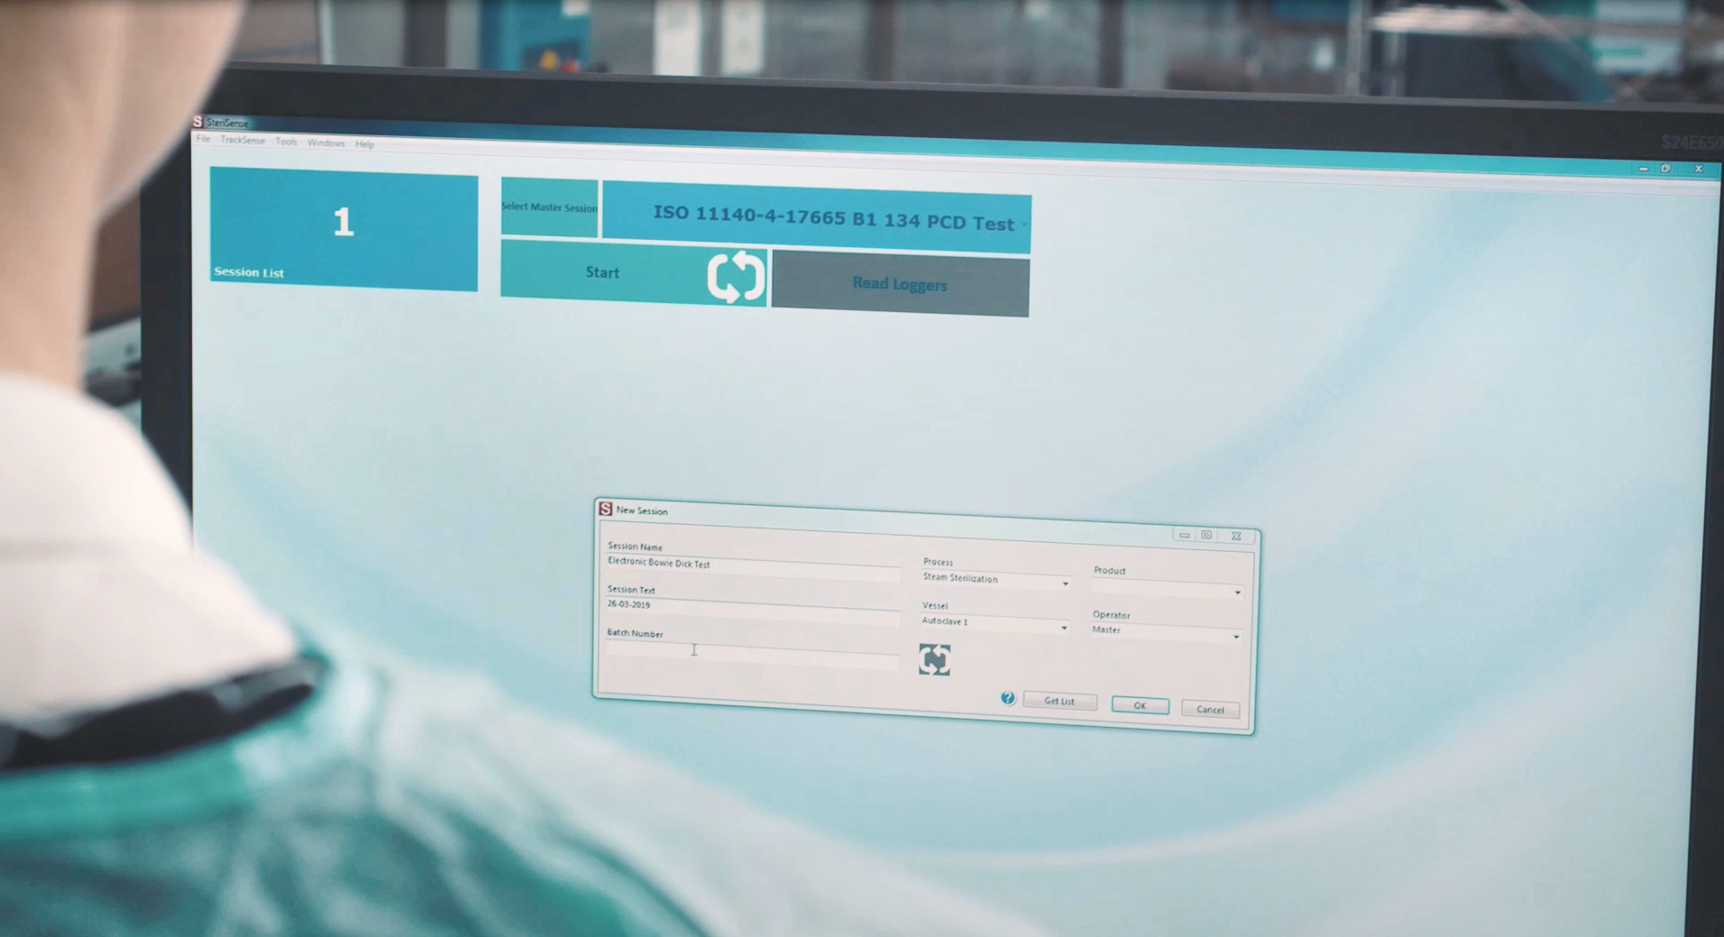

Introducing the Bowie Dick Sensor

Slide 3
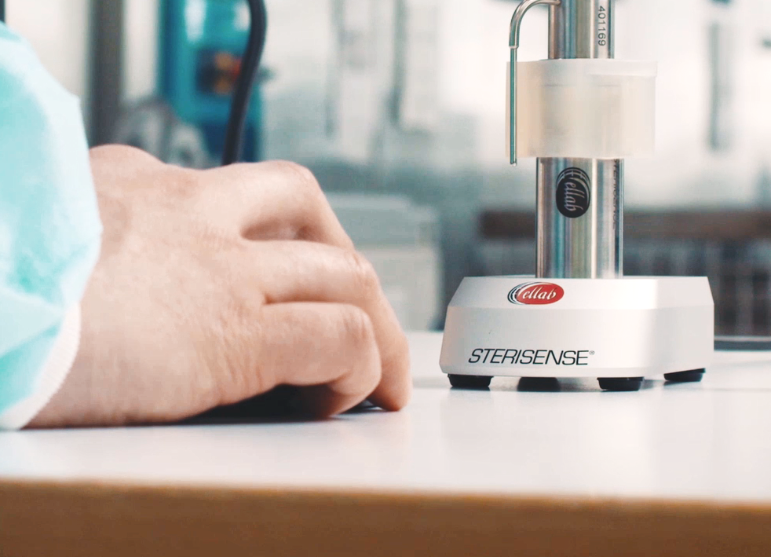

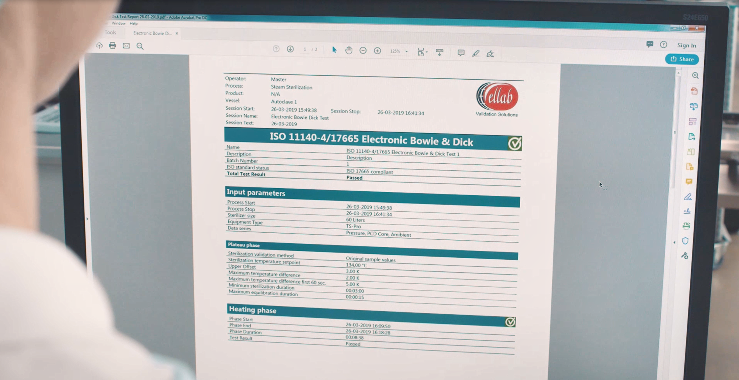
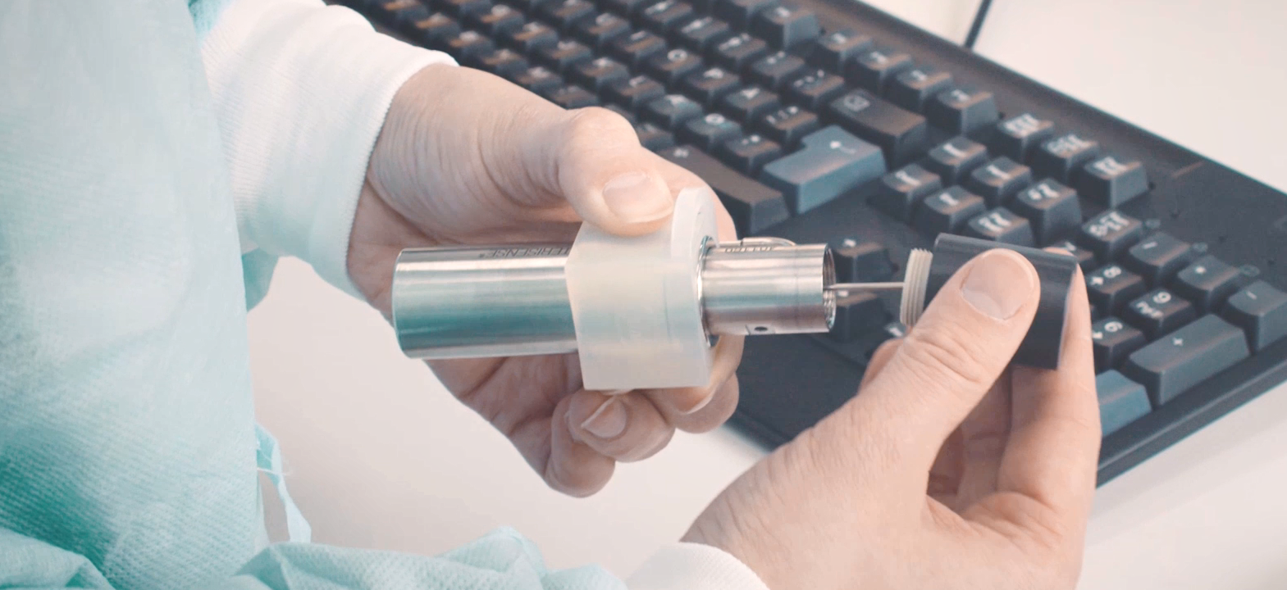

Key Advantages of SteriSense®
The Ultimate Electronic Bowie Dick Test
Accurate Electronic Bowie Dick Test
Reliable and cost efficient
Very compact size
User-friendly and intuitive software
Eliminates guesswork
and provides and objective result
Replaceable PCD to run several cycles in a sequence
Verification of critical sterilization parameters beyond traditional methods
Up to 1,000 test cycles between each calibration

Slide 4
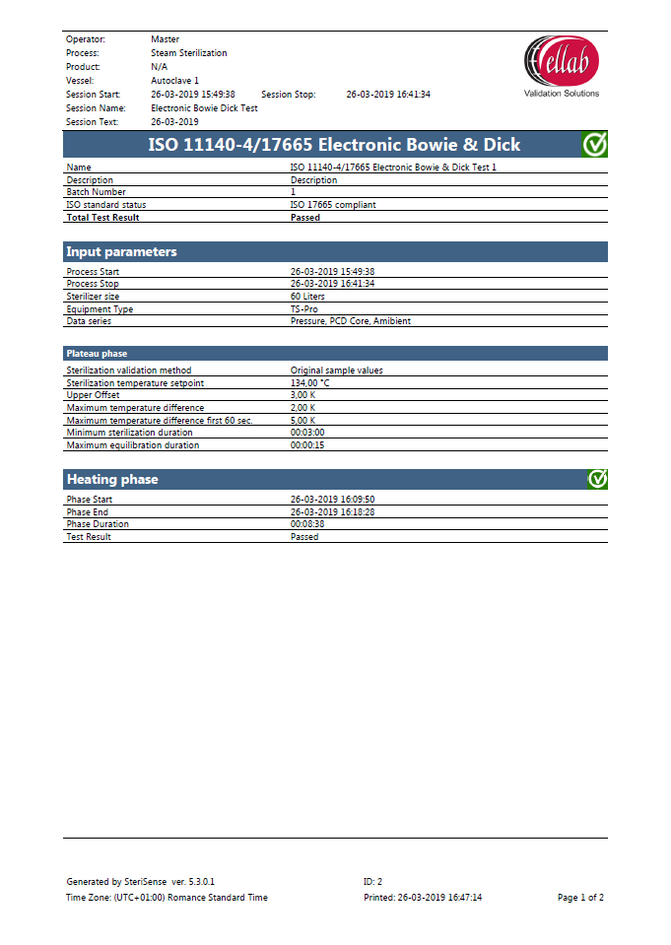
Why use SteriSense®
Instead of Traditional Indicators?
SteriSense provides a much more in-depth verification of critical sterilization parameters, eliminating any guess work.
The Software also automatically generates and stores printable reports, ensuring electronic documentation of the process.
In summary, by using SteriSense you gain the following advantages compared to chemical or biological indicators:
  Economically efficient with high test volumes.
  Improved safety - objective results that eliminate the risk of false or grey zone readings.
  Additional critical information - checks performed according to ISO 17665.
  Easy to store, retrieve and compare the data from a database - convenient and safe method that eliminates the need for guessing.
  Time stamps included to increase reliability.

Slide 5
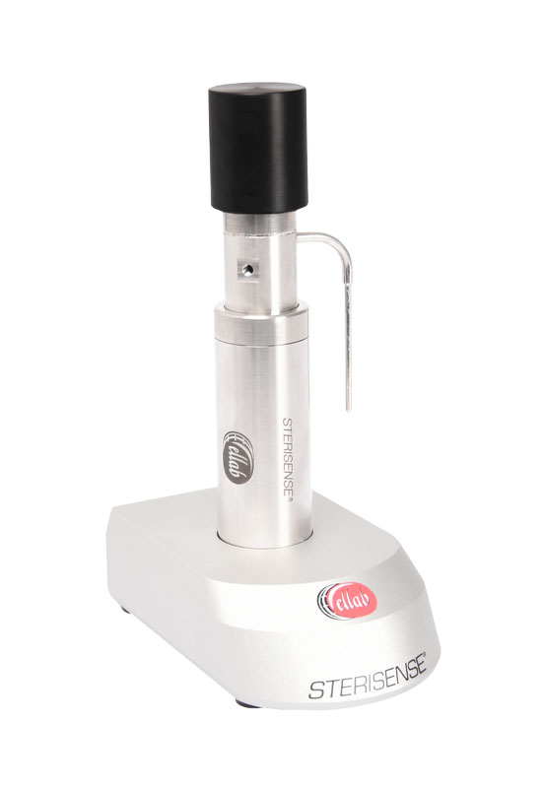
Why use SteriSense®
Instead of Other Electronic
Bowie Dick Test Devices?
SteriSense is by far the most compact Electronic Bowie Dick Test on the market.
The Process Challenge Device (PCD) has the unique feature of being replaceable, which allows the user to run several test cycles in a sequence with very limited need for cooling.
This reduces the amount of time and investments spent on unnecessary backup devices.
The replaceable PCD feature is patent pending.
In summary, by using the BD sensor you gain the following advantages compared other electronic Bowie Dick Tests:
  Ultra-compact size
  Highly user-friendly software
  Advanced sterilization analysis
  Environmentally friendly process
  Up to 1,000 test cycles between each calibration

Slide 6
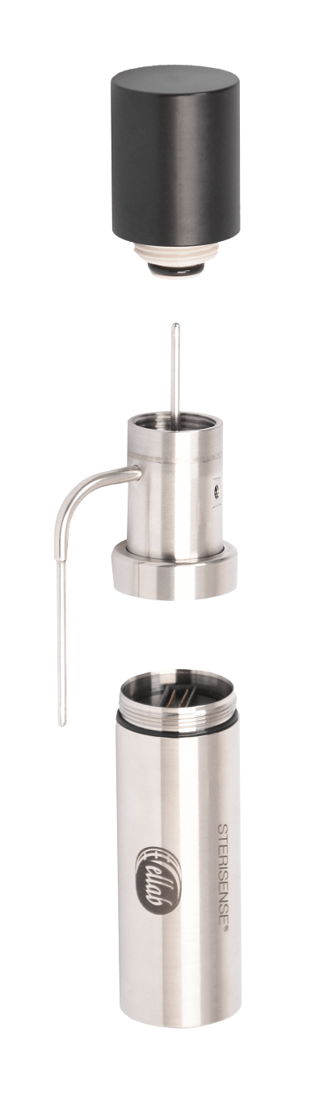
How does the Bowie
Dick Sensor work?
Process Challenge Device (PCD)
The PCD has been specially designed to reflect the reference method originally developed by Dr. J. Bowie and J. Dick in the 1960’s
The function of the PCD is to “challenge” the steam penetration of a steam sterilizer in accordance with ISO 11140-4,134˚C & 121°C
Triple Sensor
(2 x TMP & 1 x PRS)
The two temperature sensors measures the temperature inside the PCD and the ambient temperature in the sterilization chamber, of which the values have to follow each other
The pressure sensor measures the ambient pressure value within the chamber, which is used for detecting vacuum pulses, calculating the theoretical ambient temperature and detecting super heated steam
Data logger
with large battery capacity
It is also possible to check for the presence of non-condensable gases (NCG) by analysing the steam’s capability to heat the steel core inside the PCD
The checks performed in the Master Session is referring to ISO 17665

Slide 7
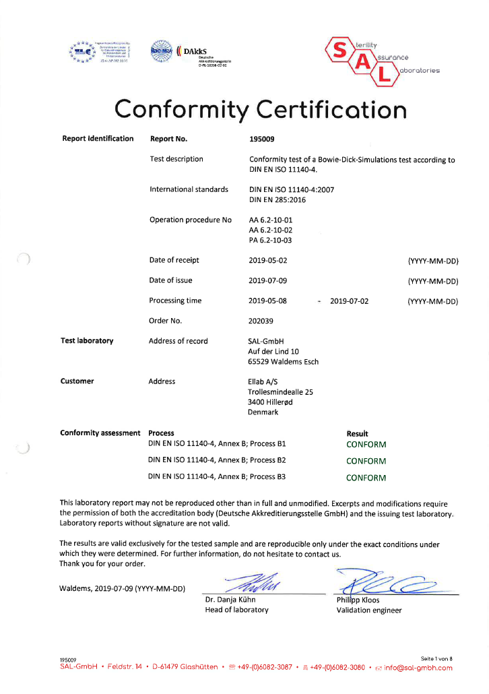
Why use SteriSense®
Instead of Other Electronic
Bowie Dick Test Devices?
Ellab’s Electronic Bowie Dick Test has been conformity certified by SAL GmbH against the provisions of ISO 11140-4 Annex B, Process B1, B2 and B3 for 121°C
and 134°C.
SAL GmbH is a test laboratory accredited by the German accreditation body DAkkS
The test procedures involves the official reference method for Bowie Dick testing (defined in EN 285 and ISO 11140-​4), ​which is the standard cotton test package and involves temperature measurements with thermocouples
To be approved as Bowie Dick test method, it must comply to a test program, which is based on temperature/pressure profiles defined in one of the test cycles B1, B2 or B3
Not only the device has to present a Pass when the Bowie Dick reference test passes, but more importantly it must show a Fail result when this reference method fails

Slide 8
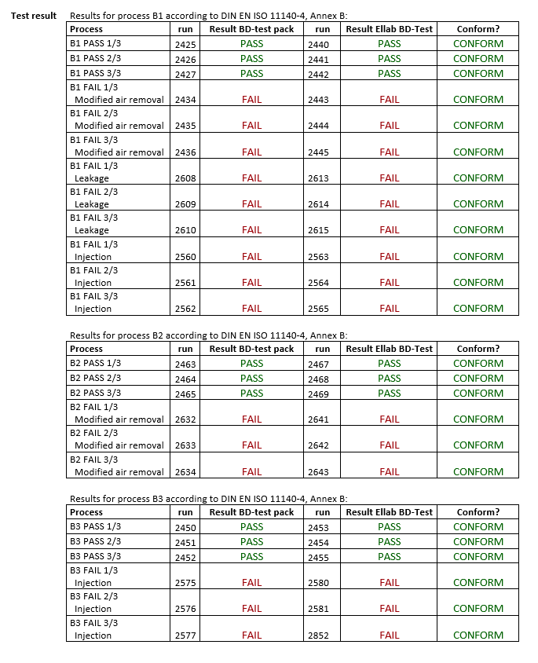
Conformity Test Results

Slide 9


Product Benchmark
​ | SteriSense®​ | Ebro EBI 16​ | 3M ETS​
Price per test⁽¹⁾​ | € 1.7​ | € 1.4​ | € 4.0​
Size​ | 125 mm x 25 mm​ | 150 mm x 90 mm ​ | > 250 mm x 150 mm​
Software package level​ | High​ | Medium​ | Low​
Result presented on device​ | No​ | No​ | Yes​
Replaceable PCD​ | Yes​ | No​ | No​
Cooling needed between test cycles​ | No cooling if PCD is replaced ​ | Yes​ | Yes​
Maximum number of test cycles between calibration / per unit​ | 1,000​ | 1,000​ | 400​
Detecting of Non-condensable Gases (NCG)​ | Indirectly via condensation on steel core in PCD​ | Indirectly via condensation on small glass balls in PCD​ | Indirectly via condensation on two aluminum cores in PCD​
Additional tests / checks​ | Dilution factor​ Superheated Steam Determination​ Batch control ​ Vacuum leak test​ Validation study​ | Superheated Steam Determination​ Vacuum leak check​ Validation study​ | Dilution factor​ Superheated Steam Determination​
Calibration lead time​ | No lead time with a Subscription Plan​ | >2 Weeks​ | No re-calibration, as new unit must be ordered​
Notes​
Assumptions: 3 autoclaves using 1 logger,1000 test cycles per year in 5 year period​

