Slide 1
Continuous Monitoring - IceSpy

Slide 2



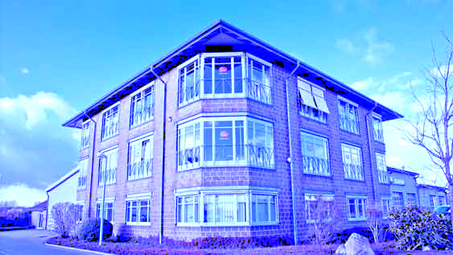


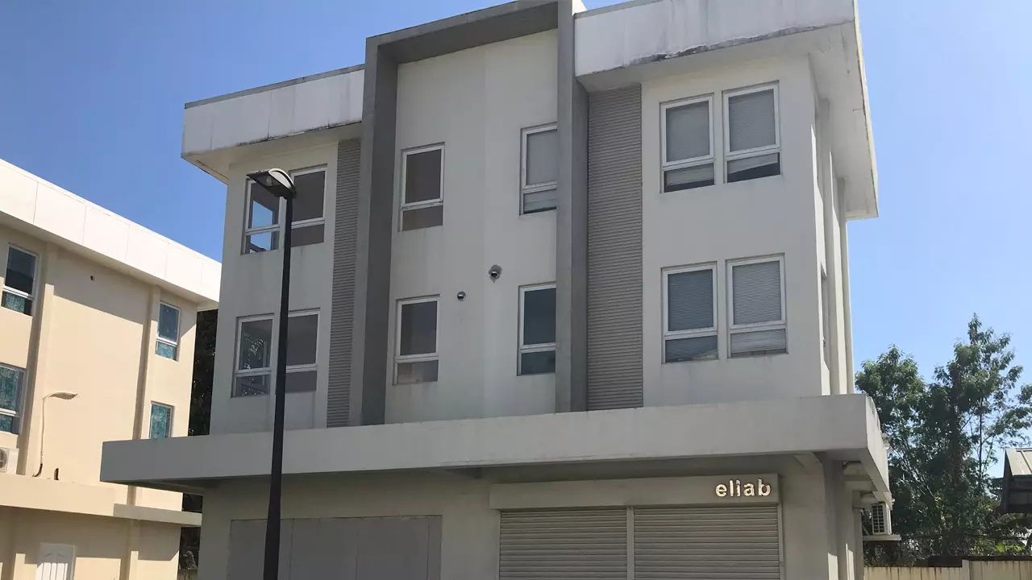




Company overview
Global Expertise with local reach
Established in Denmark in 1949
  ~800+ employees and growing
US Headquarters – Denver, CO
  Multiple offices around US
  Validation Equipment
  Calibration, Qualifications, Validations
    150+ engineers located around US
  Continuous monitoring
    40+ years of experience
Ellab
UK & Ireland
Ellab Hanwell UK
Ellab Nordic
Ellab DACH
Ellab
USA
Ellab Philippines
Ellab Benelux
Ellab France
Ellab
Italy
Ellab Dubai
  Ellab performs direct sales in 24 countries and is represented by a dedicated Distribution Network in +50 countries
  Ellab distributors

Slide 3
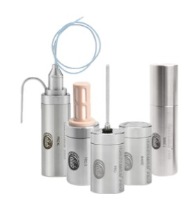


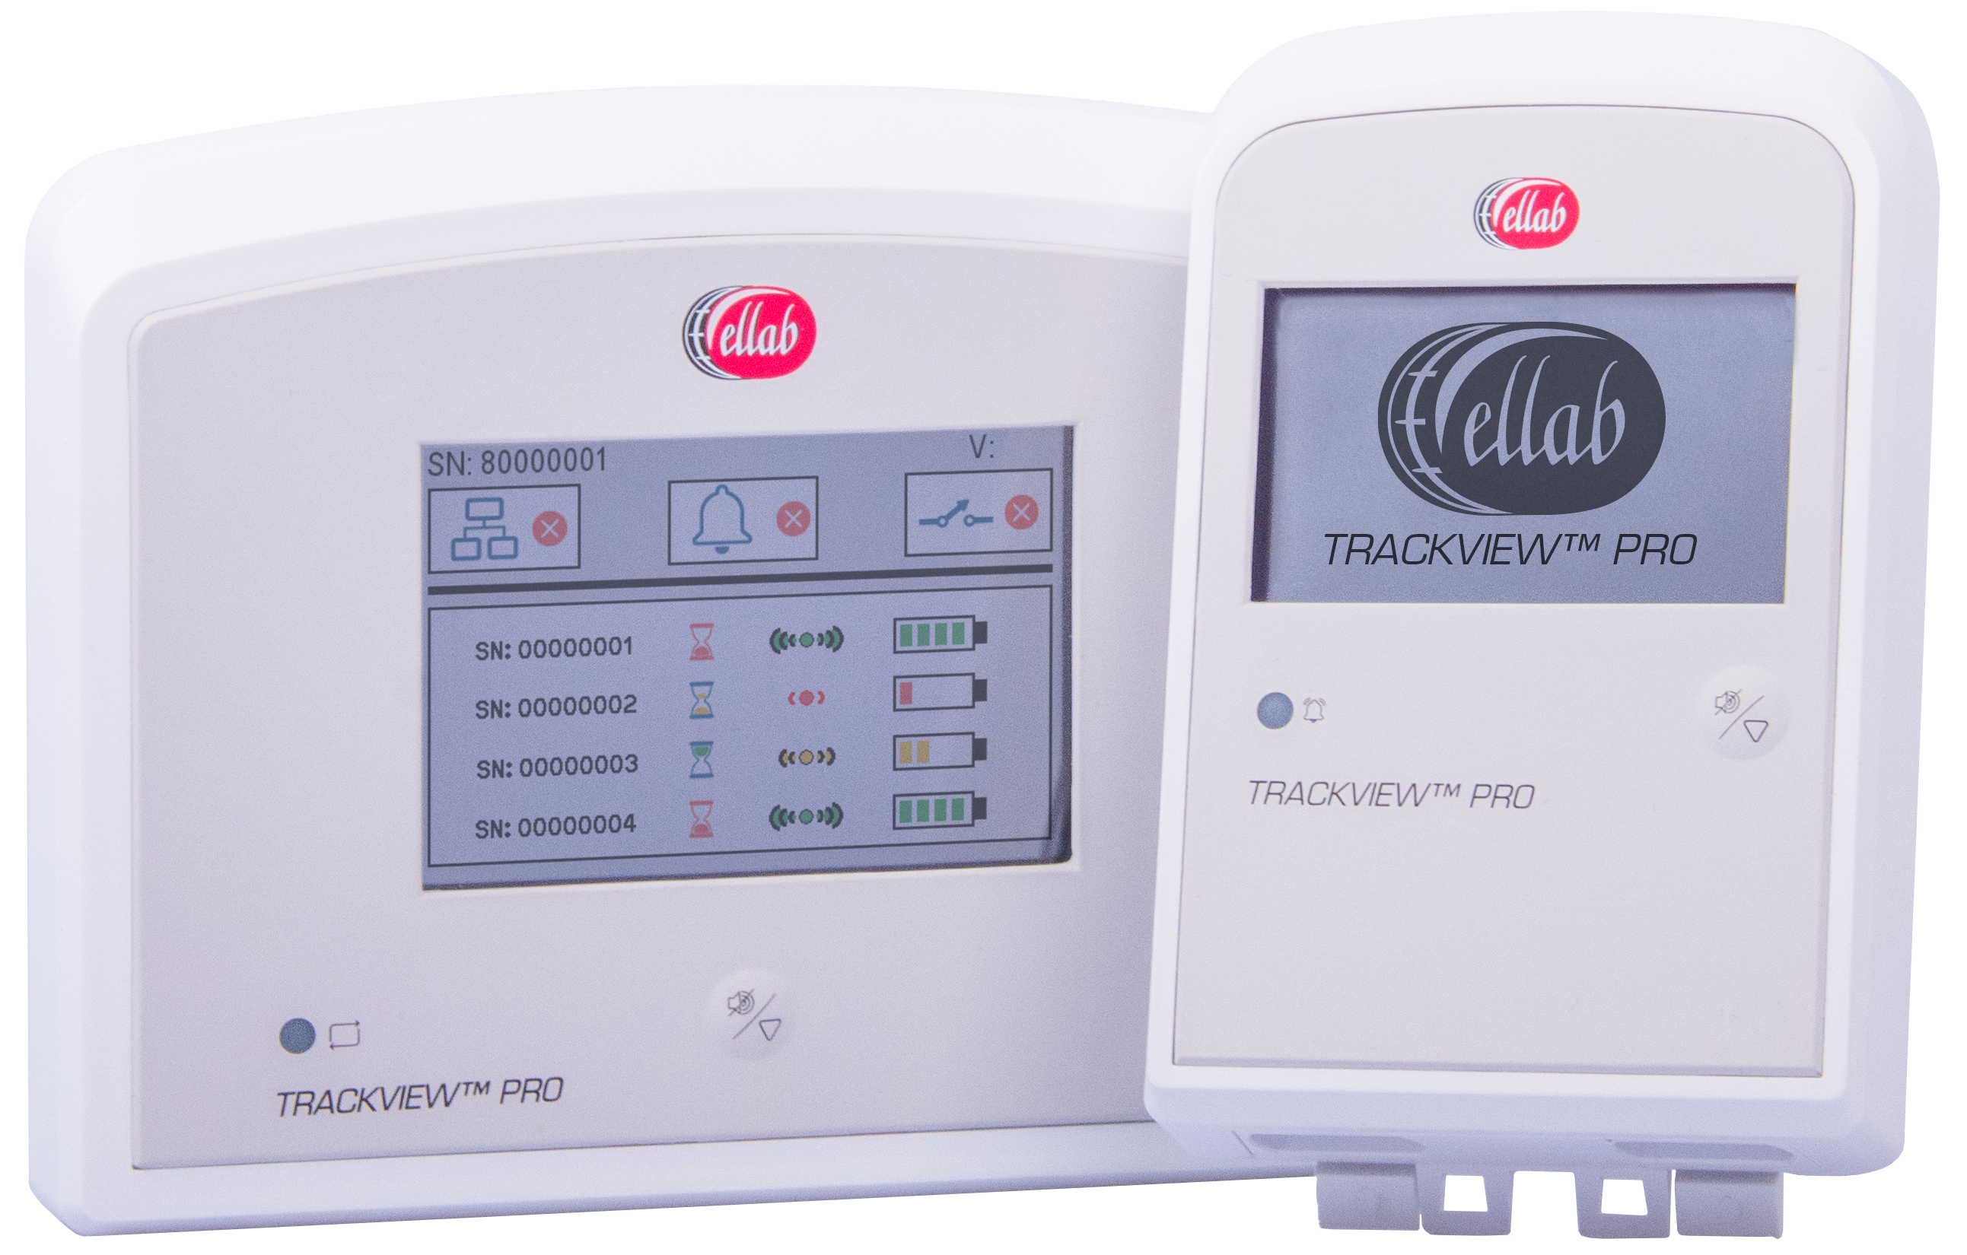
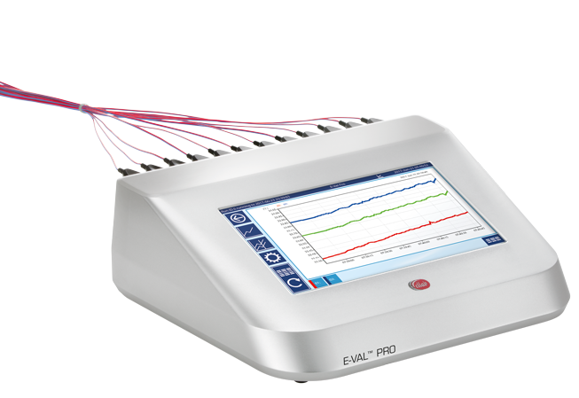
Leading Supplier of Validation & Monitoring Solutions
Equipment
Field Services & Consulting
Solution snapshot
Data loggers
Thermocouple system
Monitoring
Validation & Calibration
Consulting
Solution description
Industry leading accuracy measurements of temperature, pressure, humidity, conductivity, CO₂ and vacuum
Wide range of applications within Life Science and Food Manufacturing
Used to qualify or re-qualify laboratory or manufacturing equipment, as well as validation of product quality
Rental of validation equipment is also available
Constantly monitors a critical process or environment wirelessly
Includes extensive measurement options, such as temperature, humidity, diff. pressure, CO2, flood and leak
Skilled validation engineers conducting thermal validation at customer’s facilities
Long-term staffing assignments
Field calibration of sensors in various equipment
Compliance Consulting (GMP, FDA, IFS etc.)
Pharma Process/ Equipment Engineering
Various other consulting or project management within the V-model
In addition, Ellab has its proprietary software systems for all equipment as well as Field services

Slide 4




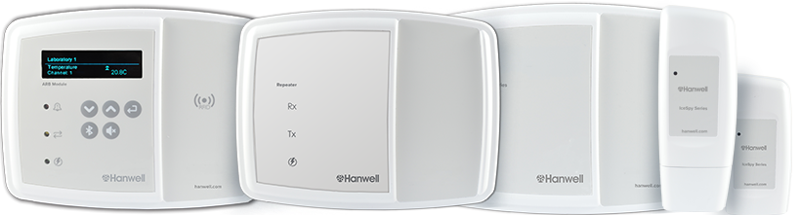
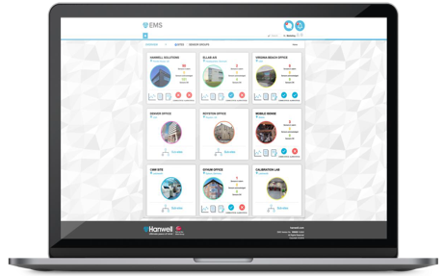
EMS software and IceSpy Hardware
Sensor Probe
Transmitter
Receiver
Server
Software & Database

Slide 5



Overview: System Structure
Core System Components
Wireless Transmitters
Receiver
Software
  Standard and Part 11 options
  Automated Reporting
  Automated E-mail Alarms
Optional:
SMS
Mobile APP
External Alarms – Light beacons, Sound beacons
Text alerts
Email alerts
Mobile app

Slide 6
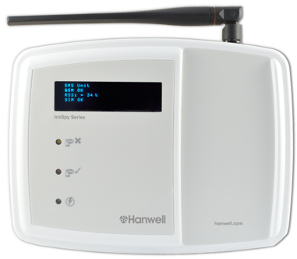
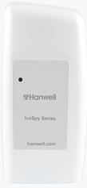
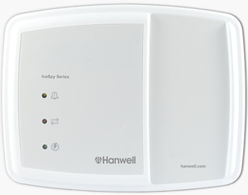





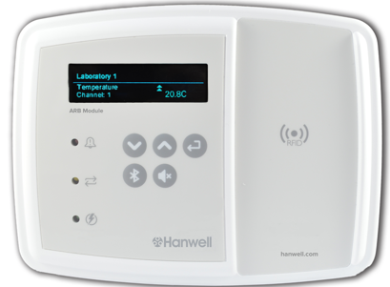


IceSpy Monitoring System Structure Overview
SMS Module
Software Options:
EMS Standard
EMS Validatable
EMS Validated 21 CFR Part 11
Option 1:
Customer Server
IceSpy RF
IceSpy Receiver*
Port 443 HTTPS
On-Site or Remote
User PC interface
Port 10997 TCP
IceSpy Receiver*
Email
IceSpy RF
Option 2:
Cloud Server
ARB Module
Cloud based
Middleware
Mobile App
Beacon/
Sounder
*Receivers store data during network and power outages and backfill when conditions are restored
Notes:
This diagram shows how all the components can connect together into one software platform, and shows all options for data collection.
The system allows all our wireless hardware to be used together.
Users can view data in the following ways:
On a local PC
On any PC with internet access
On a tablet
On a mobile device
Via the alarm App
Alarms by email or text

Slide 7
Network Requirements
Ethernet Connections & AC Power Outlet Required For:
Receivers
ARB Modules
SMS Module
Firewall Port
Port 10997 TCP/IP Send & Receive for Communication between Hardware and Software
Port 80 Send & Receive
  Remote Viewing Capability (On-Premises)
  Data export to Mobile APP (if selected)
Port 443 Send & Receive for access to EMS URL address

Slide 8
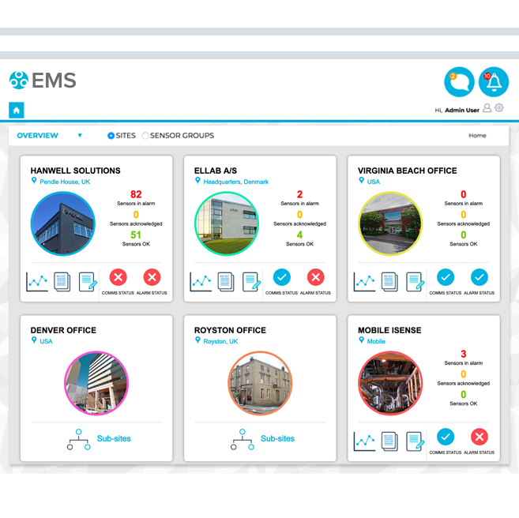
Project Implementation - Typical
Software Installation
  Completed remotely by Ellab technicians
  Software IQ completed at same time as Installation
  Software OQ typically leverages Ellab’s previously executed OQ
Hardware Configuration
  Hardware is configured as required for installation
Hardware Installation
  Receivers are installed, and network connection verified
  Transmitters are installed and connection through to software is verified
Hardware IQ/OQ
  Access Points typically receive 100% IQ and 100% OQ
  Transmitters typically receive 100% IQ and 10% OQ (family Approach)
Training
  After Installation. Often performed remotely.

Slide 9
Key System Considerations
Reliable and accurate wireless monitoring
Unmatched transmit range
Long battery life (up to 2 years from single AA battery), with user changeable batteries
Single software installation for all users & locations
  End users have no direct access to data
  Option for either Ellab Cloud solution or client owned and managed
  Viewed through standard web browsers such as Firefox & Chrome
  Automated Reporting
  Automated Alarming
No required monthly/annual fees*
No required service plan*
User Calibratable hardware*
    IceSpy calibration without adjustment. Adjustments need to be made by Ellab

Slide 10
Software Installation Options
Same software functionality, different level IT effort
On-Premises
Customer purchases and owns the software
Installed on Server, Virtual Server, or Azure (with Microsoft SQL)
Customer is responsible for all costs, maintenance, and support of system
Customer remains in complete control of their data
Can leverage either SQL Express or Customer’s SQL database
Customer must open appropriate firewall ports for the system to communicate
One-time fee for the software
Ellab Cloud
Ellab provides the environment that the software is installed
Ellab is responsible for all costs, maintenance, and support of keeping the software running
Client is still responsible for configuring and managing their software.
Isolated environment just for your installation
Customer must open appropriate firewall ports for the system to communicate
Backups of data can be supplied for customer’s retention requirements
Annual fee applies

Slide 11
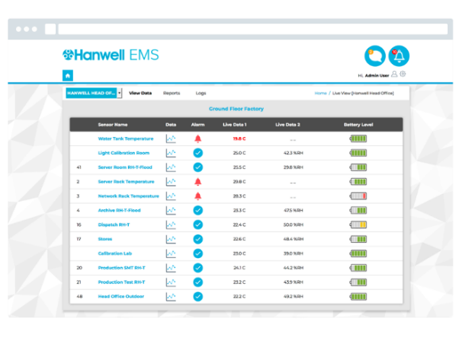
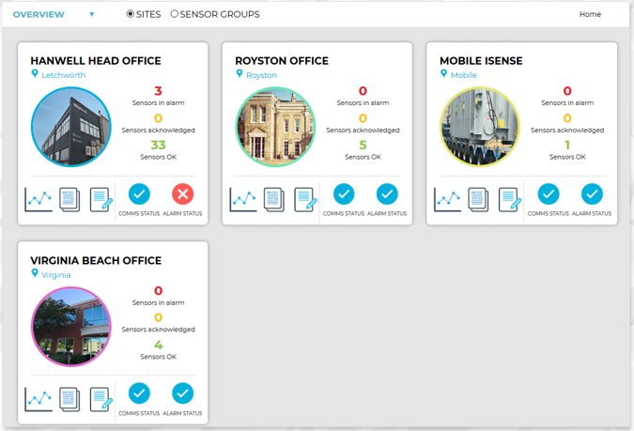
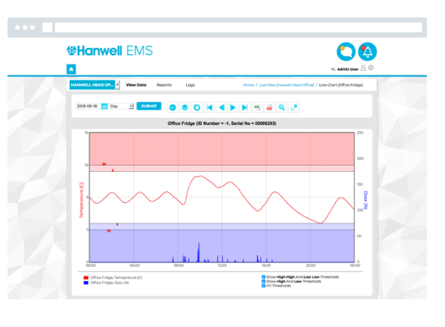
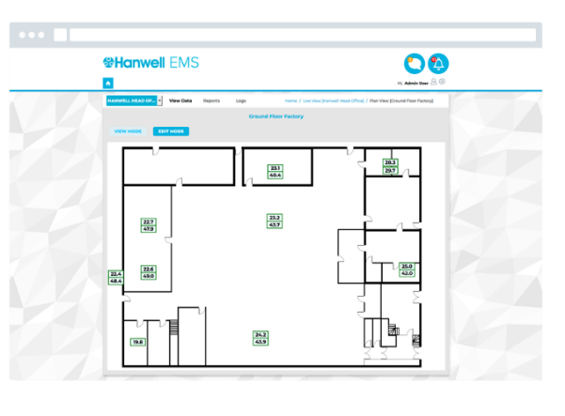
EMS Software – Data Views

Slide 12
System Requirements: On-Premises
Operating System: Windows Server 2008 R2, 2012 R2, 2016, 2019
Processor: 2.5GHz or faster
RAM: 8GB or more
Hard Drive:
Physical Machine: 250GM
Virtual Machine: 70GB
Network: 1 GB Ethernet Network Port

Slide 13
SQL Options: On-Premises
Option 1) SQL Express
Provided as part of the A version of the software
300 sensors transmitting at 90 seconds will take 2.5 years to fill active database
  Archiving the database on an annual basis will free up space in the active data base
    Archived data bases are accessed when signing into the software if the user has that level of access
Option 2) Customer’s SQL
B version of the software needs to be able to access and use the Customer’s SQL database

Slide 14
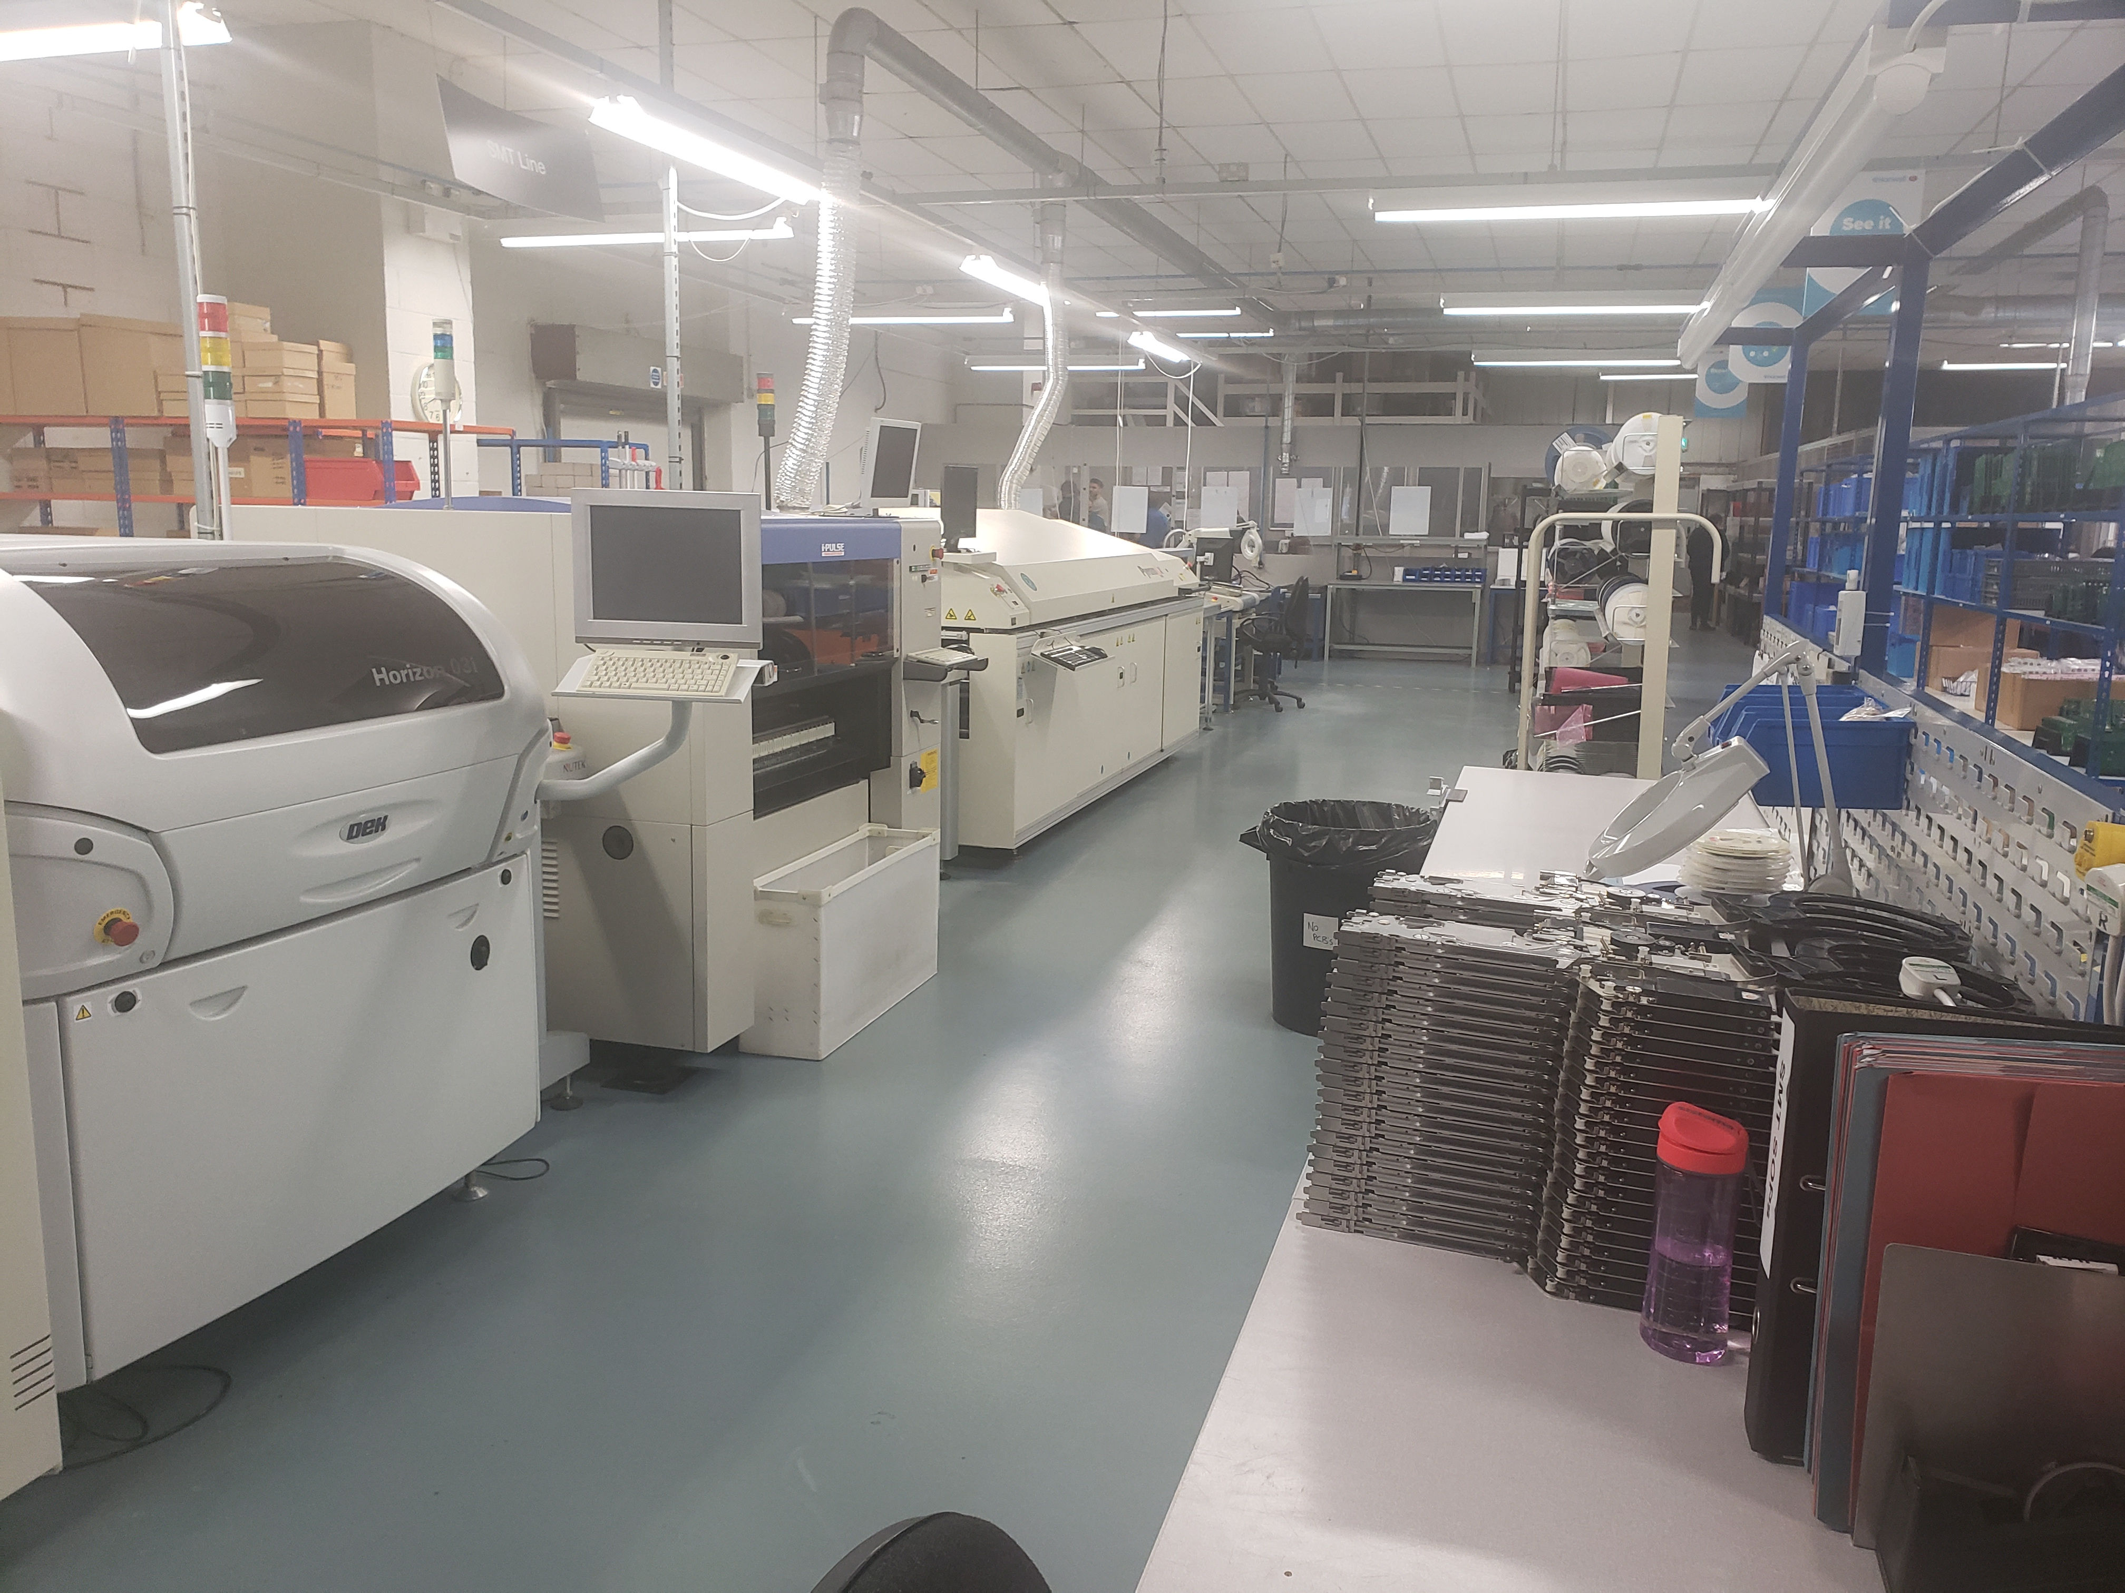
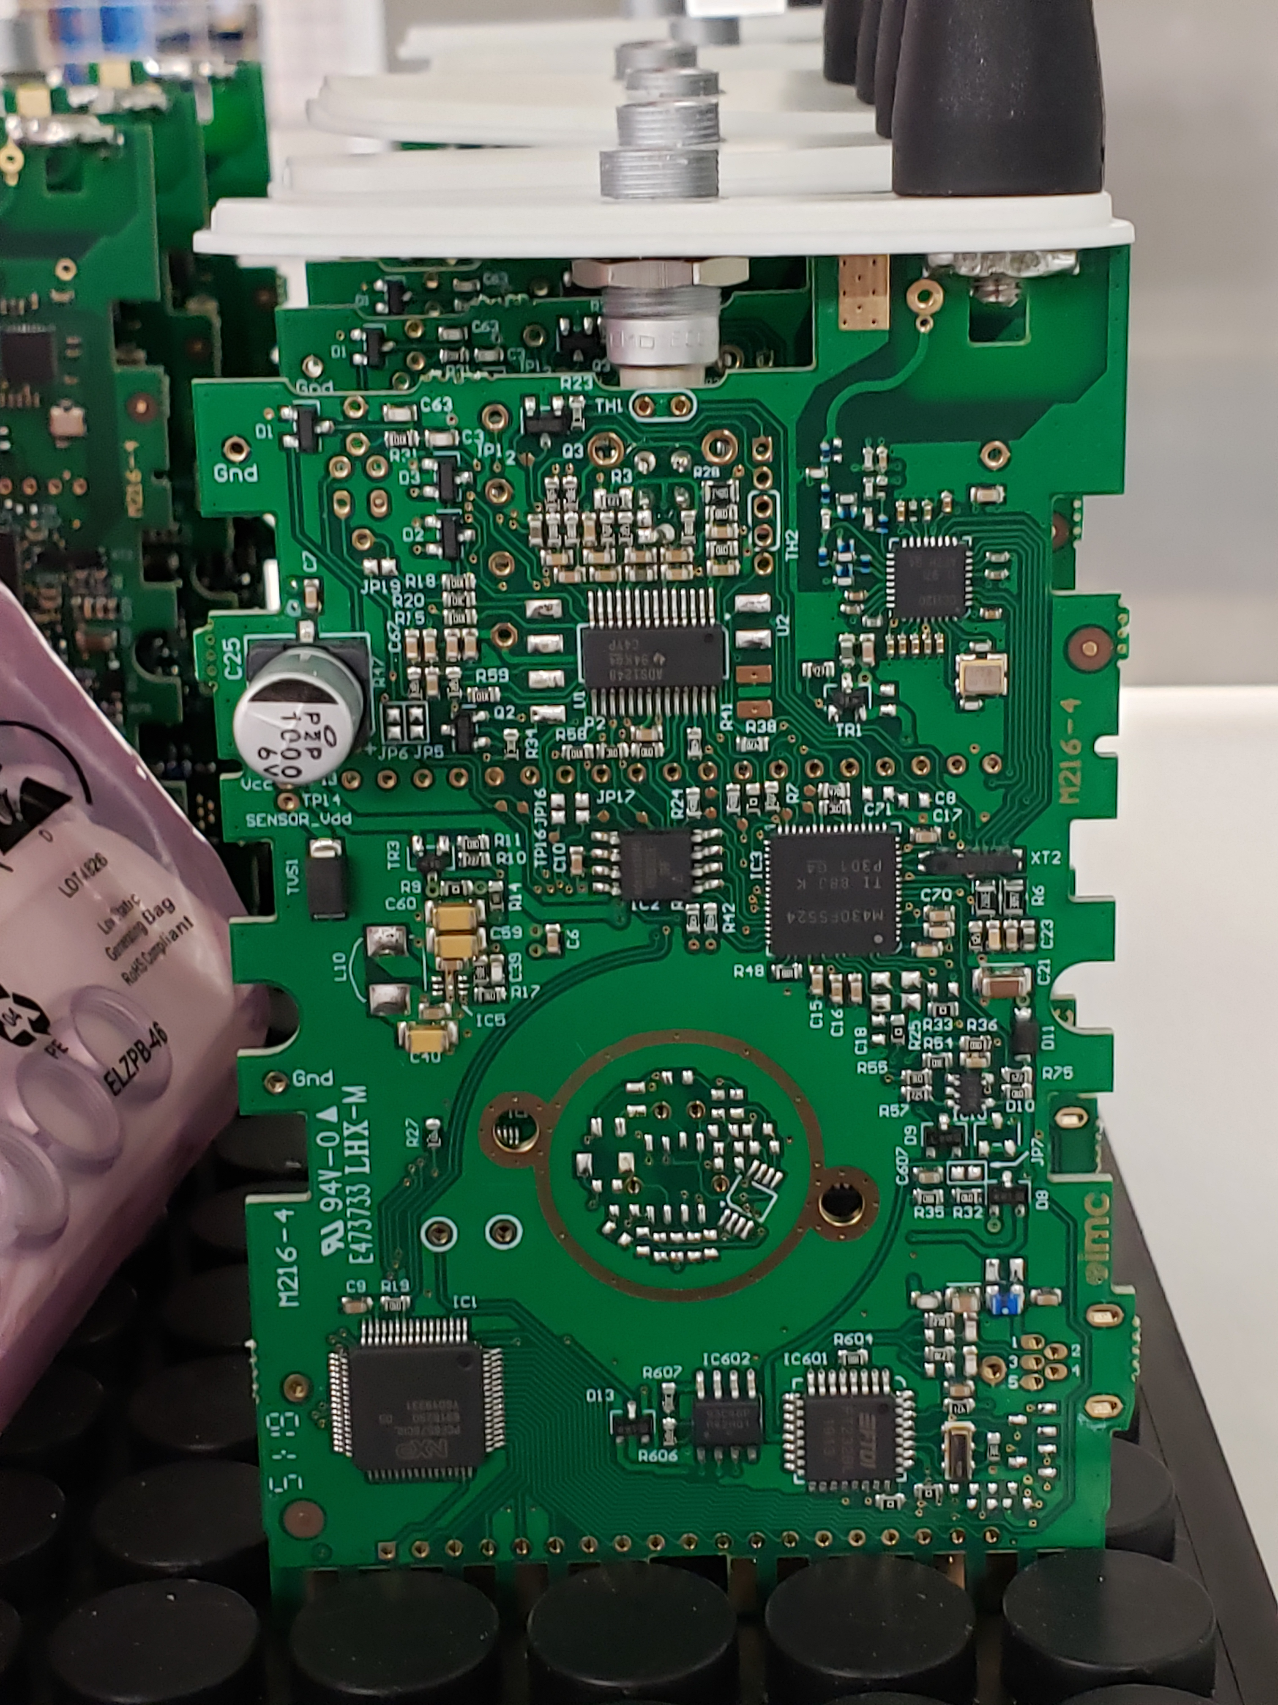
Manufacturing process and components matter

Slide 15





Common Sensor Types
Temperature
Humidity
CO₂
Differential Pressure
Door Switches
Flood & Leak
Light (Lux/UV)
Utility measurements such as energy, water, gas
Many other sensors can be added through analog or voltage input

Slide 16

IceSpy – General Information
Sector leading wireless range (1,000 ft line-of-sight)
Wide range of sensors: Temperature, Humidity, Door, Analog, Voltage
Wide range of temperature: Standard range is -200C to 200C, but optionally can go much higher
Best Accuracy: ±0.5C / ± 3 %RH
Durable and Waterproof sensors
Battery life up to 2 years with 1.5V lithium AA
90 second transmit rate @ 915MHz
Memory backup for redundancy

Slide 17
What are the different RF Types
2.45 GHz – Bluetooth
2.4 GHz – Mesh Networks
2.4 GHz – (802.11 Wi-Fi)
868 to 916 MHz – Mesh Network
868 to 916 MHz – Point to Point
  IceSpy 902 to 916 MHz – 1,000ft range with good wall penetration capabilities. Low Battery Consumption.

Slide 18
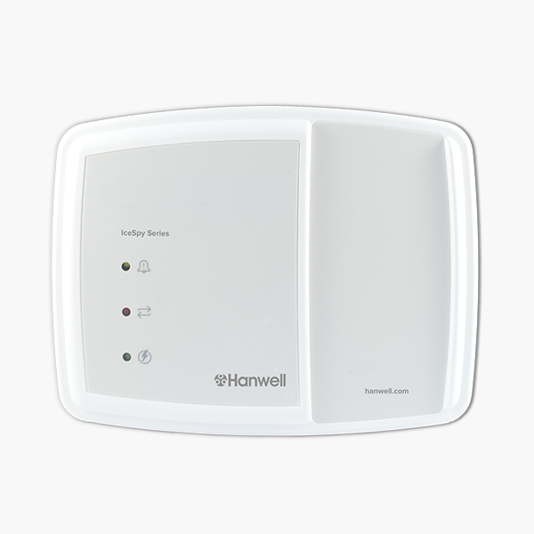
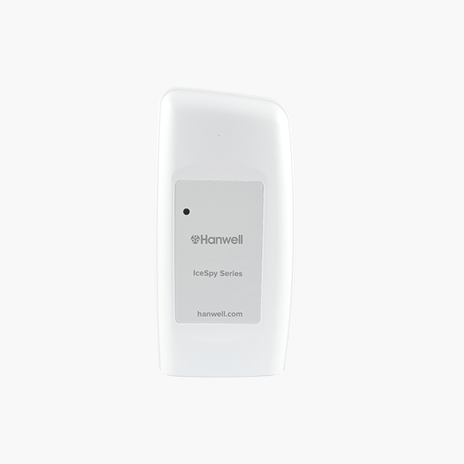
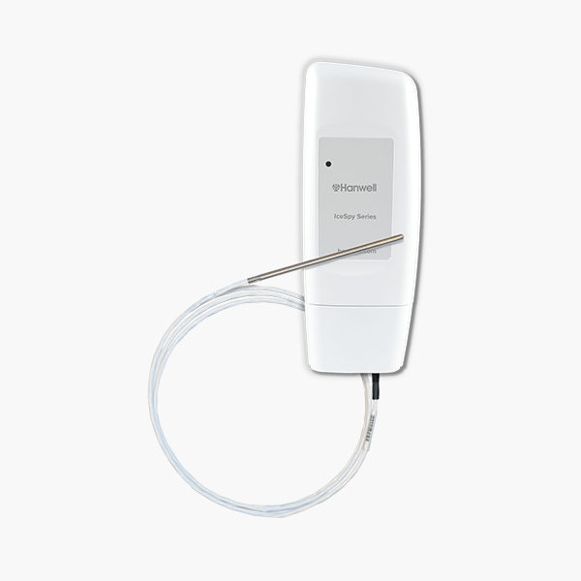
Hardware Overview

Slide 19
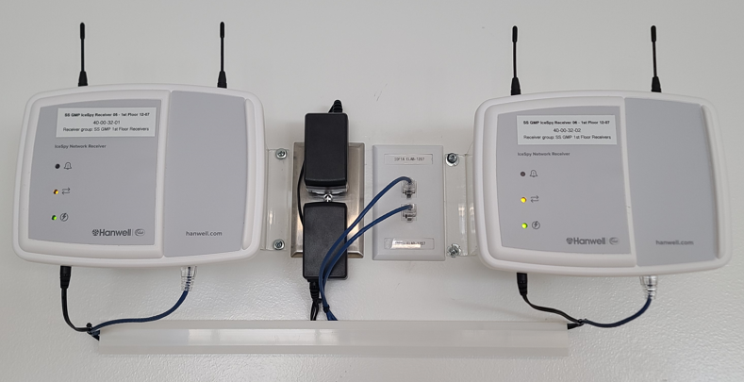
IceSpy Receiver
IceSpy Network Receiver
Uses standard TCP/IP communication protocols for data handling
Collects data from up to 200 transmitters
Onboard relays for common alarm and power failure
Battery backup for up to 3 days
  5-Year battery life
Memory backup: up to 5 days with 50 measuring points
Requires Ethernet and 115V AC power outlet

Slide 20
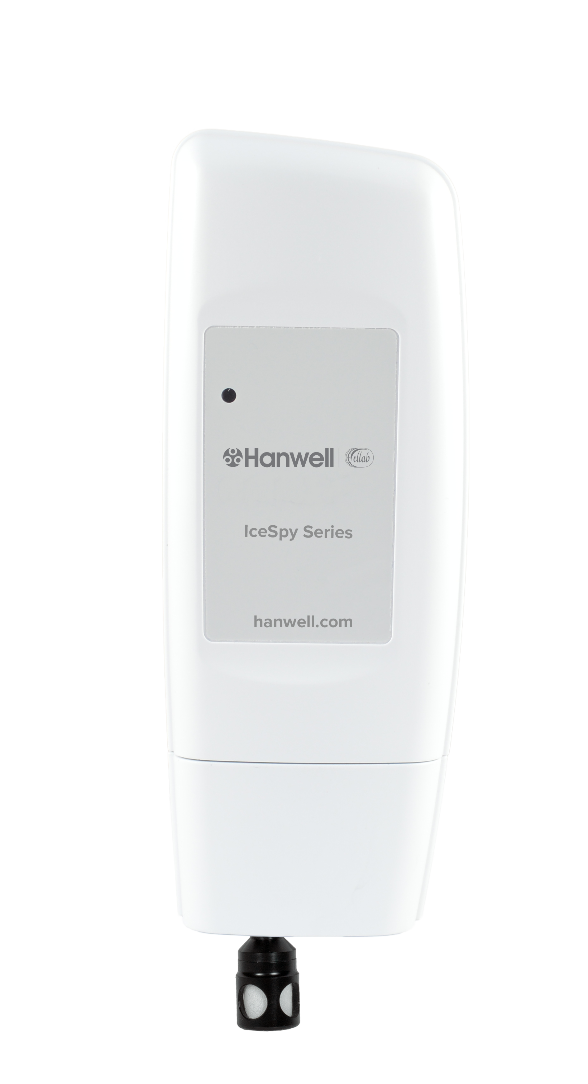
IceSpy Transmitter
Transmitter Range: 1,000ft
Radio Frequency: 915MHz
Radio Power: 10mW
Standard Sample & Transmit Rate:
90 seconds
Memory Backup:
720 samples split between quantity of sensors
15-minute backup sample rate
IP Rating: IP 65 (unless otherwise specified)
Power supply: 1.5V AA Lithium Battery
Single or Dual Channel units Available
Permanently configured to the channel type selected

Slide 21

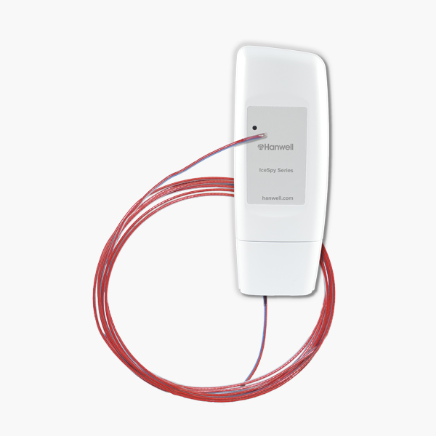
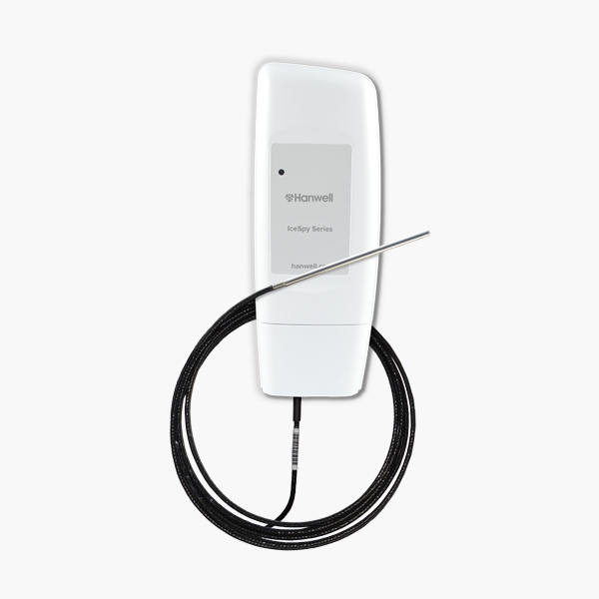
IceSpy Temperature Options
Internal Thermistor: -30C to 50C
-20C freezers, Refrigerators, Labs, Storage Areas, Warehouses
Thermocouple:
-200C to 200C: FEP coated Type T
-200C to 300C: Metal coated Type T
LN₂, -150C, -80C, -20C, Refrigerators, Incubators, Ovens, Furnaces
PT100: -100C to 200C
-80C, -20C Freezers, Refrigerators, Incubators
Thermistor: -40C to 60C
-30C, -20C Freezers, Refrigerators, Incubators

Slide 22
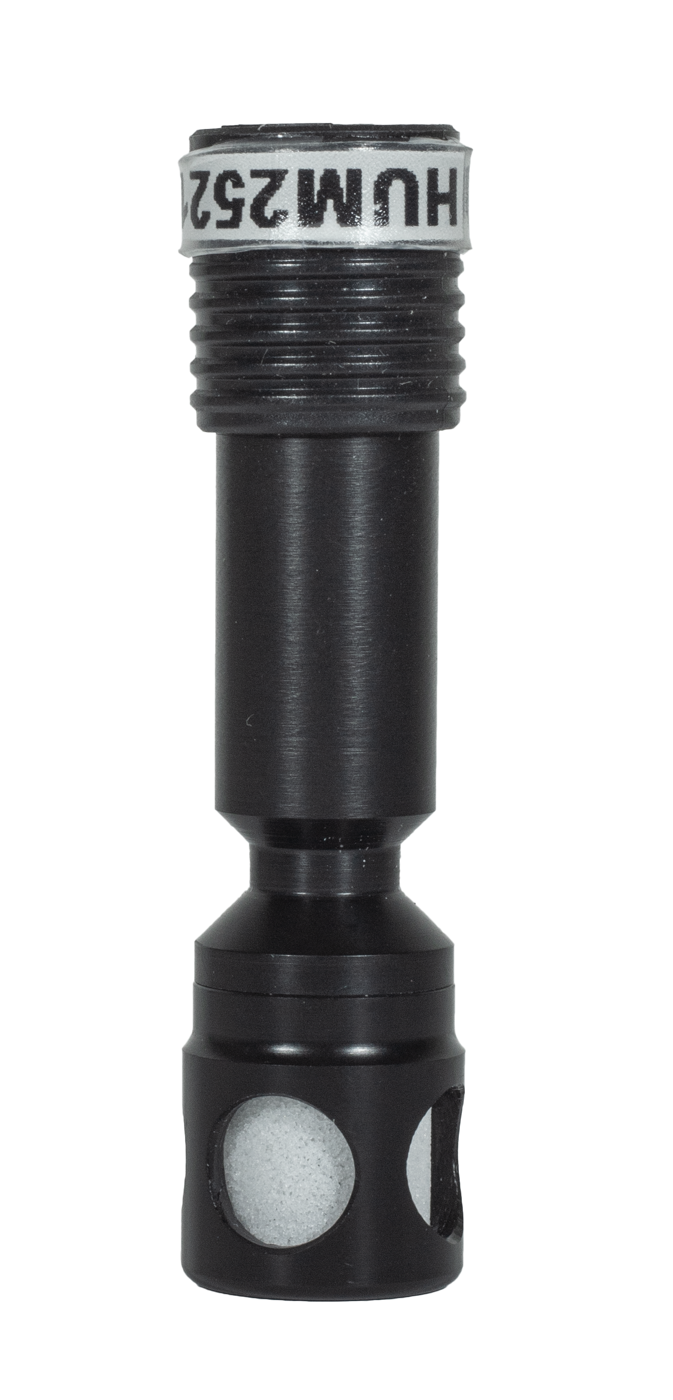
IceSpy Combined Temperature & RH
Single sensor for Temperature & RH
Temperature Range: -30C to 50C
Temp Accuracy: ±0.4C at 23C, ±1.3C at -30, ±0.7 at 50C
RH Range: 0 to 100% RH (Non-condensing)
RH Accuracy: ±3%
Warehouses & Lab spaces the RH sensor is directly attached
Incubators and Stability Chambers the transmitter often remains outside and the RH sensor is placed inside via 1.5m extension cable

Slide 23
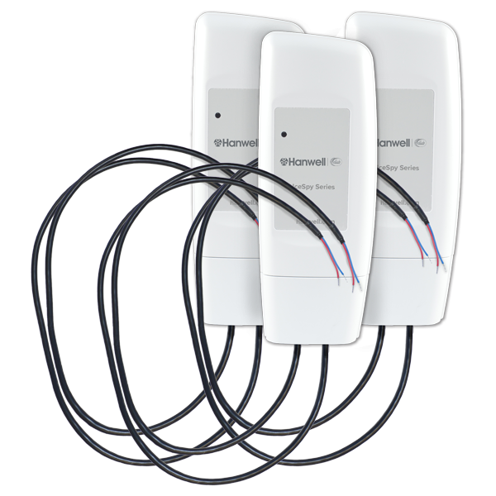
IceSpy Analog and Voltage
Options Available
4-20mA
0-1V
0-5V
0-10V
Typical Applications
Differential Pressure
Carbon Dioxide (CO₂)
Airflow
Power
High Temperatures

Slide 24
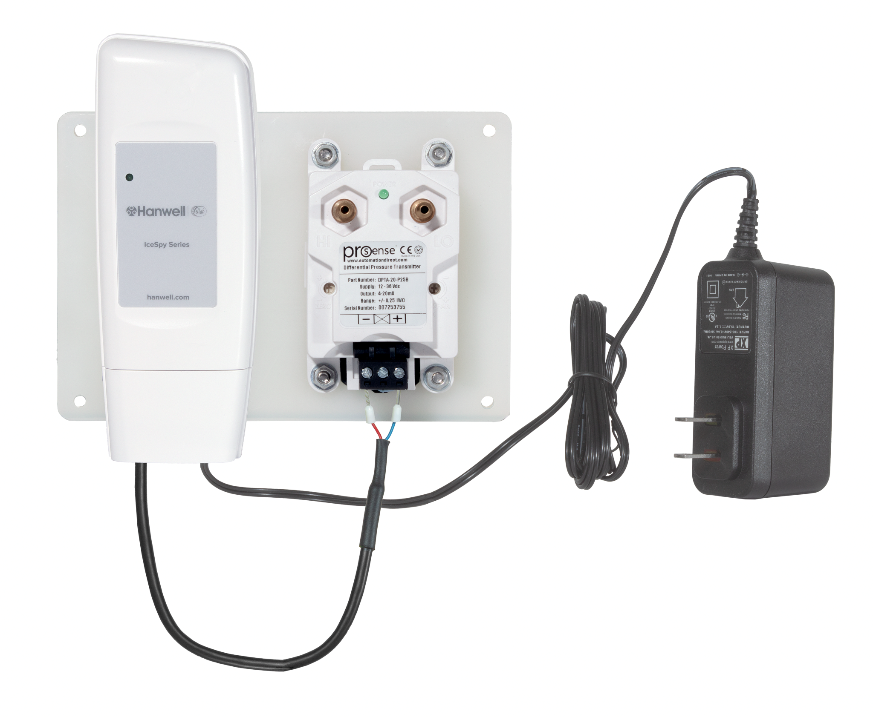
IceSpy Differential Pressure Kit
Off the shelf DP sensor with 4-20mA output
Includes IceSpy 4-20mA transmitter
Power supply integrated into the transmitter
Cleanroom DP application of ±62 pascal
Requires 115V AC power outlet

Slide 25
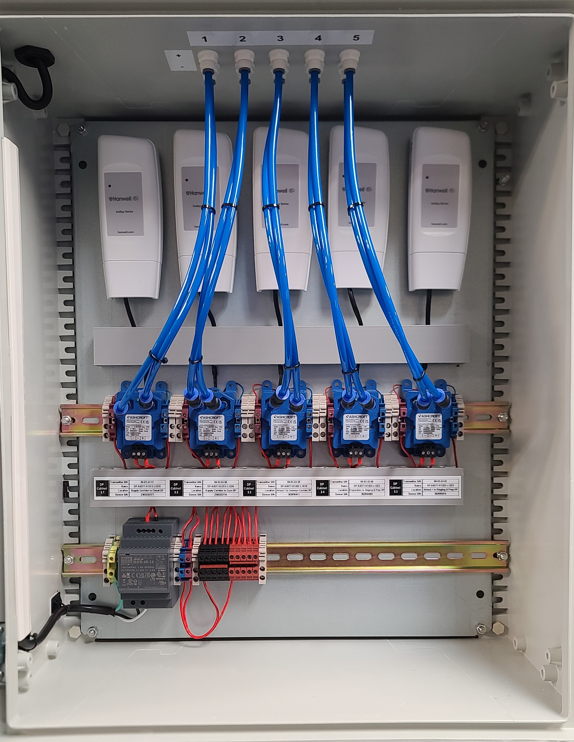
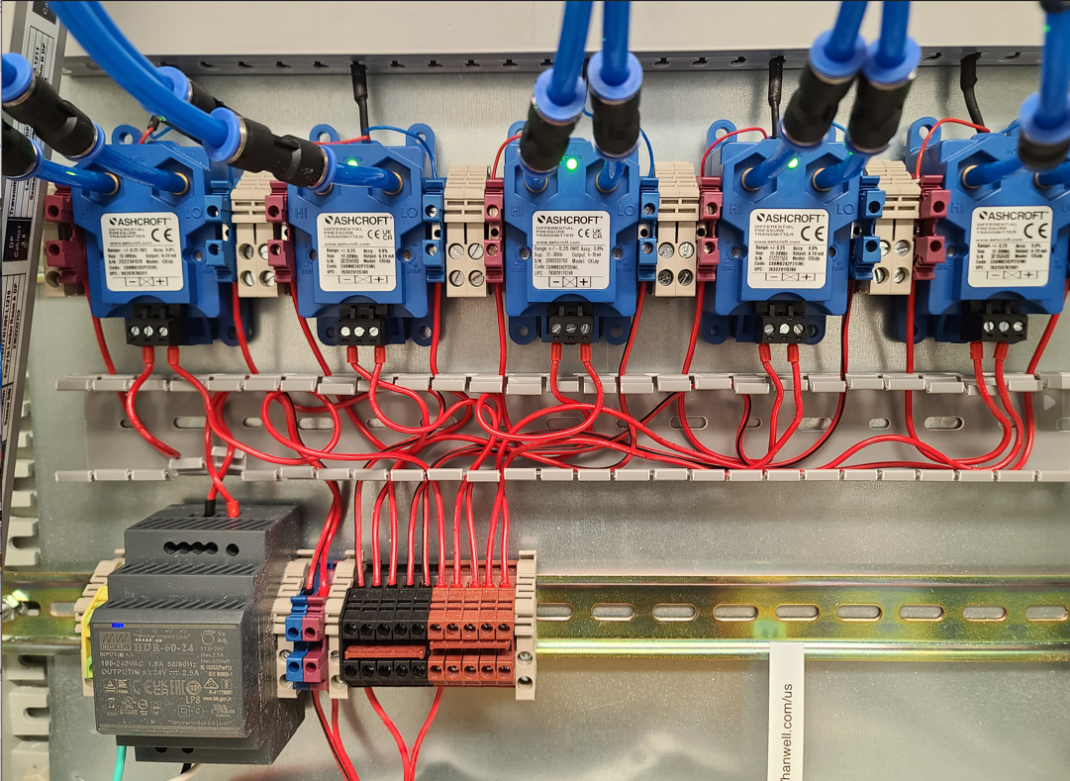
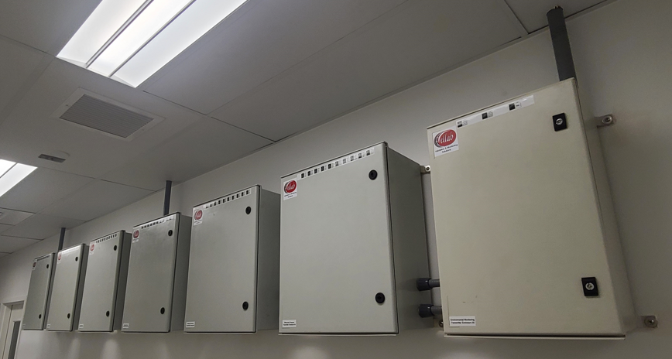
IceSpy Differential Pressure Encasement
Kits with up to 5 IceSpy Transmitters and off-the shelf DP sensors with ±62 pascal range
Single power supply for each encasement via 115v AC power plug or can be hard wired
Customer required to run pneumatic tubing & power to installation location

Slide 26
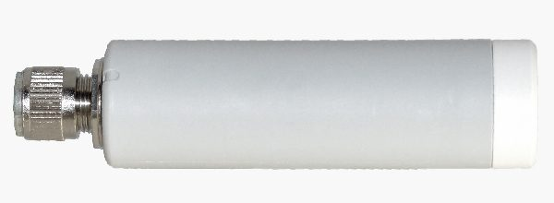
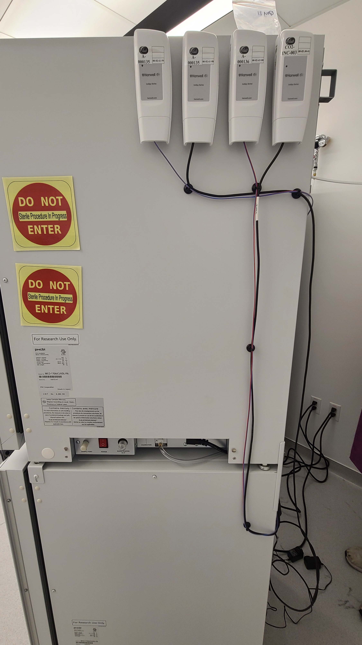
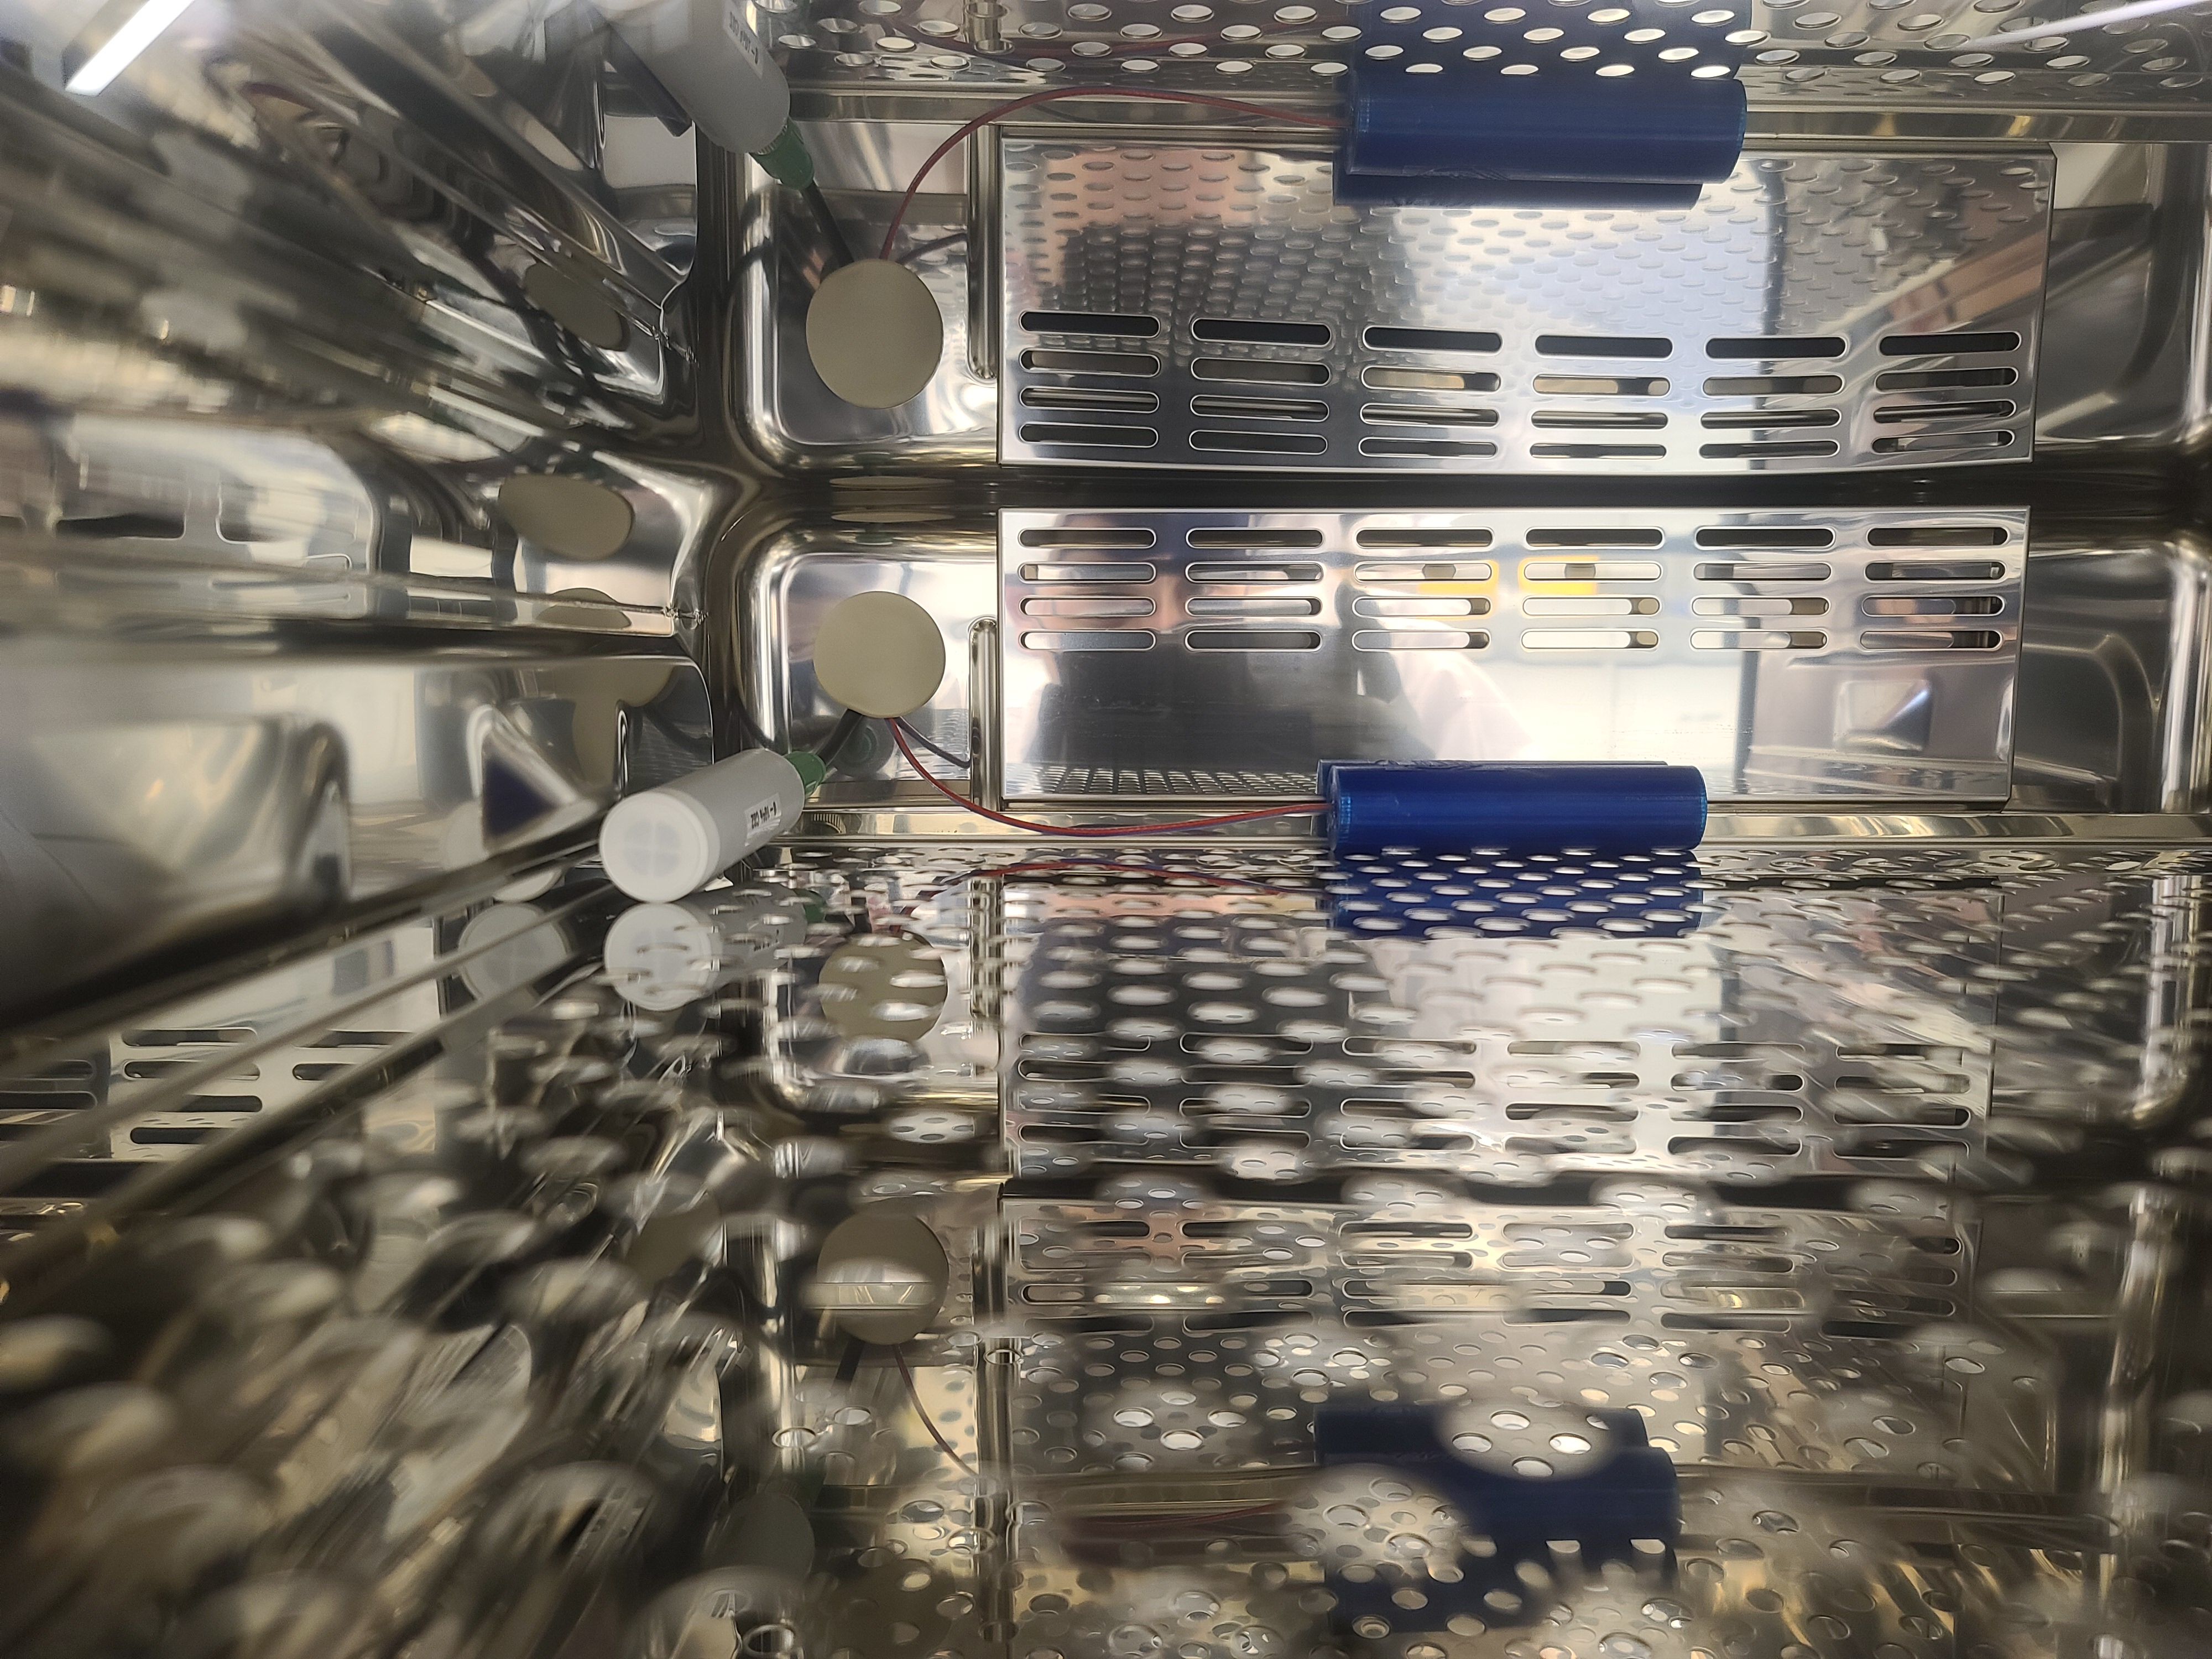
IceSpy Carbon Dioxide (CO₂) Kit
Off the shelf CO₂ sensor with 0-5VDC output
  CO₂ sensor comes with manufacturer’s calibration certificate.
For use with IceSpy 0-5V transmitter
Connection cable includes integrated power supply with AC/DC power plug
Vaisala GMP 241 CO₂ Sensor
Ranges Available
0-5%
0-10%
0-20%

Slide 27
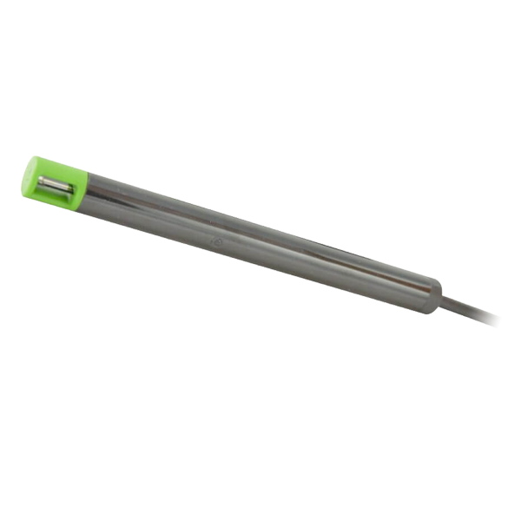
IceSpy Airflow Kit
Off the shelf hot wire airflow sensor with 0-1VDC Output
For use with IceSpy 0-1V transmitter
Power supply integrated into connection cable
For monitoring fume hoods, evaporators, extraction systems, HVAC
Airflow Sensor Options
0-5 m/sec
0-10 m/sec
0-20 m/sec

Slide 28
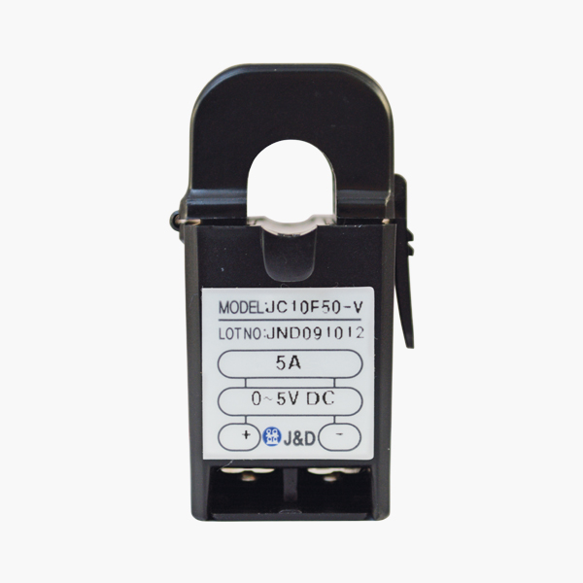
IceSpy Power Sensing Kit
Current Sensor Options
0-5A
0-50A
0-100A
Off the shelf sensor with a 0-5VDC Output
  External power supply not required as sensor self generates the 0-5VDC output
For use with IceSpy 0-5V transmitter

Slide 29
Additional Options

Slide 30

Alarm Notifications
Reliable alarm notifications is a vital part of any continuous monitoring system. We have a variety of available options.
Email Alerts
Text Alerts
Mobile App

Slide 31
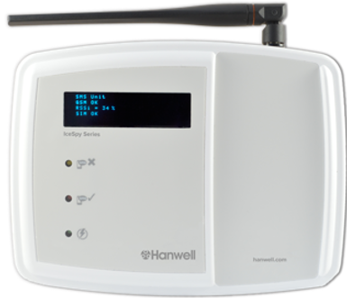
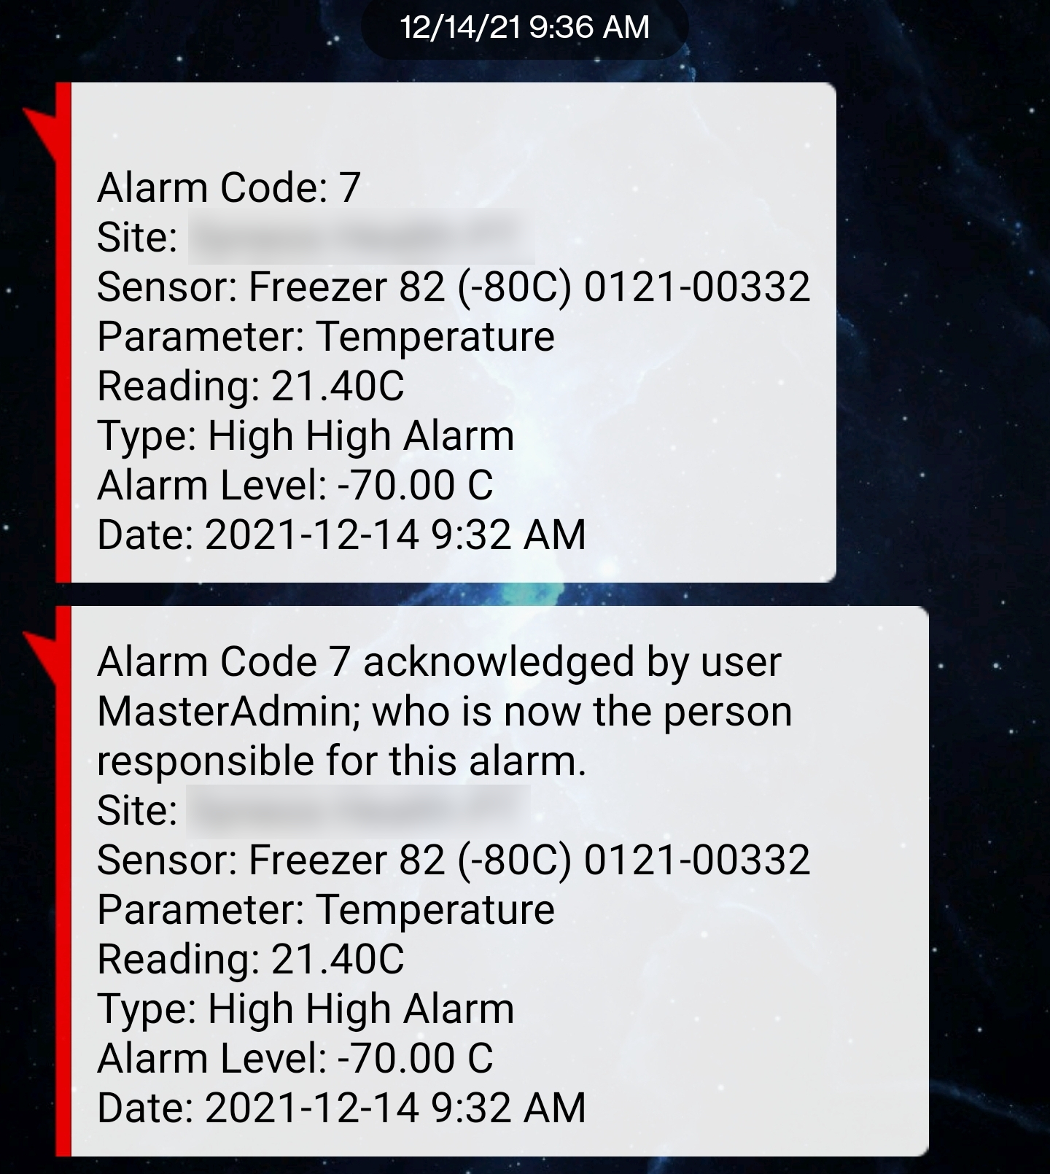
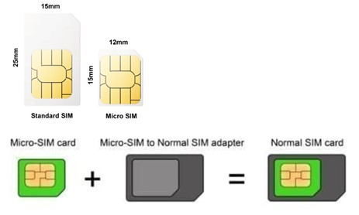
SMS Alarm Module – 4G
Independent Module for generating text message alarms
SIM Card Requirements
Full size 4G SIM card
Phone number with text message capability
Not compatible with SIM PIN
Requires Ethernet connection and 115V AC power outlet

Slide 32
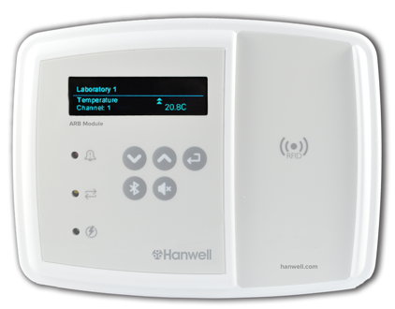
ARB Module
ARB (Alarm, RFID, Bluetooth) Module
Visual and audible alarms
RFID for data backfill for IceSpy transmitters
Bluetooth interface for handheld thermometers
Audible alarm trigged through Sensor Groups with a max of 50 sensors
Multiple modules can be installed throughout a facility
Can be set up with additional external beacon
Requires Ethernet connection and 115V AC power outlet.

Slide 33
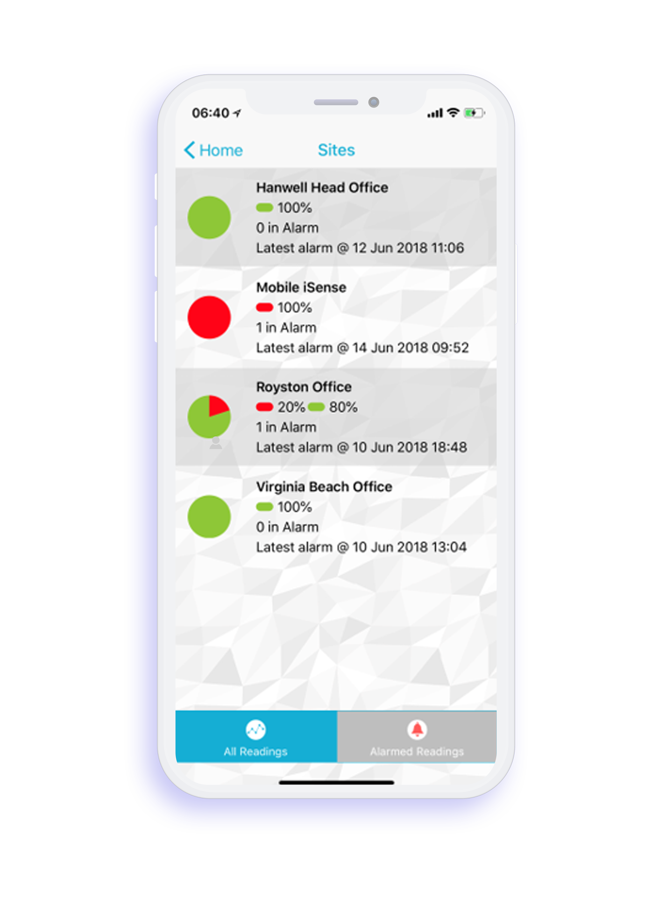
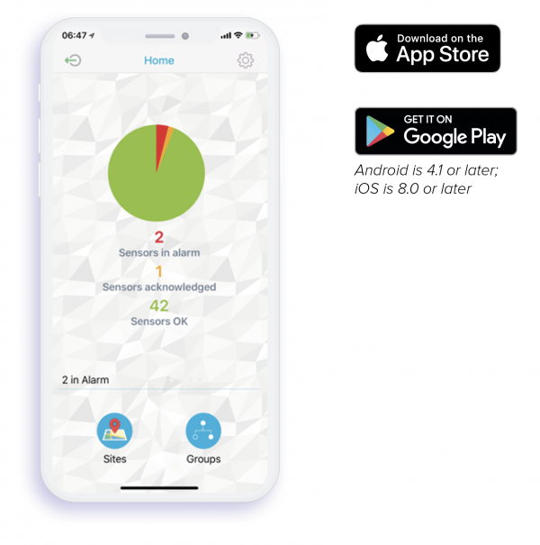
EMS Mobile APP
Instant view of overall system status
Pop-up notifications of new alarms
See details of individual alarms
Annual service fee required – Based on total system size

Slide 34
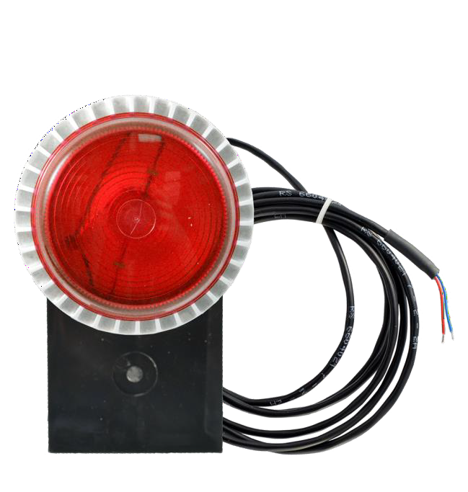
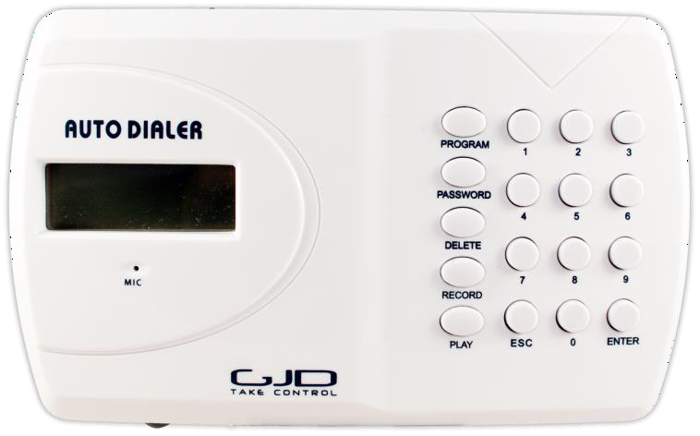
Beacons and Auto Dialer
LED Light
LED Light & Sound
Auto Dialer

Slide 35
Prerequisites
We have a suite of supporting documents to help prepare for your installation

Slide 36
Installation and Validation Workflows
EMS System Configuration
Software IQ/OQ
Hardware IQ/OQ
On-site Services
Project Management
Hardware and IT specs
RF site survey
Project Timeline
IT Pre-Requisites
Hosted Server
Remote installation
IQ/OQ protocols
Installation on-prem (customer)
IQ/OQ protocols
System report and alarm configuration
Support Contract
Re-calibrations
Trainings
Expansions

Slide 37
Supporting validation documentation

Slide 38

Thank you!
Do you have any questions?
Email us: usa@ellab.com
Call us: +1-303-425-3370
linkedin.com/company/ellab/
youtube.com/c/EllabValidationMonitoringSolutions
twitter.com/ellabsolutions
ellab.com

Slide 39
Title
Row title: | Row Content
Row title: | Row Content
Row title: | Row Content
Title
Row title: | Row Content
Row title: | Row Content
Row title: | Row Content
Row title: | Link

Slide 40


Ellab Slide Assets V1
Copy as needed then delete this slide!
Ellab Icons
Validation Solutions
Monitoring Solutions
Field Services & Consulting
Note: PowerPoint’s stock icons can be used in Ellab brand colors:

Slide 41

Ellab Slide Assets V1
Copy as needed then delete this slide!
Ellab Icons - White
Validation Solutions
Monitoring Solutions
Field Services & Consulting
Note: PowerPoint’s stock icons can be used in white:

Slide 42
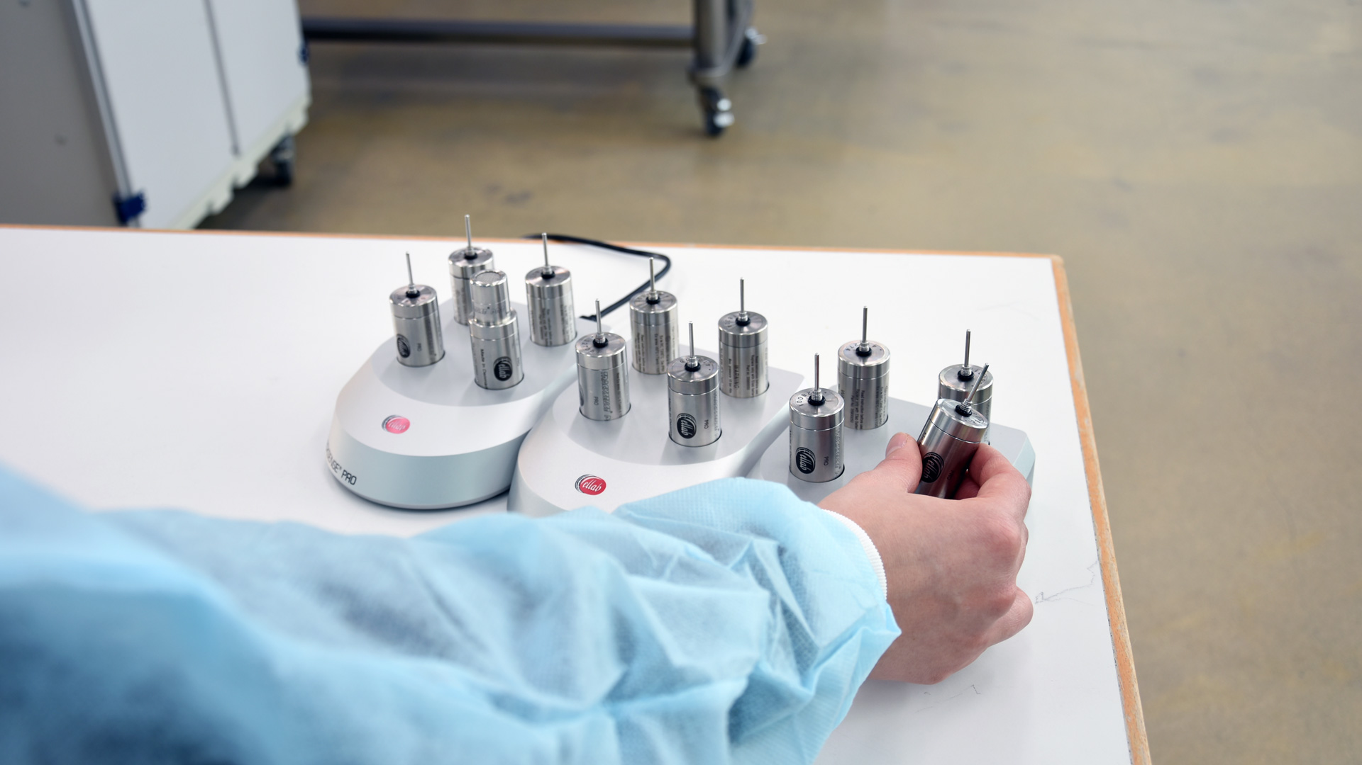



Ellab Slide Assets V1
Copy as needed then delete this slide!
Misc. Objects/shapes
ellab.com

Slide 43
Ellab Slide Assets V1
Copy as needed then delete this slide!
Tables
Title
Row title: | Row Content
Row title: | Row Content
Row title: | Row Content
Title
Row title: | Row Content
Row title: | Row Content
Row title: | Row Content
Row title: | Link
Standard table
​ | ​ | Column Title ​ Sub-title | Column Title​ Sub-title | Title | Title | Title | Title®​
Row Sub-title | ​ | Cell bullet points Cell bullet points | Cell bullet points Cell bullet points | Cell bullet points Cell bullet points | Cell bullet points Cell bullet points | € 0​ | € 0​
​ | ​ | ​1,000​ | ​1,000 | ​1,000 | 1,000​ | 1,000​ | 1,000​
Row | ​ | Span two rows | Text | Text | Span two rows | N/A​ | N/A​
Row | ​ |  | Text | Text |  | N/A​ | N/A​
Row | ​ | 1,000​ | 1,000​ | 1,000​​ | 1,000​ | N/A​ | N/A​
Row Sub-title | ​ | €0​ | €0​ | N/A​ | €0 | €0 | €0
Row - Sub-title | ​ | €0 | €0 | > €0 | €0 | €0 | €0
Complex table

