Slide 2
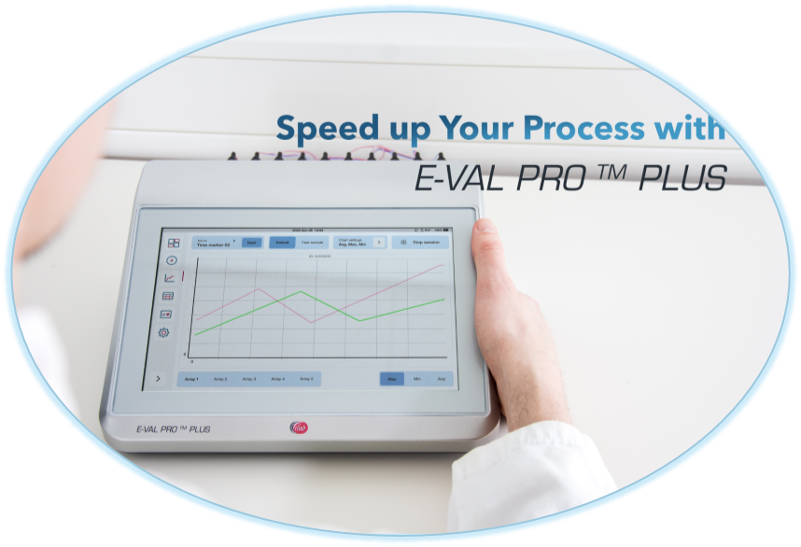
Competitive Battlecards
Kaye AVS Validator vs E-Val-Pro Plus
April 2024

Slide 3

Competitive Battlecards – Kaye Validator AVS
Observations | Why We Win | Anticipated Landmines
Kaye is the known brand and benchmark within wired validation solutions. | Ellab wired validation solutions might be less known, but when the customers has used it ones, they would not go back to the AVS Validator. | The customers are used to operate their validation equipment the “Kaye-Way”.
The Validator AVS is designed as a self-contained (stand-alone) equipment: The operation of the Validator AVS together with the console is made easy as the Console is pre-loaded and configured with the Kaye AVS Software, which is customized to specific validation tasks. This means no requirement of any interaction with a PC to setup a session. Kaye claims this greatly simplifies software validation and dependency on changing PC and OS. | The ValSuite software is the center of our validation solutions, which ensures full flexibility and integration between the E-Val Pro Plus module and TSP sensors. The E-Val Pro Plus Module can also be operated as stand-alone too without connection to a PC. The EVP Plus Module comes with new improved GUI for easy and fast setup of sessions. The integration between the E-Val Pro Plus Module and ValSuite ensures data easily can be transferred either by connecting via an USB cable or ethernet or by transferring the session with an USB stick. This ensure full flexibility and easy handling of sessions as well as software/hardware updates. | Focus on the ease of use of an E-Val Pro Plus and the advantages of data management before and after collection of data. → Be onsite and make a demo test showing the ease of using the E-Val Pro Plus Module. OBS! Kaye has recently launched the possibility to download a study from the AVS Validator to the console or PC for reporting.
Internal Use Only

Slide 4
Competitive Battlecards – Kaye Validator AVS
Observations | Why We Win | Anticipated Landmines
The setup with the Validator AVS and Console is flexible: - The Console and Validator AVS can be connected in Docking or by Network Mode by using ethernet or WIFI. | This might be smart. However the EVP Plus module can also be operated as a stand-alone or be connected to a laptop by either USB, LAN or WIFI. | The customers are used to operate their validation equipment the “Kaye-Way”. NOTE: Often equipment like the AVS Validator and E-Val Pro Plus has not permission to access the internal WIFI. With the E-Val Pro Plus there is no worries as it can be connected to a router and create an internal network.
Internal Use Only

Slide 5
Competitive Battlecards – Kaye Validator AVS
Observations | Why We Win | Anticipated Landmines
The Validator AVS has a capacity of up to 48 channels distributed in 4 SIMs with 12 channels per SIM. 1 SIM can only handle the same type of sensors. i.e. a study with both pressure requires minimum 2 SIMs | The EVP Plus module can contain up to 52 channels - 1 array of 4 and 4 arrays of 12 channels. Each can accommodate both pressure and temperature sensors and are inter-changeable. | No need to focus on the number of channels, Instead emphasis the high flexibility, that comes with the inter-changeability of the arrays and USB sensors.
Kaye has push pin connectors. | They might has been improvement, however the Ellab USB sensors can be plugged in and out any time – and to any channel port in the array. The USB plug contains ID for software recognition | Focus on the flexibility of the E-Val Pro Plus system. Be onsite and make a demo test showing how easy and flexible our USB sensors are.
Kaye claims they have eliminated manual methods of sensor calibration / verification resulting, which results in better accuracy. | It might sound good. The reality is different, in case a sensor requires replacement, the whole group SIM need to be re-calibrated. The sensors for EVP plus are interchangeable with the calibration constants and off-set values stored in the USB connector. | The customer might be used to perform the calibration the “Kaye-Way” by calibrating one SIM at a time. With the E-Val Pro Plus system the customer gets the same high flexibility during calibration as under operation.
Internal Use Only

Slide 6
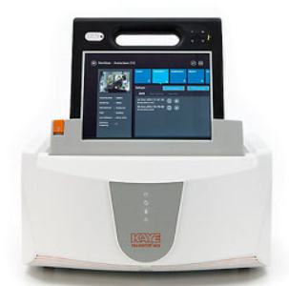
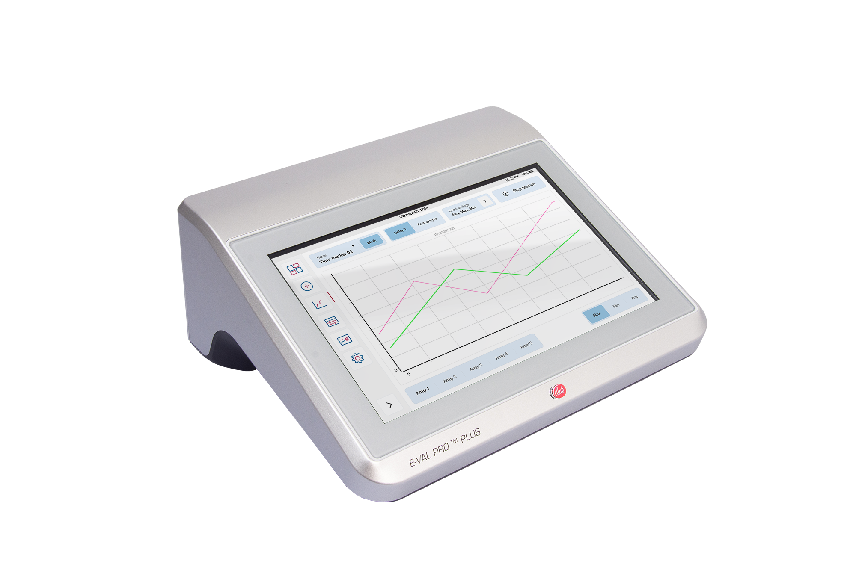
Competitive Battlecards – Kaye Validator AVS
Features | AVS Validator | E-Val Pro Plus | Why We Win
 | Kaye praises the design features of Validator AVS: | The E-Val Pro Plus is more powerful than the Validator AVS: | Do not compare the features one to one, instead focus on the benefits they offer:
Battery Back-Up and Memory: | Battery back-up of 3hrs for the AVS Validator and 6 hrs for the console 4 GB for data collection | The battery back-up of the E-Val Pro Plus is 12hrs +10 GB for data collection | Additional battery back-up and memory minimize the risk of loosing data and potential re-do or studies due to issues with power supply and in general ensures more flexible operations
Weight and Size: | The Console weight 1.33kg and the AVS Validator itself 11kg The Validator AVS has a large footprint – 411 x 381mm (x 190h mm) | The weight of the E-Val Pro Plus Module is only 4,0 kg, The EVP Plus has a footprint of 276 x 238mm (x 112h mm) | The compact size and weight of E-Val Pro Plus make it easy to carry around and place during operation and transport
Display: | The Console comes with 11.6-inch capacitive touch screen, which is anti-glare, anti-smudge and glove-capable | The E-Val Pro Plus comes with at 10.1” capacitive touch screen, which is easy to clean and glove-capable | Together with the new GUI the new display makes the E-Val Pro Plus easy to use
Cooling: | The Validator AVS uses a fan for cooling | The EVP Plus module uses passive cooling | The use of passive cooling makes the E-Val Pro Plus module suitable for use in clean rooms
Accuracy: | The Validator AVS has a system accuracy +/- 0.25°C @ 121°C | The system accuracy of E-Val Pro Plus is +/- 0.1°C @ 121°C | With the best in class accuracy the customer get trustworthy data
Internal Use Only

