Slide 2
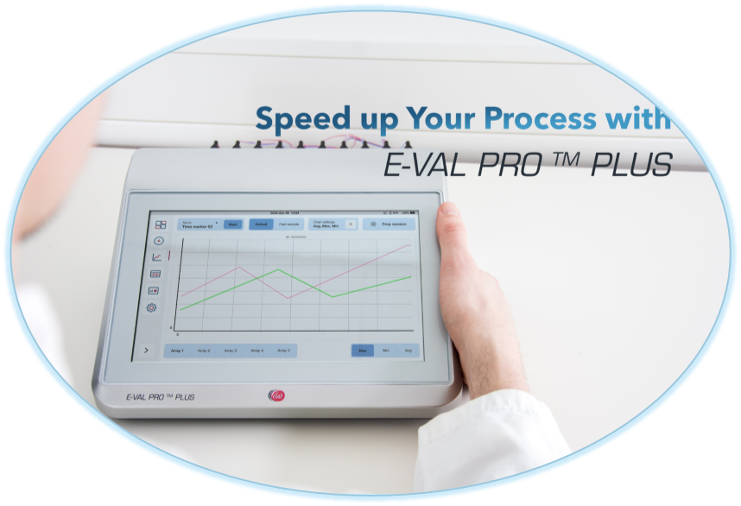
Competitive Battlecards
E-Val Pro Plus Upsale
April 2024

Slide 3

Competitive Battlecards – EVP vs EVP Plus
Observations - EVP | Why E-Val Pro Plus Win | Anticipated Landmines
The E-Val Pro Module is a fully integrated compact lightweight module with touch screen and large battery back-up time. The E-Val Pro Module is fast and efficient to setup and start of a new session | The E-Val Pro Plus is all that and much more. The display is larger, the battery back-up time is improved, and it has more internal memory: The new processor is more powerful than its predecessor, which makes it faster and more efficient. The new and improved user interface and graphics, makes the use of the module easier to navigate and faster too, the look & feel is like an iPad. It is responsive, even with plastic gloves. With the new USB plug & play feature ValSuite recognize the E-Val Pro Plus immediately. There is no limitation of number of modules in ValSuite or hazzle with setting them up. | This is not important for me. The E-Val Pro Module has the features I need. → The new features makes the E-Val Pro Plus Module work faster, the larger display gives you a better overview of your sessions and the new user interface makes it easier to navigate around the menus and thereby save time. → If you are a frequent user of the old E-Val Pro module, you will fast adapt to the new user interface, which is build on the known logic from the old E-Val Pro and is more intuitive as well.
EVP module can run as stand alone and will work immediately when sensor(s) are plugged in without any kind of registration or setup. | The E-Val Pro Plus can all that too and is compatible with existing E-Val Pro components and ValSuite i.e. it is backward compatible with existing arrays, sensors and sensor plugs. | I prefer the old E-Val Pro Module as I do not want to update my PC/Laptop(s) with the latest version of ValSuite: → No worries, you can run the E-Val Pro Plus in Classic mode. Then it will be like using an old E-Val Pro, but you are missing out the possibility of using the extra Array.
Internal Use Only

Slide 4
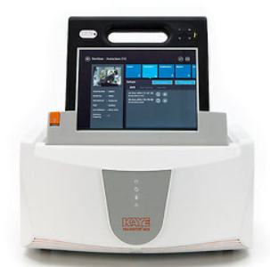
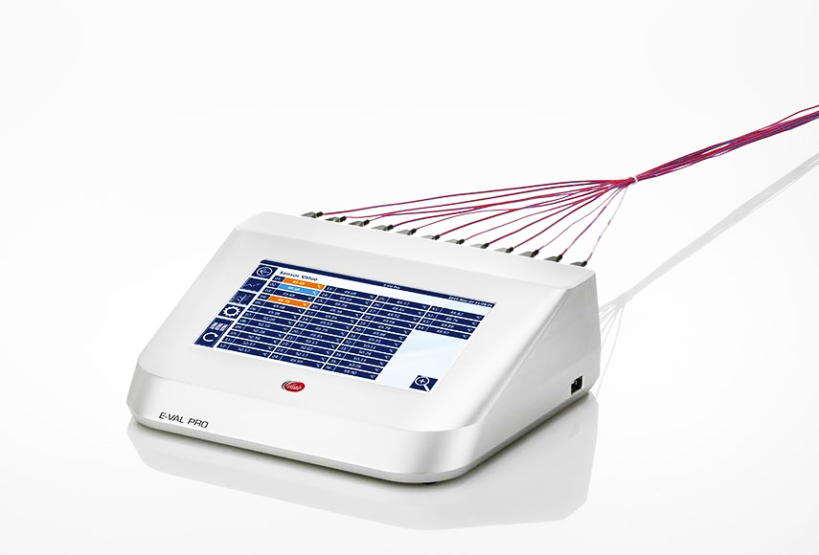
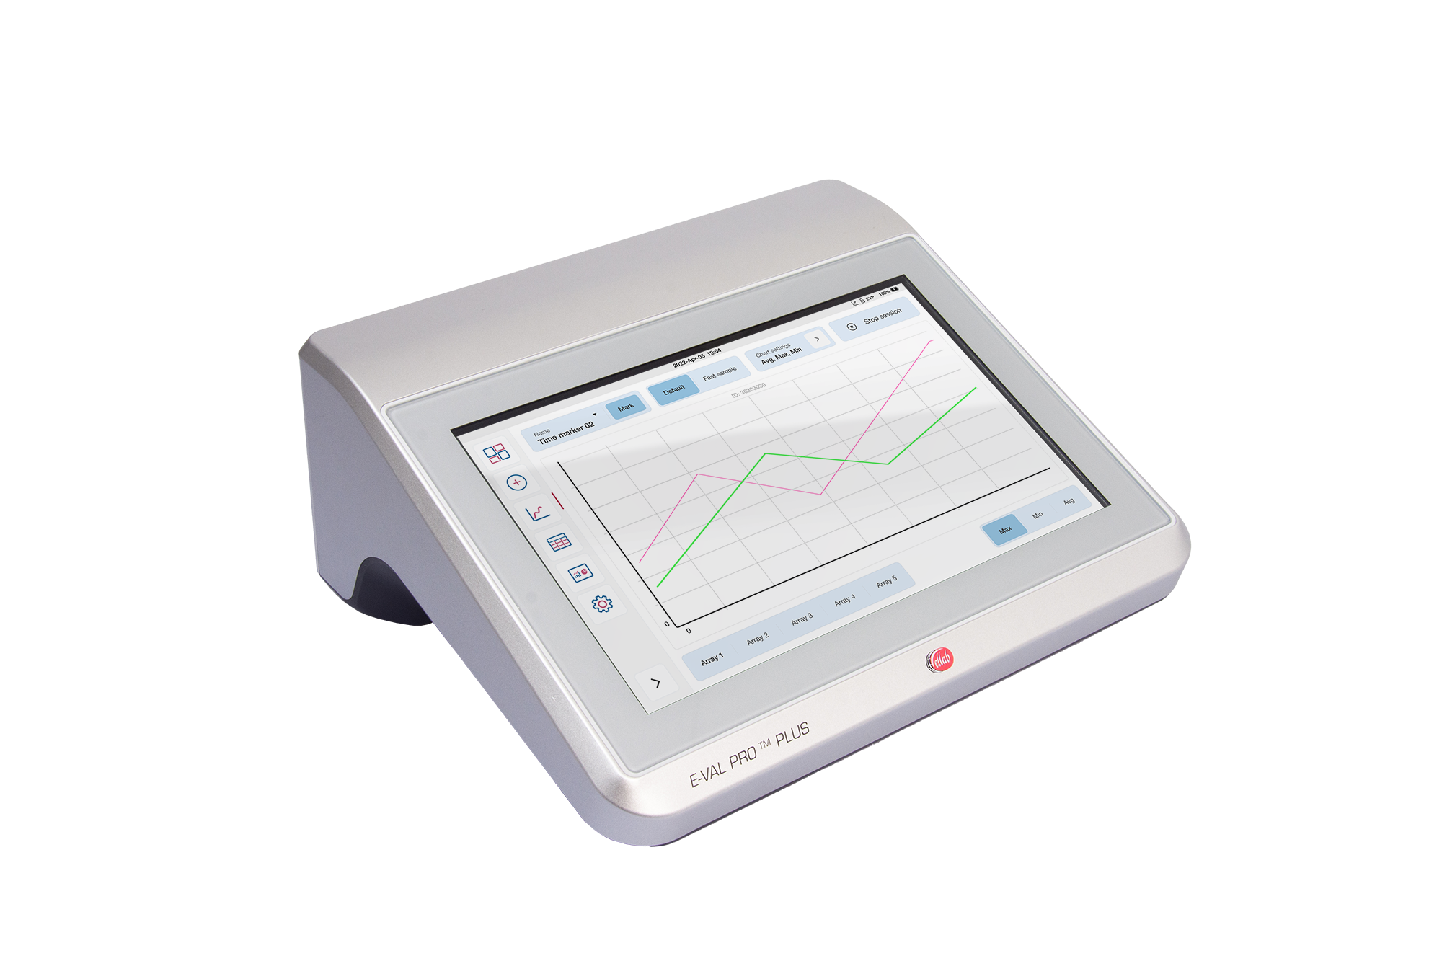
Competitive Battlecards – EVP vs EVP Plus
 | E-Val Pro | E-Val Pro Plus | Kaye Validator AVS
Display: | 8” integrated touch screen (resistive) | 10.1” capacitive touch screen, which is easy to clean and glove-capable | Mounted 11.6” touch screen console (capacitive)
Channels Available: | 4 arrays, which gives a total of 40 channels | 5 arrays, which gives a total of 52 channels | 4 SIMs, which gives a total of 48 channels
Battery Back-up and Memory: | 8 hrs 0.5 GB for data collection | 12 hrs +10 GB for data collection | Battery back-up of 3hrs for the AVS Validator and 6 hrs for the console 4 GB for data collection
Weight and Size: | The weight of the E-Val Pro Module is 3,4 kg, Footprint – 271 x 220mm (x 82h mm) | The weight of the E-Val Pro Plus Module is 4,0 kg Footprint of 276 x 238mm (x 112h mm) | The weight of the Console is 1.33kg and the AVS Validator is 11kg Footprint of 411 x 380mm (x 190h mm)
Cooling: | Passive cooling | Passive cooling | Fan
Internal Use Only

