Slide 1
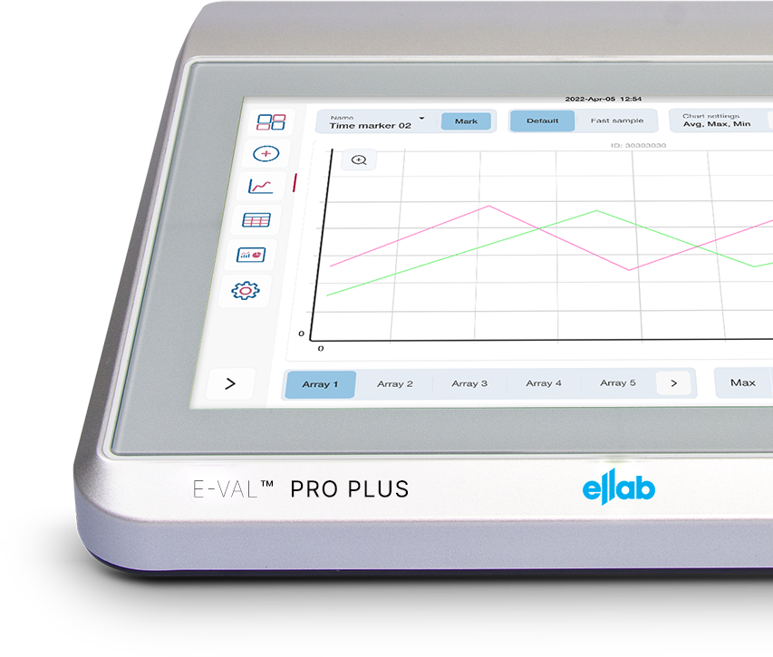
E-Val Pro Plus
Wired Validation Solution

Slide 2

Agenda
1. Our Expertise
2. E-Val™ Pro Plus – Wired Validation
3. E-Val™ Pro Plus Key Features & Benefits
4. E-Val™ Pro Plus Comparisons

Slide 3
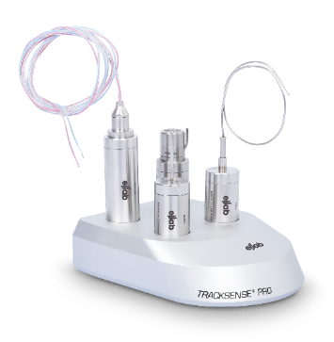
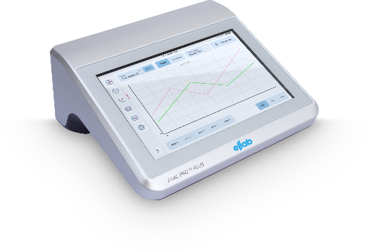
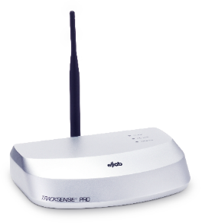
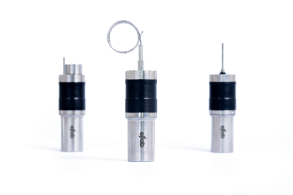
Our Validation Options in Market
Wireless Real-time
Wired
Wireless
Real-time data
Versatile (-196°C to +400°C)
Cost-efficient depending on application
Well-established
No vacuum test after installation
Cost-efficient depending on application
Fast and easy
No vacuum test after installation
Real-time data
Fast and easy

Slide 4

Agenda
1. Our Expertise
2. E-Val™ Pro Plus – Wired Validation
3. E-Val™ Pro Plus Key Features & Benefits
4. E-Val™ Pro Plus Comparisons

Slide 5

Agenda
1. Our Expertise
2. E-Val™ Pro Plus – Wired Validation
3. E-Val™ Pro Plus Key Features & Benefits
4. E-Val™ Pro Plus Comparisons

Slide 6
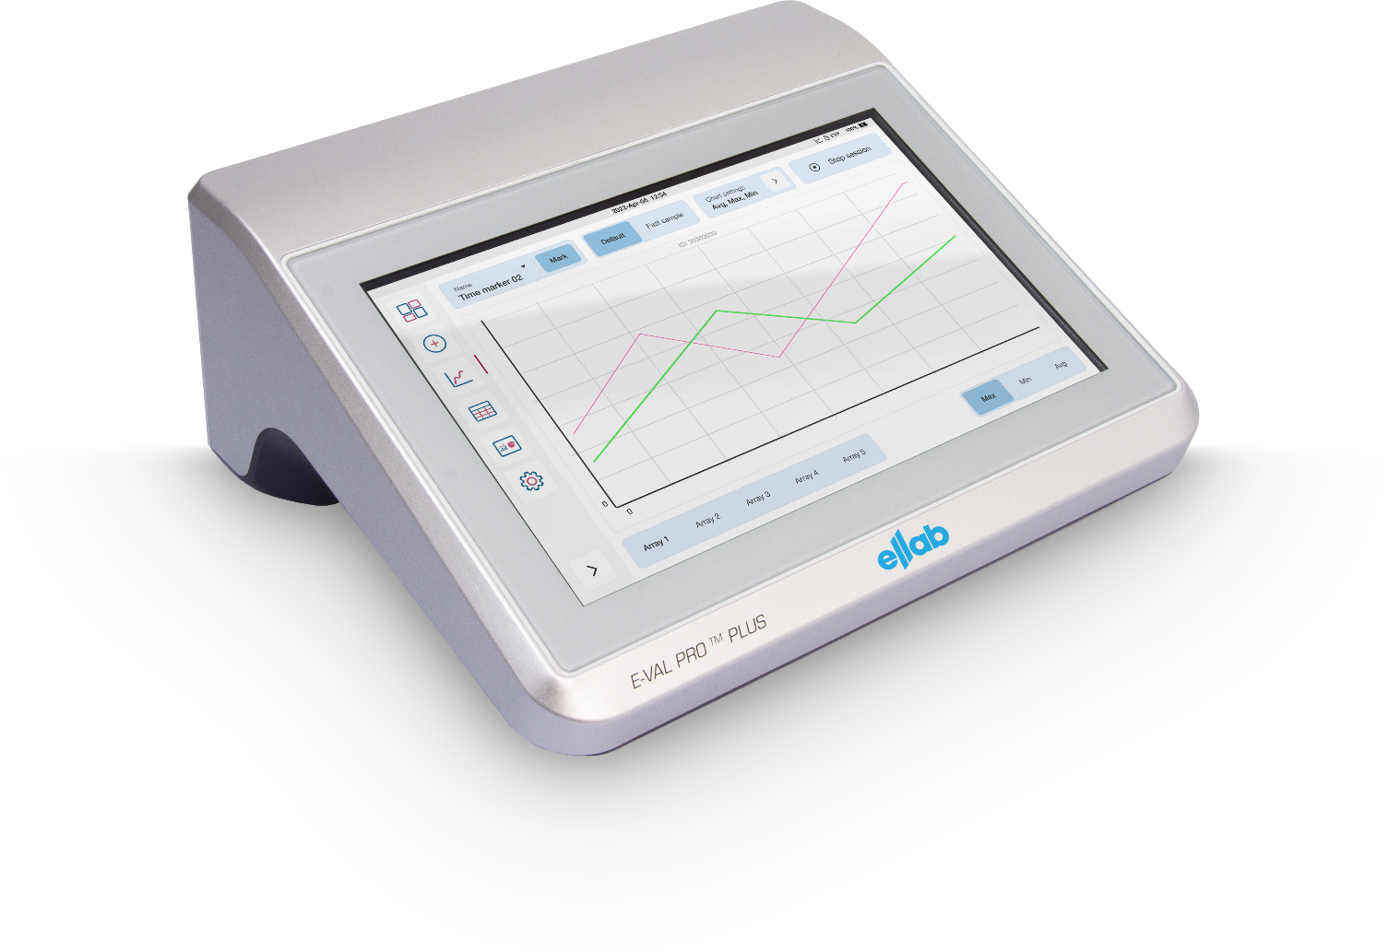
E-Val Pro Plus: Wired Validation
Used in wide range of applications, with best-in-class range and accuracy for any validation setup
Steam-in-place (SIP)
Dry Heat Tunnel and Oven Solutions
Freeze Drying and Lyophilization
Liquid-Nitrogen (LN2)
Steam Sterilization
Freezers/Fridges
Depyrogenation
Stability Chambers
Incubation
Water-Cascade Sterilizer
Cold Rooms
Fermentation

Slide 7

Agenda
1. Our Expertise
2. E-Val™ Pro Plus – Wired Validation
3. E-Val™ Pro Plus Key Features & Benefits
4. E-Val™ Pro Plus Comparisons

Slide 8
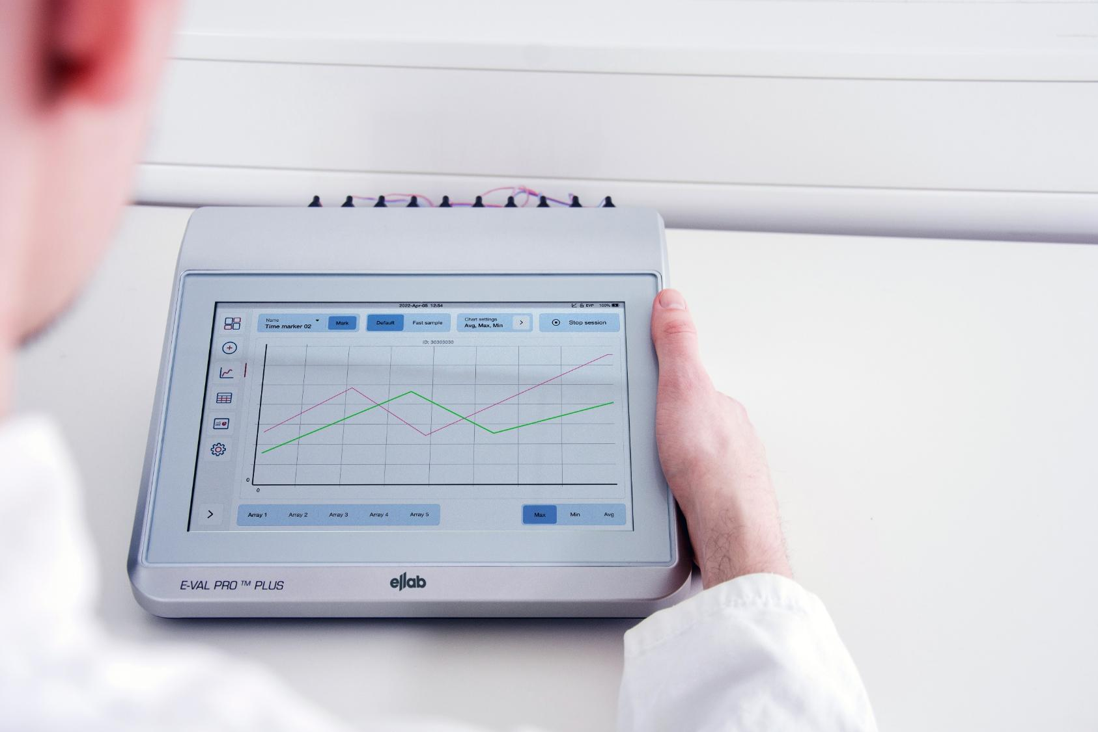

System Highlights
E-Val Pro Pus
Real-time Data
E-Val™ Pro Plus provides real-time data, perfect for initial qualification/validation where immediate control and response can save valuable time.
Compliance
E-Val™ Pro Plus is an FDA CFR 21 Part 11 compliant system designed for the life science industry.
Backward Compatible
The E-Val Pro Plus Module is backwards compatible with ValSuite 5.2 in its classic mode.
The "normal“ new mode" is available from ValSuite 6.5 onwards.
Comprehensive Reporting
Facilitates fully compliant processes, product safety, and quality, ensuring peace of mind.
Precision
The ValSuite® (software) advanced technology ensures precise measurements thorough analysis.
Benefits
No need to update to the latest ValSuite software to be able to use the E-Val Pro Plus module
Advanced Software
Our wired validation solution is built on renowned and reputable technology with all the benefits from the ValSuite software.
A Complete Solution
Reliable, Versatile, Efficient. Ensures Compliance with confidence.

Slide 9
System Highlights
E-Val Pro Plus
Real-time Data
E-Val™ Pro Plus provides real-time data, perfect for initial qualification/validation where immediate control and response can save valuable time.
Compliance
E-Val™ Pro Plus is an FDA CFR 21 Part 11 compliant system designed for the life science industry.
Backward Compatible
The E-Val Pro Plus Module is backwards compatible with ValSuite 5.2 in its classic mode.
The "normal“ new mode" is available from ValSuite 6.5 onwards.
Comprehensive Reporting
The comprehensive reporting facilitates fully compliant processes, product safety, and quality, ensuring peace of mind.
Precision
The ValSuite® (software) advanced technology ensures precise measurements thorough analysis.
Benefits
No need to update to the latest ValSuite software to be able to use the E-Val Pro Plus module
Advanced Software
Our wired validation solution is built on renowned and reputable technology with all the benefits from the ValSuite software.
A Complete Solution
Reliable, Versatile, Efficient. Ensures Compliance with confidence.
9

Slide 10

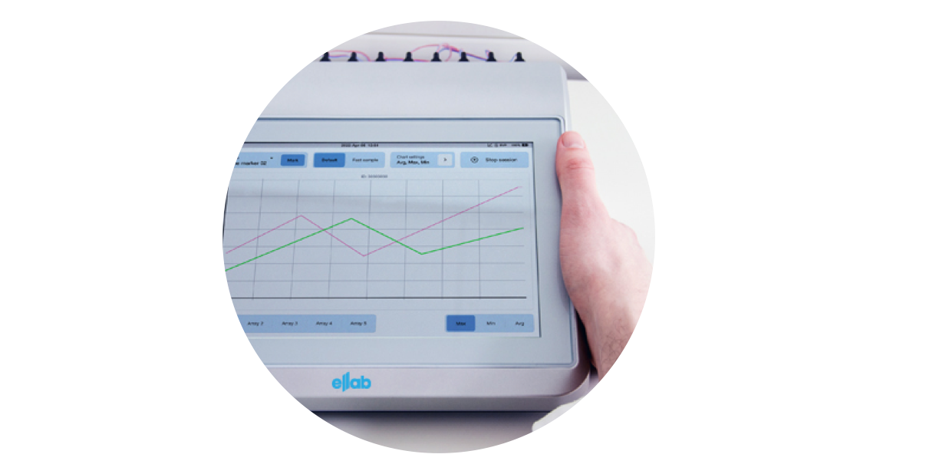

Technical Highlights
01
Freedom in Reporting Structure
Pre-define your scope and setup in ValSuite without being locked in – you can always change as you go.
Versatility features
Efficiency features
02
Compact design
Non-fan assisted
4-52 sensor inputs, temp and more
Multiple setup template and report options
Plug & play setup
Touchscreen navigation
Direct onscreen guidance and feedback
Standalone analysis and control
Collect Data
Straightforward, real-time data collection
Reliability features
Compliance with confidence
Up to 12 h battery backup
±0.1°C accuracy with Ellab smart type Ts
Session back-up to never lose data
Traceable and interchangeable, single smart TCs
Centralized database
FDA 21 CFR part 11 compliance
User management with password protection
Audit trail with full traceability w sensor end point
03
Get Your Analysis and Reports
High flexibility until the finish line – restructure your way of reporting at any time.

Slide 11
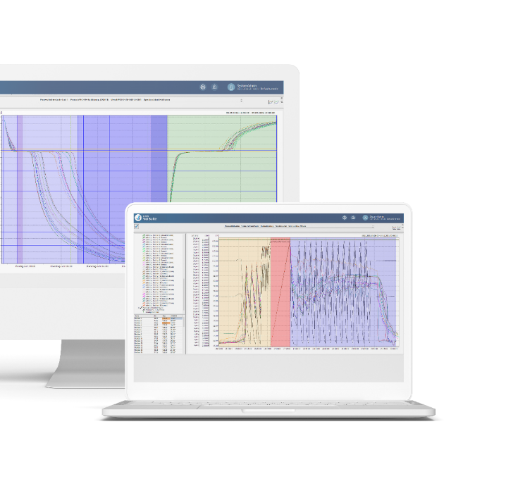
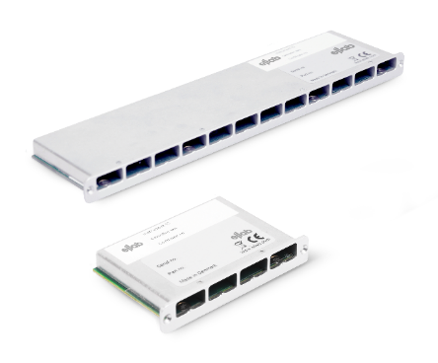
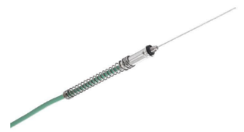
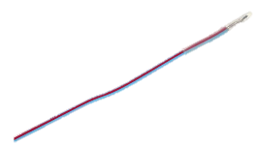
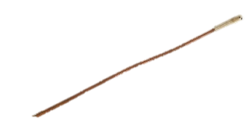
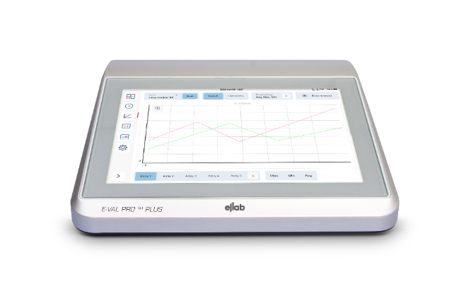
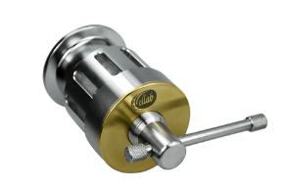
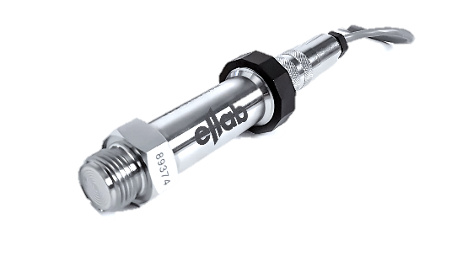
Components
E-Val Pro Plus Module
Thermocouple sensors, wires and connectors
ValSuite software
Data compilation and report generation compliant
with FDA CFR21 part 11 and GAMP 5
Calibration
Sensor arrays
Feedthrough systems
Fittings
11

Slide 12
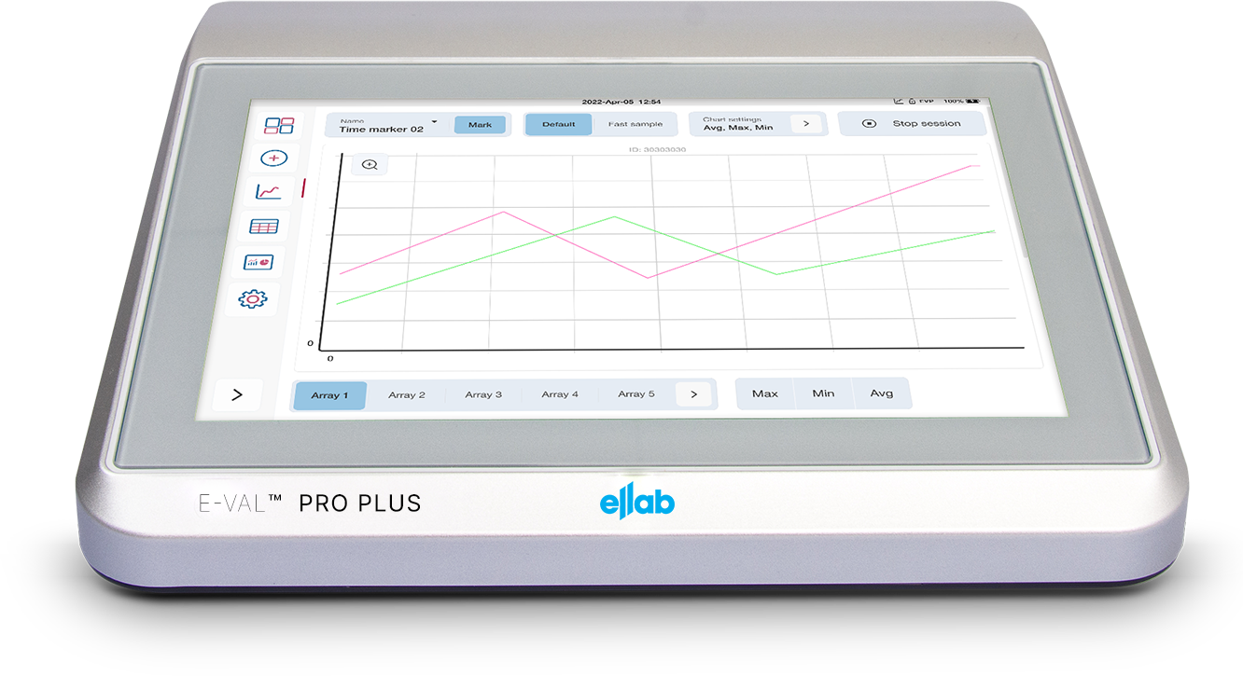
E-Val Pro Plus
Design: Module
E-Val Pro Plus
Features
Small footprint (276 x 238 x 112mm ) with up to 52 channels per module
Compact size and low weight of maximum 4 kg* allows for total mobility and easy setup
Smooth and rounded cabinet design with 10” color touch display allows for optimal cleaning e.g., cleanroom
Accurate to ±0.1°C and fast sample rate speed
of 1 sec / all 52 channels
(*) Fully configurated with 5 arrays

Slide 13

E-Val Pro Plus
Design: Module
E-Val Pro Plus
Features
Expanded memory for storing up to 20 individual studies*
Stand-alone operation using Authentication system (access login) - or PC connected through LAN/USB
Programmable auto-start (time) - also as stand-alone mode
Internal rechargeable battery pack for 12 hours operation
(*) 52 channels with 1 second sample rate in 12 hours for 20 sessions

Slide 14
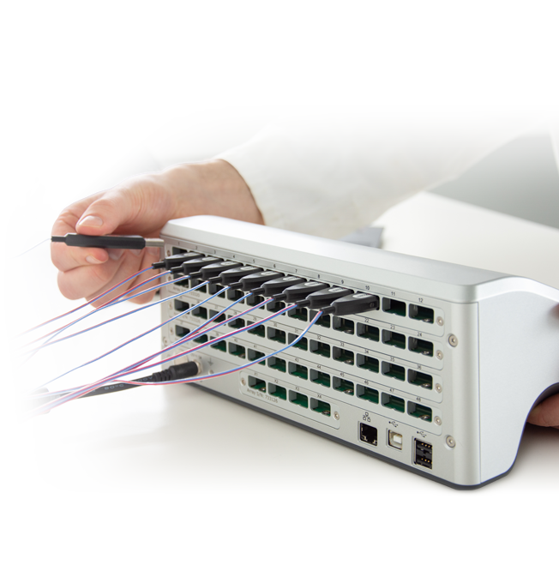
Sensor Arrays
Features
Previous Sensor Arrays (E-Val Pro) are compatible with the new E-Val Pro Plus
Galvanic arrays available (to use with not isolated sensor tips)
Versatile configuration with interchangeable Sensor Arrays
Designed for Thermocouples, Ellab pressure and RH sensors, 4-20 mA and 0-10V sensors and digital Input/Output connectors
4 channel multipurpose sensor array

Slide 15
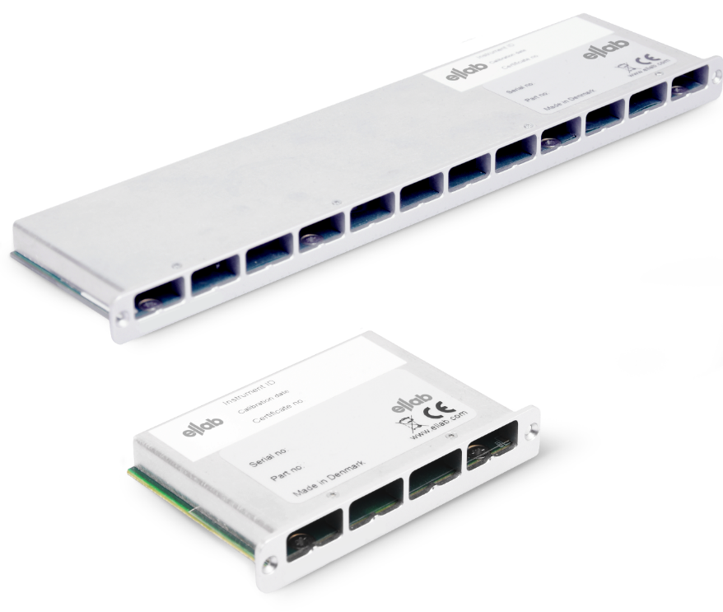
Sensor Arrays
E-Val Pro Plus
Features
Type | Wire Composition |  | Typical EMF Output and Range
B | Platinum-30% Rhodium | Platinum – 6% Rhodium | 0 to 13 mV0 to 1820 °C
E | Nickel – Chromium Alloy | Constantan (Copper-Nickel Alloy) | -10 to 77 mV-270 to 1000 °C
J | Iron | Constantan (Copper-Nickel Alloy) | -8 to 70 mV-210 to 1200 °C
K | Nickel – Chromium Alloy | Nickel – Aluminum Alloy | -6 to 55 mV-270 to 1372 °C
N | Nickel – Chromium - Silicon Alloy | Nickel – Silicon Alloy | 9 to 46 mV-270 to 1300 °C
R | Platinum – 13% Rhodium | Platinum | 2 to 12 mV-50 to 1450 °C
S | Platinum – 10% Rhodium | Platinum | 2 to 11 mV-50 to 1450 °C
T | Copper | Constantan (Copper-Nickel Alloy) | 4 to 19 mV-270 to 400 °C
TC type T (ready for type K,J, B, E, N, R and S)*
I/O relay
12 channel TC sensor array, type T (ready for type K,J, B, E, N, R and S) as well as other low power analog/digital inputs.
(*) Versatile with a wide range of industry standard thermocouples

Slide 16


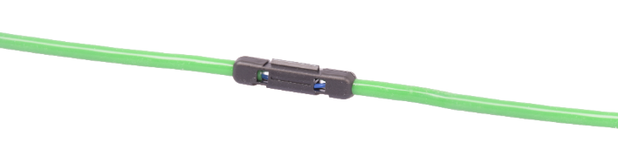
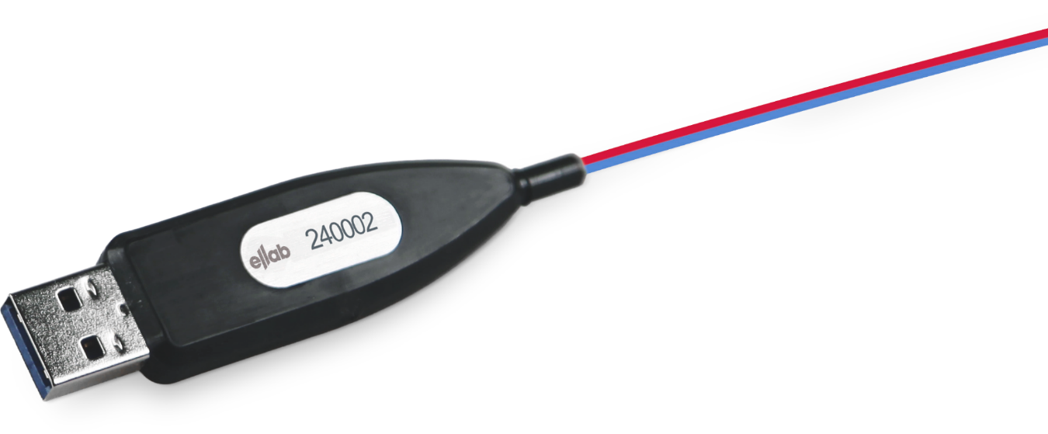
Smart Plug
Features
Traceable and interchangeable smart thermocouples
Significantly reduced time for pre- and post-calibration
The plug is molded and fully sealed at the TC entry point to prevent any capillary water from the autoclave seeping into the sensor array.
Drain for channeling water away from the sensor plug
Benefits
Ease of use when switching thermocouples with no data loss
No disturbances or discrepancies in data monitored and transmitted due to leakages

Slide 17
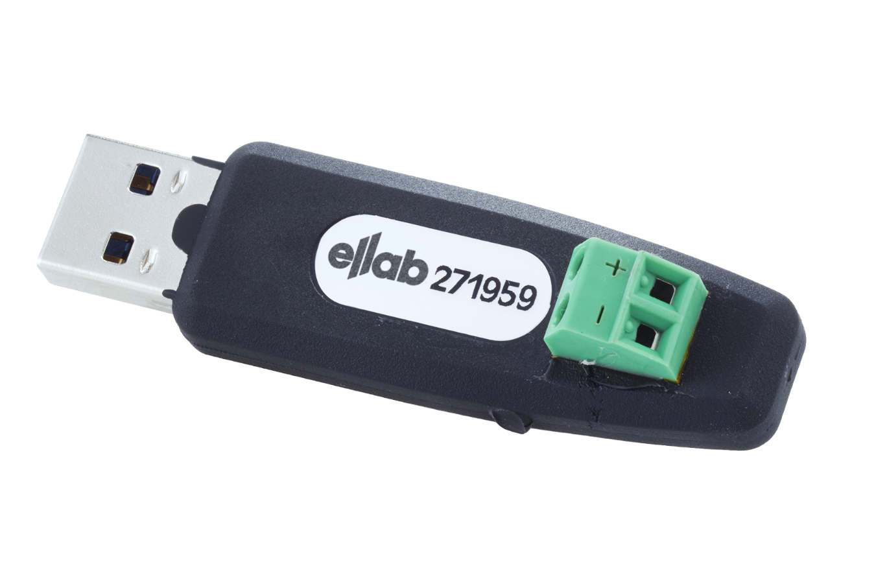
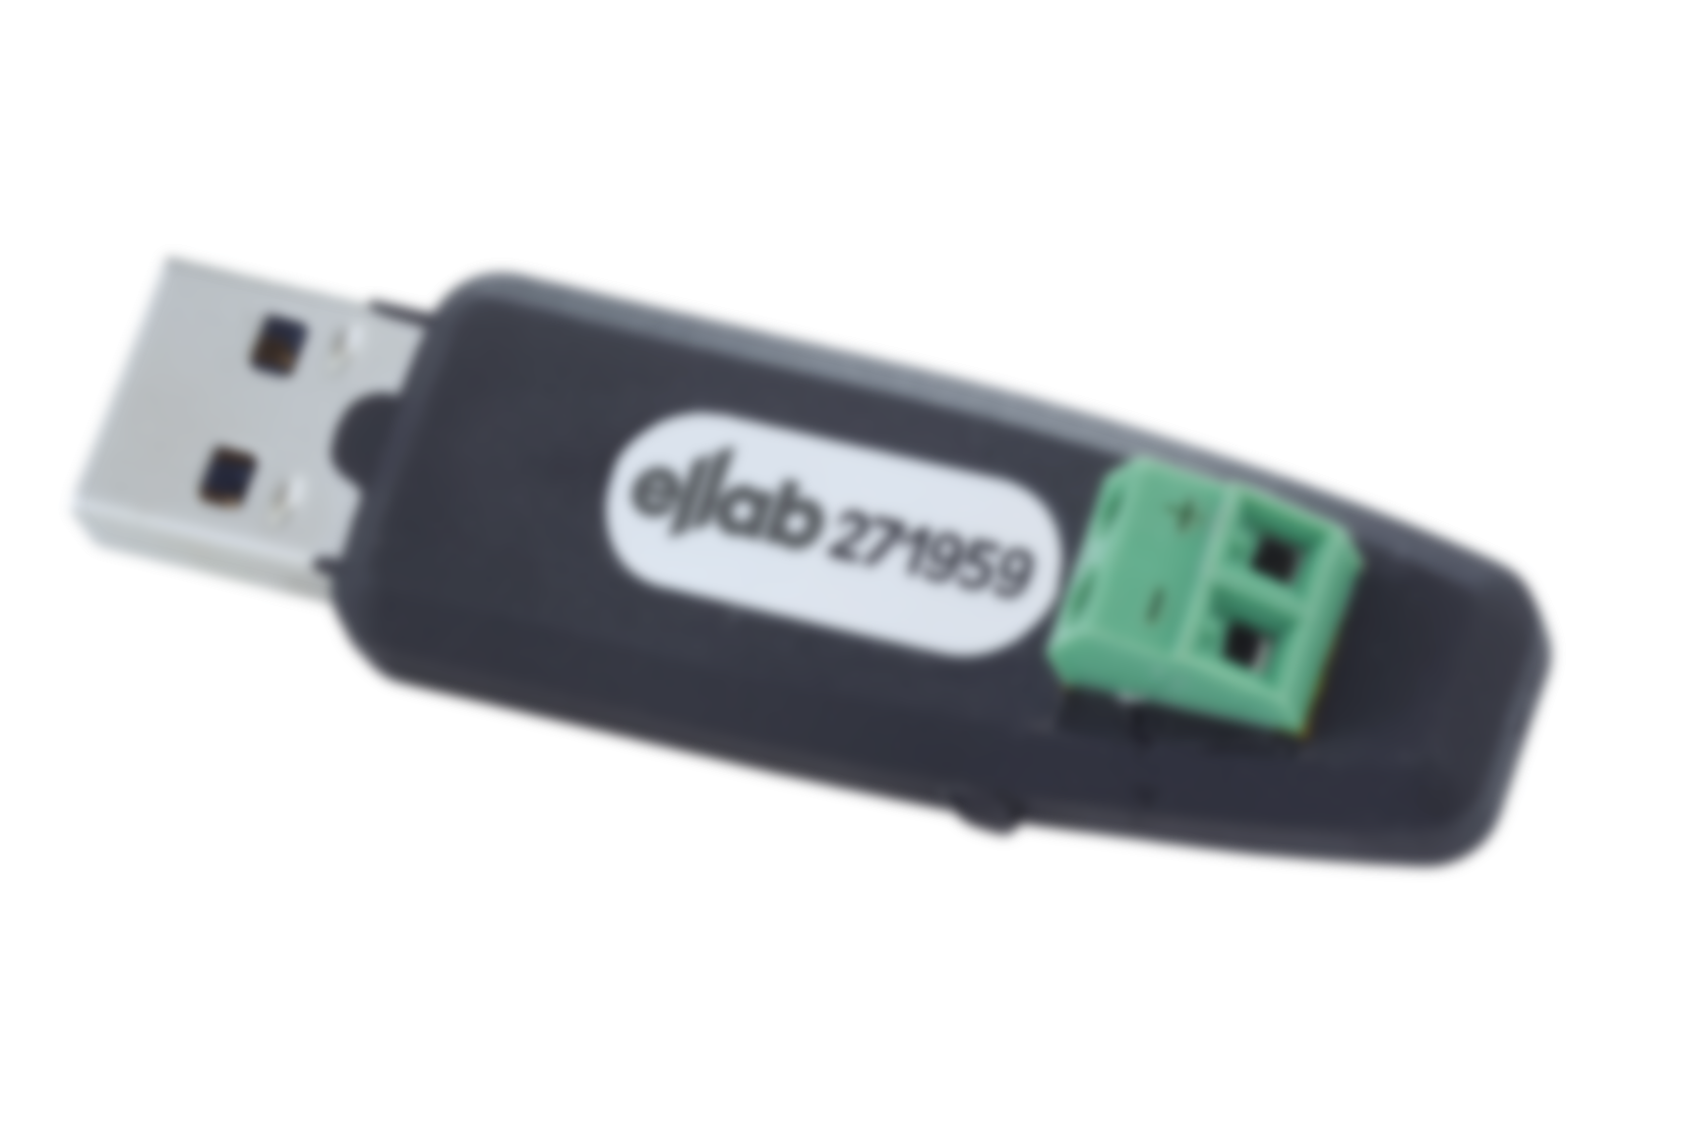


Smart Plug
Features
Unique & coded screw terminal plugs available as:
  Thermocouples type T
  Thermocouples type N,J,K and R
  Ellab pressure and RH sensors
  4-20 mA or 0-10 V sensors
  Digital in- and outputs
Integrated PT1000 sensor for cold junction compensation
ID # for traceability
Memory for calibration offsets (factory and user)
Benefits
Individual cold junction compensation for each TC sensor, enabling high accuracy
Smart Plug enables switching out sensors prior to starting a validation session

Slide 18
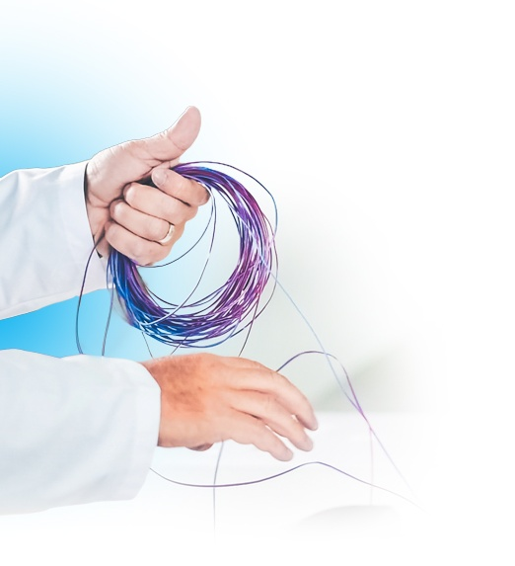
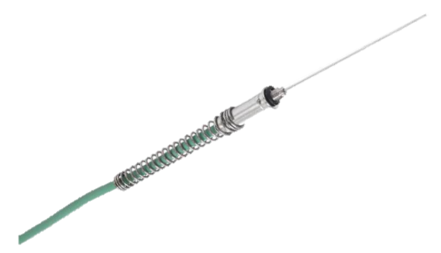
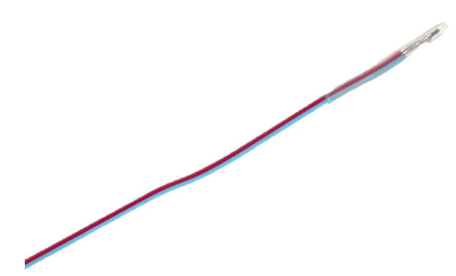
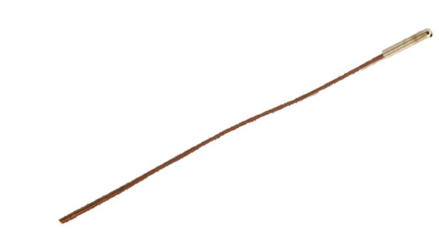
Thermocouples
E-Val Pro Plus
Welded Copper/ Constantan tip combined with FEP insulation provides a well-defined measuring point
Type T ultra premium grade, 7 strand thermocouple
Vacuum proof FEP insulation and PTFE protection cap provides extended cycle lifetime
SSA thermocouples with silicone jacket
for improved handling (e.g. food industry customer)
STC thermocouples have drains approx. 3 ft. from the plug to drain any capillary water from the autoclave
Ellab’s smart thermocouples are easy to clean/disinfect due to round and smooth design with no screw terminal connections or open-ends

Slide 19
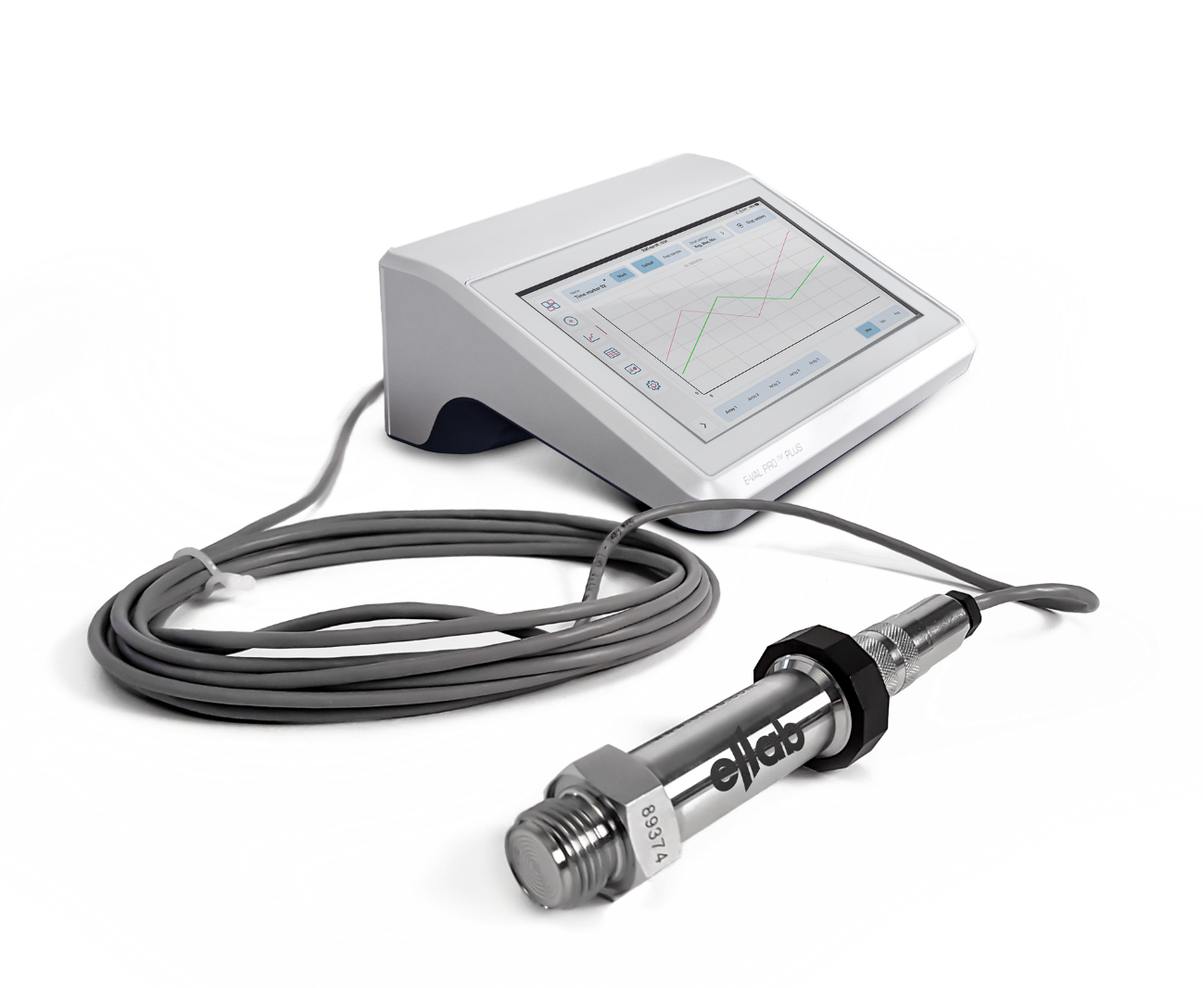
Sensor Interface
Expand the usage of E-Val Pro Plus with additional parameters e.g., Pressure, CO2, RH and Conductivity
Compatible with all TSP sensors / easy mounting by using standard pin connector
Optional thread adaptors for ½” and ¾” connection
Easy connection of the Sensor Interface to the sensor array by using USB plug
Use several sensors in the same process, e.g. making it possible to monitor both internal pressure in the container and inside the autoclave
User calibration constants stored in USB plug
Requires ValSuite 5.2 or later version

Slide 20
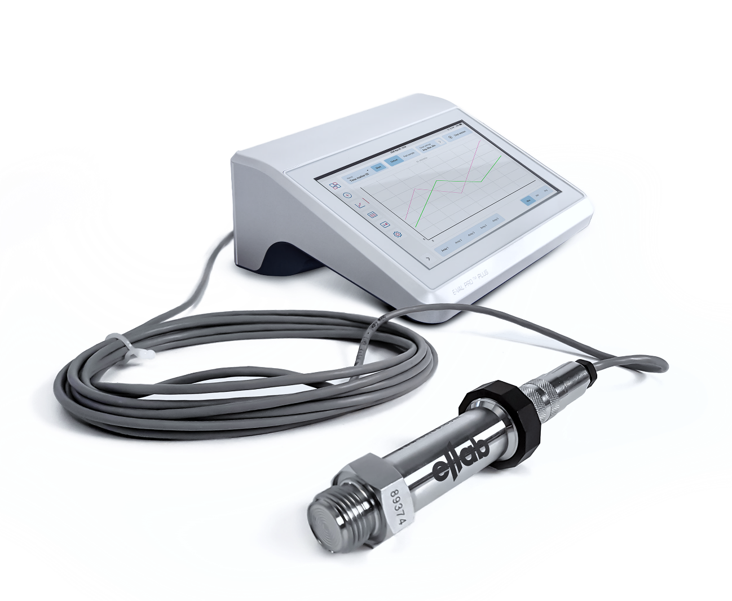
Sensor Interface
Expand the usage of E-Val Pro Plus with additional parameters e.g., Pressure, CO2, RH and Conductivity
Compatible with all TSP sensors / easy mounting by using standard pin connector
Optional thread adaptors for ½” and ¾” connection
Easy connection of the Sensor Interface to the sensor array by using USB plug
Use several sensors in the same process, e.g. making it possible to monitor both internal pressure in the container and inside the autoclave
User calibration constants stored in USB plug
Requires ValSuite 5.2 or later version

Slide 21

Agenda
1. Ellab Expertise
2. E-Val™ Pro Plus – Wired Validation
3. E-Val™ Pro Plus Key Features & Benefits
4. E-Val™ Pro Plus Comparisons

Slide 22
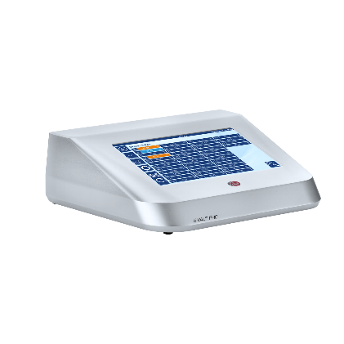

E-Val Pro Plus versus E-Val Pro
Themes | E-Val Pro Plus | E-Val Pro
Battery Back-up | 12h | 8h
Memory | +10GB data collection | 0.5GB data collection
Weight & | Module & TCs = 4.0kg | Module & TCs = 3.4kg
Footprint | Footprint = 276 x 238 x 112mm | Footprint = 271 x 220 x 82mm
Display | 10.1” capacitive touch screen Easy to clean & glove capable | 8” integrated touch screen (resistive)
Cooling | Passive Cooling | Passive Cooling
# of channels | 52 arrays available | 40 arrays available

Slide 23
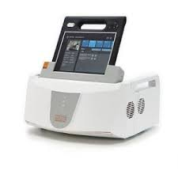
E-Val Pro Plus versus Competitor A
Specifications | E-Val Pro Plus | Competitor A
Operation | The ValSuite software is the center of our validation solutions, which ensures full flexibility and integration between the E-Val Pro Plus module and TSP sensors. | The system is designed as a self-contained (stand-alone) equipment pre-loaded and configured with software
User Interface | New improved GUI for easy & fast set-up of sessions enabling flexibility in set-up | All settings, reporting etc for a study need to be set in the software prior to start, which eliminates flexibility and fast start
Data Transfer | Easy data transfer to ValSuite via USB cable or ethernet or session transfer with USB Full flexibility & easy handling of sessions including SW & HW updates | Studies can be downloaded to a PC by USB stick for reporting

Slide 24
E-Val Pro Plus versus Competitor A
Specifications | E-Val Pro Plus | Competitor A
Battery Back-up | 12h | 3h for Validator & 6h for console
Memory | +10GB data collection | 4GB data collection
Weight | Module = 4.0kg (easier to transport) | Console = 1.33kg & Validator = 11kg
Footprint | Footprint = 276 x 238 x 112mm | Footprint = 411 x 381 x 190mm
Display | 10.1” capacitive touch screen Easy to clean & glove capable | 11.6” capacitive touch screen Anti-glare, anti-smudge & glove capable
Cooling | Passive Cooling | Fan Cooling

Slide 25
E-Val Pro Plus versus Competitor A
Specifications | E-Val Pro Plus | Competitor A
Channels | 52 total (1 array of 4 channels & 4 arrays of 12 channels) | 48 distributed in 4 SIMs of 12
Sensor Connectivity | USB sensors plugged into any channel port USB plug with ID for easy SW recognition | Push Pin Connectors
Sensor Replacement | Interchangeable sensor with calibration constants | Each SIM need re-calibration with sensor replacement

Slide 27

Back Up Slides
1. Technical Specifications
2. Demo Session Checklist
3. Hands-On – EVP Plus menus Step-by-Step

Slide 28
E-Val Pro Plus
Technical Specifications - Module
Module Specification | E-Val Pro Plus
Operating Range | 5° to 50°C
Environmental | 0 - 90% RH, non-condensing
Sample Rate/Time accuracy | 1 sec per 24 hours
Weight | 4.0kg (with battery & 52 channels)
Electrical Protection Class | IP40
Power Consumption | < 30 watts (52 temperature sensors)
Memory | 52 channels with 1 sec sample rate in 12h for 20 sessions
# of channels | 52

Slide 29
E-Val Pro Plus
Technical Specifications - Module
Temperature Specification | E-Val Pro Plus
Measuring Range | - 200° to +1300°C (ready for -270° to +1820°C) depending on sensor type
Measuring Range (Type T) | - 200° to + 400°C
Measuring Accuracy at ambient temperature at 23° C (Type T) | ± 0.05°C between – 100° & + 400°C, and ± 0.1° C between - 200° & – 100°C*
Total System Accuracy at ambient temperature of 23° C (Type T) | ± 0.10° C between – 50° & +150°C
Resolution | 0.01° C

Slide 30

How to demonstrate
Several uses of E-Val Pro Plus that would be useful for a customer to experience in a demonstration.
Turn on, check setup, and navigate
Run E-Val Pro Plus as standalone (+ import in ValSuite)
Run E-Val Pro Plus from ValSuite
Advanced templates
Unit templates
Delayed start/stop
Lethality calculation
Standalone navigation features (graph, settings, time markers, calibration details)
Classic mode
Custom sensor
TSP interface

Slide 31
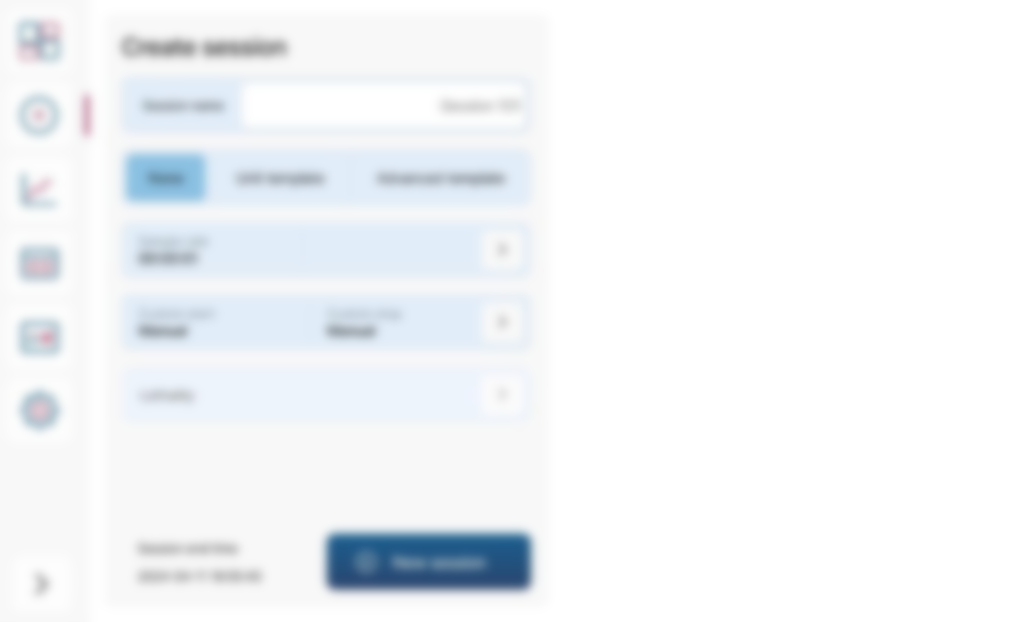

E-Val Pro Plus
Hands-On
Ellab Wired Validation Solutions
– Operation Modes
With Ellab Wired Validation Solution you have full flexibility and can operate in three modes:
Operating and Running sessions directly from ValSuite
Semi Stand-alone, where the session is setup in ValSuite, while the E-Val Pro Plus Module is used, when the session is running
Operating the E-Val Pro Plus Module as a stand-alone
Instrument Mode
(*) Fully configurated with 5 arrays

Slide 32

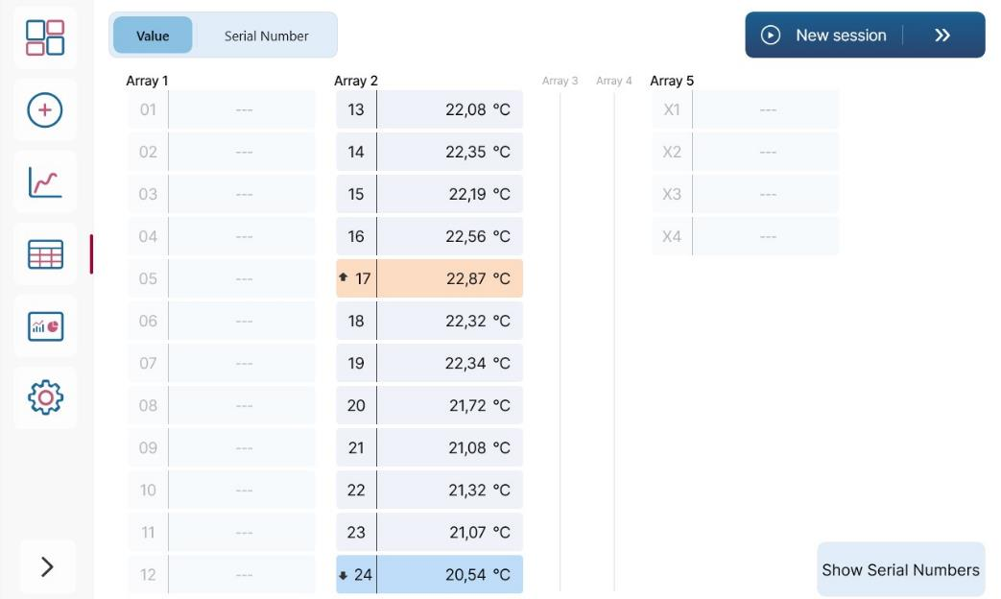
E-Val Pro Plus
Hands-On
Starting up the E-Val Pro Plus Module
When the E-Val Pro Plus Module is turned on or rebooted, the following start-up screen will appear:
In this menu, Sensor View it is easy to check, if all sensors are:
Connected, the live value is showed
In the correct channel as the serial number can be displayed
From this menu, it is possible to navigate directly to the Session menu for starting a new session

Slide 33
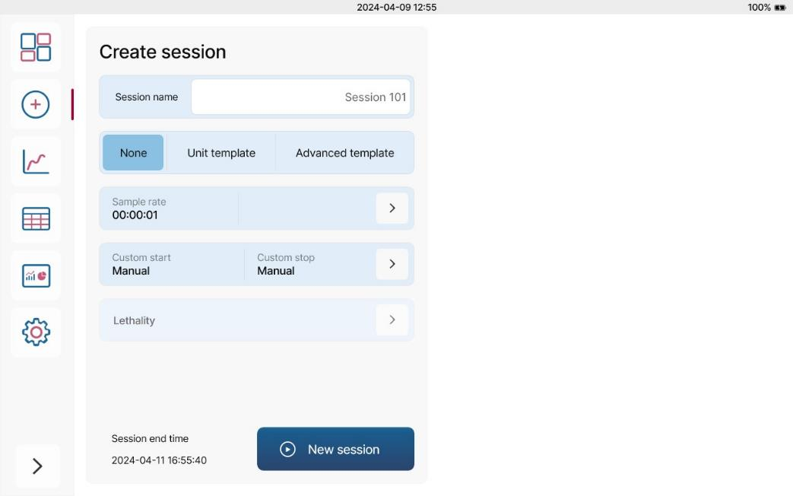
E-Val Pro Plus
Hands-On
Session Menu
Start a New Session:
In this menu, Sensor View it is easy to check,
if all sensors are:
Input Session Name
Add Unit Template (if transferred to the module)
Add Advanced Template (if transferred to the module)
Set Sample Rate, default is 1 sec.
Add fast sample rate (only possible if default sample rate is changed)
Set Custom Start and Stop
Add Lethality

Slide 34
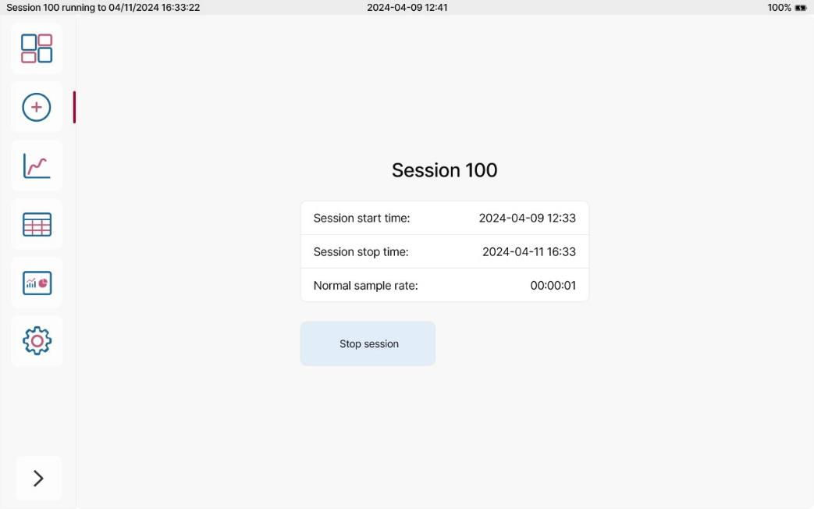
E-Val Pro Plus
Hands-On
Session Menu
When a session is running, this menu will show information about Session Name, Start and Stop Time and Sample Rate(s)

Slide 35
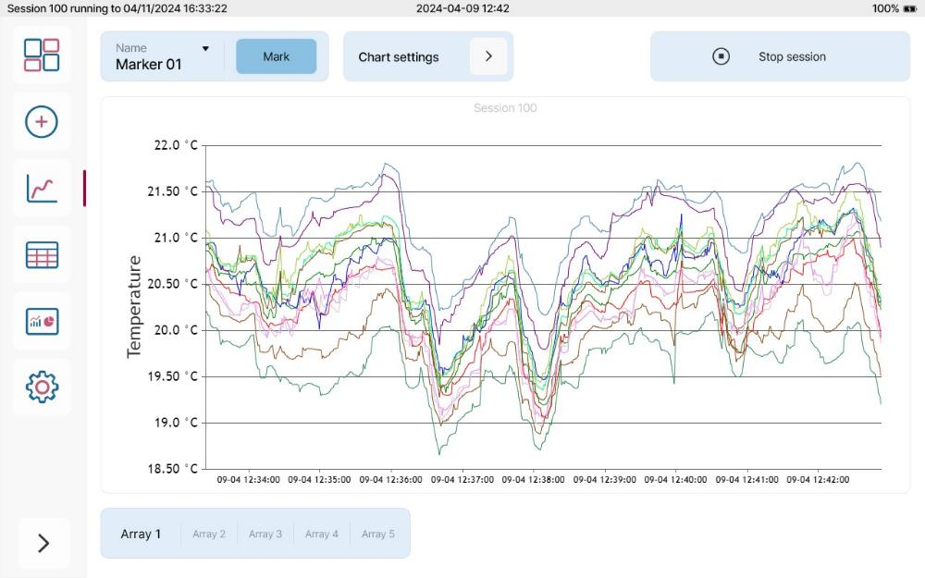
E-Val Pro Plus
Hands-On
Chart – Live Data in a Graph
When a session is running the following can be edited:
In this menu, Sensor View it is easy to check,
if all sensors are:
Chart Settings: - add statistics, edit units at the Y-axis and change the Session View Mode
Highlight specific sensors: Select Array followed by Sensor position
Time markers can be added
Zoom in on specific data points
A session can be stopped from this menu too
Note: If no session is running, the graph will be updated with live data

Slide 36
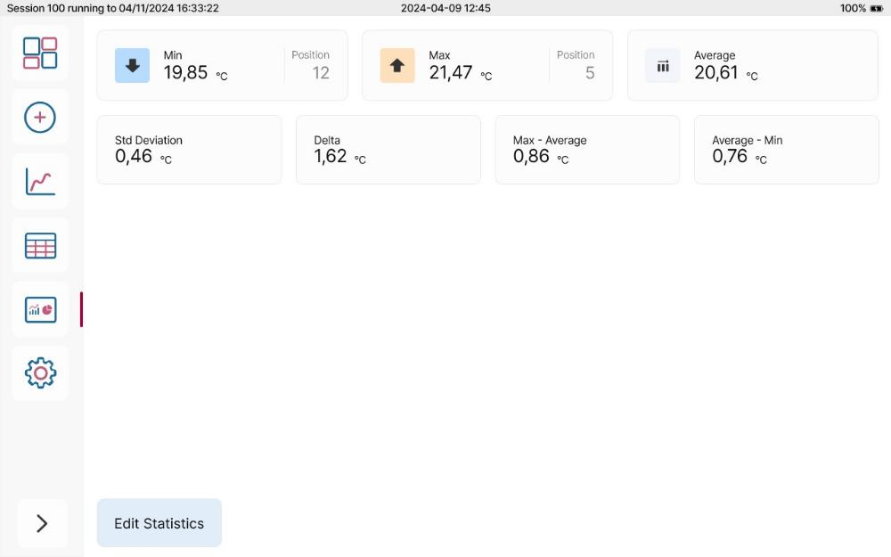
E-Val Pro Plus
Hands-On
See Statistics on the Module
From this menu, it is possible to review, add or remove statistics:
As default min, max and average temperature values will be shown
Additional statistics can be added or removed from a pre-defined menu either before or during session
A session can be stopped from this menu too
Note: The statistics can be added before a session or when
a session is running.
It is live values and will not be imported to ValSuite

Slide 37
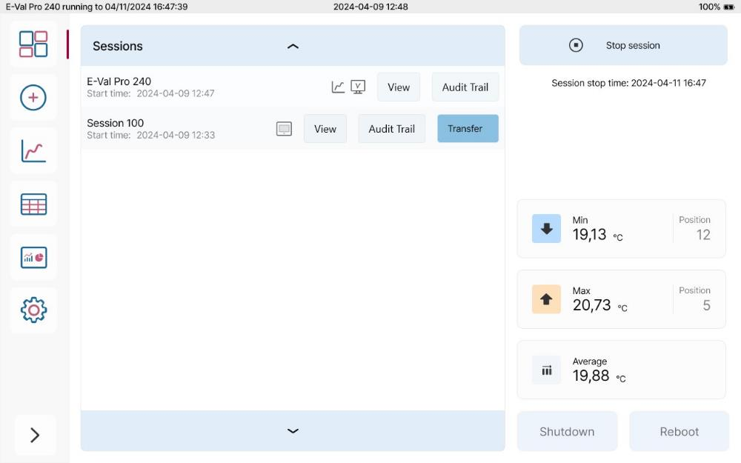
E-Val Pro Plus
Hands-On
The Overview
This menu will give you a quick overview before, during or after a session.
Here is information about:
Overview of the sessions stored on the module
Icons will show, if the session has been running as stand-alone or from ValSuite and indicate as well if a stand-alone session has been transferred to ValSuite
Navigate directly to the session menu or stop a session
Live Statistics
Shutdown or reboot the module

Slide 38
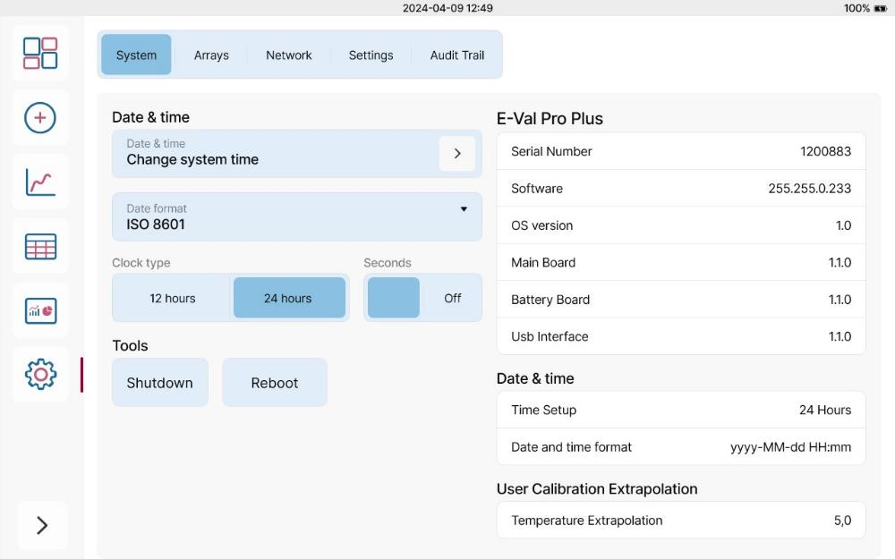
E-Val Pro Plus
Hands-On
Control Center - System
Here it is possible to:
Set Data & Time, Date Format and Clock Type
Find system information about firmware and hardware of the E-Val Pro Plus
Shutdown or Reboot the E-Val Pro Plus Module

Slide 39
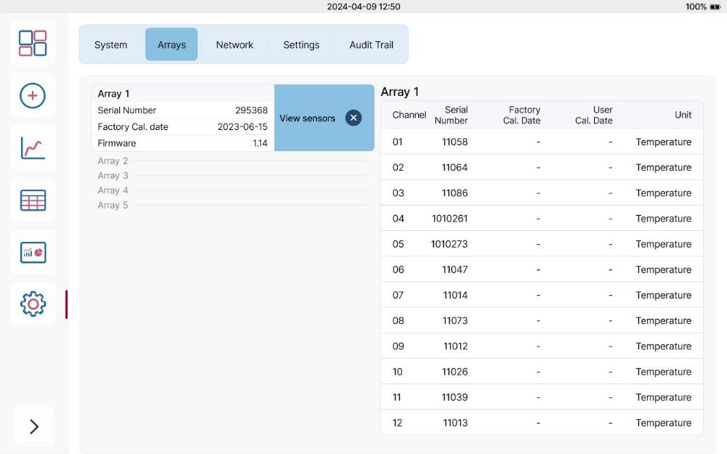
E-Val Pro Plus
Hands-On
Control Center - Arrays
Information about the arrays and sensors:
Serial Number
Factory Calibration Date
User Calibration Date (only sensors)
Firmware (only arrays)
Unit (only sensors)

Slide 40
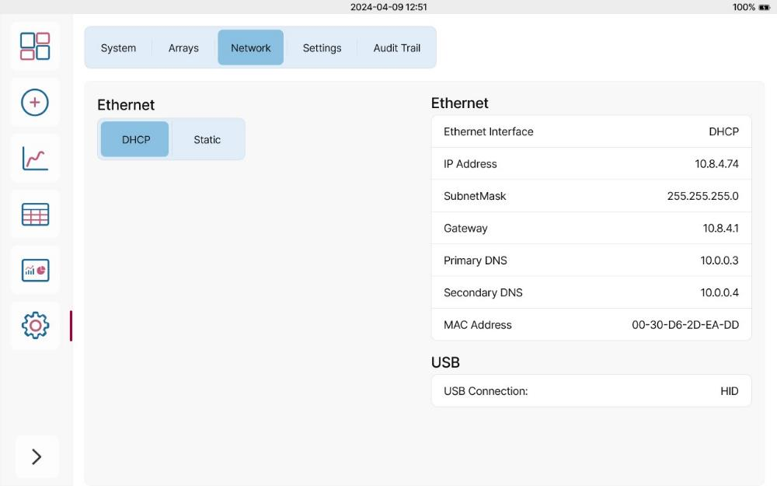
E-Val Pro Plus
Hands-On
Control Center - Network
Network information about ethernet and USB:
The ethernet connection can be set to either DHCP or Static
If Static is chosen, Ethernet Information can be edited
When running the E-Val Pro Plus in Classic Mode the USB connection: USB1, USB2 or USB3 can be selected

Slide 41
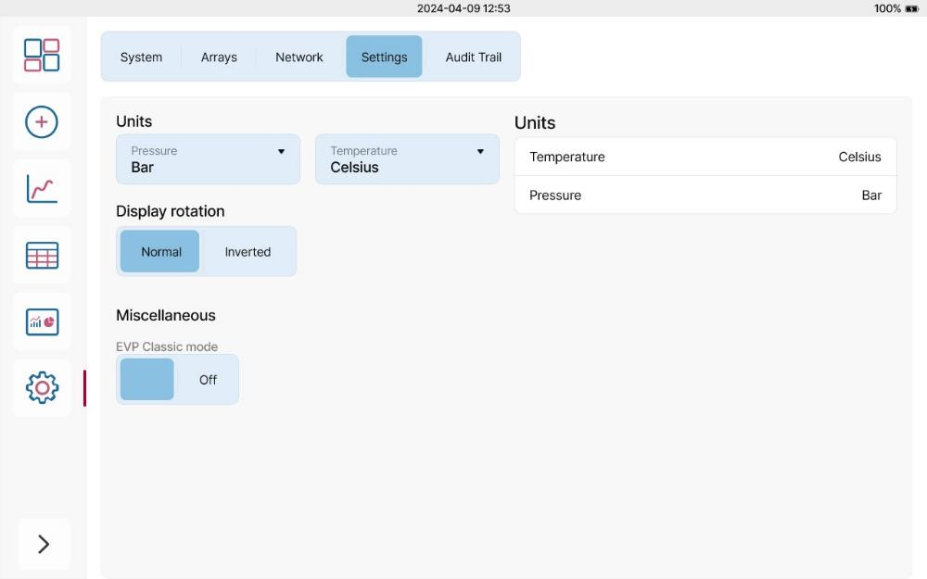
E-Val Pro Plus
Hands-On
Control Center - Settings
In this sub-menu it is possible to:
Change Units of Pressure and Temperature (this cannot be changed during a session)
Rotate the Display
Change the mode of the module from E-Val Pro Plus-mode to Classic Mode*
Note: In Classic Mode the E-Val Pro Plus module will be running and configurated like an E-Val Pro Module i.e. It is only possible to use 4 Arrays: 1 to 3 from the top and the bottom array with 4 channels.

Slide 42
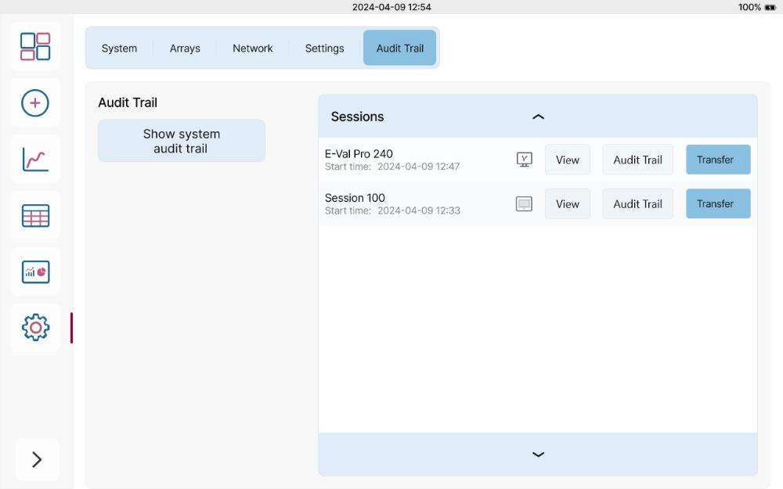
E-Val Pro Plus
Hands-On
Audit Trail
In this sub-menu it is possible to:
An audit trail of the E-Val Pro Plus module
An overview of all sessions stored in the E-Val Pro Plus modules memory. The list is identical to the list in the Overview-menu,

