Slide 1
Thermal Validation
The Ellab Way…

Slide 2


What We Offer
Your life science compliance partner.
Consistent across the globe.
Purchase  Rent  Lease  SaaS  On-Site  In-Lab  Consulting & Engineering  Staffing  Managed Services 
Ellab combines services and products to support your projects and daily operations – ensuring long-term compliance within validation, monitoring,
and calibration.
Equipment.
Services.
Expertise.
Tailored to
Your Needs
Notes:
Those 4 Core offerings are made to create awareness of the capabilities of Ellab throughout our organisation and facing the customer.

Slide 3
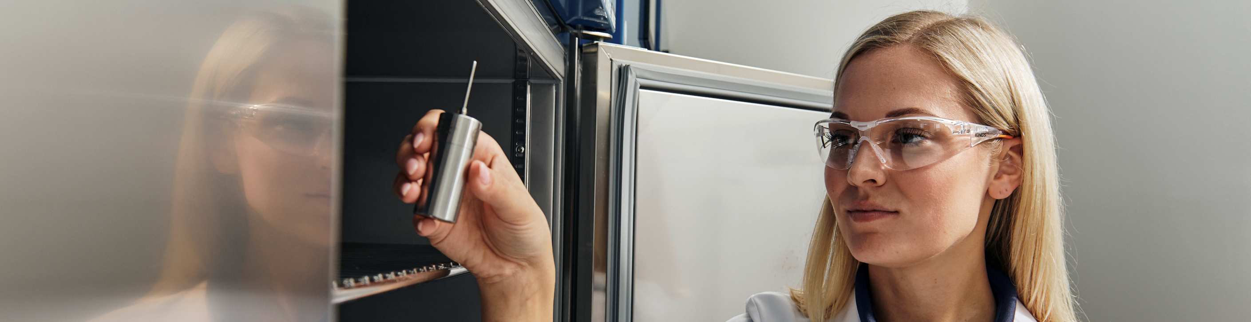
Thermal Validation
Your challenges are our daily business. Together, we find the perfect balance of Ellab’s equipment and service offerings.
Ellab enables you to minimize production downtime and keep your life science processes in a validated state by combining thermal validation equipment, services and expertise – tailored to your needs.

Slide 4




Thermal Validation
Validation Equipment & Mapping Services
Full Life Cycle Coverage, Globally
Support from initial concept to ongoing process verification and decommissioning.
Stay In Control of Your
Thermal Environments & Processes
Keep your projects and daily operations on schedule with Ellab’s thermal validation solutions.
Our unique combination of equipment and skilled manpower prevents bottlenecks and ensures consistent high-quality execution on site.
Consistent approach with standardized methods, tools, and documentation – tailored to your needs and deployed globally.
Scalable Solutions & Minimized Downtime
Access to massive fleet of validation equipment means simultaneous studies and reduced downtime.
Purchase, rent, or lease equipment for projects or peak periods – or hire engineers for the task.
Notes:
Ellab is able to support your full life cycle. Any thermal validation project from beginning until the end.
As we are able to do so, it eases up vender complexity and guarantees consistency for our customers.
We are able to scale up our solution by simultaneous mappings and the massive fleet of equipment behind. That will lead to massive time savings for our customers.
What makes us unique is the combination of equipment and manpower.
The flexible delivery options like, buy, rent or lease equipment and hiring engineers to do the job is one of our advantages on the market.

Slide 5



Thermal Validation Scope
Experts in a Wide Range of Applications…
Temperature-Controlled Storage
Sterilization & Decontamination
Bioprocessing & Manufacturing
Environmental & Stability Testing
Utilities & Facility Systems
Local Validation Engineers
Across the World…
150 in North America
140 in UK & Ireland
90 in Mainland Europe
With Access to a Massive
Fleet of validation equipment
+8.000 in North America
+4.500 in Mainland Europe
Your Life Science
Compliance
Partner
… that can be shipped across the globe.

Slide 6



Thermal Validation Services
Our offering spans from providing validation mapping equipment to turn-key on-site validation support
Deep expertise in Qualification and capability of ramping up on manpower and equipment to meet strict project timelines.
Qualification
Continuous Process Verification
Thermal Mapping Services
Protocol Generation
IQ/OQ/PQ qualifications
Temperature mapping studies
Process validation
Summary Reports
Requalification Services
Requalification & mapping studies
Review & update IQ/OQ documentation
Process validation enhancements
Notes:
Here some deeper details of our services in Thermal validation. What exactly can we do for our clients straight away on a very short notice.
- No one else combines equipment, expertise, and scale like we do – and we do it globally.
- We support our clients throughout the entire GMP journey – from beginning to end.
- Our resident consultants are not just resources – they help us see needs before the client does.
- CapEx projects strengthen trust and let us deliver seamlessly across borders.
- We sell structured solutions – not just time or bodies.
This is what positions Ellab as a strategic partner, not a service provider.

Slide 7
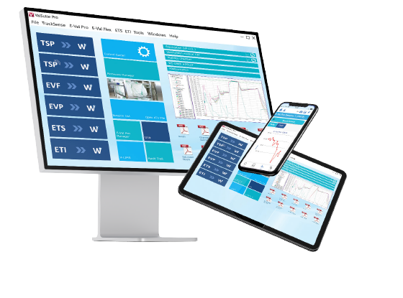
Validation Software
Everyday mapping made quicker with ValSuite®
Direct Pass/Fail criteria.
KNEAT integration
Merge sessions to detect trends.
Periodic evaluation.
Pre-defined reports according to ISO norms.
Local or client server installation.
Windows AD integrated security.
Citrix installation options.
Easy setup:
Installation & user setup
Result orientated:
Fast evaluation
Guaranteed data integrity.
Full system validation on site.
Data saved in encrypted database – no tampering possible.
Password protected – user profile operated.
Repeat sessions using the same setup.
Dual dynamic Auto transfer to work online and offline.
Drag-and-drop pictures in templates.
Time saving:
Pre-defined names & templates
Compliant:
21 CFR Part 11
& EU Annex 11
Your Life Science
Compliance
Partner
Notes:
All those services if done by our teams or the customers teams, are supported by the best software on the market for thermal validation projects.
Easy setup and various installation options to meet the customers requirements.
Compliant to the global standards.
Quick results & fast evaluation as well as compatibility with 3rd party validation software like KNEAT.
A real time saver, as you can repeat studies easily or start them with out any setup. You also can work offline and at the same time do reports somewhere else with the dual dynamic installation.

Slide 8
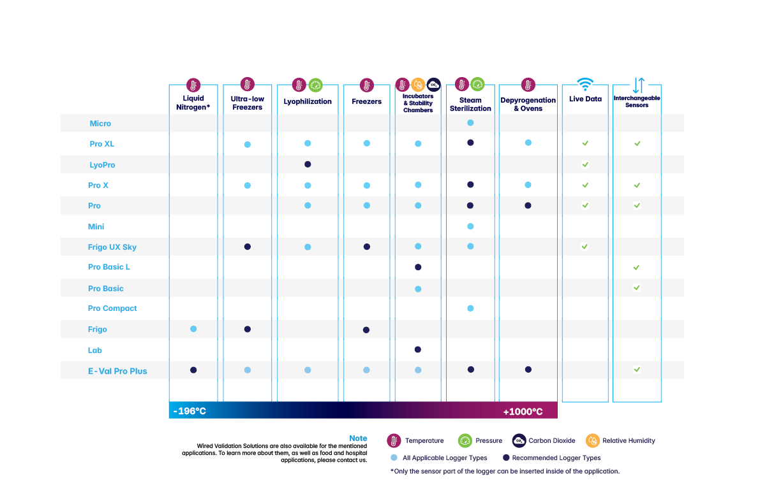
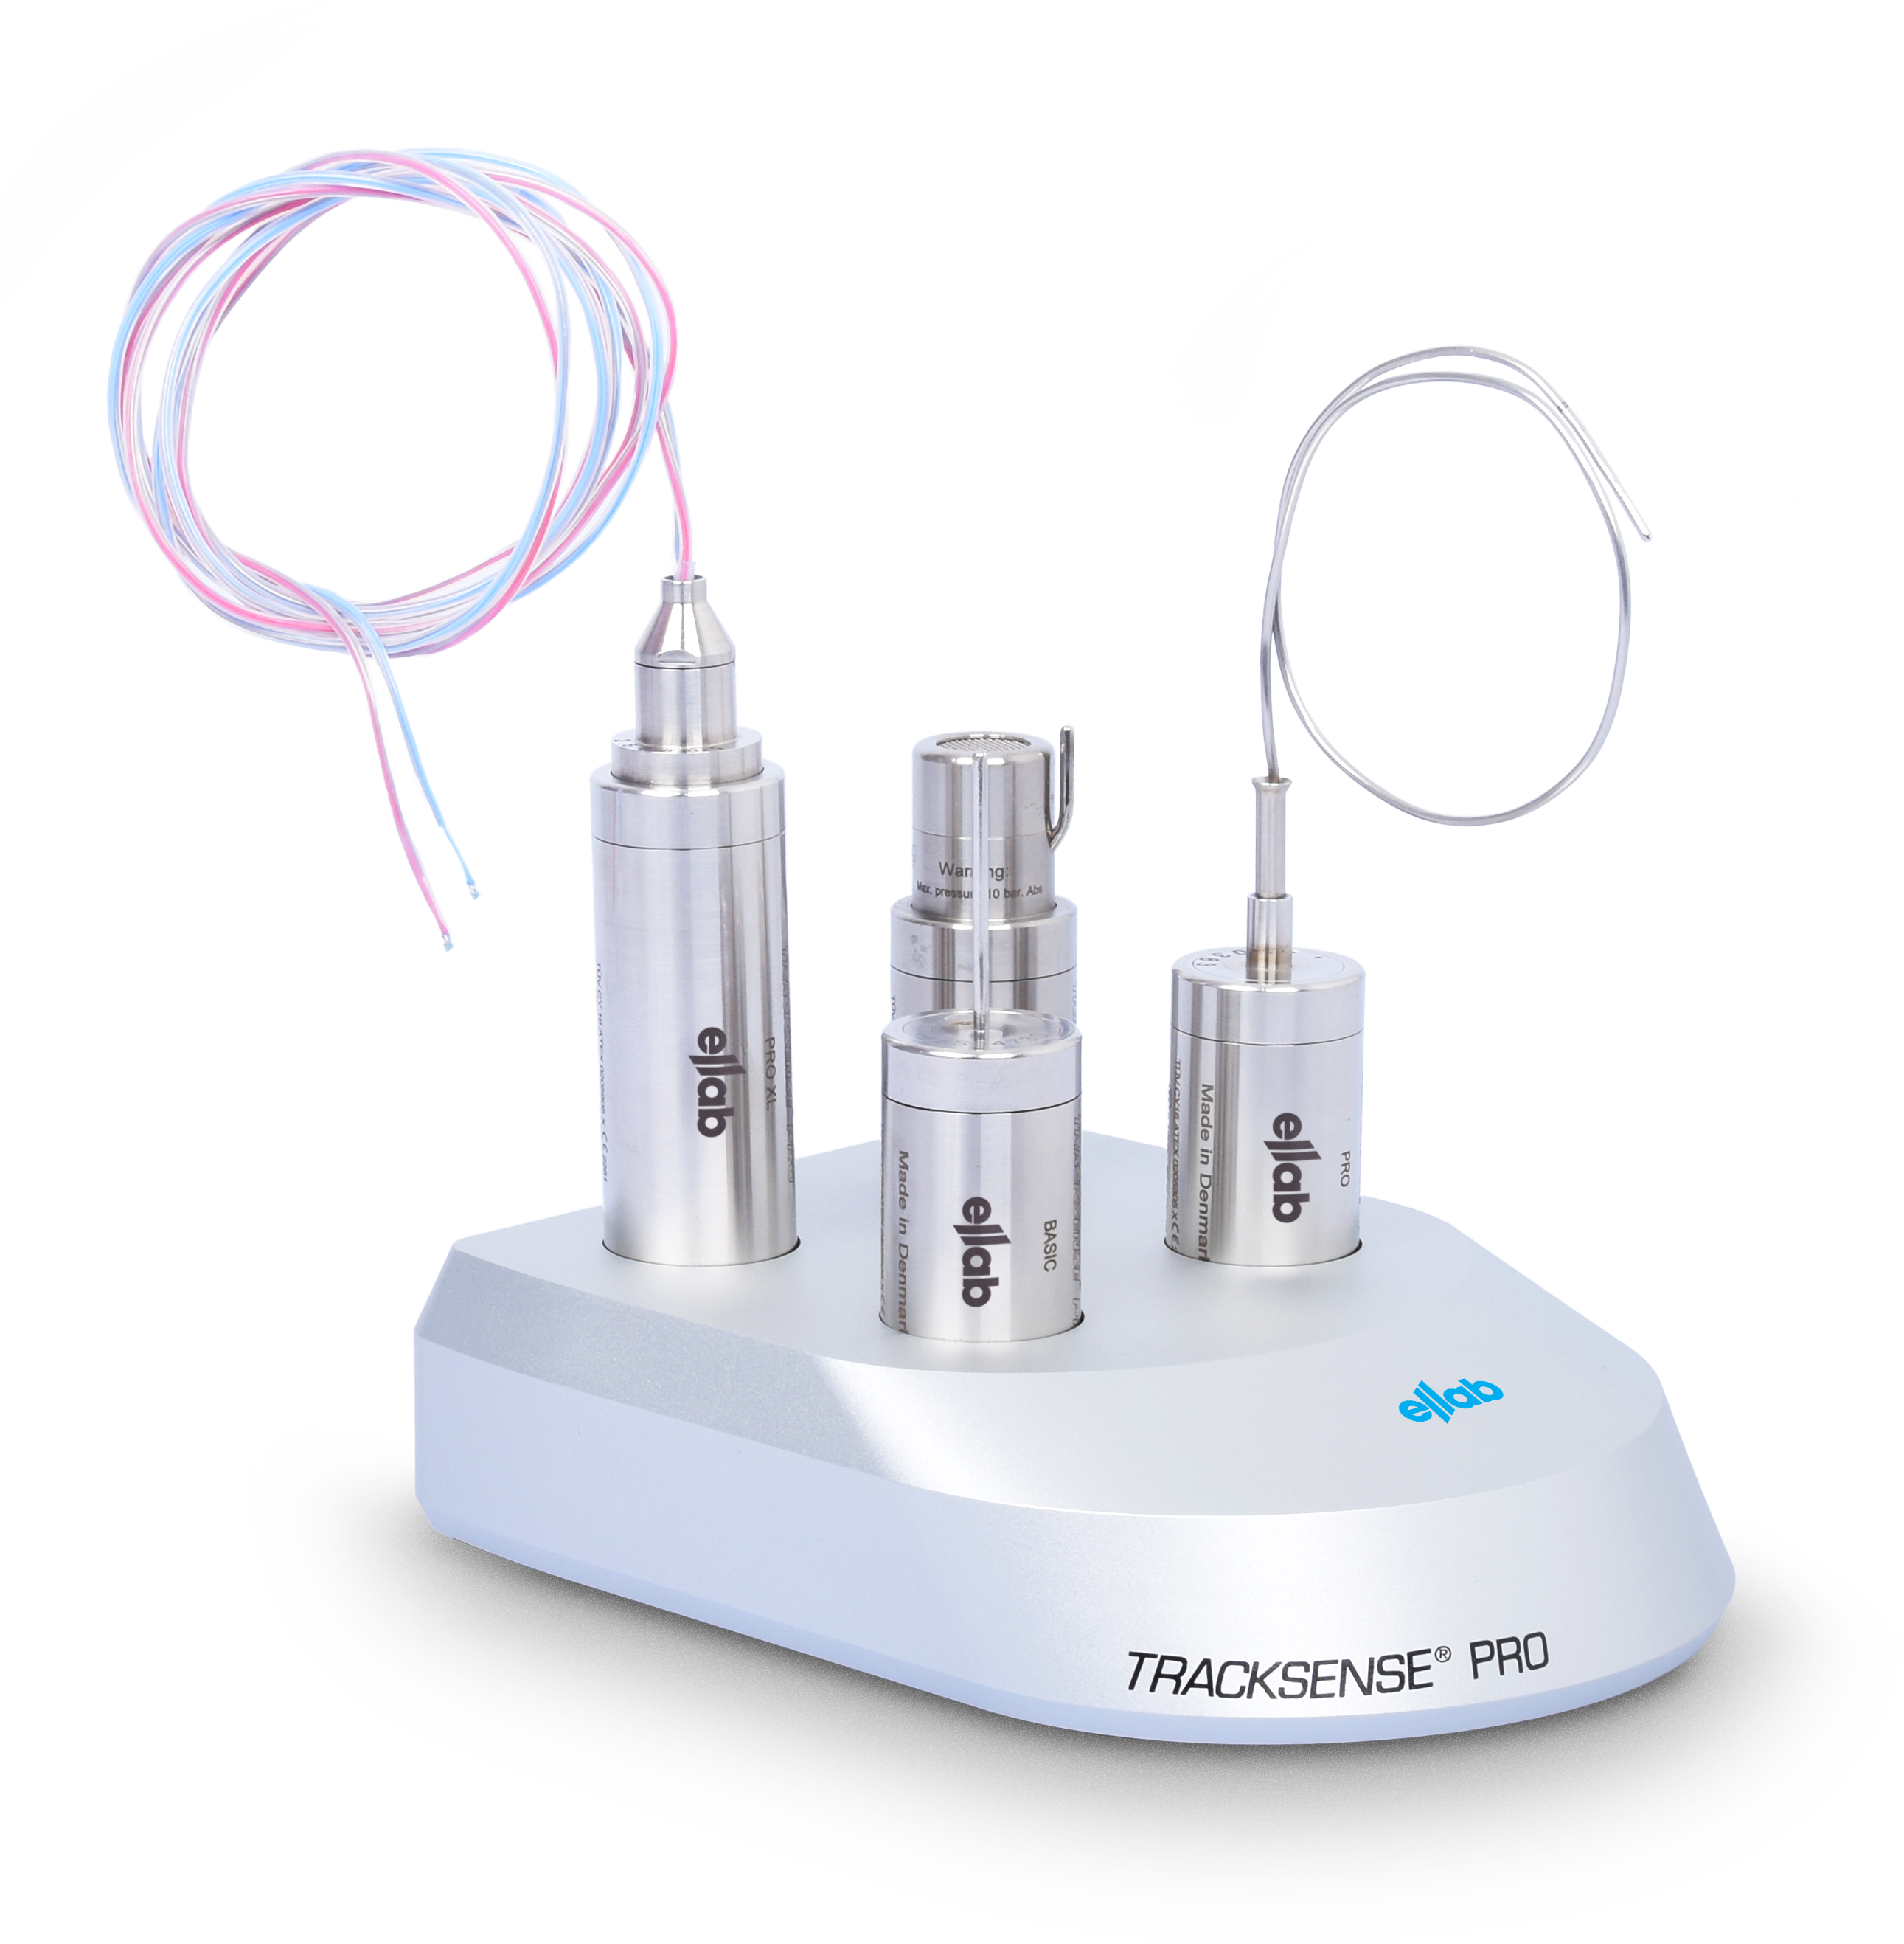
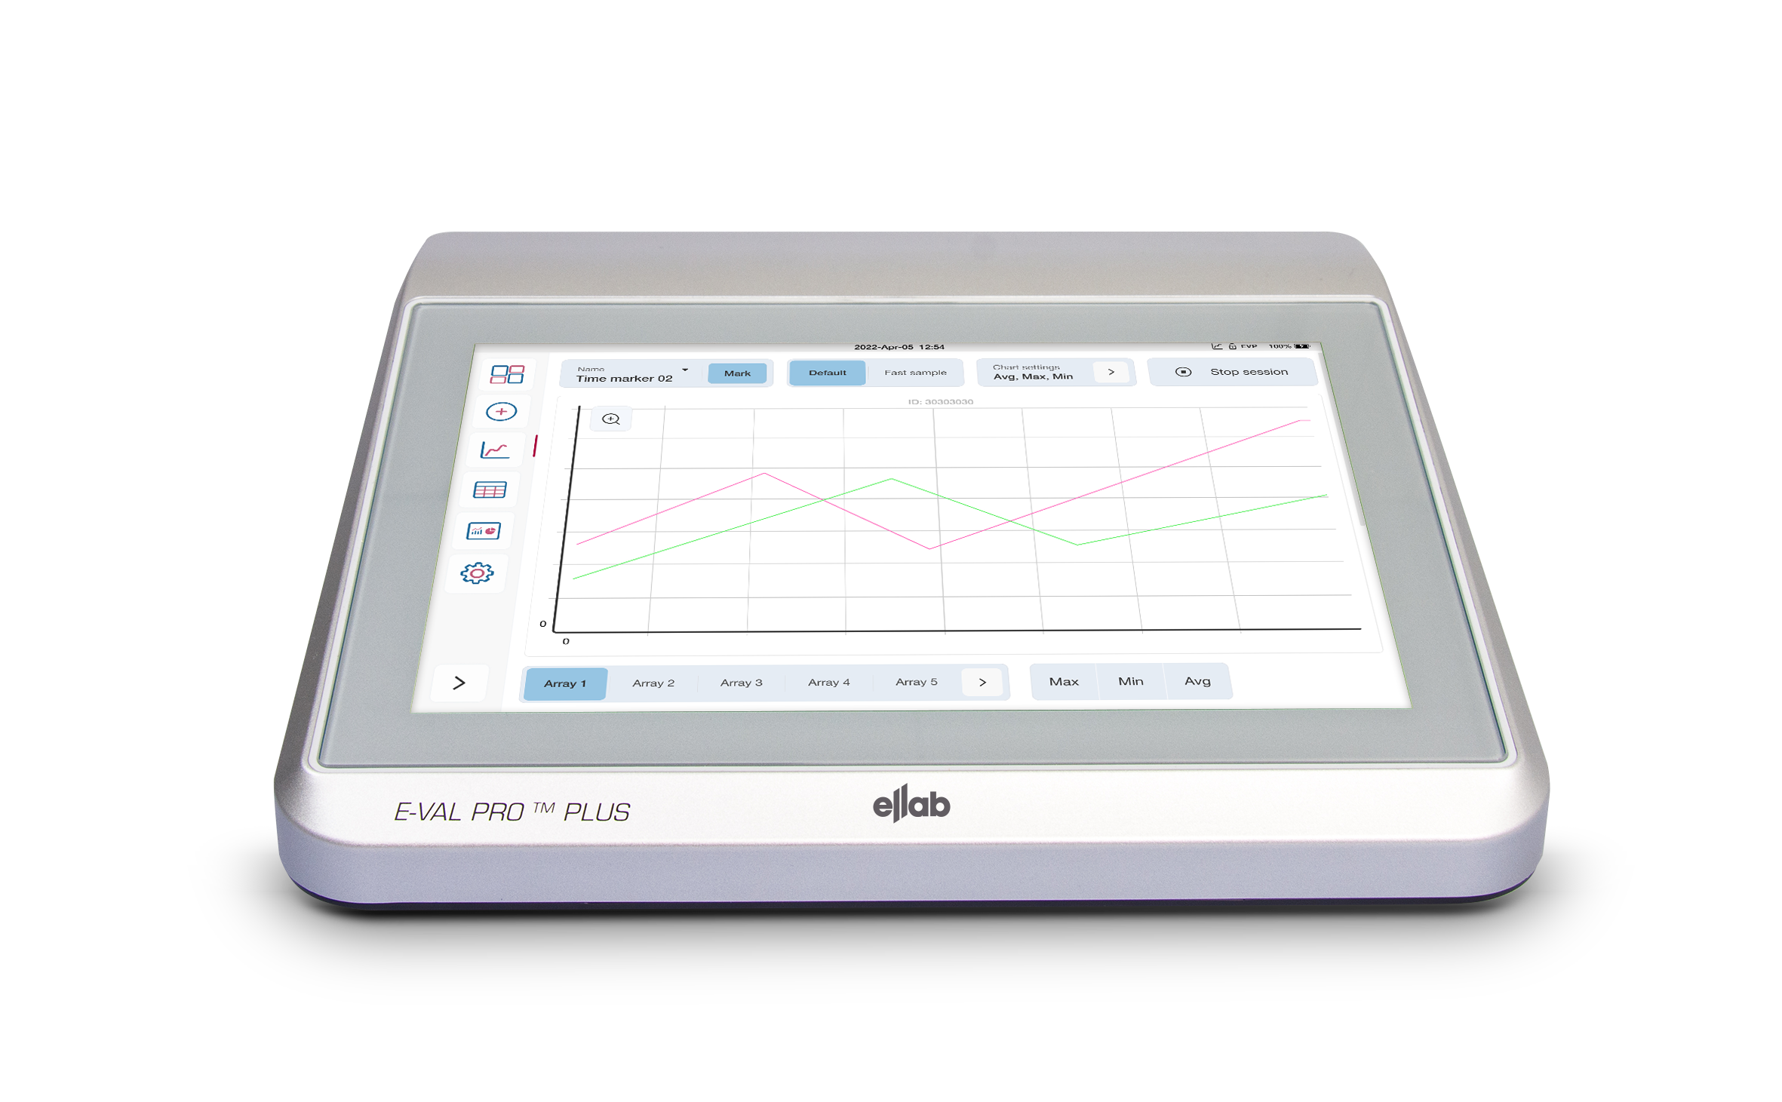

Validation Hardware
For each application, the perfect measurement solution
Notes:
Important as well is to choose the right Hardware for the application the customer needs to be mapped or qualified.
Here a short overview to give more details about the existing options.

Slide 9



Calibration & Service Agreement
We lighten the compliance burden to ensure your equipment is always ready to use
Reduce Downtime
Fast track calibrations
Immediate remote support
Reduce Costs
Included data logger batteries
Discount on repairs & parts
Free firmware updates
Free software updates within version numbers
Free delivery
Reduce Errors
Annual maintenance & inspection
Continuous training
Superior Support
We take care of your equipment
Notes:
A very strong selling point for validation equipment, is the aftermarket support in regards of turnaround times for calibration.
We are working on a global agreement that puts ellab in a advanced position to the competitors and guarantees a high satisfaction for our customers.

