Slide 1
Continuous Monitoring The Ellab Way…

Slide 2

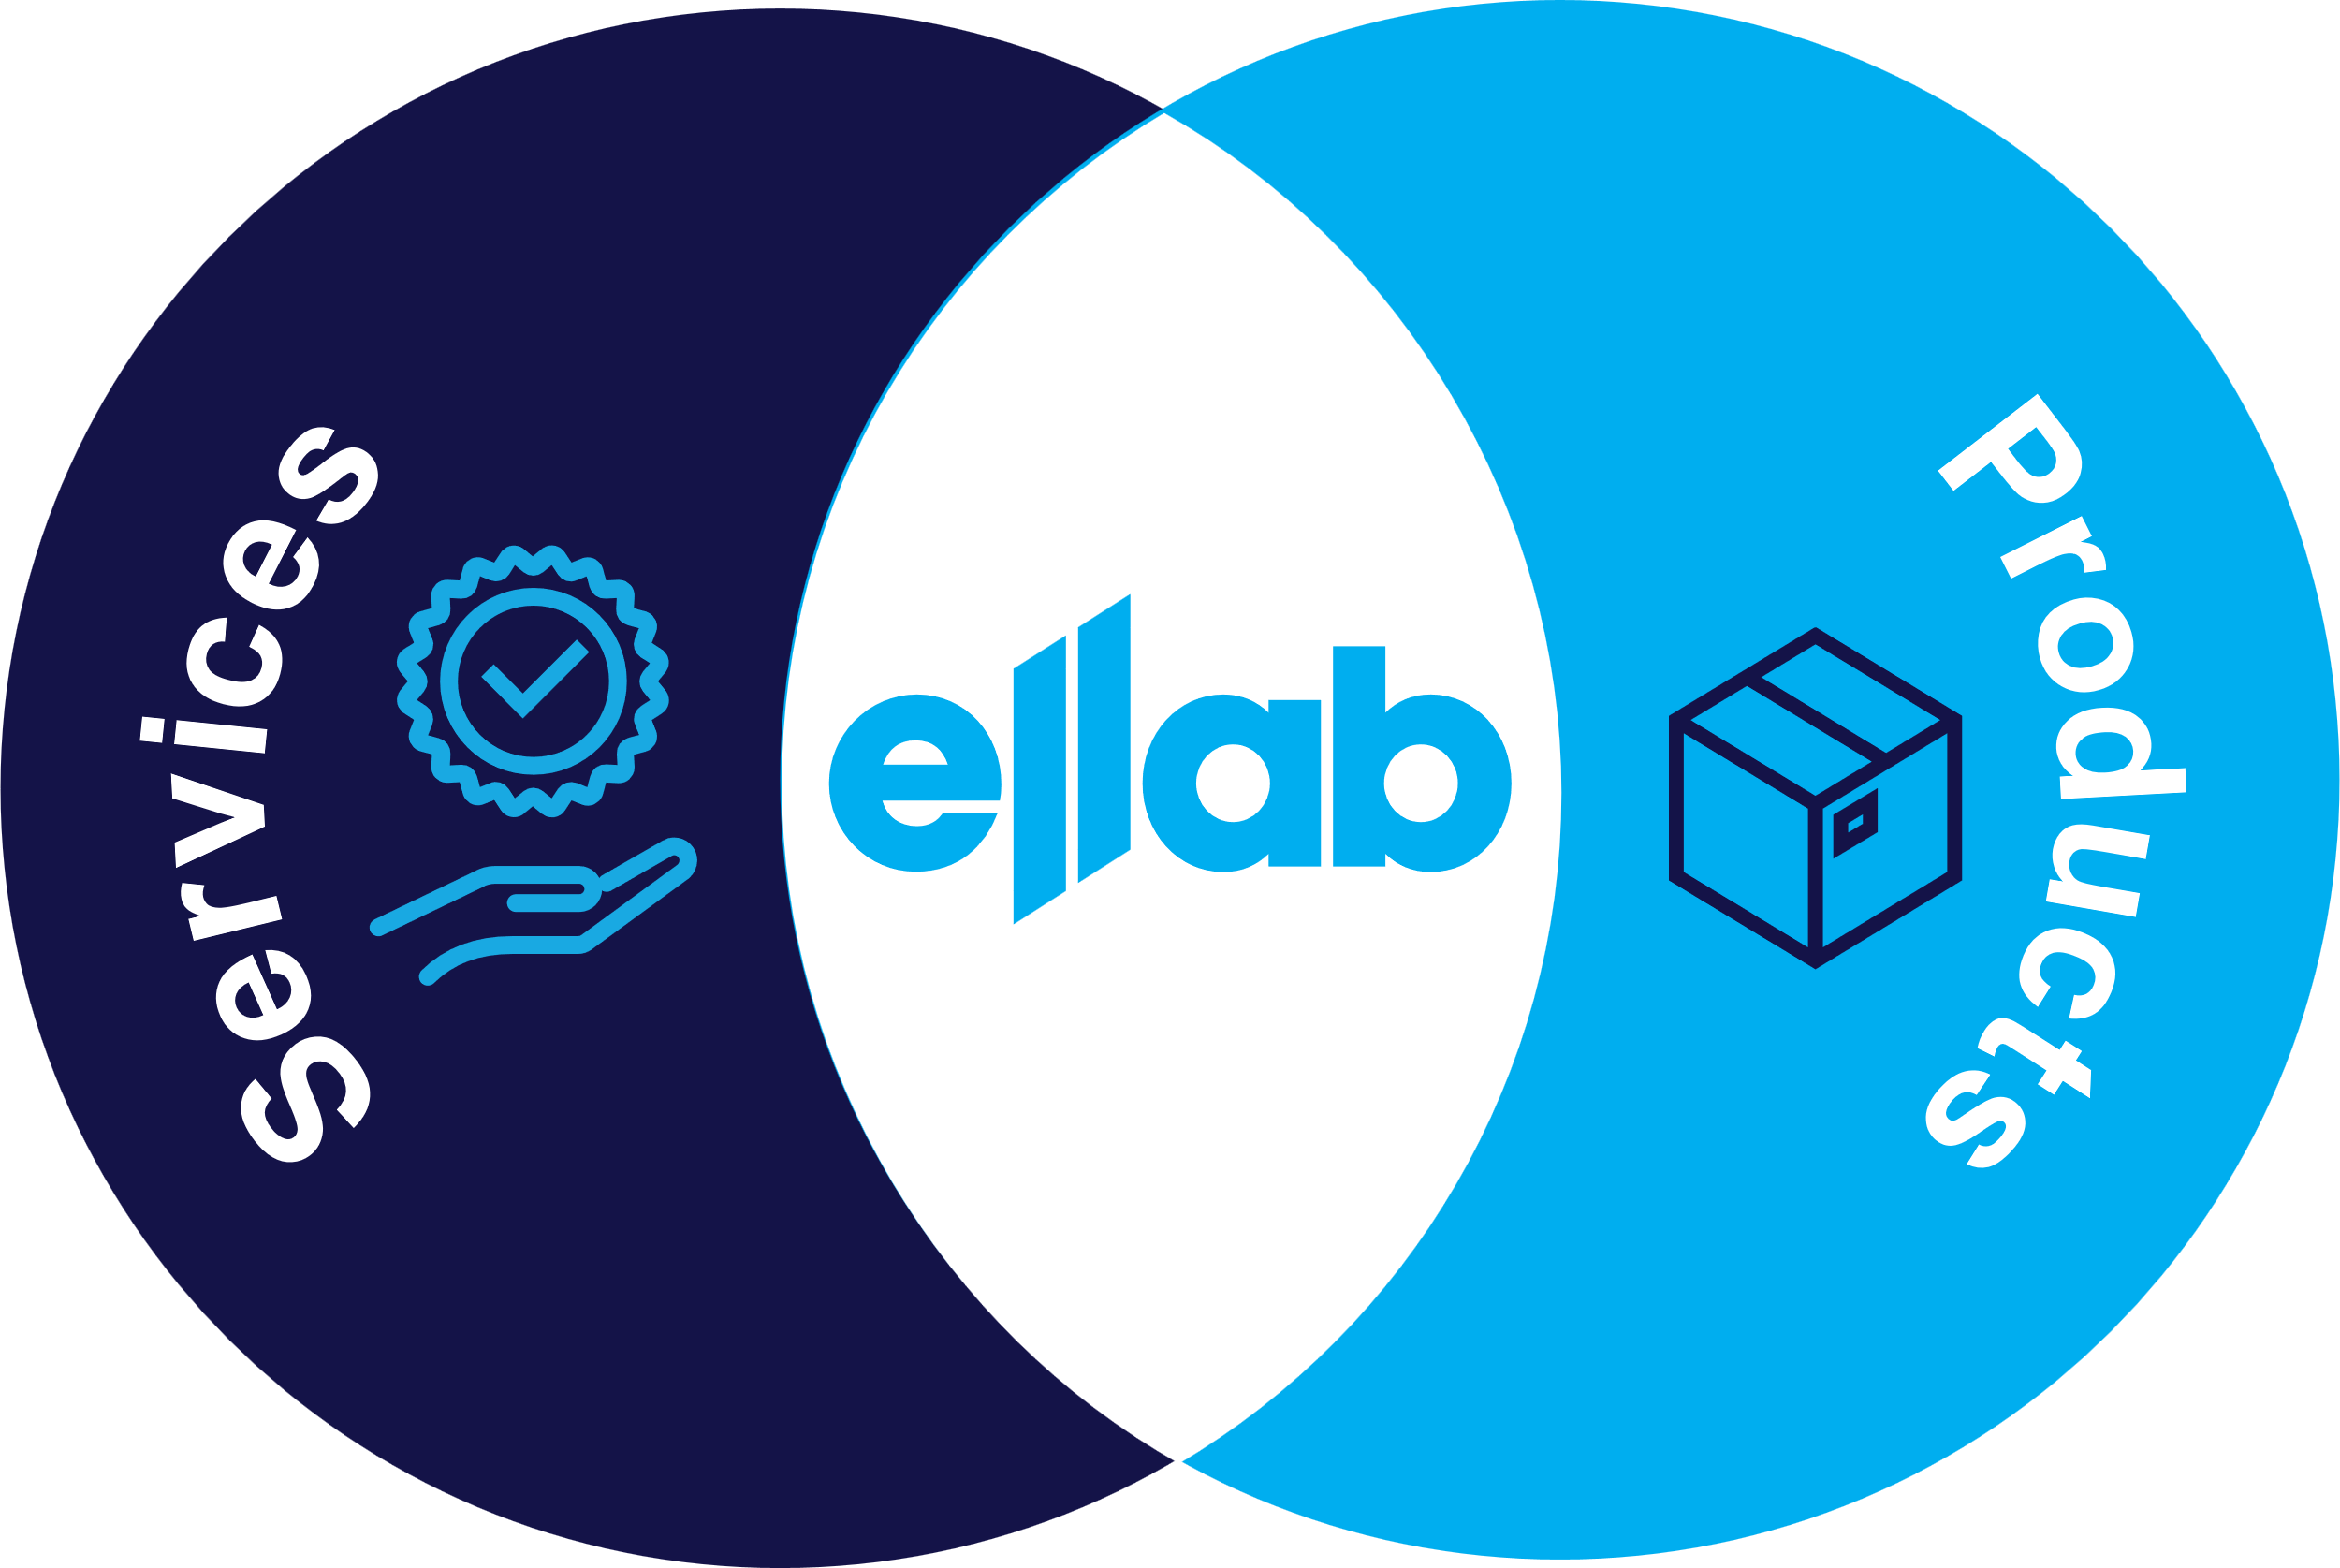
What We Offer
Your life science compliance partner. Consistent across the globe.
Purchase  Rent  Lease  SaaS  On-Site  In-Lab  Consulting & Engineering  Staffing  Managed Services 
Ellab combines services and products to support your projects and daily operations – ensuring long-term compliance within validation, monitoring, and calibration.
Equipment. Services. Expertise. Tailored to Your Needs
Notes:
Those 4 Core offerings are made to create awareness of the capabilities of Ellab throughout our organisation and facing the customer.

Slide 3
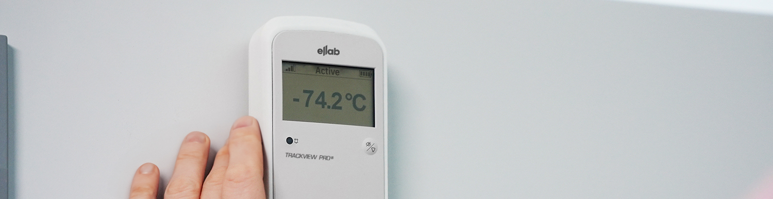
Continuous Monitoring
Your compliance is our commitment. Together, we find the right fit – from on-premise to cloud-based solutions – to ensure uninterrupted monitoring of your critical environments.
Ellab provides fully compliant, 24/7 monitoring solutions - calibrated, installed, and validated to meet FDA, GMP, and GxP standards - ensuring continuous oversight, product integrity, and audit readiness for life science organizations.

Slide 4



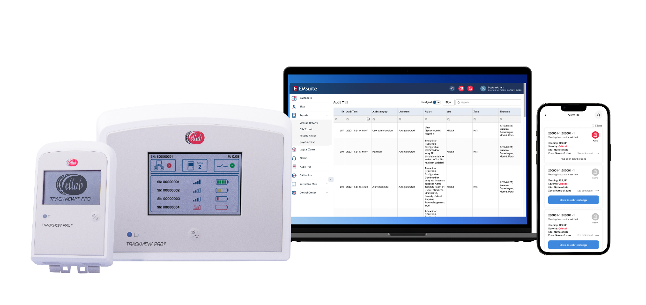


Continuous Monitoring (CMS)
Comprehensive monitoring of life sciences’ most valuable assets and applications
Continuously Monitor
Your Equipment & Facilities
Safeguard your critical assets with reliable 24/7 continuous monitoring.
Built for regulated life science environments, Ellab’s continuous monitoring system ensures data continuity, integrity, and compliance - supported by expert installation, calibration, CQV, and consulting services.
Your Monitoring Partner, Globally
Support from initial concept, implementation, validation, maintenance, calibrations, and expansions
Alarms, notifications, escalation, and reporting
Compliant: 21 CFR Part 11, Annex 11, GAMP 5
Supports: cGxP, Annex 1, ISO, WHO, USP, ISPE, VFC…etc.
Scalable Solution
Scalable from one site to thousands around the world
Flexible software and hardware options:
Software: Purchase, SaaS, Cloud
Hardware: Purchase, Lease, Rent

Slide 5



Turn-Key CMS Support Services
Compliance Support
cGxP consulting
Documentation and SOP support
Hardware and software
Installation qualification
Operational qualification
System Startups and Expansions
Infrastructure analysis
Signal strength mapping
Project management
System configuration
Training
Continuous Support
Required standard annual support plan
Optional 24/7 premium support plan
System upgrades
Calibration support
Your Life Science
Compliance
Partner

Slide 6

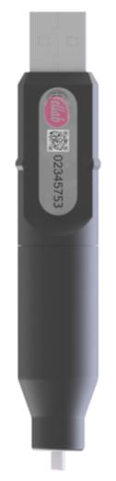

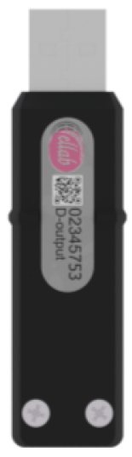
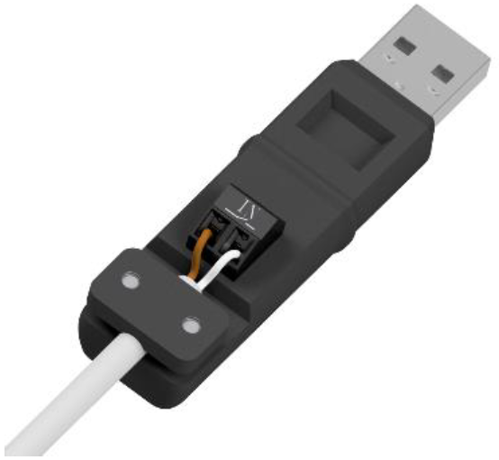
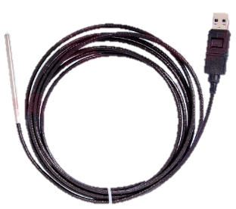
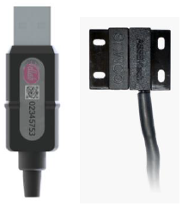
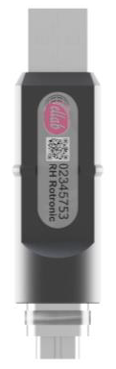
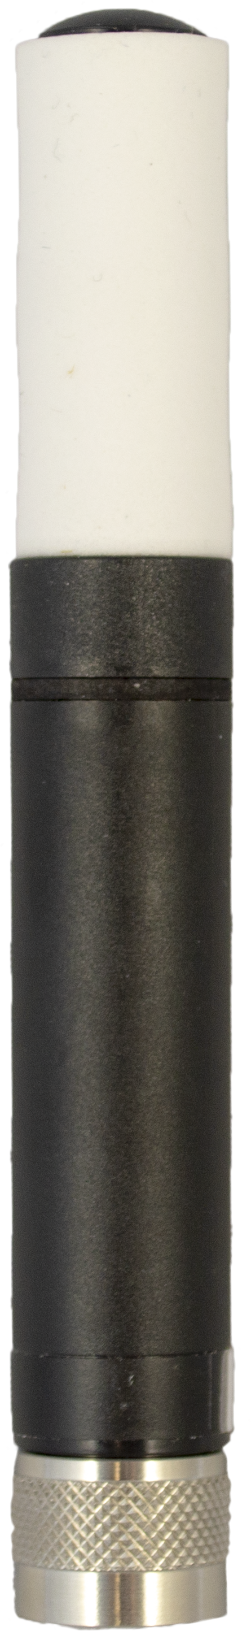





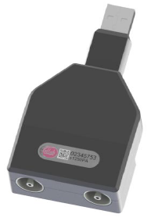

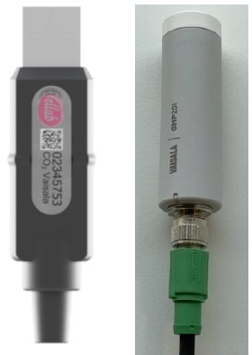
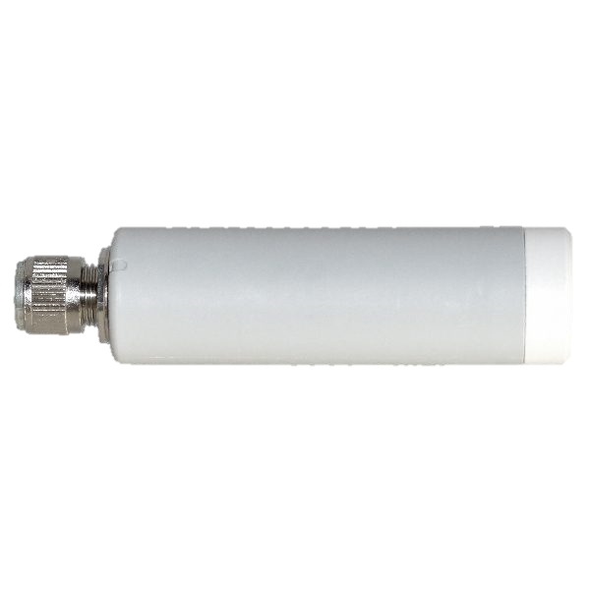

Monitoring Critical Life Science Applications
Ambient Room / Lab Conditions, Controlled Room Temperature (CRTs) & Warehouses
Laboratory Equipment | Freezers (LN₂ to -20C) Reach-ins & Walk-in Rooms
 | Refrigerators & Fridge/Freezer Combo Units Reach-ins & Walk-in Rooms
 | Incubators / Stability Chambers Reach-ins & Walk-in Rooms
 | Water Baths, Ovens
Clean Rooms (Lab Cascade)
Animal Rooms
Packaging
Connecting to 3rd party sensors |  | 4-20 mA, 0-10V, Digital Input, Digital Output, Modbus TCP-IP
Notes:
We can monitor the most common applications that our customers face. We can also monitor a wide range of measuring parameters outside of this list with the utilization of 3rd party sensors.
Common sensor types:
Temp
RH
CO2
Differential Pressure
Airflow
Light – In Development
Particle Counter – In Development
Door

Slide 7
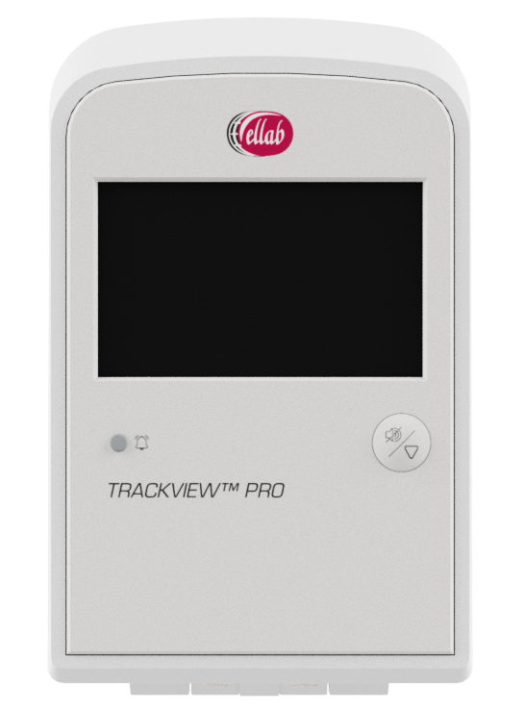
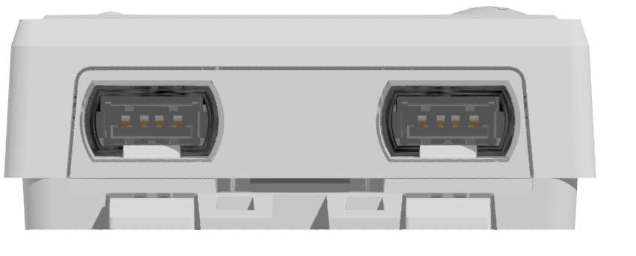
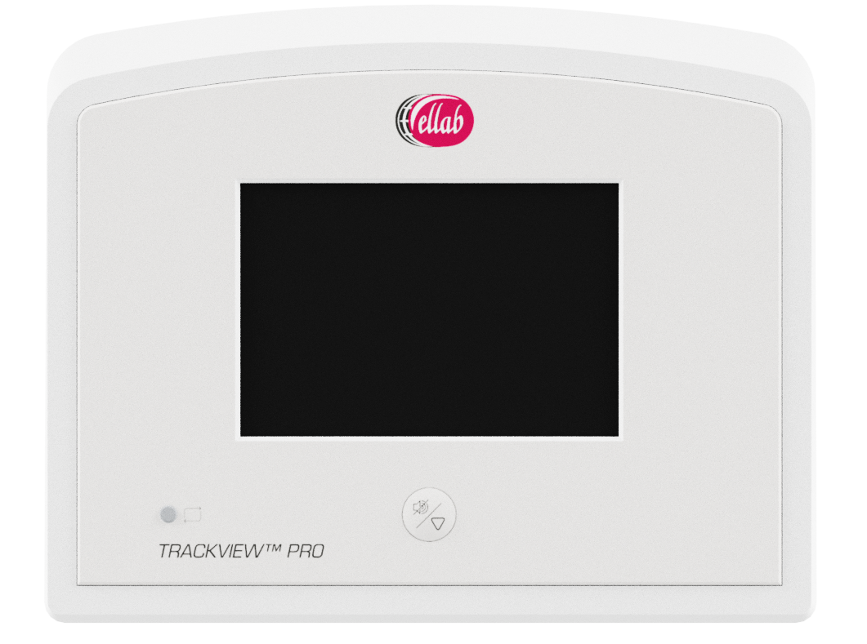
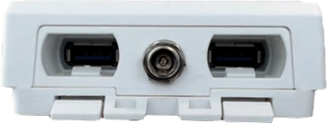
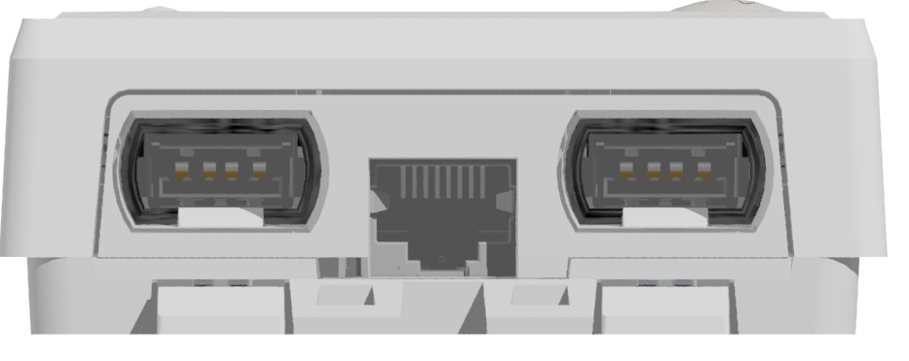









Flexible Hardware to Meet Modern Facility Requirements
Infrastructure
Wireless RF, Wireless RF-DC, Wired PoE
Hybrid approach
RF
RF-DC
Network Friendly
PoE
PoE equipped hardware
Industry accepted network ports
Encrypted HTTPS data
Transmitter
RF Access Point
RF
Sensor Probe
Transmitter
Receiver
Server
Software & Database
Robust Hardware
Data continuity protected by 2-way communication with intelligent transmission rates and backfilling
On-board data storage to ensure continuity
Customer-friendly calibration options
Hot-swappable SMART sensors
PoE
RH
Notes:
Value Proposition
Infrastructure:

Slide 8
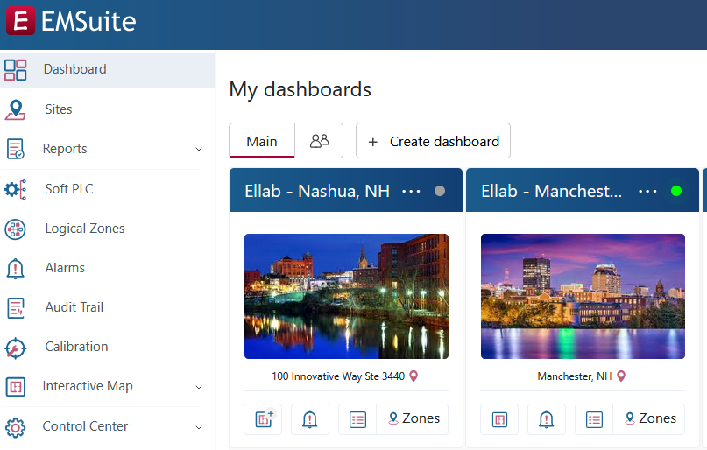
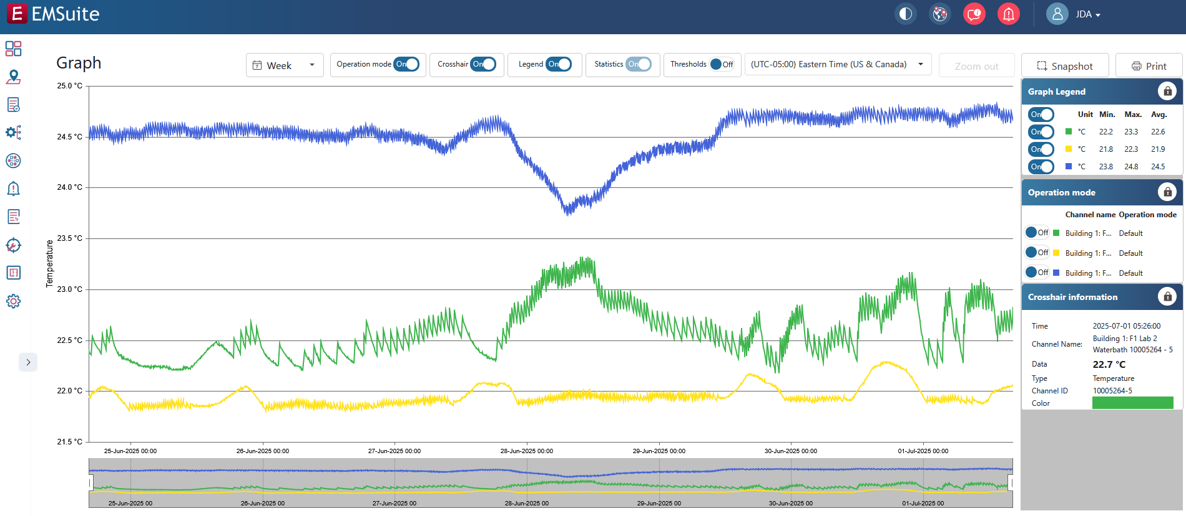
Compliant Software with Unmatched Performance
EMSuite is configurable to meet life science business requirements
Alarms
Variety of notification options: Mobile APP, Email, SMS, Voice Calls, Light Beacons, Transmitter, Software
Step-by-step alarm response SOP through Action Cards
Reports
Wide array of customizable report modules
Save time with automated report schedules
Audit ready modules with clear pass/fail options
Reduced alarm fatigue with clear escalation paths
Compliance
21 CFR Part 11 / Annex 11 features, GAMP 5 documentation
Data Continuity, Data Integrity, and ALCOA+
System Integration
Active Directory & Single Sign-On (SSO)
OPC-UA, Rest API, Modbus TCP-IP
Supports: cGxP, Annex 1, ISO, ISPE, WHO, USP, VFC, ICH
MS Azure Cloud Capable
Notes:
Alarms
Notification options: Email, SMS, Voice Call, Mobile APP, Local lights/sounds, in-software
Escalation paths can be created
Action cards provide response items that can be included in alarm response
Reports:
Ellab provides a variety of modules that can be selected and configured to create a report
Many modules provide pass/fail criteria for auditors
That report can be set to run on a schedule
Data Integrity:
21 CFR Part 11, Annex 11 compliant
Audit trail tracking
ALCOA+
Attributable, Legible, Contemporaneous, Original, Accurate, Complete, Consistent, Enduring, Available
System Integration
Single Sign On (SSO)
OPC-UA: Connect to BMS systems
Rest API: Connect to LIMS systems
Modbus TCP-IP: Pull in data from devices such as particle counters, or control light towers

