Slide 1
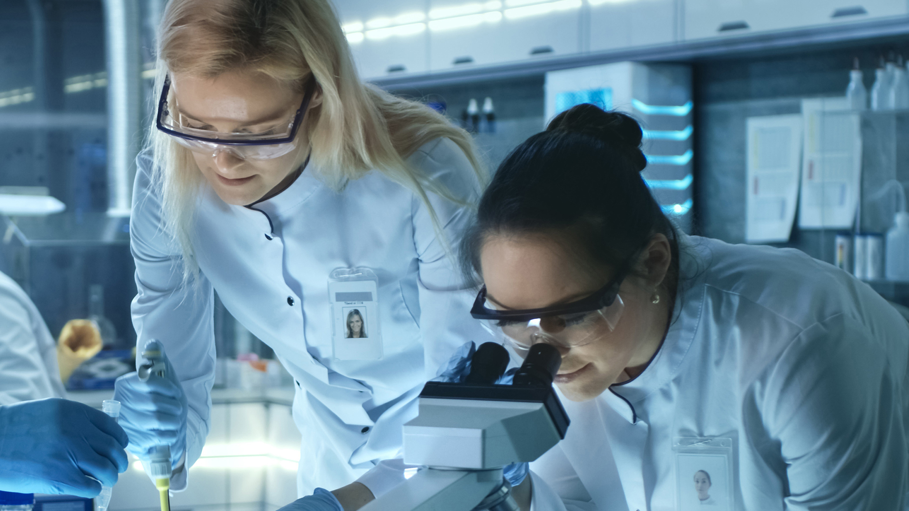

Your Life Science Compliance Partner

Slide 2


Fewer vendors.
More production time.
One long-term partner.
With global expertise and local reach, Ellab delivers tailored validation, monitoring, and calibration solutions, consistently across your sites.
2

Slide 3






Adding Value to the
Life Science Industry
From projects to daily operations
Reduced
Vendor Complexity
Less time and money spent on coordination and training.
More consistency.
End-to-End Compliance
Seamless transitions from project to daily operations.
Support for your entire process life cycle.
Increased
Production Time
Scale teams and equipment to run tasks in parallel.
Reduced downtime and maximized uptime.
Global Expertise
& Local Reach
Local teams deliver fast, on-site support across the globe.
Global standards and tools adapted to your SOPs.
3

Slide 4
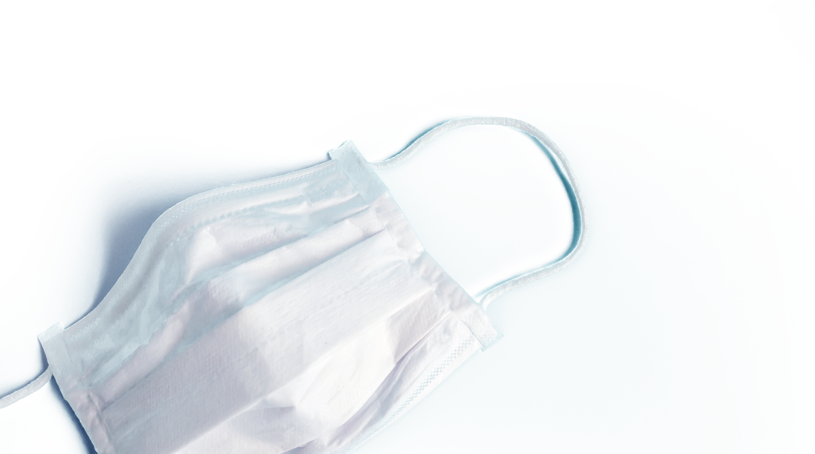
End-to-End Life Cycle Support
Support in overcoming deadlines and floods
Situation
Solution & Result
Amid the COVID-19 vaccine race, a customer faced aggressive timelines, strict regulatory oversight, and unexpected disruptions including a major facility flood.
Ellab served as a dedicated compliance partner – embedding CQV specialists, executing protocols, managing flood remediation, and ensuring qualification across multiple systems in parallel, resulting in:
✓ Enabling continuous manufacturing
✓ Maintaining validation continuity despite flooding
✓ Achieving zero critical findings during inspection
✓ Saving 12–18 months through parallel execution
Challenge
They needed full life cycle CQV support to stay audit-ready and ensure continuity, while adapting to five major project pivots under intense pressure.
Notes:
Customer: Merck & Co.

Slide 5
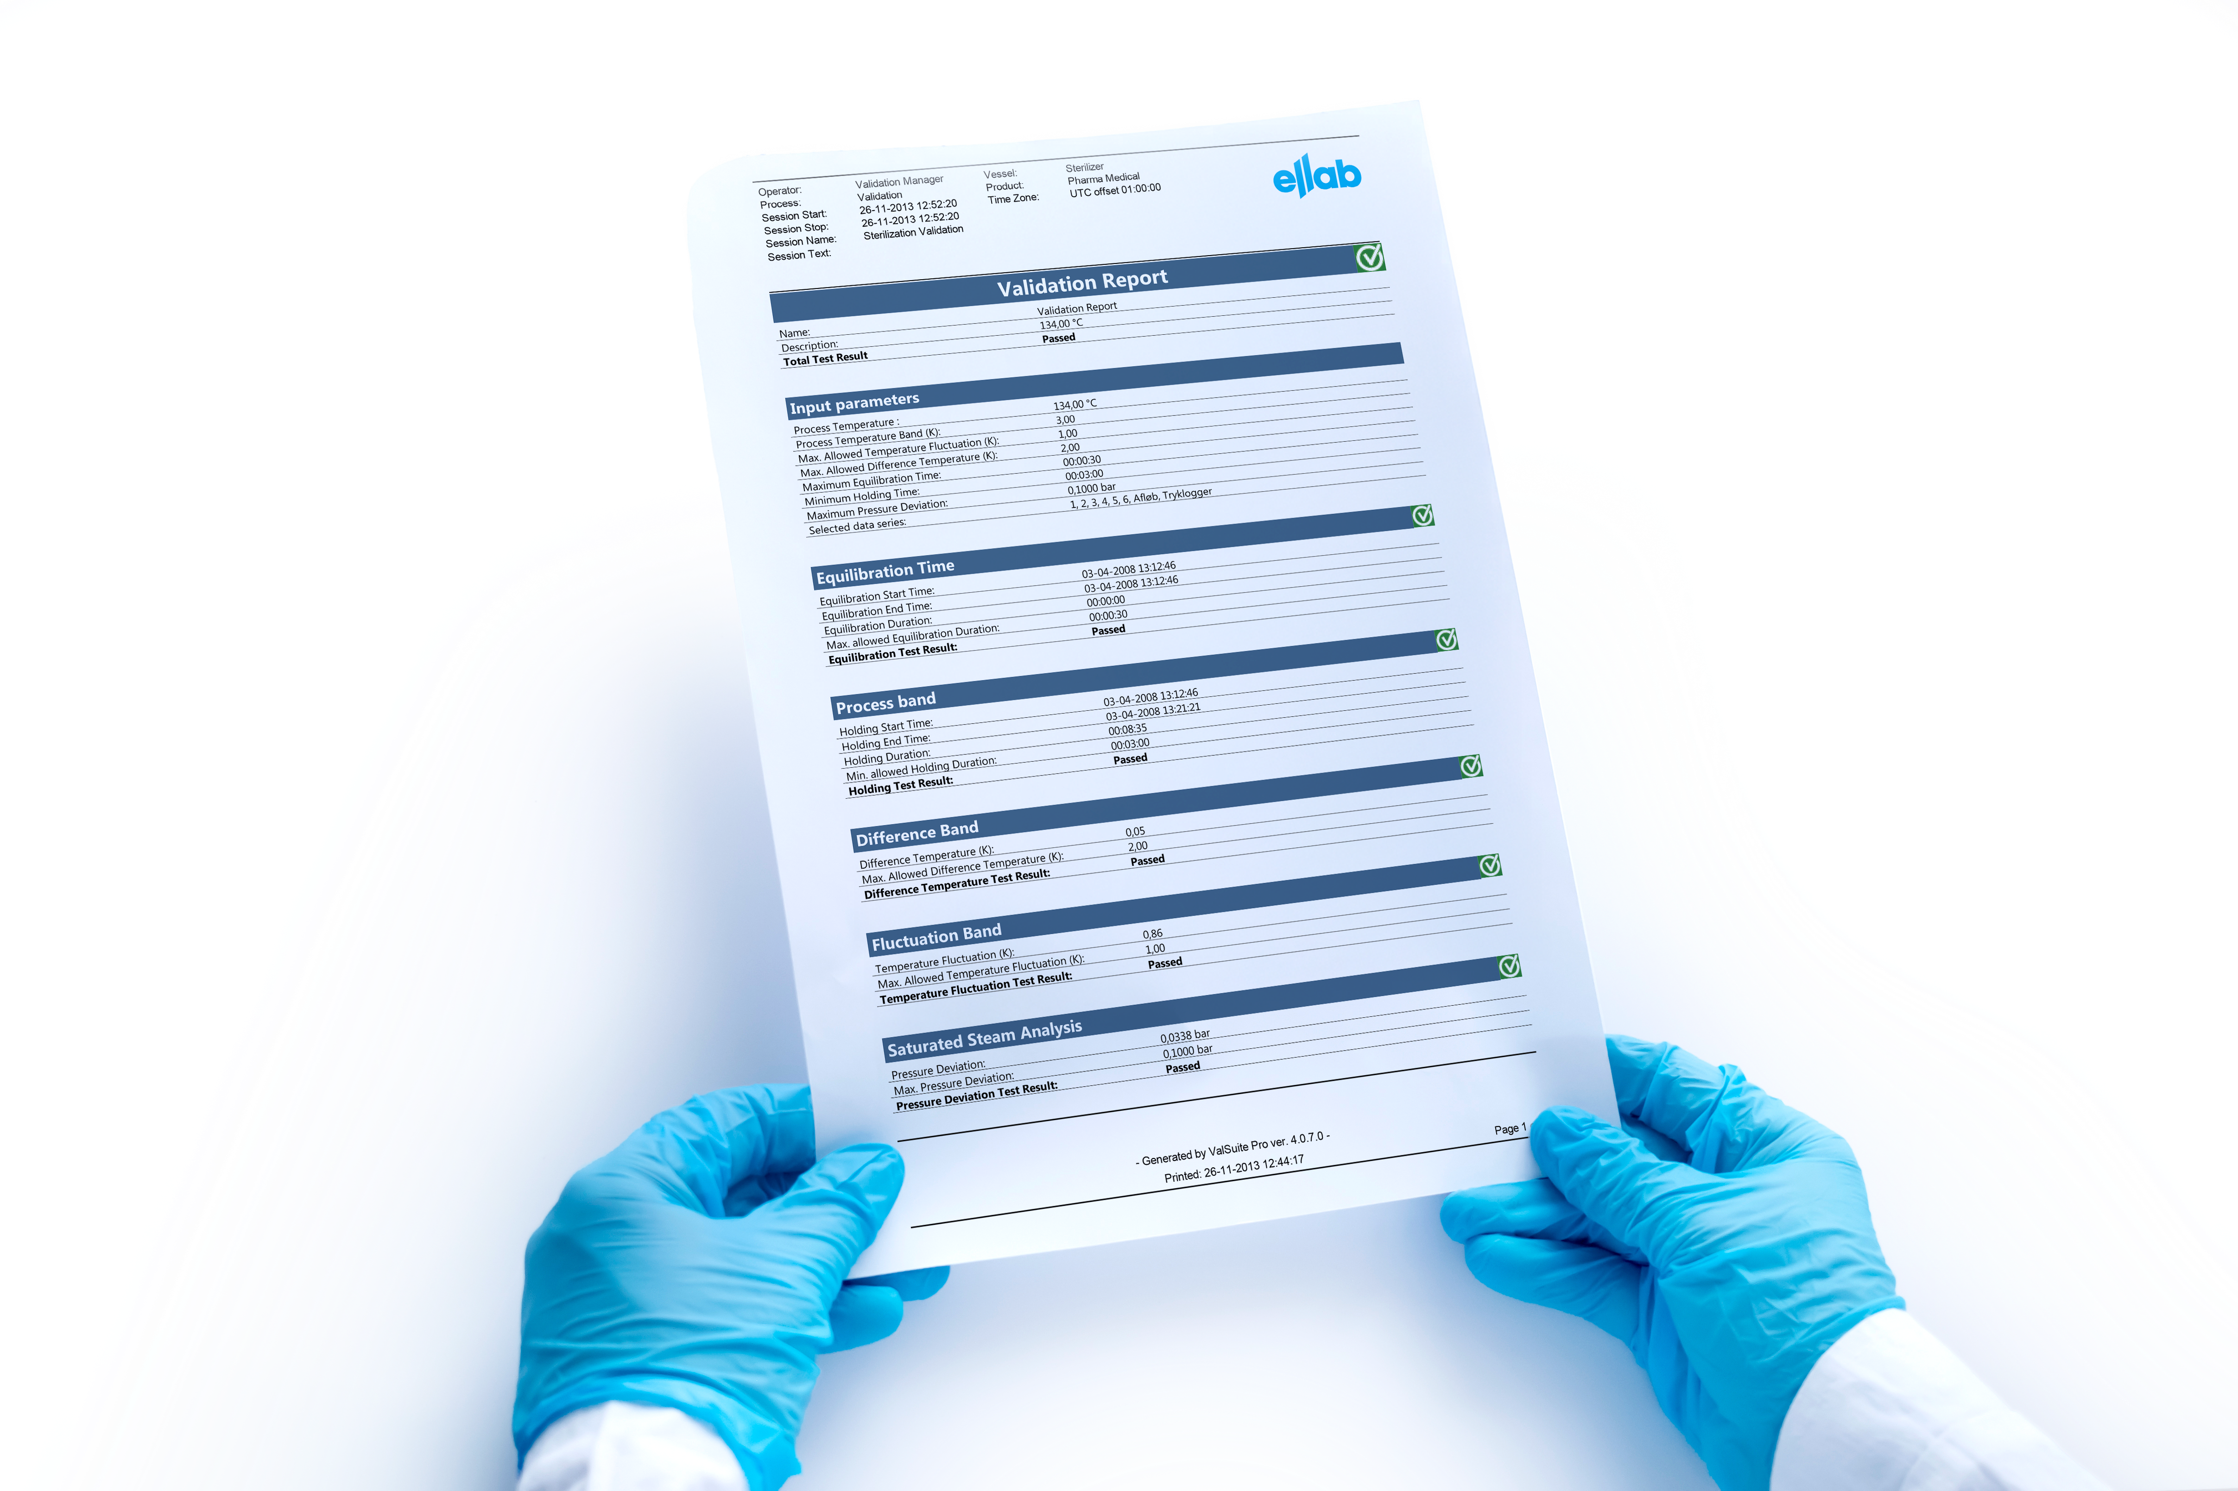
Equipment, Expertise, and Services
Support in optimizing workflows
Situation
Solution & Result
A customer aimed to modernize their sterilization validation workflow, previously dependent on slow, manual Excel-based processes.
Ellab delivered a live, two-week demo of its integrated
E-Val™ Pro system and ValSuite® Pro software, supported by on-site specialists, resulting in:
✓ Reporting time reduced from hours to <30 minutes (88%
efficiency gain)
✓ Eliminating manual Excel work
✓ Delivering audit-ready, traceable validation data
✓ Improving decision-making speed and data confidence
Challenge
Manual data handling slowed reporting (2–4 hours), risked data integrity, and delayed decisions in a compliance-critical process.
Notes:
Customer: Merck & Co.

Slide 6

Reducing Vendor Complexity
Support in becoming audit ready from the ground up
Situation
Solution & Result
A stalled audit-response program at a legacy site risked compliance due to overdue protocols, fragmented vendor oversight, and under-trained QA staff.
Ellab became a single-source compliance partner – conducting a triage workshop, embedding specialists, executing overdue protocols, and streamlining validation, monitoring, and calibration, resulting in:
✓ Re-establishing compliant validation activities
✓ Closing remediation gaps and reduced audit findings
✓ Regaining momentum and project control
✓ Cutting remediation time from “years away” to “quarters
complete”
Challenge
The customer faced looming re-inspection with documentation gaps, unqualified assets, and no clear governance.
Notes:
Customer: Merck & Co.

Slide 7
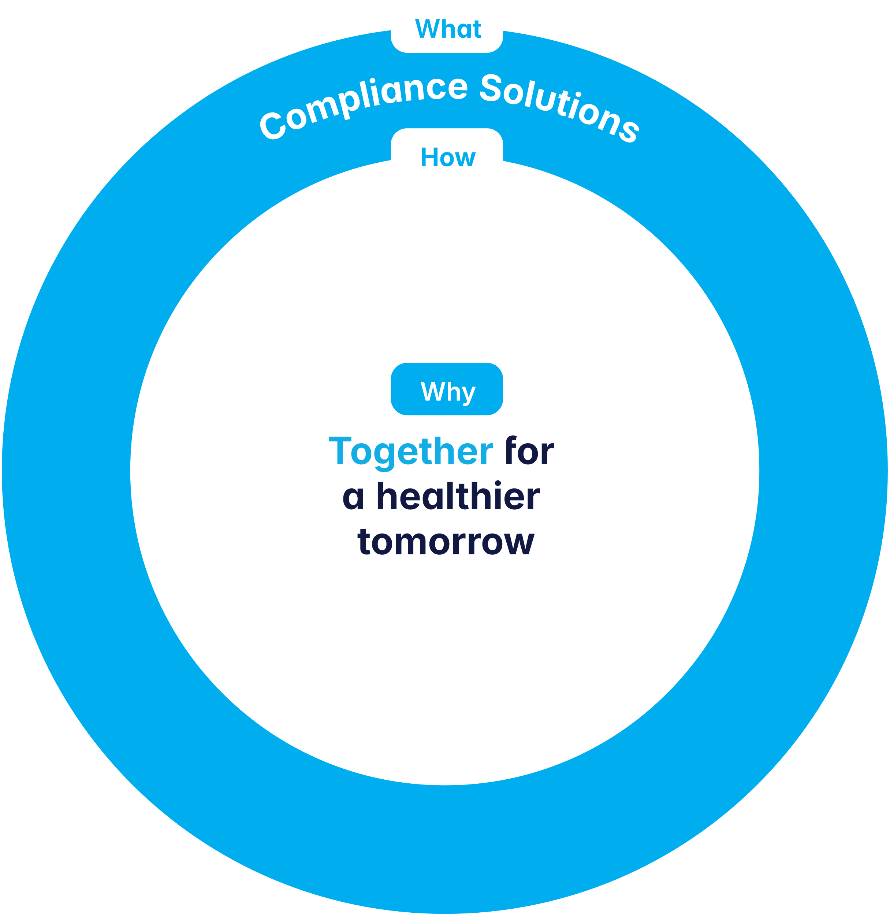
Our Foundation
Why
do we do it?
  “Together for a healthier tomorrow”
  We contribute to a better, healthier tomorrow – from simplifying compliance to driving sustainability and beyond.
How
do we execute it?
  Value Through Customer Centricity: Delivering real, measurable value in everything we do.
  Innovate the Industry: Pushing boundaries and help shape evolving industry standards.
  One Global Ellab: Operating as one global team, combining local knowledge with global strength.
What
do we do?
  Compliance Solutions
  We’re your dedicated life science compliance partner – combining validation, monitoring, and calibration to protect your products and accelerate your success.
7

Slide 8



Our Core Principles
We enable all-time audit readiness
We shape industry standards
Maintain real-time compliance with validation, calibration, and monitoring – and always remain audit ready.
Regulations the life science industry are constantly evolving - we keep you
ahead with regulatory intelligence
and best practices that
future-proof your
compliance.
We deliver end-to-end compliance
We unite equipment, expertise & services
With one trusted partner, you can eliminate vendor complexity, ensure better cost control and expect faster project execution.
You get tailored solutions that fit your project goals, timeline, and budget - from equipment rental to acquisition, and scalable personnel support.
From greenfield to full operation, you get support in every phase of the project to ensure compliance.
You get reliable, consistent compliance - no matter where you operate in the world.

Slide 9


Ellab at a Glance
Certifications, Accreditations,
and Compliance
Software and services aligned with GAMP 5 and FDA 21 CFR Part 11
Who are we?
+75 years
of innovating compliance solutions for the life science sector.
75/100
of the top life science companies across the world use Ellab today.
ISO 9001
ISO 17025
ISO 14001
UKAS
DANAK
~800 employees
across the globe, half of which perform on-site calibration, mapping, and CQV support.
A2LA
EcoVadis
+20 offices
across North America, Europe, and Asia, with HQ in Denmark.
9
Capabialities
CQV services & validation systems
Monitoring systems
Calibration services & systems
Consulting & engineering services
Accreditations
ISO 17025 | ISO 9001 | ISO 14001
Scale
~800 employees worldwide

Slide 10
Ellab at a Glance
Certifications, Accreditations,
and Compliance
Software and services aligned with GAMP 5 and FDA 21 CFR Part 11
Who are we?
+75 years
of innovating compliance solutions for the life science sector.
75/100
of the top life science companies across the world use Ellab today.
ISO 9001
ISO 17025
ISO 14001
UKAS
DANAK
~800 employees
across the globe, half of which perform on-site calibration, mapping, and CQV support.
A2LA
EcoVadis
+20 offices
across North America, Europe, and Asia, with HQ in Denmark.

Slide 11
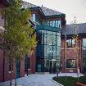
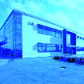
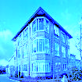
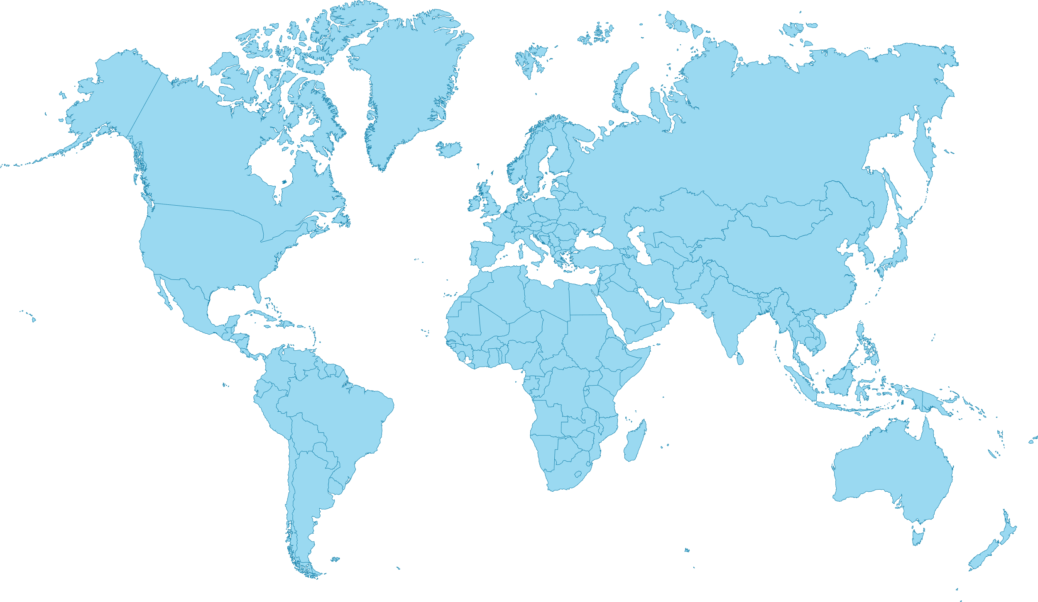
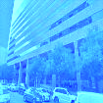
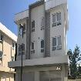
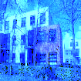

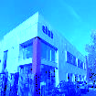
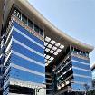
What’s Our Presence?
Ellab
UK & Ireland
Ellab HQ Nordic
Ellab DACH
  Global expertise with local reach in +70 countries
Ellab
USA
Ellab Philippines
Ellab Singapore
Ellab Benelux
Ellab France
Ellab
Italy
Ellab Dubai
  Ellab offices
  Ellab distributors

Slide 12
End to End
Compliance Solutions
Whatever you need…
Validation
Equipment, software, mapping, CQV, and consulting
Calibration
Equipment, on-site or in-lab services, accredited, traceable
Monitoring
Equipment, software, SLAs, installation, 3rd-party integration
We offer a unique combination of
equipment, expertise, and services within
validation, monitoring, and calibration.
However you need it…
Equipment
Purchase, rent, or lease
Consulting
GxP consulting and process engineering
Calibrations
On-site or in-lab
Residency/Staffing
Purchase, rent, or lease
Managed Services
Complete or partial support
12

Slide 13
We Support Your Full Life Cycle
Design
& development
Qualification
Continuous
process verification
Decommissioning
Validation
Monitoring
Calibration

Slide 14
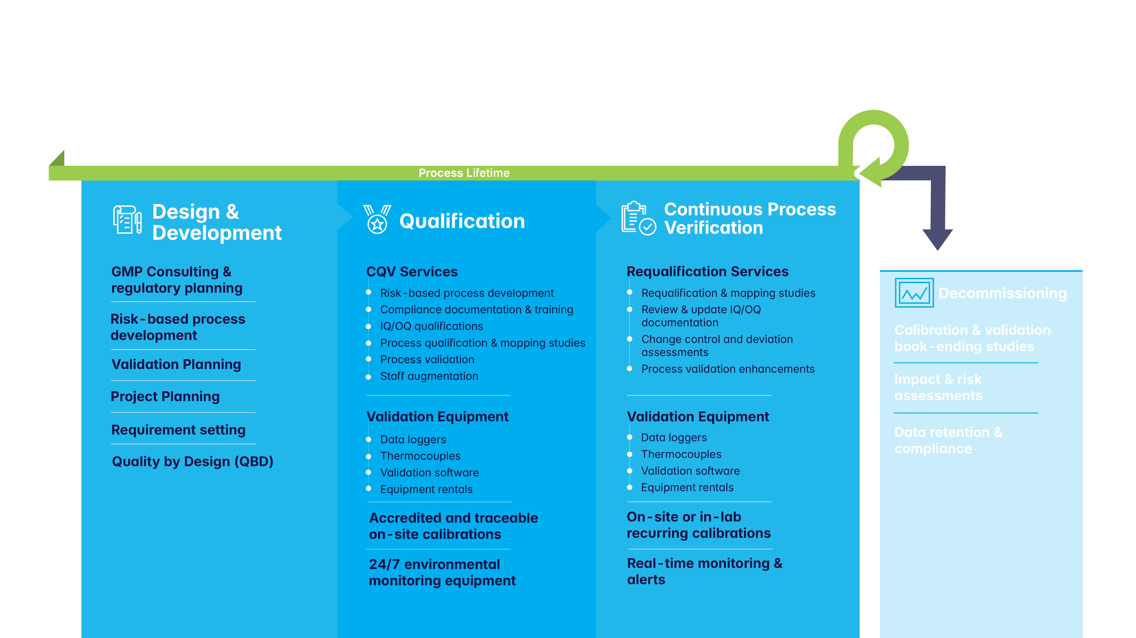
Compliance Solutions for Your Full Life Cycle

Slide 15
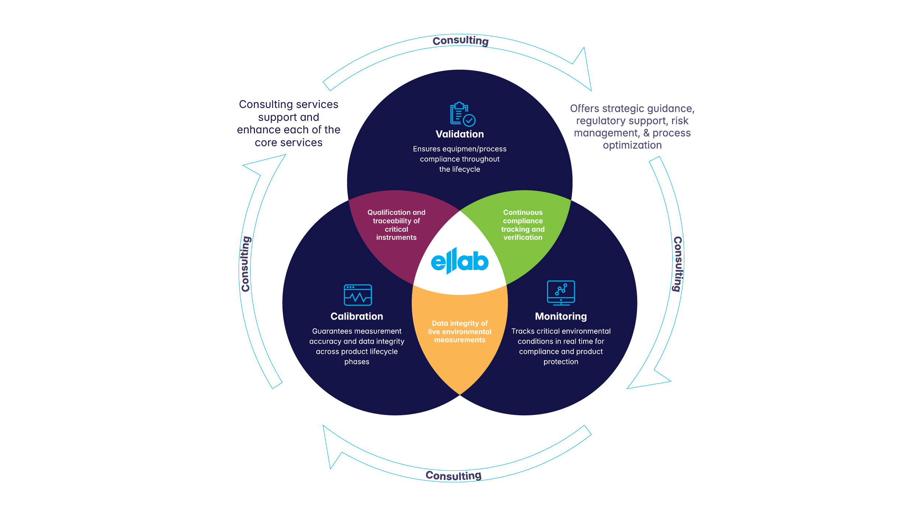
Complete Compliance Solutions

Slide 16
Flexible Delivery Methods
 | Validation | Monitoring | Calibration
Purchase/Rent/ Lease Equipment
Consulting & Engineering
Managed Services
On-Site or In-Lab Calibration
Staffing/Residency

Slide 17
How Do We Think To the Future?

Slide 18



With the goal of minimizing our environmental footprint while maximizing value for our customers by integrating sustainability into:
Product Innovation
Operational Optimization
Supply Chain Partners
Our ambition is to continuously drive improvements that support long-term growth, customer success, and the planet’s well-being.
Sustainability is not just a goal; but a core pillar of Ellab’s strategic vision.
We work to embed sustainability into the company’s strategic development
Our commitment aligns with global standards:
Life Cycle Assessment
ISO 14001
Fleet Electrification
SBTi
CDP
Renewable Energy Sourcing
Circular Design
Your Life Science
Compliance
Partner

Slide 19














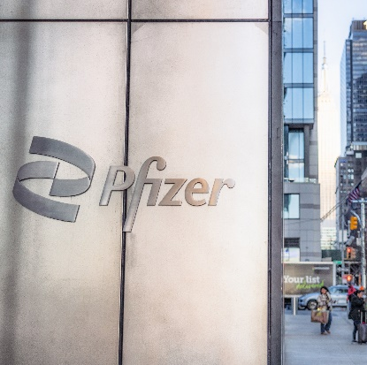




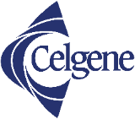



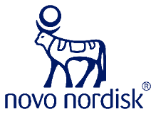
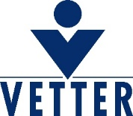



Who Do We Partner With?
We’re proud to work with all the top brands within the life science industry:
Validating the Sterilization Process at Pfizer Manufacturing
“We are very satisfied with the flexibility and support we received from Ellab. The project was changed several times during the entire process, but we never experienced any issues. After the demo, we were blown away by the possibilities of the software and the user-friendliness of the hardware.”
Pfizer Manufacturing,
Belgium NV

Slide 20

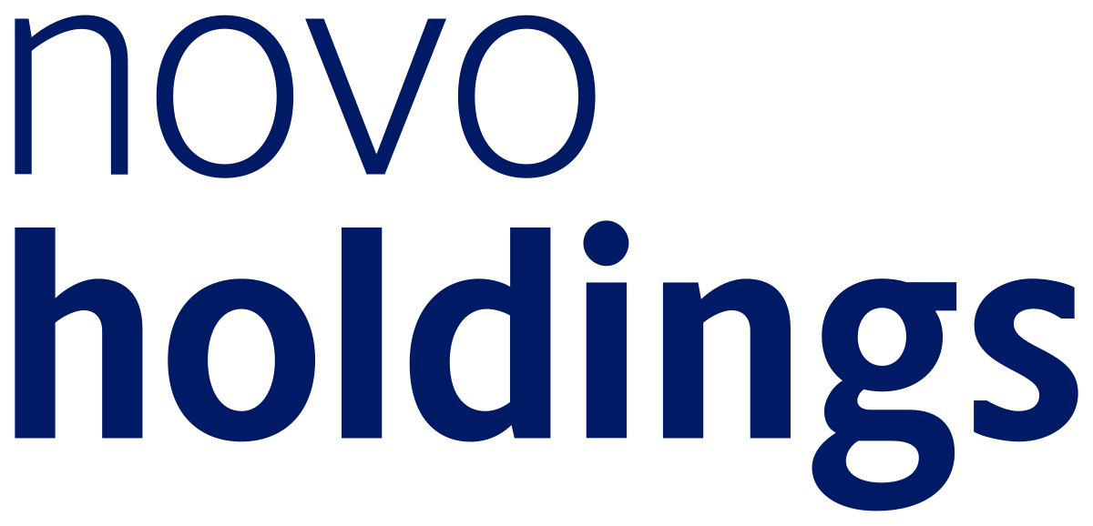

Who Supports Our Journey?
We are supported by Novo Holdings and Lundbeckfonden – two of the most respected life science investors in the world.
Long-term investment strategies enable sustainable growth and innovation
Strong alignment with Ellab’s mission and vision
Deep industry expertise and global reach to support us worldwide
Trusted names in pharma and life sciences enhance credibility and recognition
Pride in ownership thanks to their philanthropic reinvestment of returns
20

