Slide 1
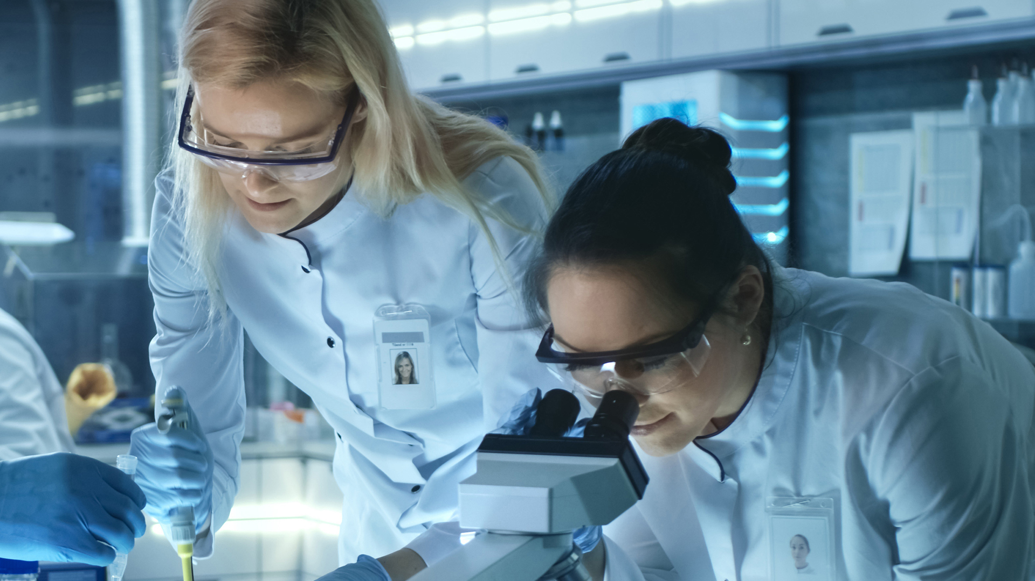

Your Life Science Compliance Partner

Slide 2



At Ellab, we’re more than a service provider, we’re your dedicated partner in mastering life science compliance.
With global expertise and local reach, we deliver tailored solutions that ensure consistent support across sites and markets – protecting your products and accelerating your path to success.
2

Slide 3


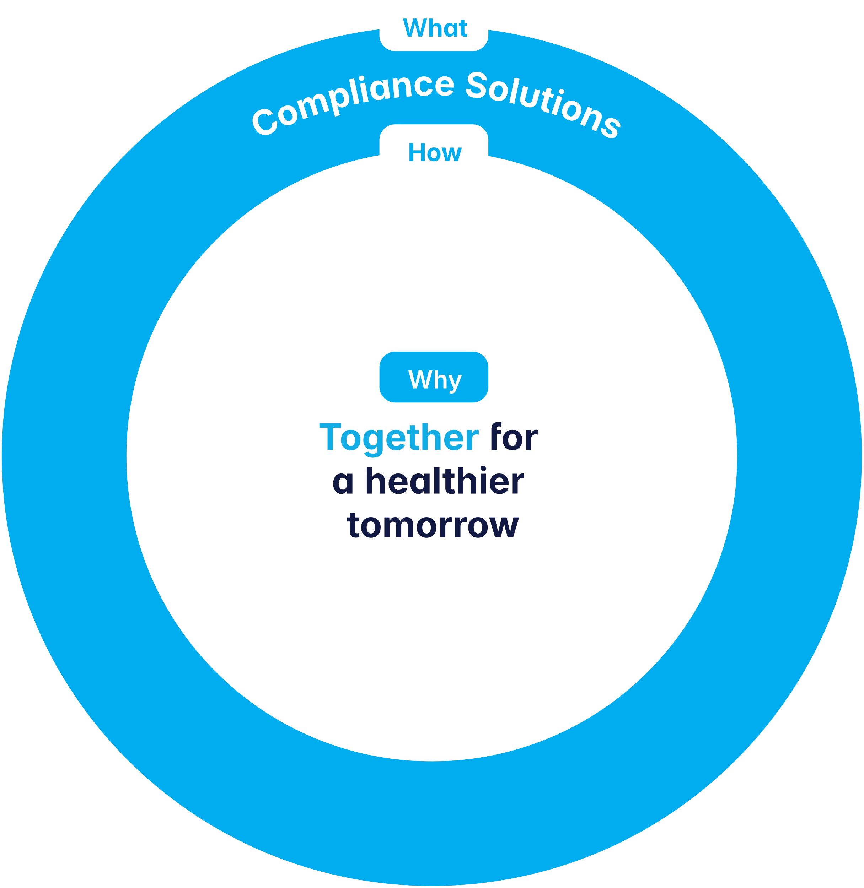
Our Foundation
3

Slide 4
Our Foundation
Why
do we do it?
“Together for a healthier tomorrow”
Our purpose is to contribute to a tomorrow that is better and healthier than today - from making compliance manageable to our focus on sustainable initiatives, and beyond.
How
do we execute it?
Value Through Customer Centricity: Ensuring that everything we do adds value to our partners.
Innovate the Industry: Pushing the boundaries and shaping industry standards.
One Global Ellab: Being one global team that leverages strengths and expertise across the globe.
What
do we do?
Compliance Solutions
We are a dedicated compliance partner to the life science industry, combining our products, services, and expertise within validation, monitoring, calibration, and consulting to safeguard your products and accelerating your path to success.
4

Slide 5

Who Are We?
Ellab Summarized
Established in 1949 in Denmark.
Long history of innovating measuring equipment for the life science sector.
Recent decade with the expansion of monitoring, consulting, and services has seen us develop into an end-to-end compliance partner.
5
Capabialities
CQV services & validation systems
Monitoring systems
Calibration services & systems
Consulting & engineering services
Accreditations
ISO 17025 | ISO 9001 | ISO 14001
Scale
~800 employees worldwide

Slide 6



Who Are We?
Ellab Summarized
Capabilities
CQV services & validation systems
Monitoring systems
Calibration services & systems
Consulting & engineering services
Accreditations
ISO 17025 | ISO 9001 | ISO 14001
Scale
~800 employees worldwide
Established in 1949 in Denmark.
Long history of innovating measuring equipment for the life science sector.
Recent decade with the expansion of monitoring, consulting, and services has seen us develop into an end-to-end compliance partner.

Slide 7
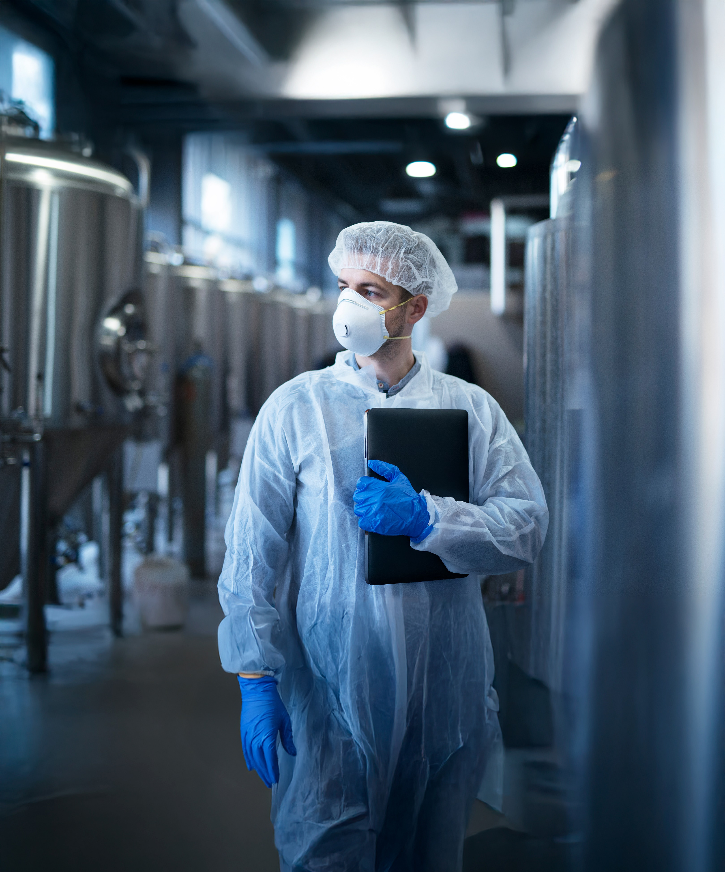
There is More to Life Science Compliance
Our Narrative
7
In life science, compliance isn’t just a checkbox.
It’s the backbone of trust, safety, and success.
For ambitious companies navigating ever-changing regulations, even the smallest misstep can lead to costly delays and reputational damage.
At Ellab, we’re built to keep you ahead.
As the only company to seamlessly combine state-of-the-art equipment with unmatched expertise, we support your full life cycle. From validation to calibration and monitoring, we streamline processes, eliminate bottlenecks, and lighten the compliance burden.
More than a service provider, we’re your dedicated partner in mastering life science compliance.
With global expertise and local reach, we deliver tailored solutions that ensure consistent support across sites and markets – protecting your products and accelerating your path to success.
Ellab – Your life science compliance partner.

Slide 8
There is More to Life Science Compliance
Our Narrative
In life science, compliance isn’t just a checkbox.
It’s the backbone of trust, safety, and success.
For ambitious companies navigating ever-changing regulations, even the smallest misstep can lead to costly delays and reputational damage.
At Ellab, we’re built to keep you ahead.
As the only company to seamlessly combine state-of-the-art equipment with unmatched expertise, we support your full life cycle. From validation to calibration and monitoring, we streamline processes, eliminate bottlenecks, and lighten the compliance burden.
More than a service provider, we’re your dedicated partner in mastering life science compliance.
With global expertise and local reach, we deliver tailored solutions that ensure consistent support across sites and markets – protecting your products and accelerating your path to success.
Ellab – Your life science compliance partner.

Slide 9
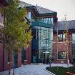
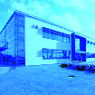
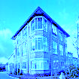
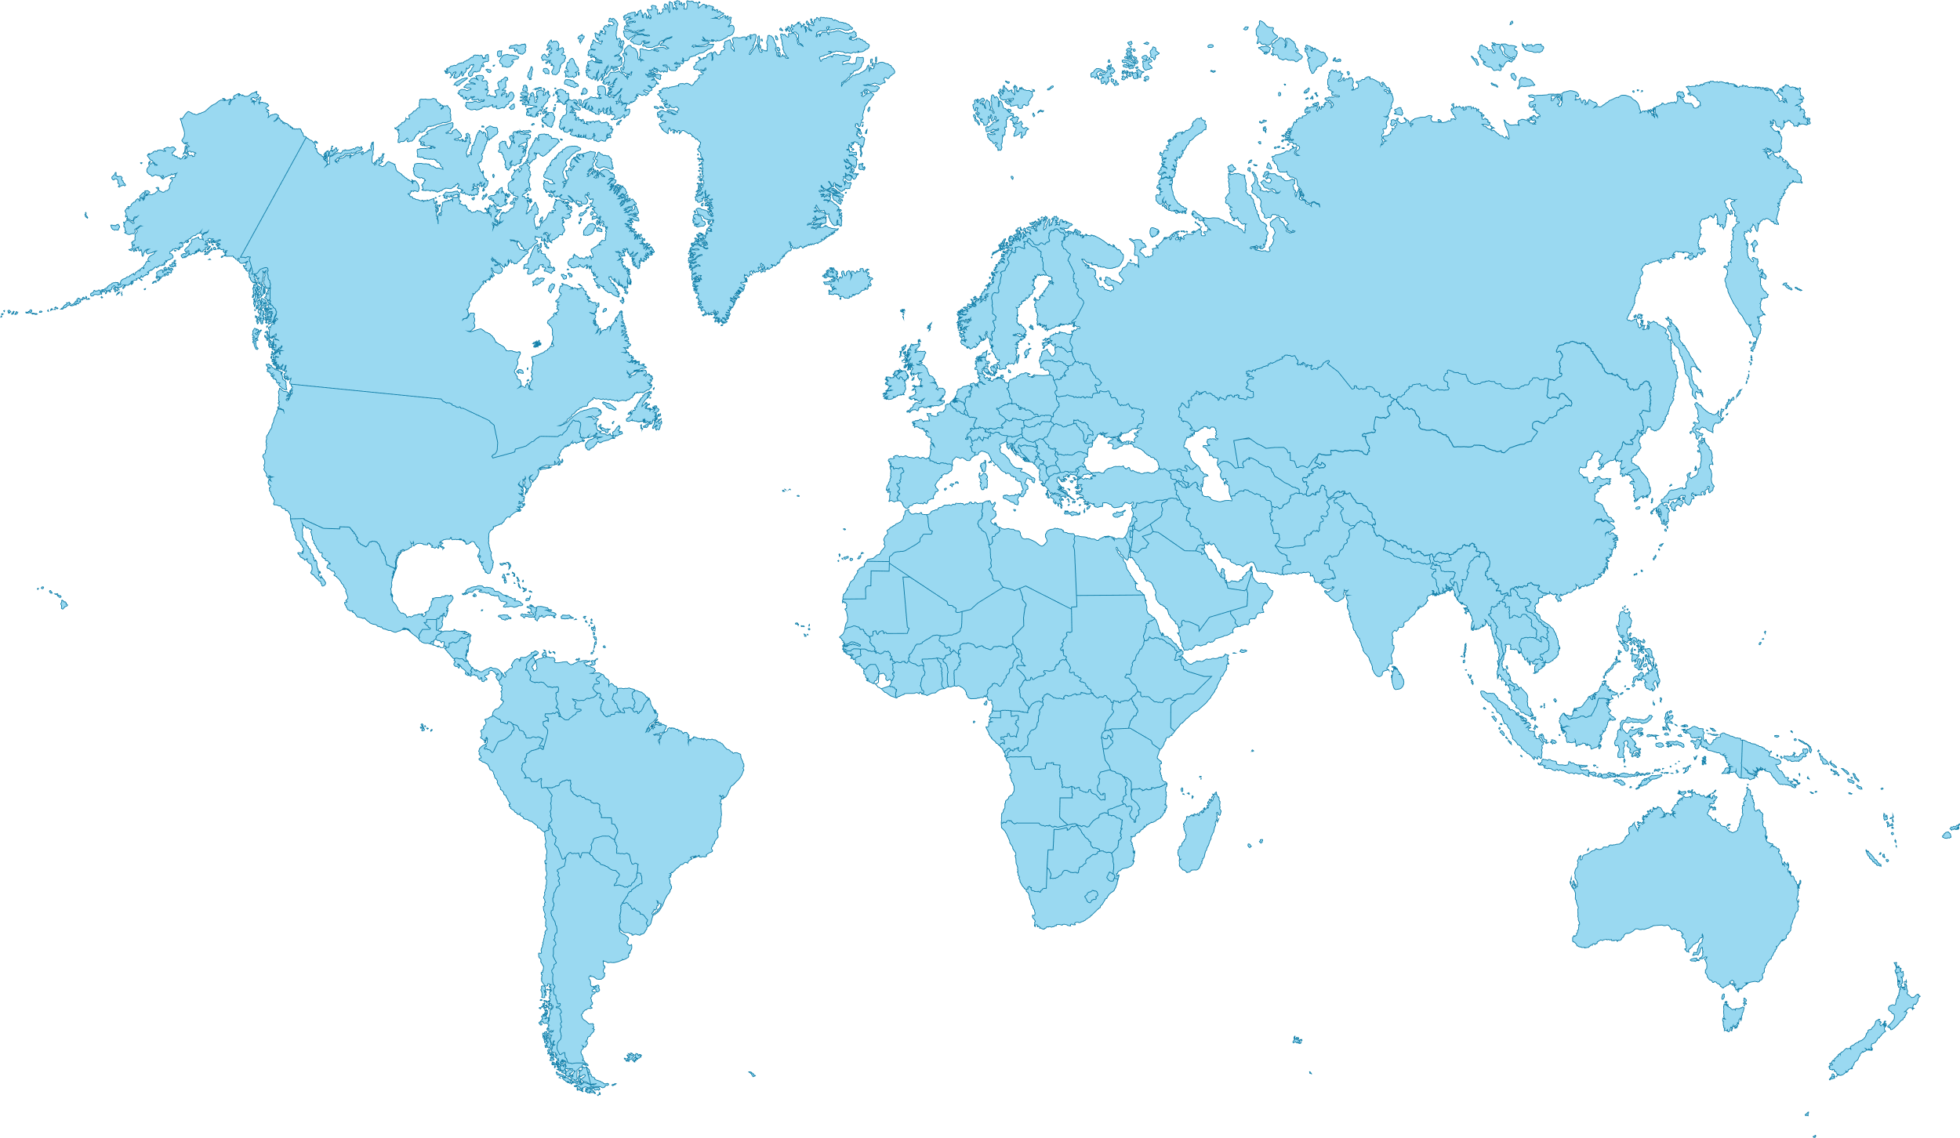
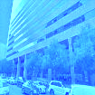
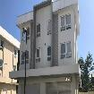
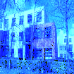
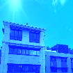
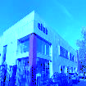
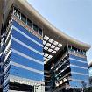
What’s Our Presence?
Ellab
UK & Ireland
Ellab HQ Nordic
Ellab DACH
Global Reach, Local Expertise
~800 employees globally
Headquartered in Hillerød, Denmark
20+ offices across the US, Europe, and Asia
Represented in 70+ countries
Ellab
USA
Ellab Philippines
Ellab Singapore
Ellab Benelux
Ellab France
Ellab
Italy
Ellab Dubai
Ellab offices
Ellab distributors

Slide 10



How Do We Ensure Success?
We enable all-time audit readiness
We shape industry standards
Maintain real-time compliance with validation, calibration, and monitoring – and always remain audit ready.
Regulations the life science industry are constantly evolving - we keep you
ahead with regulatory intelligence
and best practices that
future-proof your
compliance.
We deliver end-to-end compliance
We unite equipment, expertise & services
With one trusted partner, you can eliminate vendor complexity, ensure better cost control and expect faster project execution.
You get tailored solutions that fit your project goals, timeline, and budget - from equipment rental to acquisition, and scalable personnel support.
From greenfield to full operation, you get support in every phase of the project to ensure compliance.
You get reliable, consistent compliance - no matter where you operate in the world.

Slide 11
We Support Your Full Life Cycle
Design
& development
Qualification
Continuous
process verification
Decommissioning
Consulting
Validation
Monitoring
Calibration

Slide 12

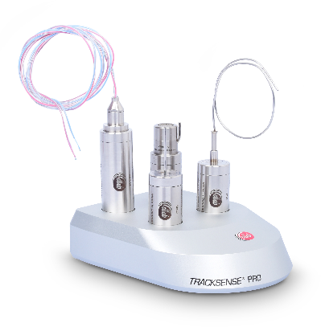
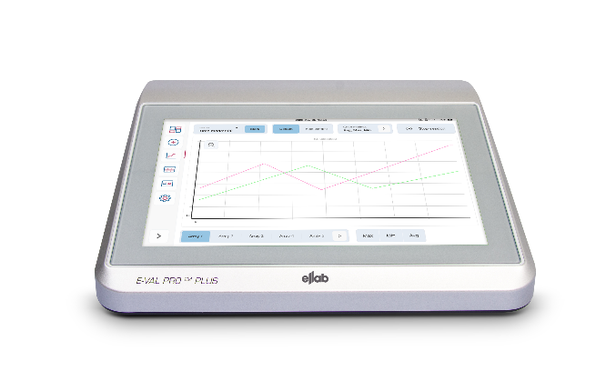
What Do We Offer?
Consulting
Achieve end-to-end compliance with seasoned experts throughout your process life cycle.
GMP consulting
Process engineering
Project management
Validation
Monitoring
Calibration
Ensure properly tested and documented processes for smoother production and audits.
CQV & mapping services
Full- or part time staffing
Wireless and wired validation systems
Validation equipment rentals
Protect valuable assets with continuous environmental monitoring.
24/7 monitoring systems for regulated environments
IQ/OQ and installation of environmental monitoring
Rely on your readings and processes through regular and thorough calibrations.
On-site calibration services
Factory calibration
Accredited & traceable calibrations
Calibration equipment
12

Slide 13
How Do We Think To the Future?

Slide 14



At Ellab, we’re working to embed sustainability into the company strategic development.
Our efforts aim to integrate sustainability into Product Innovation, Operational Optimization, and but also to engage with our supply chain partners, aiming to minimize our environmental footprint while maximizing value for our customers.
Our commitment aligns with global standards (SBTi validated since 2023, CDP reporting since 2024), ensuring compliance (ISO 14001 since 2019) and leadership in sustainable practices such as Fleet Electrification, Renewable Energy Sourcing, Circular Design, and Life Cycle Assessment.
We have the ambition to continuously drive improvements that support our long-term growth, our customers’ success, and the well-being of our planet.
Sustainability is not just a goal; it’s a core pillar of Ellab’s strategic vision.
Your Life Science
Compliance
Partner

Slide 15




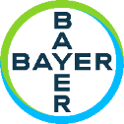









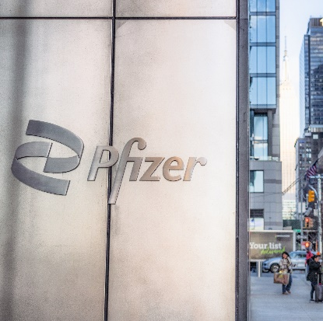




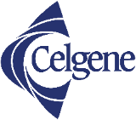



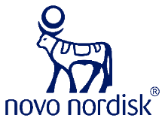




Who Do We Partner With?
We’re proud to work with all the top brands within the life science industry:
Validating the Sterilization Process at Pfizer Manufacturing
“We are very satisfied with the flexibility and support we received from Ellab. The project was changed several times during the entire process, but we never experienced any issues. After the demo, we were blown away by the possibilities of the software and the user-friendliness of the hardware.”
Pfizer Manufacturing,
Belgium NV

Slide 16


Who Supports Our Journey?
We are supported by the world’s leading life science investor, Novo Holdings
Long-term holding strategy will enable different kinds of investments
Growth and innovation strategy is a perfect fit for Ellab
Industry expertise and global presence can be leveraged worldwide
Revered in the pharma industry boosting brand recognition and acknowledgement
Pride in ownership due to philanthropic use of profits
16

