Slide 1
Value Selling

Slide 2

Did you watch the videos?

Slide 3
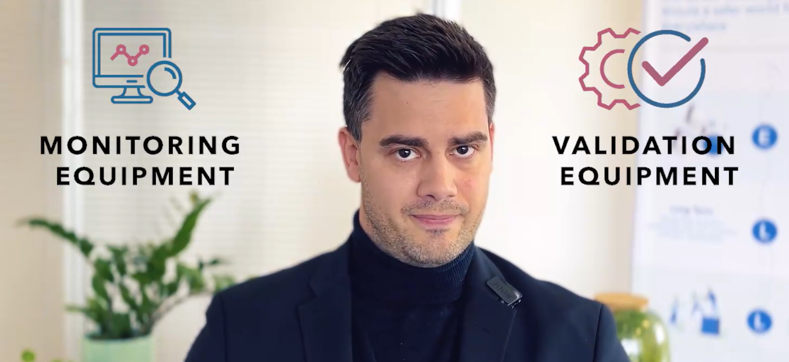
Did you watch the videos?

Slide 4
Aim of the training
Become familiar with the main Ellab products
What are they?
How to use them?
How to quote?
Get inspired on how to sell Ellab solutions
Overall process and timelines
How to explore customer needs?
DEMO
Get to know your HQ
Factory
2nd Line support
Network with your colleagues

Slide 5
Participant Intro

Slide 6
Ellab Strategy

Slide 7


















The Ellab Strategy – Executive Summary
Ambition
To be the leading full solution provider and become #1 in all three business lines
Validation Solutions
Monitoring Solutions
Field Service & Consulting
Where to play
Prioritize the fastest growing industry segments…
…in countries with the strictest regulatory requirements and the most manufacturing sites
Biotech
Cell & Gene Therapy
CDMOs
Chamber Manufacturers
North America
Europe
East Asia
~10% p.a.
~17% p.a.
~10% p.a.
~13% p.a.
How to win
Continue the successful Ellab journey with focus on 7 must-win battles
Mature Field Services
Grow BioPharma coverage
Build Monitoring Position
Win in Asia
Strengthen Finance & IT
People & leadership
Technology leadership
Business plan 2027
Total revenue target 2027
Validation Solutions revenue target
Monitoring Solutions revenue target
Field Service & Consulting revenue target
DKK 2.8 bn (~€390m)
DKK 0.9 bn
(€120m)
+16% growth p.a.
DKK 0.2 bn
(€30m)
+40% growth p.a.
DKK 1.7 bn
(€240m)
+36% growth p.a.
+28.5% growth p.a.
+18.5% organic growth p.a.
31%
7%
62%

Slide 8


At Ellab, we’re more than a service provider, we’re your dedicated partner in mastering life science compliance.
With global expertise and local reach, we deliver tailored solutions that ensure consistent support across sites and markets – protecting your products and accelerating your path to success.
8

Slide 9



How Do We Ensure Success?
We enable all-time audit readiness
We shape industry standards
Maintain real-time compliance with validation, calibration, and monitoring – and always remain audit ready.
Regulations the life science industry are constantly evolving - we keep you
ahead with regulatory intelligence
and best practices that
future-proof your
compliance.
We deliver end-to-end compliance
We unite equipment, expertise & services
With one trusted partner, you can eliminate vendor complexity, ensure better cost control and expect faster project execution.
You get tailored solutions that fit your project goals, timeline, and budget - from equipment rental to acquisition, and scalable personnel support.
From greenfield to full operation, you get support in every phase of the project to ensure compliance.
You get reliable, consistent compliance - no matter where you operate in the world.

Slide 10
We Support Your Full Life Cycle
Design
& development
Qualification
Continuous
process verification
Decommissioning
Consulting
Validation
Monitoring
Calibration

Slide 11

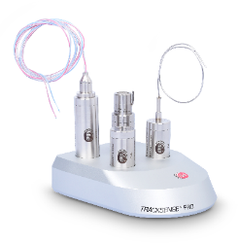
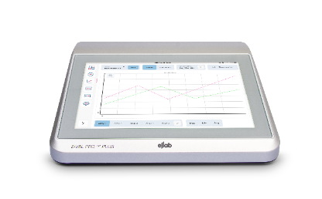
What Do We Offer?
Consulting
Achieve end-to-end compliance with seasoned experts throughout your process life cycle.
GMP consulting
Process engineering
Project management
Validation
Monitoring
Calibration
Ensure properly tested and documented processes for smoother production and audits.
CQV & mapping services
Full- or part time staffing
Wireless and wired validation systems
Validation equipment rentals
Protect valuable assets with continuous environmental monitoring.
24/7 monitoring systems for regulated environments
IQ/OQ and installation of environmental monitoring
Rely on your readings and processes through regular and thorough calibrations.
On-site calibration services
Factory calibration
Accredited & traceable calibrations
Calibration equipment
11

Slide 12

What is Validation - Thermal Validation? What is Monitoring?

Slide 13
Ellab Sales Process

Slide 14

How to convert a customer?
My experience
There are 1000 ways of reaching a sale. This is my experience.

Slide 15

How to convert a customer?
Identify your target customers

Slide 16

How to convert a customer?
Reach out for an introduction meeting
(Have a small script ready)

Slide 17

How to convert a customer?
Do a first approach. Ask/Listen
Maybe there is a need now, maybe you are constructing for the future.
Goal: The customer team now knows Ellab is a good option in the market.
(DEMO?)
Next steps to aim for:
You schedule a test of the equipment at facility.
Quote.

Slide 18

How to convert a customer?
Once the user is excited about the product,
give some space but be available depending on how urgent you have identified the need to be.

Slide 19

How to convert a customer?
Once the opportunity is closer… you need to go into detail. Equipment and buying process.
Make sure to understand the driver/trigger of the decision and the decision makers.
Discuss about equipment, but also about installation and training.
As the deal gets closer, the communication will intensify. ~5 months.
Make sure to create trust

Slide 20
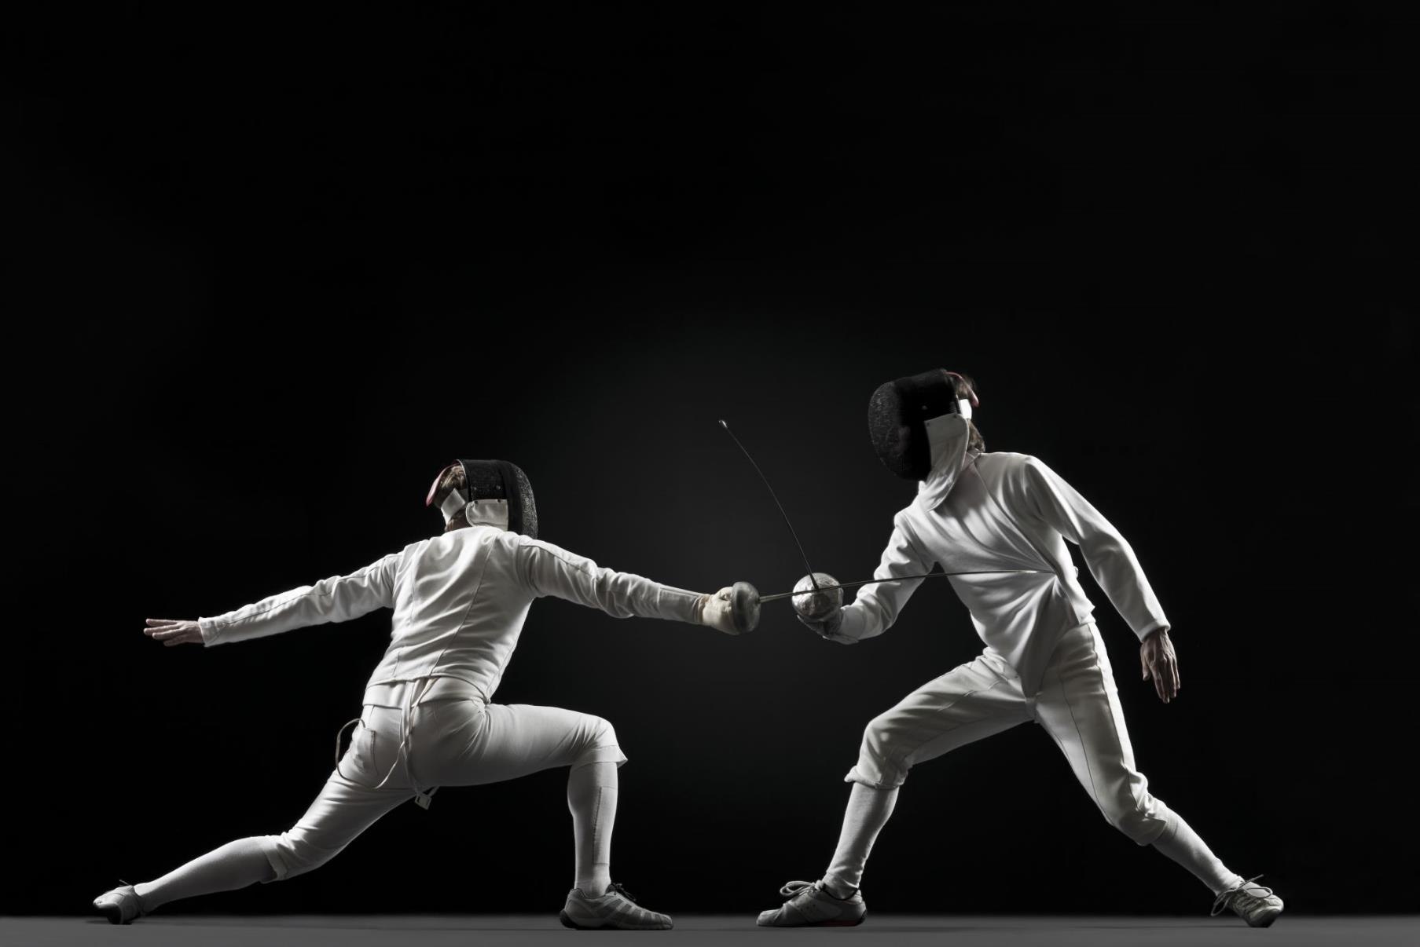
How to convert a customer?
Be prepared to defend your price. (Have clear the value we give)
Maybe here you will face the purchasing department.

Slide 21

How to convert a customer?
If all goes as planned, you will reach a deal!
Converting a new account is the sales team superpower.
Only we can do it!

Slide 22
Value-based sales

Slide 23







What we’ll cover for the next hour
Value based sales – what is it and when is it the right play?
Definition
Process
Overall structure of value-based sales
Inspiration
Underlying need
Personas
What does it mean for Ellab?
Role-play example
Notes:
What could be some benefits of a value-based approach
Find out about hidded needs
Less price focus
Longterm partnerships
Happy customers

Slide 24

Taking a customer from a lead to a closed deal has never been more complex
Information available
Corporate complexity
Regulatory complexity
!
Successful sales people guide customers through the complex and sometimes overwhelming amount of available content

Slide 25
Let’s start with some definitions
Feature
Benefit
What the product does
Why the feature is relevant
Irrelevant Benefit
Notes:
Umbrella example
If all I need to make the purchase is to understand some features – what type of sales rep do I need? A sign.

Slide 26
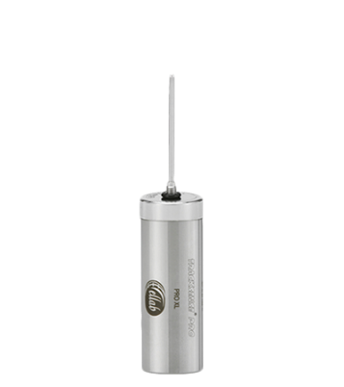
What could this mean for our products?
Feature
Benefit
If we think this is the need we’re in trouble – because who else can support this need
We need to understand more about the need, to the extend that we become more unique. The more we know the more we can show the customers our true unique features, and how it’s relevant for them.
So that you...
Probe length
Battery capacity
Guarantee
Robust
Temp reading in the right place
Less hassle
Predictability in budgeting
Don’t break easily

Slide 27
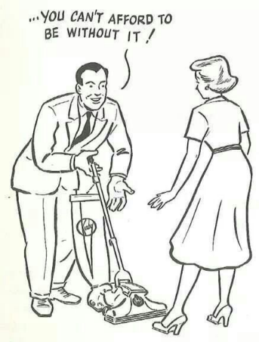

Say it to whomever wants to listen
Product features
Product sales
Product features
Circumstance
True need
Value-based sales
Customer’s problem
Persona
Solution benefit

Slide 28

For the sales you actively engage in – where on the scale is Ellab’s business
Product sales
Features
Value sales
Benefits
Fast and simple sales
Transactional
Few stakeholders
Repeat business
Cheap/commodity
Long decision process
Complex features
Several stakeholders
New qualification
Premium product
Talk
Pitch
Seen as supplier
Listen
Discuss/inform
Seen as partner/advisor

Slide 29
Asking questions is great, asking open questions is even better
Open
Closed
What
Where
Is/are
Why
When
Do/did
How
Which
Would/will
Who
Could/can
Was/were
What does your current setup look like?
Who is your current supplier?
Are you happy with your current supplier?

Slide 30
What’s the value-based sales process
Discovery
Find customer needs
Satifsy
Ask open questions
Confirm needs
Present benefits

Slide 31
How do we know if we found the need?
I want
I hope
I need
What matters is
It’s important
We’re looking for
I’d like
My goal is
I wish
We’re interested in
We must
We’re trying to
Our objective is
We have to change
!
Closed questions could be useful to confirm

Slide 32

Let’s take it one step further
Why is the need important?
Notes:
Behind this need, is a deeper need that we have to connect to.
Performance, image, finance
Save Solve, Increase, Emotion

Slide 33
The underlying need, is why the need is important
Scenario
Need
Underlying need
Employees are unhappy with the current setup, so unhappy that they are considering leaving
To be known as a good employer (image)
To find a solution the employees like
To not have too high employee turnover because it increases cost (financial)
Employees leaving could result in less production output (performance)

Slide 34

Fully understanding the problem to solve
Scenario
The problem
The solution
You and 3 colleagues are driving to a meeting. The car breaks down in the middle of a busy intersection.
The car is blocking other cars
Tow-truck
We’re going to be late for the meeting
Inform the meeting we’re late
We’ll miss important information in the meeting
Dial in to attend the meeting
Cannot get to the office
Taxi

Slide 35

Categorizing customers based on their roles and responsibilities
Notes:
Types of buyers
Strategic – Long term, overall business improvement
Financial (ROI, alternatives and if the product is even needed at this time)
Technical (Does it do the job, is it future proof)
User (help me save time, ease of use)
Soft/personality characteristics
Decisive
Consensus
Trust and relationship
Sceptical (usually closed,
Analytical (used Kaye before and it worked) – Need a lot of data, facts and understanding to change
Innovative (attitude towards - Let’s try – let this type be creative, involved and you direct her forward)
How risk aweresness they are or ´their personality types

Slide 36

What is a persona, and why is it important?

Slide 37

User buyers need to understand the customer experience
Care about how it will help them
Let them see, touch, feel, experience the product.
Prepare free trial, demo, show the software etc.
(Commonly Validation engineer)

Slide 38

Technical buyers want to buy – not be sold
They are analytical, risk averse and can seem introvert
They often have the right to say no to a solution, but not yes
Do your homework
Prepare proof
Let them come to the conclusion it’s a good buy
(commonly RA or QA)

Slide 39

Financial buyers want to make the smart financial decision
Will it increase revenue or reduce cost?
Prepare case studies, financial models and referrals
Help the financial buyer understand and be involved
(commonly procurement, finance)
Notes:
https://www.growthaspire.com/know-your-5-types-of-enterprise-buyers/

Slide 40

Strategic buyers want to understand the business impact
How will it impact the overall business
Long-term focus
Does it create strategic advantage
Build a good rapport, share information, case studies
(Commonly director or other senior title)
Notes:
PROJECT (COACH) BUYER
These buyers if they exist in the buying cycle as separate individuals or can be the same as the technical buyer or user buyer itself.
The key consideration will be of overall solution complexity, ease of implementation, timelines, milestones, services, etc.
You must build a good rapport and personal relation with this buyer and provide him with enough materials, informations which helps him ease the implementation. Also, this buyer may have to influence internal stakeholders. So it becomes important for your assist him which helps him in the role.
You can coach this buyer on what your solution can do and help him experience the same.

Slide 41





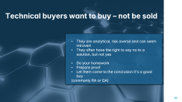
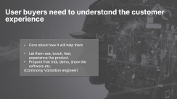
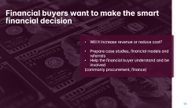
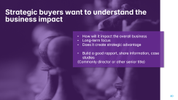

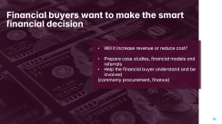
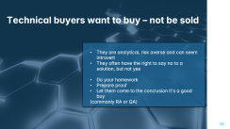

!
All these types are usualy represented at all our pharma customers. Ideally you connect with all types and present benefits related to them

Slide 42

Practical Steps Towards Value Sales
Prepare
Stay updated in the industry
Listen more than you talk
Practice using open questions
Put yourself in the customer’s shoes
Notes:
Do your homework
Ask questions
Negotiations come second
Effective / high close rate
Less on the price discussion
Retain and grow customers
Happy customers

Slide 43
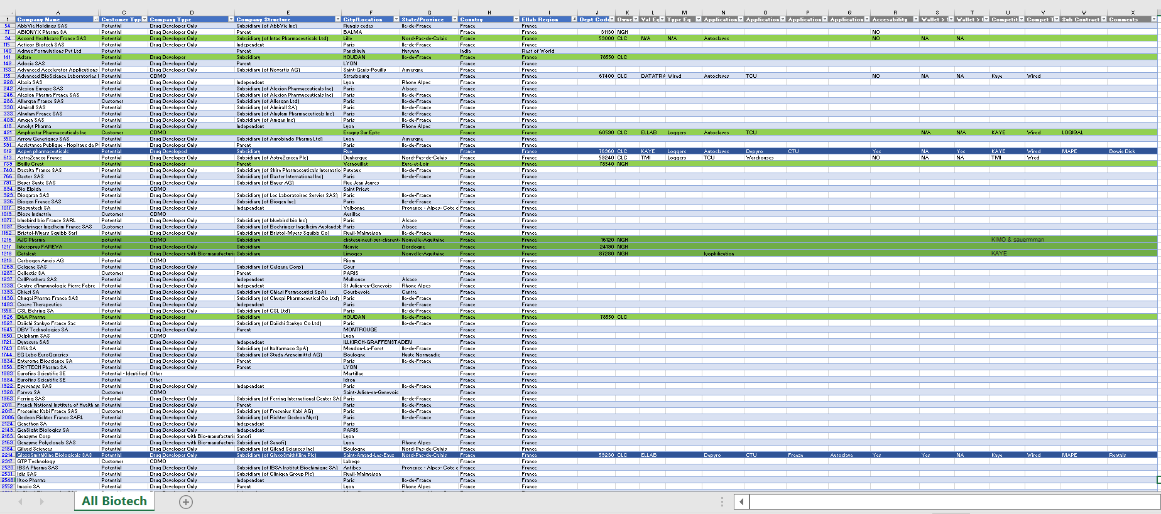
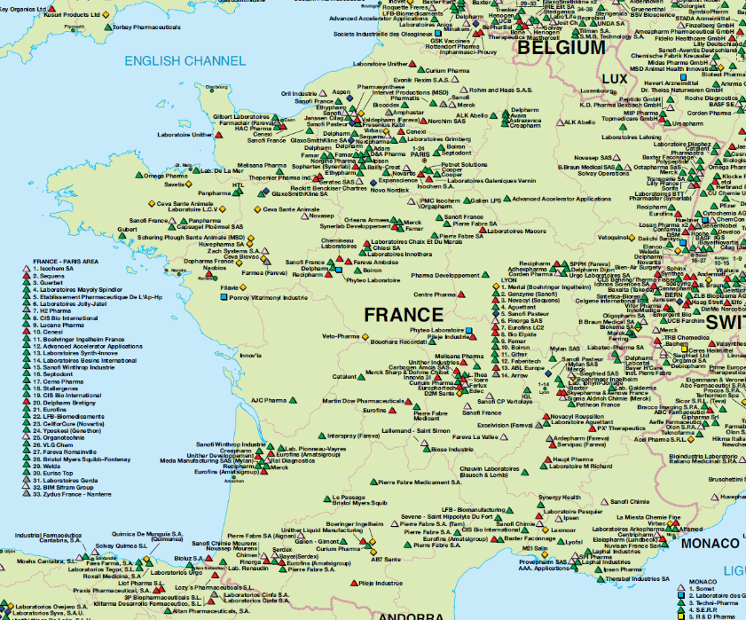
Who do we target and how?
Map out locations

Slide 44
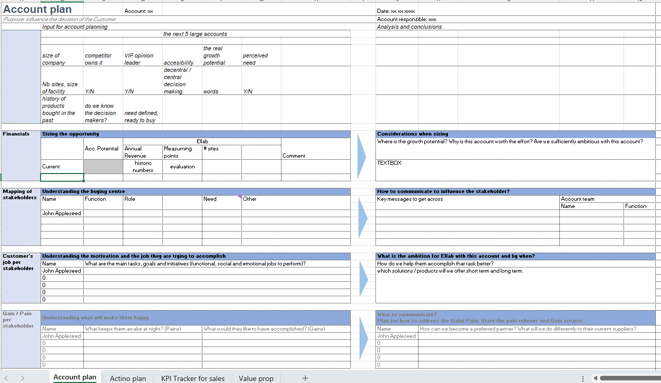
Account planning

Slide 45
Who do we target and how?
1
BIOPHARMA DRUG DEVELOPERS
2
BIOPHARMA CDMOs
3
SMALL MOLECULE
4
PARTNERS
5
FOOD PRODUCTION
6
HEALTHCARE
Segment
HUNT & FISH
HUNT & FISH
FARM & FISH
HUNT & FARM
FARM & FISH
FARM & FISH
Strategy
Biopharma division of large pharmaceuticals
Emerging biopharma companies
Developers of C&G therapies, new vaccine technologies, antibodies and other biologics
CDMOs with biologics capabilities
Specialty Cell & Gene facilities
CDMOs with global reach / key markets
More heavy on manufacturing (CMOs)
Large pharmaceutical companies in key markets
Focus on oncology related molecules
Equipment chamber manufacturers
Larger consulting firms that outsource some project activities – e.g. temperature mapping
Large food production companies in key markets
Large healthcare providers in key markets
Profile
BECOME “ADVISOR”
BECOME “PREFERRED PARTNER”
STAY “FRIENDS ”
BECOME “PREFERRED SUB-CONTRACTOR”
STAY ”TRUSTED PROVIDER”
STAY ”TRUSTED PROVIDER”
Goal

Slide 46


Databases & Contacts
COMPANIES DATABASES
Companies / Targets
Research what factories are in territory
Segment by type of products
CONTACT DATABASES
Contacts
Validation Department
Technical
Services
Quality
Department
Facility
Management
Laboratory Operations
Engineering Department

Slide 47
Value Proposition- Along with customer all the way
Monitoring CQV “One-Stop-Shop” Long-term relationships Customer Service & Support
Selling Points
R&D
EARLY-MID STAGE CLINICAL DEVELOPMENT
LATE-STAGE CLINICAL DEVELOPMENT
COMMERCIAL MANUFACTURING
Get visibility of our people and products through Consulting & Monitoring
Cater to increasing need of cold storge, freezers and quality requirements – scaling compliance and capacity
Support with everything the customer needs related to commercialization
Do things quickly and efficiently - prepare for rapid scaling.
Assist customer in becoming self-sufficient and maintaining compliance status - ongoing compliance and new projects
OUR OFFERING
OUR OFFERING
OUR OFFERING
OUR OFFERING
Value Proposition
100%
100%
100%
100%
80%
80%
80%
80%
60%
60%
60%
60%
40%
40%
40%
40%
20%
20%
20%
20%
Consulting
CQV
Field Calibration
Rental
Monitoring EQ
Validation EQ
Consulting
CQV
Field Calibration
Rental
Monitoring EQ
Validation EQ
Consulting
CQV
Field Calibration
Rental
Monitoring EQ
Validation EQ
Consulting
CQV
Field Calibration
Rental
Monitoring EQ
Validation EQ

Slide 48




Along with customer all the way- Detailing the needs
R&D
EARLY-MID STAGE CLINICAL DEVELOPMENT
LATE-STAGE CLINICAL DEVELOPMENT
COMMERCIAL MANUFACTURING
Consulting: Need help with starting up and scaling up
Monitoring EQ: Will be needing a small-scale monitoring system. We are competing against non-part 11 systems (non-validated) in this early stage, but if we can get in with a small system, we can continue growing with them as they face increasing compliance requirements.
If they go with another system that cannot meet requirements (part 11), we will have another opportunity later.
Field Calibration: If they are going to monitor, then they will likely calibrate
CQV: Very small likelihood we will do this work for them at this stage - unless they are part of a larger corporation in which they decide to apply the quality system down this far into the process
Rental: Same rational as CQV - smaller companies may rent to do the work or have someone else do the work as a turn-key
Validation EQ: Not many companies are willing to make that investment at this point
Consulting: Need help with starting up and scaling up
Monitoring EQ: Moving towards increasing compliance requirements (part 11), which improves our likelihood with clients that has not yet purchased a validated monitoring system
Field Calibration: If they are going to monitor, then they will likely calibrate
CQV: They may not be qualifying at this point, but if they are, they typically do not have an internal team to do the work
Rental: If they do have an internal team qualifying, they might have a need for renting equipment
Validation EQ: Usually not ready to make the investment at this time, and usually not looking for a premier system if they are
Consulting: TBD
Monitoring EQ: Part 11 is now a firm requirement for data integrity and audit trails. Having robust validation documentation package is necessary. Potentially replacing chart recorders or competitor CMS at this stage.
Field Calibration: Their need will depend on how much variety of calibrations they would want us to perform
CQV & Rental: This is when they are scaling up and will either get hourly support and rent equipment or utilize our turn-key support. If we can get in for both hourly staffing and rental equipment that is a double bonus
Validation EQ: Now more likely willing to make an investment in equipment as they realize that mapping will be happening more frequently
Consulting: TBD
Monitoring EQ: Now competing with other monitoring companies and building management systems (BMS). If they are utilizing BMS, we do have the opportunity to be the redundant system in place.
Field Calibration: At this point, larger companies are likely to be developing this capability in-house rather than outsource.
Small and mid-size companies might still outsource this activity or have a calibration house that can do all their calibrations and perform the work separately from CQV
CQV: The need for CQV support is more often utilized during larger projects to support the staff they likely have on-site. This often opens up more opportunities for hourly/staffing type roles in conjunction with turn-key support
Rental: Client may decide to rent the equipment if they have adequate staffing
Validation EQ: Now have more capital to make investments in the best equipment to support their processes

Slide 49
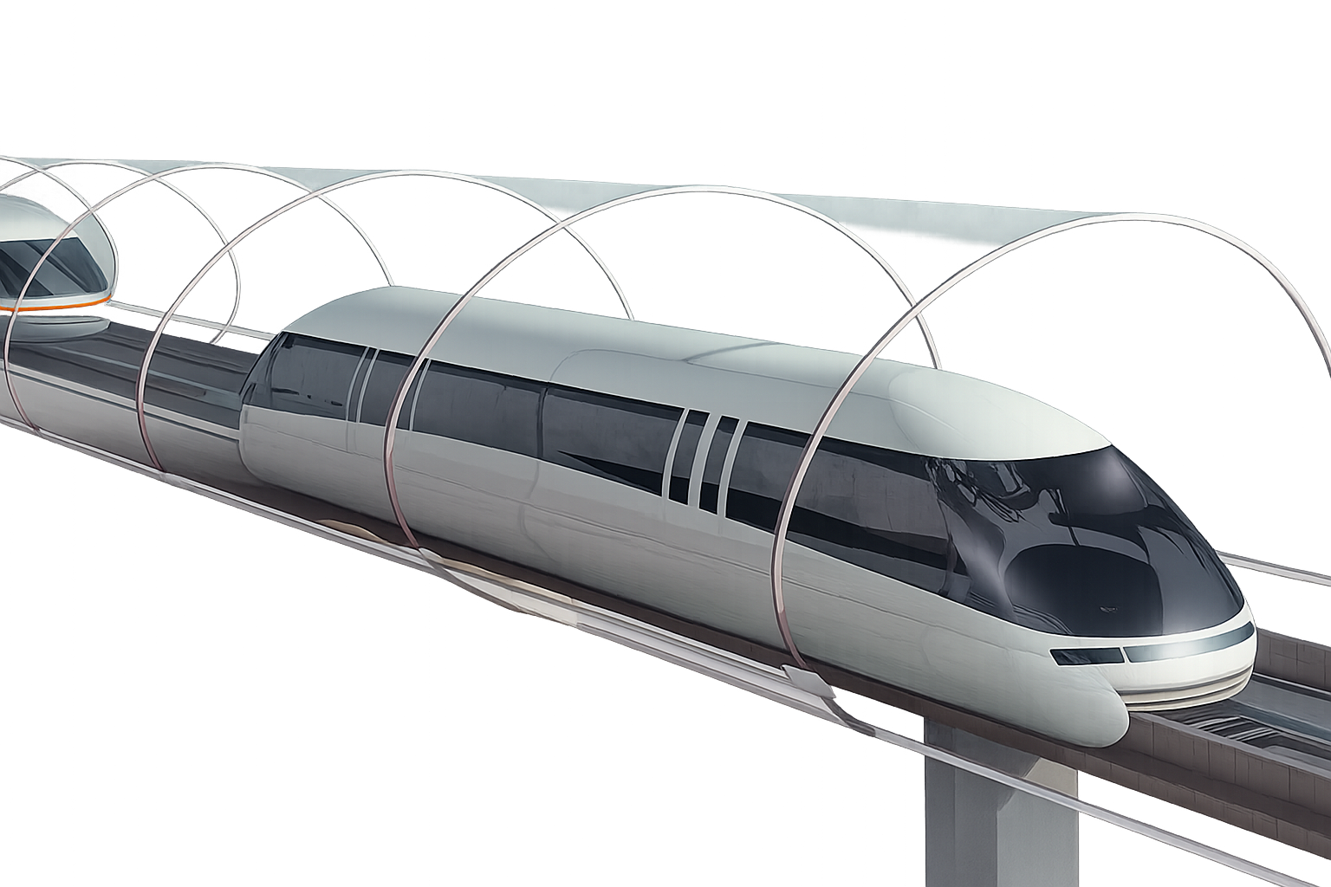
Future of Ellab Sales
Notes:
Do your homework
Ask questions
Negotiations come second
Effective / high close rate
Less on the price discussion
Retain and grow customers
Happy customers

Slide 50
Ellab ValSuite software – selling strategies

Slide 51
Practical Steps Towards Value Sales
Prepare
Stay updated in the industry
Listen more than you talk
Practice using open questions
Put yourself in the customer’s shoes
Notes:
Do your homework
Ask questions
Negotiations come second
Effective / high close rate
Less on the price discussion
Retain and grow customers
Happy customers

Slide 52

What is the Best Way to Show Ellab Equipment?

Slide 53
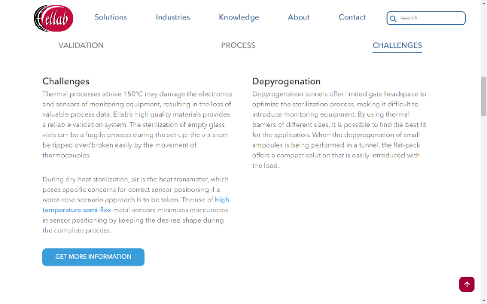
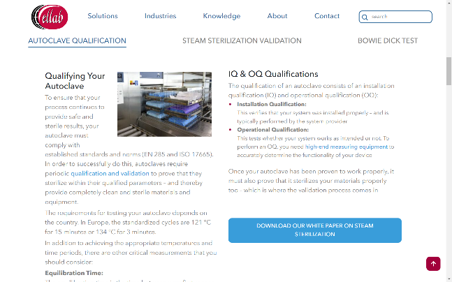
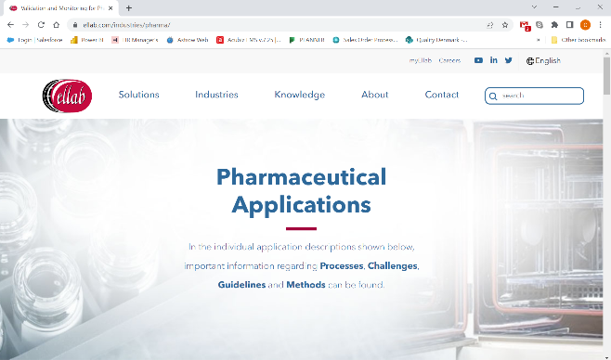
What is the best way to present Valsuite
Research the equipment to validate (Ask questions to customer)
Look into the application notes at Ellab.com
Be familiar with the challenges of the application. (But ask questions to customer)
Have a relevant report at hand.
Explain the report and how easy it is.
The report is a value adder!

Slide 54
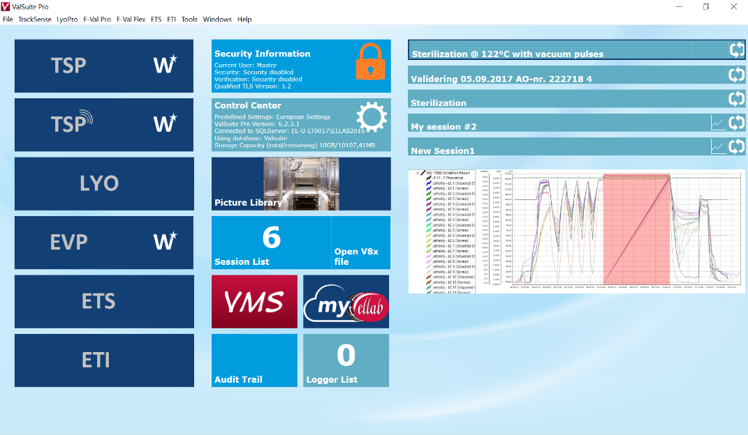
What is The Best Way to Show Ellab Equipment?
ValSuite Software

Slide 55

What is the best way to show Valsuite?

Slide 56

Start from the end

Slide 57
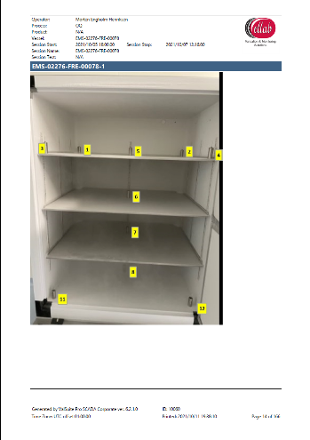
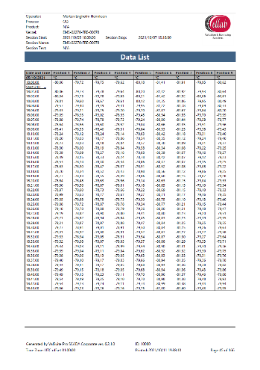
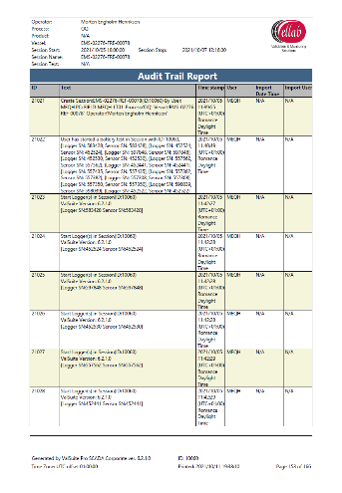
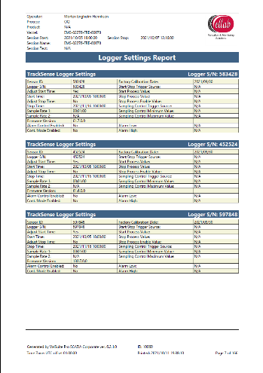
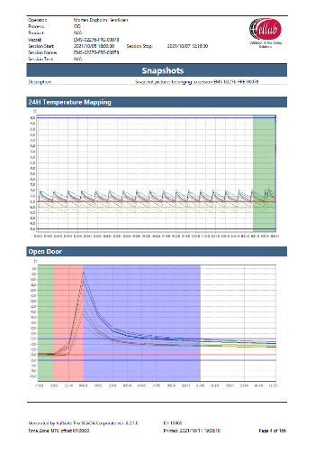
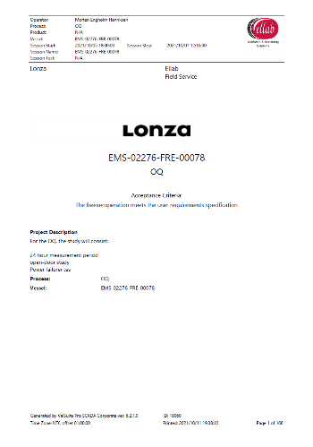
What is the Best Way to Present ValSuite?
ValSuite Report

Slide 58
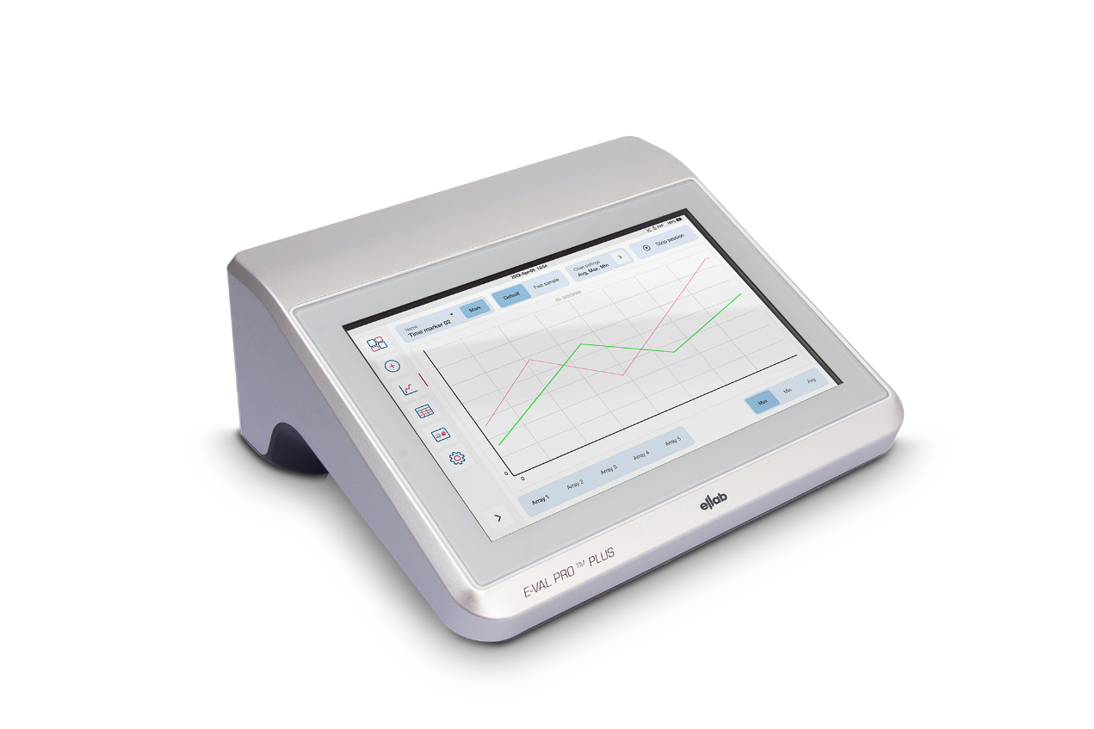
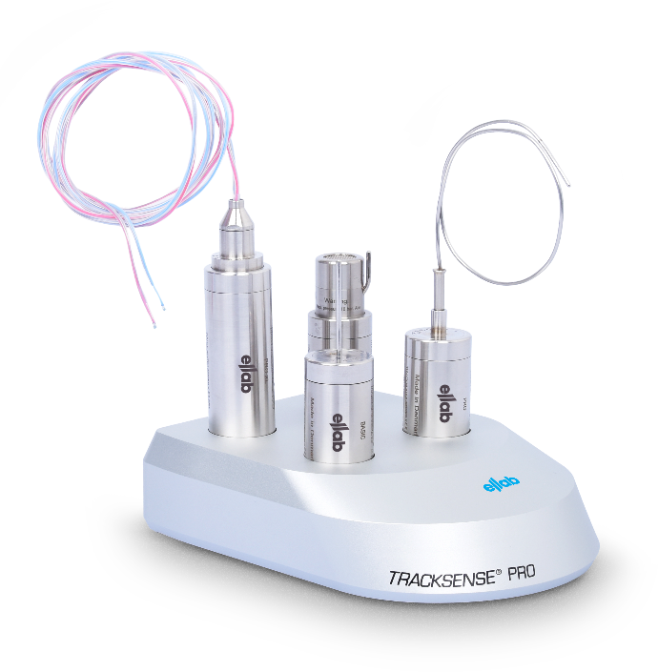
What is the Best Way to Show Ellab Equipment?
Now you can show the hardware…
Small quick session.
Just start and stop. A few seconds

Slide 59
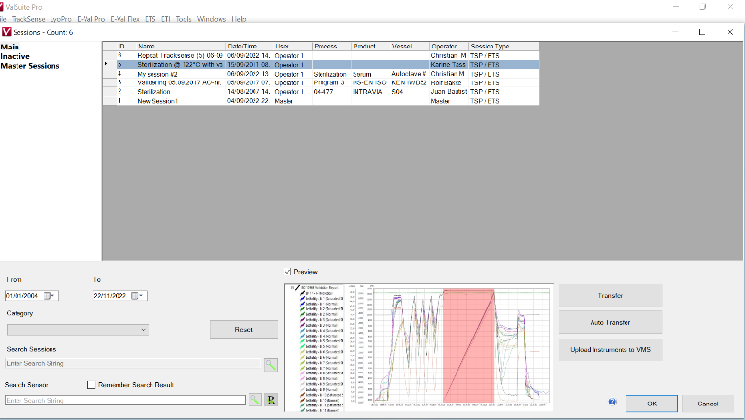
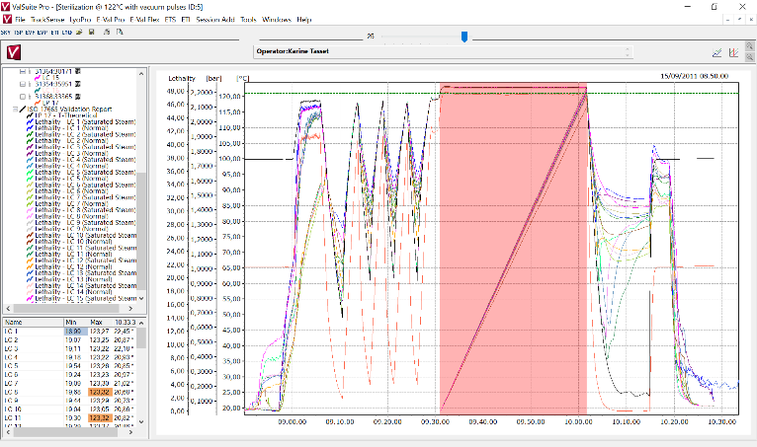
What is the best way to present Valsuite
If time allows, You can open the same session, where the report was created.
Go over the created session, and show the parts of the report.
Master a few DEMO sessions
Choose most relevant applications

Slide 60

Show how user-friendly the software is.

Slide 61
Major advantage features
ValSuite

Slide 62

Attack!
Do you have any questions?
linkedin.com/company/ellab/
youtube.com/c/EllabValidationMonitoringSolutions
twitter.com/ellabsolutions

Slide 63

What is the best wat to show Valsuite?
One software to rule them all

Slide 64

What is the Best Way to Show ValSuite?
ValSuite |  | Others
ValSuite used for all Ellab range. Wireless + Real time + Reporting. |  | Need specific software to each hardware, and then you send to the reporting tool software.
Your Life Science
Compliance
Partner

Slide 65

Strategy update RoW
What is Rest Of the World?
More than 50 mainstream languages
Different business cultures
An estimate of ~4847 pharmaceutical manufacturing sites (latest survey received from McKensey)
13 languages
More to come!

Slide 66
What is the Best Way to Show ValSuite?
ValSuite |  | Others
ValSuite used for all Ellab range. Wireless + Real time + Reporting. |  | Need specific software to each hardware, and then you send to the reporting tool software.
ValSuite with local language |  | Only English or limited options
Your Life Science
Compliance
Partner

Slide 67

Advance IT ready:
Citrix install
Server install
Local Install
AD login.
Ellab strong software team to jump to a TELCO

Slide 68
What is the Best Way to Show ValSuite?
ValSuite |  | Others
ValSuite used for all Ellab range. Wireless + Real time + Reporting. |  | Need specific software to each hardware, and then you send to the reporting tool software.
ValSuite with local language |  | Only English or limited options
IT dept is our friend |  | Afraid of IT dept.
Your Life Science
Compliance
Partner

Slide 69

Flexible Calibration

Slide 71
What is the Best Way to Show ValSuite?
ValSuite |  | Others
ValSuite used for all Ellab range. Wireless + Real time + Reporting. |  | Need specific software to each hardware, and then you send to the reporting tool software.
ValSuite with local language |  | Only English or limited options
IT dept is our friend |  | Afraid of IT dept.
Different types of calibration available |  | Rigid calibration set-up
Your Life Science
Compliance
Partner

Slide 72

No limit in reports

Slide 73
What is the Best Way to Show ValSuite?
ValSuite |  | Others
ValSuite used for all Ellab range. Wireless + Real time + Reporting. |  | Need specific software to each hardware, and then you send to the reporting tool software.
ValSuite with local language |  | Only English or limited options
IT dept is our friend |  | Afraid of IT dept.
Different types of calibration available |  | Rigid calibration set-up
No limit in #channels in report. |  | Large studies… separate reports.
Your Life Science
Compliance
Partner

Slide 74

Busy Workday

Slide 75
What is the Best Way to Show ValSuite?
ValSuite |  | Others
ValSuite used for all Ellab range. Wireless + Real time + Reporting. |  | Need specific software to each hardware, and then you send to the reporting tool software.
ValSuite with local language |  | Only English or limited options
IT dept is our friend |  | Afraid of IT dept.
Different types of calibration available |  | Rigid calibration set-up
No limit in #channels in report. |  | Large studies… separate reports.
Get the sensors in… we can set-up the report later. |  | Rigid. Not allow for quick reaction.
Your Life Science
Compliance
Partner

Slide 76


Philosophy

Slide 77
What is the best wat to show Valsuite?
Valsuite Others
Need specific software to each hardware, and then you send to the reporting tool software.
Only English or limited options
Afraid of IT dept.
Rigid calib. set-up
Large studies… separate reports.
Rigid. Not allow for quick reaction.
Old style workplace. “The validator guy”.
Valsuite software used for all Ellab range. Wireless + Real time + Reporting.
Valsuite software with local language
IT dept is our friend
Different types of calib. available.
No limit in #channels in report.
Get the sensors in… we can set-up the report later.
Ideology of modern workplace. Different collaborators.

Slide 78
What is the Best Way to Show ValSuite?
ValSuite |  | Others
ValSuite used for all Ellab range. Wireless + Real time + Reporting. |  | Need specific software to each hardware, and then you send to the reporting tool software.
ValSuite with local language |  | Only English or limited options
IT dept is our friend |  | Afraid of IT dept.
Different types of calibration available |  | Rigid calibration set-up
No limit in #channels in report. |  | Large studies… separate reports.
Get the sensors in… we can set-up the report later. |  | Rigid. Not allow for quick reaction.
Ideology of modern workplace. Different collaborators. |  | Old style workplace. “The validator guy”.
Your Life Science
Compliance
Partner

Slide 79
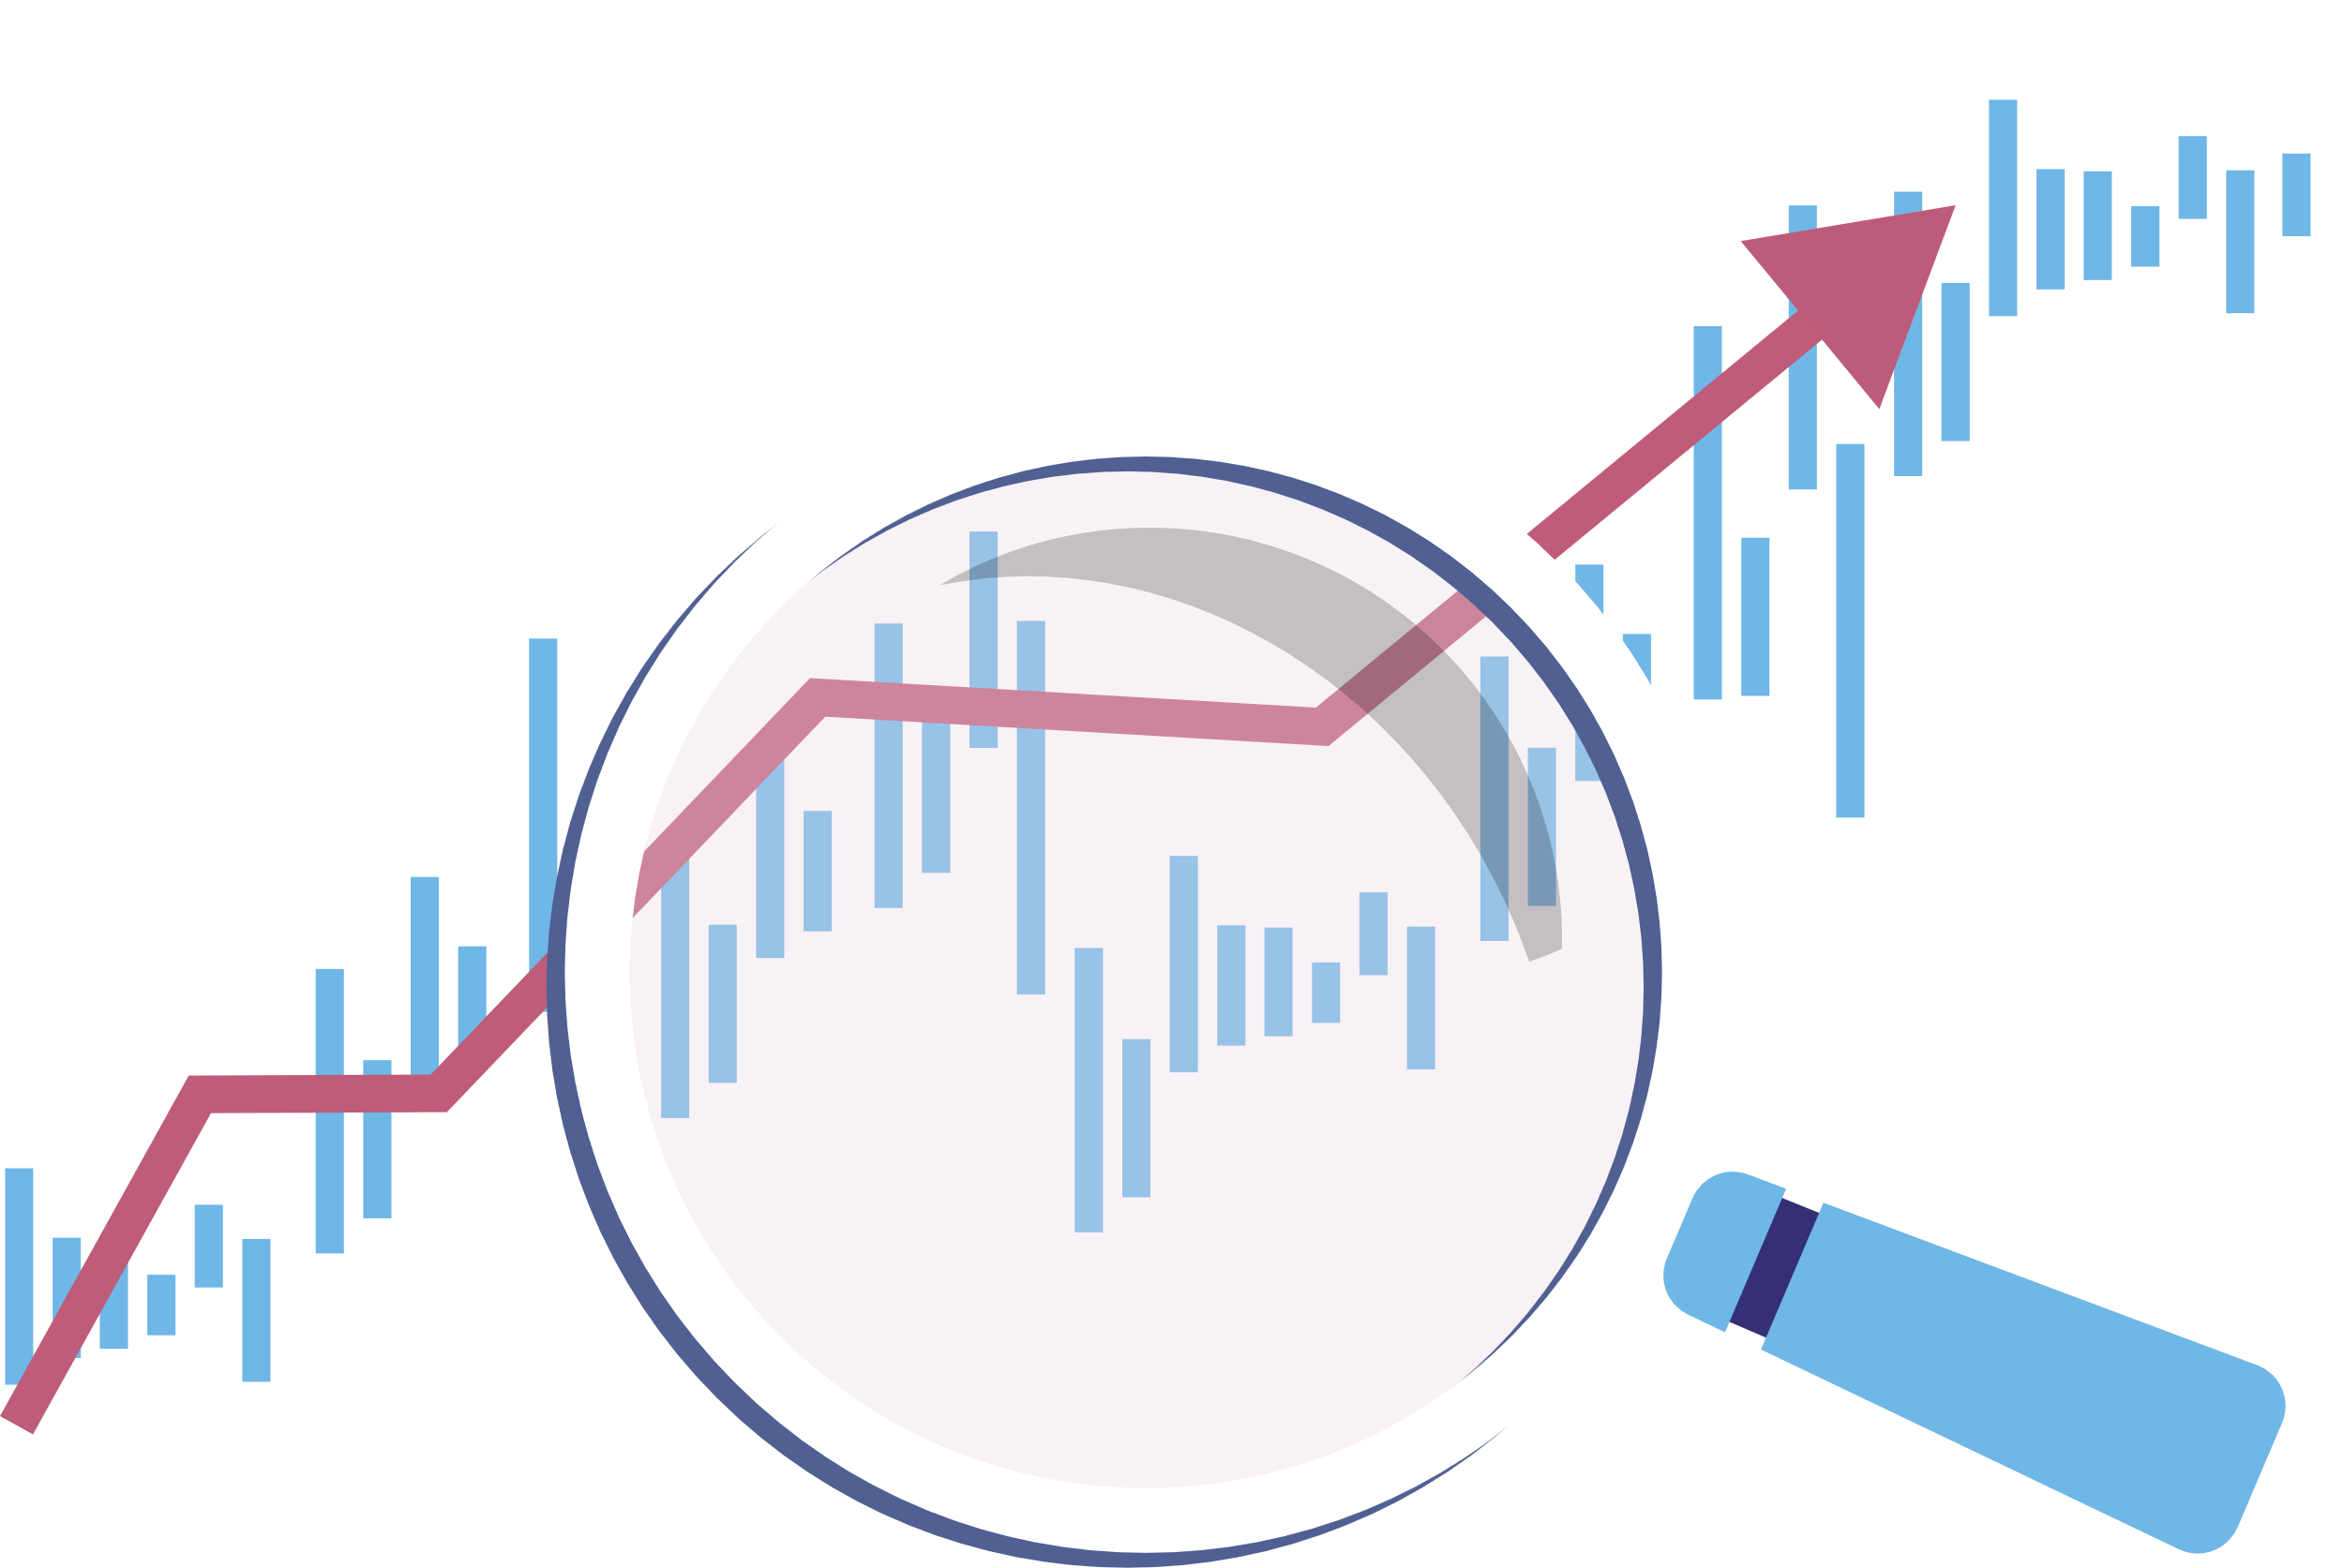
Major trends

Slide 80

Increasing regulatory stringency
Validation of deeper parts of the manufacturing process.
Document harmonization of processes worldwide.
New therapies.

Slide 81

Shortage of skilled labor for Biopharma
Multilingual environment.
Flexible workgroups and multitasking team members.
Need for technology that eases on-boarding.

Slide 82

Multiproduct facilities - Barrier world
Increase in demand for an agile and responsive validation teams as product changeover is expected to be faster.
Design and validation of multiproduct facilities raises complexity.
Process machinery for multipurpose facilities might offer challenges on traditional validation equipment.

Slide 83


More connected and data-driven pharmaceutical ecosystem
Citrix install.
Server install.
Local Install.
AD login.

Slide 84

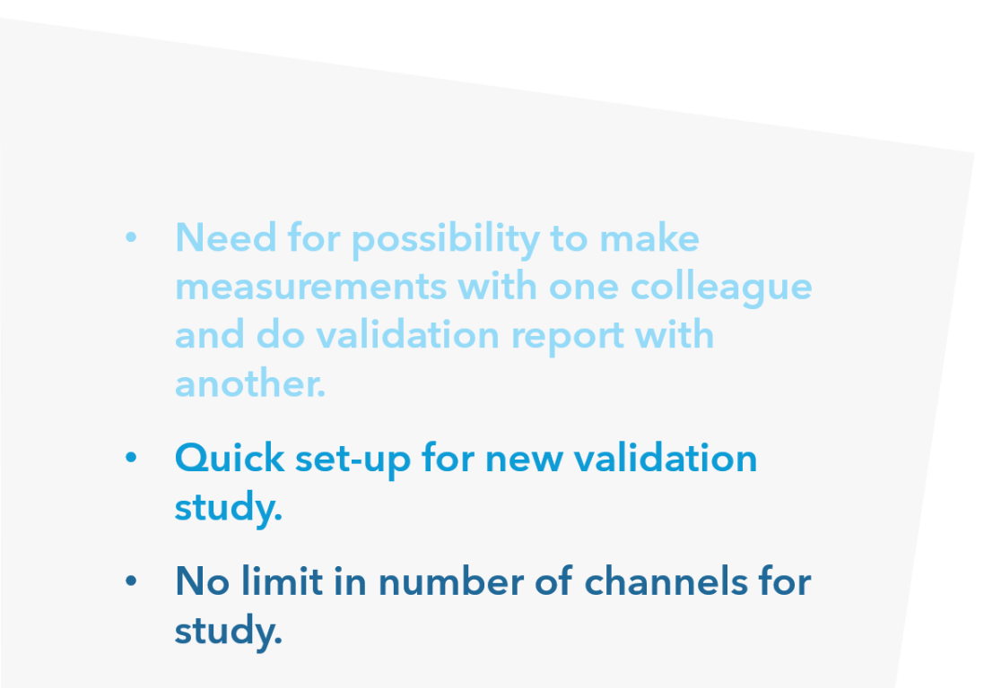

Market trends
Multi-functional collaborative departments

Slide 85
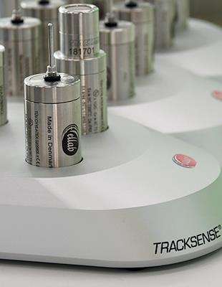
Dataloggers clearly preferred solution
Ease of use.
Multiparameter solution.
Quick in process installation.

Slide 86
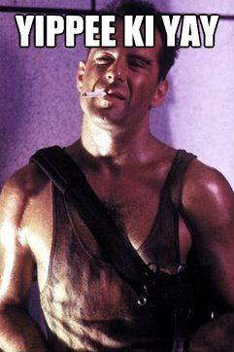
But
Thermocouples
won’t die.

Slide 87
Dataloggers and thermocouples
Specific applications may require thermocouple systems within same site. Specially for large studies.
Combine technology in a safe way.
One software to allow reporting all types of equipment in one unique report.

Slide 88
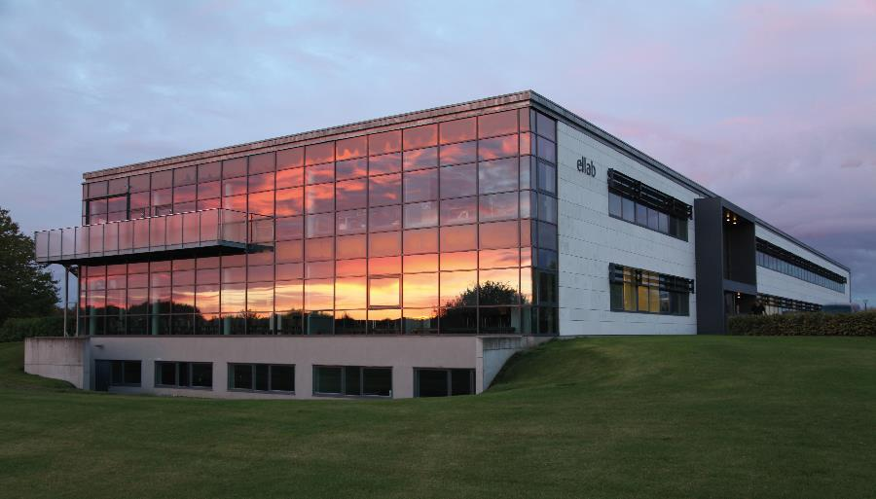
Thank you
Do you have any questions?
linkedin.com/company/ellab/
youtube.com/c/EllabValidationMonitoringSolutions
twitter.com/ellabsolutions
ellab.com

Slide 89
Workshop

Slide 90
Group exercise
Nerissa + Emma----------------------- Script for cold calling- Validation Equipment
Sandra + Stefanie --------------------- Script for cold calling- Monitoring
Barrington + Nicola------------------- How does a first meeting look?- Monitoring
Vivien + Mahery------------------------ How does a first meeting look? – Validation Eq.
Marta + Luca----------------------------- Show the stuff! (DEMO) – Validation Equipment
Gregory + (CMU?)--------------------- How to handle objections/resistance?- Val Eq.
Presenters?-------------------------------

Slide 91

Group exercise
Script for cold calling---- lets hear it! ☺
How does the first meeting look?
Manager (presenter)
Technician (presenter)
Show the stuff!
Val Manager (presenter)
Technician (presenter)
Technician, Kaye Lover (presenter)
How to handle objections
Val Manager (presenter)
Technician (presenter)
Procurement (presenter)

Slide 92


Slide 93
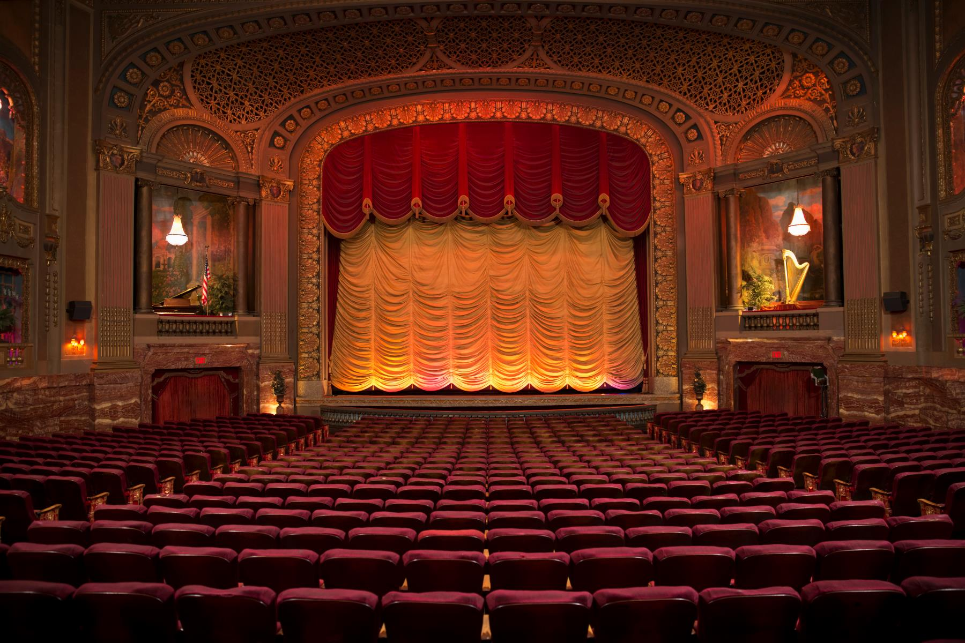
Showtime!

Slide 94
Group exercise
Script for cold calling---- lets hear it! ☺
How does the first meeting look?
Manager (presenter)
Technician (presenter)
Show the stuff!
Val Manager (presenter)
Technician (presenter)
Technician, Kaye Lover (presenter)
How to handle objections
Val Manager (presenter)
Technician (presenter)
Procurement (presenter)

Slide 95
Demo best practices
What questions to ask?
Identify what stage are you in (Intro, DEMO, test)
Direct customer focus.
Prepare the DEMO.
Prepare the test.

