Slide 1
Validation Services

Slide 2
Andreas Kößler
Brand Manager Director
Validation Solutions
In Ellab since March 2019
Positions:
Area Sales Manager
Head of Sales & Marketing DACH
Country Manager CH
Validation Engineer

Slide 3

Intro to Validation Services Part 1
Customer needs /Applications
What is it that our customer needs
Ask! Ask! Ask!
”Do not anticipate the answer”

Slide 4
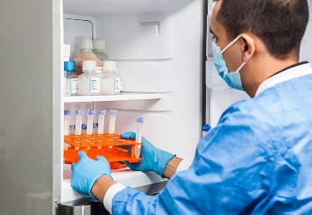
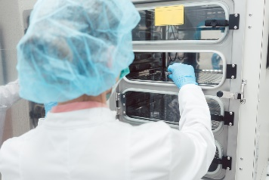
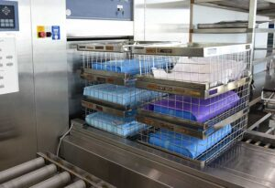
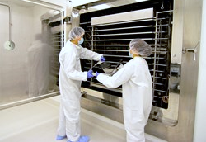
Overview of Units and Environment Under Test
Applications
Qualification Services of units and environments
Controlled Temperature Units (CTUs)
Liquid Nitrogen (LN₂) Freezers
Vapor and Liquid Phase
-150°C Mechanical Freezers
-90°C Ultra-Low to -20°C Freezers
Refrigerators (2°C to 8°C)
Environmental chambers
Incubators: Temperature, Humidity and CO₂, Shakers
Stability chambers: Temperature, Humidity and Photostability
Controlled Temperature Environments (CTEs)
Stability storage rooms, Walk-In Cold Rooms, Walk-In Freezers
Warehouse Mapping
Autoclaves (EN285) and Sterilizers
Lyophilizers / Freeze dryers
Depyrogenation Ovens & Tunnels
ETO Sterilization
Vaporized H₂O₂ processes
Steam-In-Place (SIP) processes
Centrifuges, Water baths and Washers
+ much more

Slide 5
Types of Services Commonly Required
Customer needs
Consulting, short-term, and long-term staffing
New site and site expansion support
On-Site Field Calibrations
FAT, SAT, Commissioning
Qualifications: CTUs, CTEs, Warehouses, Storage Areas
Validations: Autoclaves, Ovens (Various), Controlled Rate Freezers, Glass Washers, Lyophilizers
Additional Services: Steam Quality Testing, Monitoring Support

Slide 6
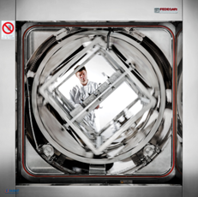
Types of On-site Thermal Validation / Mapping Services
Customer needs
Design Qualification (DQ)
Engineering Studies
Installation Qualification (IQ)
Operational Qualification (OQ)
Performance Qualification (PQ) or Continuous Qualification (CQ)
Instrument / equipment calibration
Power off / Power failure tests
Door Open tests
Temperature Distribution tests
Temperature Penetration tests
Alarm testing
Loaded and Empty Mappings
Shelf mapping, vacuum testing, Bowie Dick testing, steam quality testing, vacuum leak test, conductivity tests, riboflavin removal testing, controlled rate mapping
And several more…

Slide 7
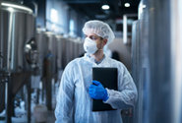
Why choose Ellab to Perform On-site Services?
Customer needs
Ellab is committed to providing world-class services to meet all our customer’s qualification, validation and calibration needs
We offer a full range of field services for GMP/GLP facilities in the Life Science and Food Manufacturing Industries
Our goal is to build long-term relationships with customers
We differ from competitors through our relationships with customers, dedicated and hardworking staff, expertise and efficiency in the services we perform
Ellab is committed to delivering high quality, which when combined with Ellab's equipment, leads to excellent qualification and validation work

Slide 8
Typical Challenges Ellab On-site Services can Solve
Solution
Examples of Challenges | Ellab’s On-site Services
Projects may come up quickly | We provide an appropriate turnaround time on proposal and manage expectations Have multiple locations with responsive engineers
Lack of specialized and trained staff | We focus on mid to sr. level engineers that are capable of qualifying equipment efficiently with a high level of quality Newer employees work in tandem with more experienced engineers till ready to work solo
Projects can vary in terms of size and turnaround times | Industry leading equipment for quality & efficiency Quantity can be optimized for each project Easy to transport Lower shipping costs Can fly with equipment on smaller projects
Cumbersome protocols Slow turnaround time of reports Lack of quality, detail, clarity on reports. Lack of GDP (Good Documentation Practices) | Streamlined protocols that are customized utilizing autofill areas for customer & unit information Easy integration of ValSuite reports

Slide 9

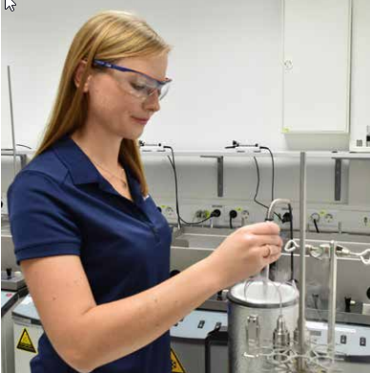
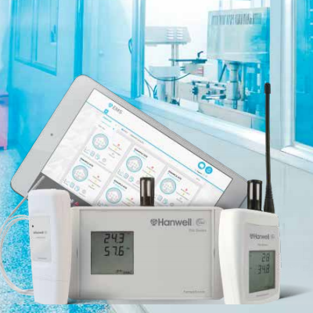
Services we offer
Applications
Staffing of Service Engineers
Thermal Qualifications/Validation Projects
Ellab offers our highly skilled engineers to perform on-site thermal qualification and other associated validation tasks
Available turn-key validation projects performed in a high quality / efficient manner including protocol generation, field execution, and summary report packages
Ability to support scopes of work for any size project
GMP Staffing & Projects
Our engineers can also perform various other GMP related tasks
Long term contracts available – Hourly, Weekly, Monthly, Annual contacts available
Calibration Services
Skilled Calibration Engineers with High Quality Equipment
Calibrations outside a conditioned metrology laboratory require a high level of field calibration knowledge and experience
With Ellab you have a competent partner for these comprehensive calibration tasks of your high-grade instruments and measuring systems
On-site Calibration Services
Control sensors on autoclaves, Pasteurization plants, UHT facilities and Cold rooms
Temperature Calibration range from -200 to +400°C plus
Monitoring Services
IQ / OQ of new monitoring systems
An essential part of acquiring a new monitoring system is have it qualified
Ellab offers both the monitoring systems and the required IQ / OQ services
IQ / OQ of additional monitoring units
Re-calibration of monitoring units

Slide 11

Intro to Validation Services Part 2
Our offering & How to quote

Slide 12

Foundational concepts:
“The better you know yourself, the better your relationship with the rest of the world”
-Toni Collette
“The most important knowledge is understanding what you can’t do.”
-Bill Buford

Slide 13
Types of Services Offered
Our offering will vary from region to region
Consulting
On-Site Field Calibrations (Various depending on standards and staff available)
Commissioning, FAT, SAT
Qualifications: CTUs, CTEs, Warehouses, Rooms
Validations: Autoclaves, Ovens (Various), Controlled Rate Freezers, Glass Washers, Lyophilizers
Additional Services: Steam Quality Testing, Monitoring Support
Short-term, and long-term staffing
Hourly projects and fixed price projects

Slide 14
Core Concept – Determining and Valuing Time
Time can vary even with similar sounding SOW (Scope of Work)
Time – Understanding the SOW to derive the expected quantity of hours, days, weeks, or months it will take to complete a particular SOW
Could be for one staff member, or for many.
A client says “Please calibrate and qualify my refrigerator”
Does that mean 2 to 3 days of work, or over a week’s worth of work? If we estimate incorrectly that could be either devastating to the company if we win and/or lose the project.
What are the expectations around efficiency, and how does that effect your pricing methodology?
Can you only qualify one unit at a time, or 4?

Slide 15
Core Concept – Materials
Material can, but should never be a showstopper
What needs to be provided by Ellab to complete the project at hand.
Calibration equipment
Ellab mapping equipment
Data Loggers, E-Val Pro, Sky, TVP, or our choice
Equipment fees built into fixed/hourly rate, or separate charge?
What if the prospect wants you to use their equipment?
Steam quality test kits
Other materials
Consumables: Binders, paper…etc.
Calibration standards, buffers…etc.
Shipping materials
TIP: Price per measurement point/day. E-Val Pro = 3Points

Slide 16

To hourly or not to hourly?

Slide 17
Hourly Price Projects (1/2)
Always safe > $$$ ☺
Staffing & Hourly projects with/without equipment (Small/Medium/Large)
Complex projects
Some calibration projects are better as hourly (Rare)
Validations
Autoclaves, SIP, Ovens, Glasswashers…etc.
Utilizing client’s quality system
Protocol and report system = Generation of documents in their system
Mapping equipment
Part of hourly rate, separate fee/rental, or no equipment required
Quantity of units under test available for simultaneously mapping may be limited
Large potential for delays
Too many variables outside of our control
Working with or through other contracting firms

Slide 18
Hourly Price Projects (2/2)
How do you figure out how many hours?
Hourly projects – Autoclaves, Ovens, SIP…etc.
Easiest – They tell you.
Likely – You need to figure out. Work out with your validation team to determine a game plan and get agreement with the prospect.
The larger and more complex projects are more difficult to gauge
Strategy: Cannot come in too low, but also cannot come high as those are often
automatically disqualified
Staffing roles
They need to tell you the duration because your staff will essentially become part of their staff for a fixed time period.
Is typically straight forward and most likely it takes longer as expected.

Slide 19
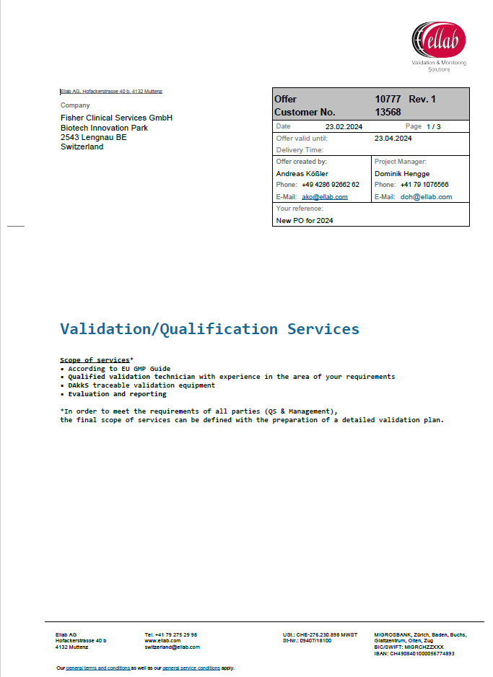
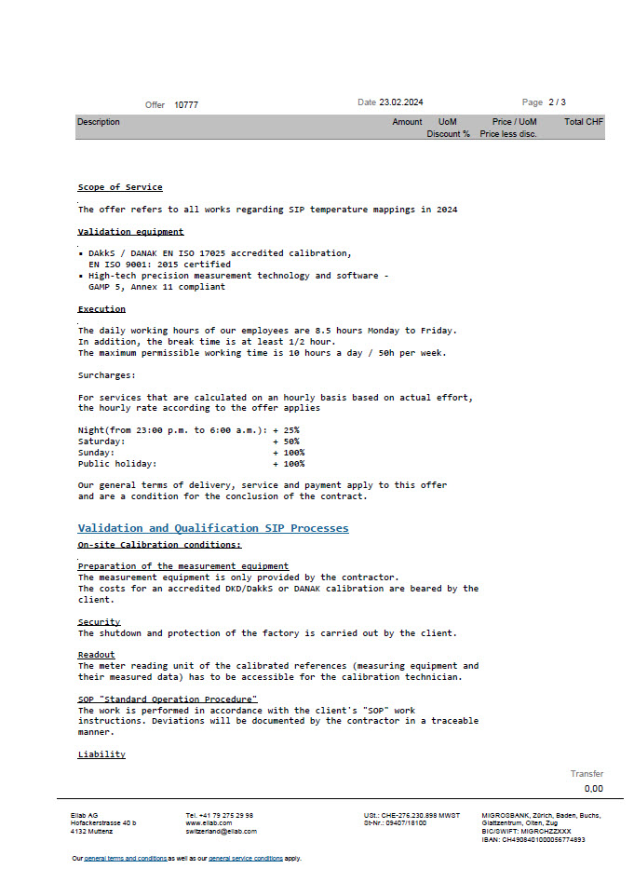
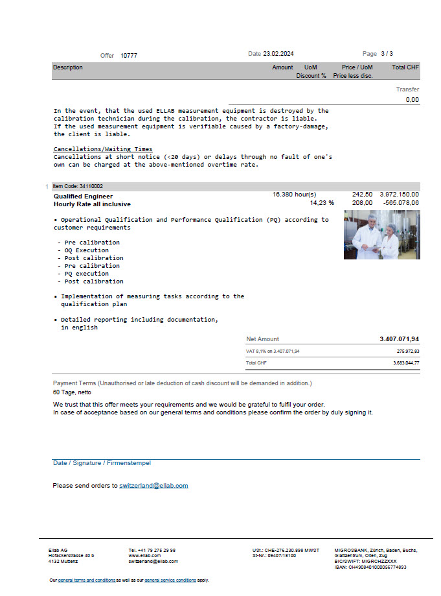


Example of hourly quote

Slide 20
Fixed Price Projects
If all is well planned and predicted-> $$$ ☺
Requires a well-defined SOW
Are there:
Training requirements
Calibrations to be executed
Protocol to be prepared filled in
Qualifications / Validations
CTUs/CTEs, warehouses, Steam Quality Testing
Defined quantity of multiple units qualified simultaneously
Mapping equipment
Summary Report Package
TIP: Put disclaimer in quote just in case things are not like promised ☺

Slide 21
Protocol Options
Protocols are hidden money loosing monsters ☺
Ellab Protocol
Does it require any customization?
Build pricing into per unit, or separate line item?
Client’s protocol
Could be simple, lean, extensive, or incredibly complex
Manufacturer’s protocol
Often not the most efficient protocol to execute
Field Test / Commissioning document
Simple 1 page document with basic tests for FAT, SAT, commissioning level testing.

Slide 22
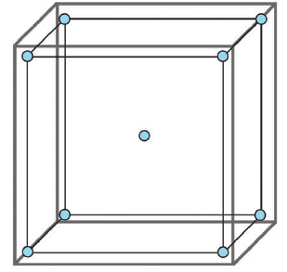
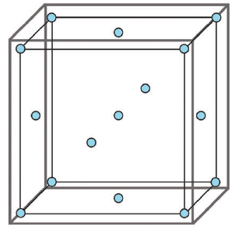
Determining the Minimum Quantity of Mapping Sensors: Reach-Ins and Walk-ins
ISPE Good Practice Guide: Controlled Temperature Chamber Mapping and Monitoring
Minimum ambient sensors based on ISPE guide
Chamber volume: X ≤ 70 cubic feet (2 cubic meters)
9 sensors
Chamber Volume: 70 < X ≤ 700 cubic feet (20 cubic meters)
15 sensors
*Actual number of mapping sensors may vary and often exceed the minimums based on the ISPE guide.
Common quantities of ambient sensors seen in reach-in sensors
Temperature only: 12
Temperature / RH: 12 Temperature, 3 RH
Temperature / RH / CO₂: 12 Temperature, 3 RH, 1 CO₂
Common quantities seen in walk-in quantities (will vary depending on size)
Temperature only: 16+
Temperature / RH: 16+ Temperature, 4+ RH

Slide 23
How long does it take on-site? Single Set Point, 24-hour mappings
Standard Cal / Requal
Requal Mapping (24-hour ‘as-is’)
Calibration
2ish days
Standard Cal / IOQ
IQ
Controller OQ (Alarm Tests, Power Interruption)
OQ Mapping (24-hour mapping, Open door Test)
Calibration
3ish days
Standard Cal / IOPQ
IQ
Controller OQ (Alarm Tests, Power Interruption)
OQ Mapping (24-hour mapping, Open door Test)
Calibration
4ish days
PQ Mapping (24-hour ‘loaded mapping)
Fully Loaded Cal / IOPQ
IQ
Controller OQ (Alarm Tests, Power Interruption)
OQ Mapping (24-hour mapping, Open Door Test, Power Loss Mapping)
Calibration
5 days
PQ Mapping (24-hour ‘loaded mapping, Open Door Test, Power Loss Mapping)

Slide 24
How long does it take on-site? 48-hour mappings
Either 2 set points, or 2 conditioners
Standard Cal / Requal
Requal Mapping(48-hour ‘as-is’ mapping)
Calibration
3ish days
Standard Cal / IOQ
IQ
Controller OQ (Alarm Tests, Power Interruption)
OQ Mapping (48-hour mapping, Open door Test)
Calibration
4ish days
Standard Cal / IOPQ
IQ
Controller OQ (Alarm Tests, Power Interruption)
OQ Mapping (48-hour mapping, Open door Test)
Calibration
6~7ish days
PQ Mapping (48-hour ‘loaded mapping)
Fully Loaded Cal / IOPQ
IQ
Controller OQ (Alarm Tests, Power Interruption)
OQ Mapping (48-hour mapping, Open Door Test, Power Loss Mapping)
Calibration
7~8ish days
PQ Mapping (48-hour ‘loaded mapping, Open Door Test, Power Loss Mapping)

Slide 25
Typical Project Workflow
A good planning always helps
Request
Verify SOW
Provide Recommendation
Order
Introduction to customer
Discuss schedule & Send out information sheet
Execution
Schedule project
Execute work
Protocol Approval
Send protocol for review and approval
Project Completion
Complete and ship Summary Report Package
Verify Mapping Equipment

Slide 26
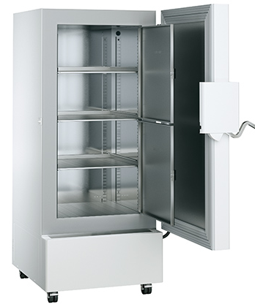
Get our Hands dirty
You quote
Customer is asking the following:
I have got 11 ULT - Freezers with two setpoints at -86°C and -65°C.
I need them to be initially qualified asap. Including all.
Could you send me a quote please?
Oh if you are on it also quote the yearly requal (24h mapping only) for all of them.
As we are in the same town – You are my guys!

Slide 28
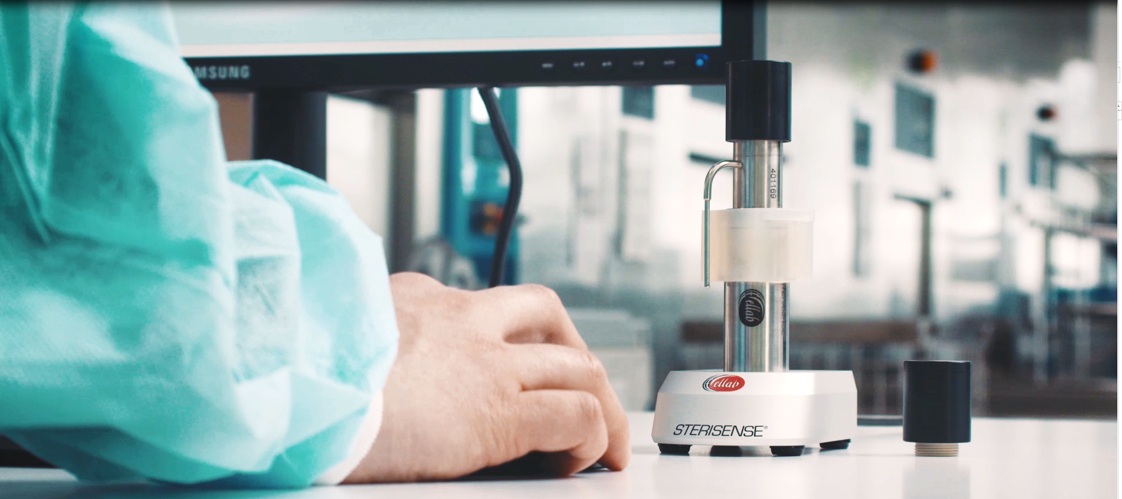
Intro to Validation Services Part 3
Sterisense
SteriSense®

Slide 29
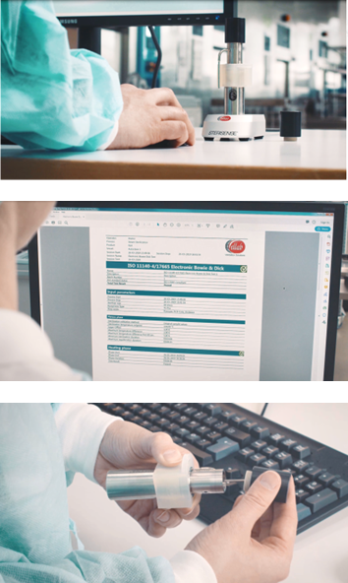
Key Advantages of SteriSense
The Ultimate Electronic Bowie Dick Test
Accurate Electronic Bowie Dick Test
Reliable and cost efficient
Very compact size
User-friendly and intuitive software
Eliminates guesswork and provides and objective result
Replaceable PCD to run several cycles in a sequence
Verification of critical sterilization parameters beyond traditional methods
Up to 1,000 test cycles between each calibration

Slide 30
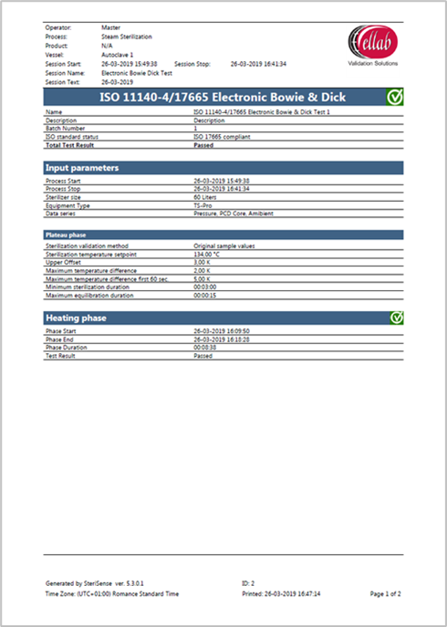
Why use SteriSense® Instead of Traditional Indicators?
The Ultimate Electronic Bowie Dick Test
SteriSense provides a much more in-depth verification of critical sterilization parameters, eliminating any guess work.
The Software also automatically generates and stores printable reports, ensuring electronic documentation of the process.
In summary, by using SteriSense you gain the following advantages compared to chemical or biological indicators:
Economically efficient with high test volumes
Improved safety - objective results that eliminate the risk of false or grey zone readings
Additional critical information - checks performed according to ISO 17665
Easy to store, retrieve and compare the data from a database - convenient and safe method that eliminates the need for guessing
Time stamps included to increase reliability

Slide 31
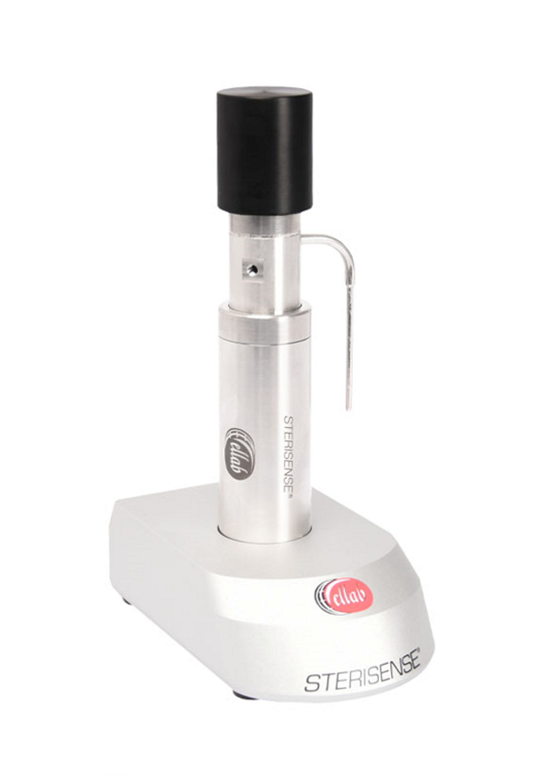
Why use SteriSense® Instead of Other Electronic Bowie Dick Test Devices?
The Ultimate Electronic Bowie Dick Test
SteriSense is by far the most compact Electronic Bowie Dick Test on the market.
The Process Challenge Device (PCD) has the unique feature of being replaceable, which allows the user to run several test cycles in a sequence with very limited need for cooling.
This reduces the amount of time and investments spent on unnecessary backup devices.
The replaceable PCD feature is patent pending.
In summary, by using the BD sensor you gain the following advantages compared other electronic Bowie Dick Tests
Ultra-compact size
Highly user-friendly software
Advanced sterilization analysis
Environmentally friendly process
Up to 1,000 test cycles between each calibration

Slide 32
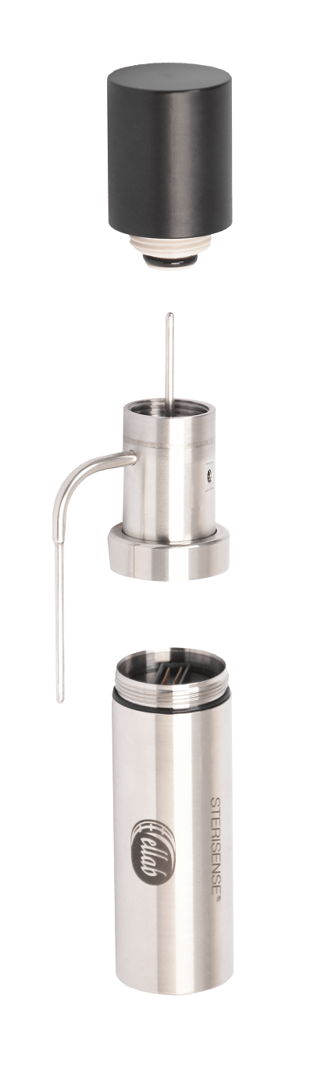
Why use SteriSense® Instead of Other Electronic Bowie Dick Test Devices?
The Ultimate Electronic Bowie Dick Test
The PCD has been specially designed to reflect the reference method originally developed by Dr. J. Bowie and J. Dick in the 1960’s
The function of the PCD is to “challenge” the steam penetration of a steam sterilizer in accordance with ISO 11140-4,134˚C & 121°C
The two temperature sensors measures the temperature inside the PCD and the ambient temperature in the sterilization chamber, of which the values have to follow each other
The pressure sensor measures the ambient pressure value within the chamber, which is used for detecting vacuum pulses, calculating the theoretical ambient temperature and detecting super heated steam
It is also possible to check for the presence of non-condensable gases (NCG) by analysing the steam’s capability to heat the steel core inside the PCD
The checks performed in the Master Session is referring to ISO 17665

